Slide 1
Introduction to Graphical Interface Programming in Java
James Brucker

Slide 2
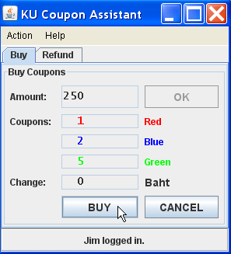
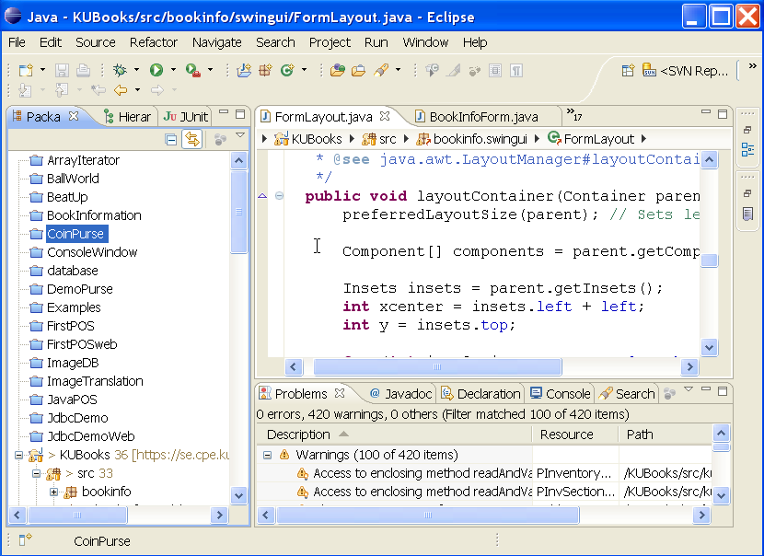
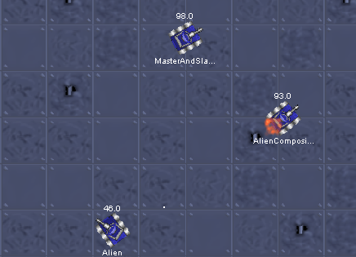
GUI versus Graphics Programming
Graphical User Interface (GUI)
Purpose is to display info and accept user input
Built using components
"Forms" applications
Graphics Programming
Manipulate graphical elements on a display
points, lines, curves, shapes
texture and lighting
animation, 3D effect

Slide 3

Simple GUI Application
A graphical interface is built using components.
Label (read-only)
TextField (input)
Button

Slide 4
Designing a Simple GUI
1. create a window (a container)
2. create components
label = new Label("Username:");
input = new TextField( 12 ); // the width
button = new Button("Login");
3. layout components in a container
container.add( label );
container.add( input );
container.add( button );
4. display the container (frame is the container here):
frame.setVisible( true );
5. wait for user to do something

Slide 5
Software for Graphics
Java provides frameworks for building graphical UIs.
AWT - Abstract Windowing Toolkit
  the first Java graphics framework
Swing - newer, OS-independent framework
SWT - Standard Widget Toolkit (used in Eclipse, Firefox)
  Eclipse project, designed for efficiency
JavaFX - layout is specified in XML (fxml), like Android
  use SceneBuilder tool to create the layout

Slide 6
Graphics Toolkits
A framework contains all the components and logic needed to manage a graphical interface.
You provide:
select components and set their properties
write application logic that controls how application responds to user actions
you may extend (subclass) existing components to create custom components

Slide 7
AWT Graphics Toolkit - java.awt
uses GUI of operating system, e.g. Windows, MacOS,
efficient, low overhead
applications look different on each platform (Linux, Mac, Windows)
difficult to write and test good quality applications
different bugs on each OS (due to difference in OS GUI) . . .
"Write once, debug everywhere"

Slide 8
AWT Example
import java.awt.*;
public class AwtDemo {
Frame frame;
public AwtDemo( ) {
frame = new Frame("Please Login");
// create components
Label label = new Label("Username:");
TextField input = new TextField(12);
Button button = new Button("Login");
// layout components in the container
frame.setLayout(new FlowLayout());
frame.add(label);
frame.add(input);
frame.add(button);
frame.pack();
}

Slide 9
AWT Example (continued)
To display the window use setVisible( true )
public static void main(String [] args) {
AwtDemo demo = new AwtDemo( );
demo.frame.setVisible( true );
}
}

Slide 10
Swing Graphics Toolkit
javax.swing packages
Swing doesn't depend on OS graphics, uses only basic functionality such as painting a region.
provides its own behavior, own "look and feel"
applications look the same on all platforms
applications may not look like native GUI apps
slower than AWT, because more work done in software
part of the Java Foundation Classes (JFC).
JFC also includes a 2D API and drag-and-drop API

Slide 11
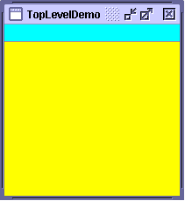
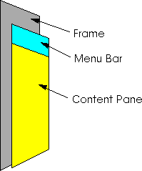
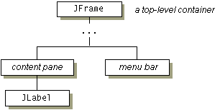
Swing Containers
JFrame is the top level container for most applications
has a title bar, menu bar, and content pane
JFrame is a heavy weight component.

Slide 12
Swing Example
import javax.swing.*;
public class SwingDemo {
JFrame frame;
public SwingDemo( ) {
frame = new JFrame("Please Login");
// create components
JTextField label = new JLabel("Username:");
JTextField input = new JTextField(12);
JButton button = new JButton("Login");
// layout components in the container
ContentPane pane = frame.getContentPane();
pane.setLayout(new FlowLayout());
pane.add(label);
pane.add(input);
pane.add(button);
pane.pack();
}

Slide 13
Swing Example (continued)
To display the window use setVisible( true )
public static void main(String [] args) {
SwingDemo demo = new SwingDemo( );
demo.frame.setVisible( true );
}
}
Bad Programming!
We should not directly access the private attributes of an object. We should invoke public behavior instead.

Slide 14
Demo
Create the simple "Login" interface.

Slide 15
Top Level Containers
A window that be displayed on screen:
JFrame - title bar, menu, and content pane
JWindow - no title bar or menu.
JDialog - a dialog window, has title bar
JApplet - for Applets (run in web browser).
Deprecated now.

Slide 16
What's a Component?
Also called "widgets".
Label
Textbox
Button
Slider
Checkbox
ComboBox
RadioButton
ProgressBar
xxx

Slide 17
Know your components
You need to know the available components
... and what they can do.
Visual Guide to Components
Sun's Java Tutorial
…/tutorial/ui/features/components.html
for Windows:
tutorial/ui/features/compWin.html

Slide 18
What Can a Component Do?
Common Behavior
setLocation( x, y )
setIcon( imageIcon )
setBackground( color )
setForeground( color )
setEnabled( boolean )
setVisible( boolean )
setToolTipText( string )

Slide 19
Important Components to Know
Component and JComponent provide most of the behavior that all components have!
Object
Component
AWT
Container
JComponent
Window
Panel
JPanel
JLabel
JList
Swing
Frame
Applet
JTextBox
JSlider
JButton
JComboBox
JMenuItem
JFrame
JApplet

Slide 20
Hierarchy of Graphics Components
Component
paint( graphics )
resize( ... )
Liskov Substitution Principle:
Any place where the program is expecting a Component you can use a JButton, JLabel, etc. and the program will work correctly.
JComponent
JButton
JLabel
MyComponent
...
JTextbox

Slide 21
Playing with a JButton
import java.awt.*;
import javax.swing.*;
JButton button = new JButton( "Press Me" );
//TODO: add button to a frame and pack
button.setBackground( Color.YELLOW );
button.setForeground( Color.BLUE );
button.setToolTipText( "Make my day." );
button.setFont( new Font( "Arial", Font.BOLD, 24 ) );
button.setEnabled( true );

Slide 22
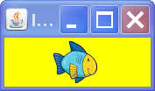
Components don't have to be boring
filename, URL, or InputStream.
Can by GIF, JPEG, PNG
ImageIcon icon = new ImageIcon("d:/images/fish.png");
button.setIcon( icon );

Slide 23
Containers and Components
A GUI has many components in containers.
Use add to put component in a container.
A container is also a component; so a container may contain other containers.
add(component)
container
component
component
add(...)
add(component)
container
container
component
component
component
component

Slide 24
Lightweight Containers
A lightweight container is one that is not a window.
You must place it inside another container.
Cannot be drawn on screen by itself.
JPanel simple rectangular area - most common
JTabbedPane - multiple panels with a tab on top
JSplitPane
JInternalFrame - like a JFrame inside a JFrame

Slide 25
Steps to Creating a GUI Interface
The Secrets of GUI Interface revealed.

Slide 26
Steps to creating a GUI Interface
1. Design it on paper
2. Choose components and containers
3. Create a window or dialog.
4. Add components to the window.
5. Preview the UI.
6. Add behavior - respond to user actions.

Slide 27
Step 1: Design it on paper
Know what the interface is supposed to do
Decide what information to present to user and what input he should supply.
Decide the components and layout on paper
Login Name:
Login

Slide 28
Step 2: Choose Components & Layout
Choose the components and layout on paper
JLabel
JTextField
JButton
Username:
Login
FlowLayout

Slide 29
Step 3: Create a Window (JFrame)
import javax.swing.*;
public class SwingExample implements Runnable {
JFrame frame;
public SwingExample( ) {
frame = new JFrame();
frame.setTitle("Please Login");
initComponents( );
}
private void initComponents( ) {
// initialize components here
frame.pack();
}
public void run() {
frame.setVisible( true );
}

Slide 30
Step 3: (alt) Be a JFrame
import javax.swing.*;
public class SwingExample extends JFrame {
public SwingExample( ) {
super.setTitle("Please Login");
initComponents( );
}
private void initComponents( ) {
// initialize components here
this.pack();
}
public void run() {
this.setVisible( true );
}

Slide 31
Step 3.1: Decorate the Frame
We can add decoration to the JFrame or components.
Add a title:
  frame.setTitle( "Please Login" );

Slide 32
Step 3.2: Close Application on Exit?
Even if you close the window, the GUI thread still running!
  GUI applications can run forever!
  Your program must tell the GUI to exit.
How to make it quit when you close the window?
  handle a WindowClosingEvent, or
  specify Exit-on-Close behavior
frame.setDefaultCloseOperation(JFrame.EXIT_ON_CLOSE);

Slide 33
Step 4: Add Components to window
Add components to the content pane of a JFrame.
As a convenience, you can add directly to JFrame.
private void initComponents( ) {
JLabel label1 = new JLabel("Username:");
input = new JTextField( 12 );
button = new JButton("Login");
frame.add( label1 );
frame.add( input );
frame.add( button );
// pack components. This sets the window size.
frame.pack( );
}

Slide 34
Step 4.1: Choose a Layout Manager
Each container uses a Layout Manager to manage the position and size of components.
Classic Layout Managers are:
  BorderLayout (default for JFrame)
  FlowLayout (default for JPanel)
  BoxLayout
  GridLayout
  GridBagLayout (the most powerful)
  CardLayout

Slide 35
4.2: Set the Layout Manager
Set the container's layout manager
private void initComponents( ) {
JLabel label1 = new JLabel("Username:");
input = new JTextField( 12 );
button = new JButton("Login");
frame.setLayout( new FlowLayout() );
frame.add( label1 );
frame.add( input );
frame.add( button );
frame.pack( );
}

Slide 36
Adding Components to a Panel
Most graphical UI use many "panels" or "panes" to group components.
This makes layout and management easier.
void initComponents( ) {
JLabel label1 = new JLabel("Username:")
input = new JTextField( 12 );
button = new JButton("Login");
JPanel panel = new JPanel();
panel.add( label1 );
panel.add( input );
panel.add( button );
frame.getContentPane( ).add( panel );
Put components in a panel
Add panel to the frame

Slide 37
Step 5: Preview the Interface
To show the window, call setVisible(true)
public class SwingExample {
....
// create a run() method to display the window
public void run() {
frame.setVisible( true );
}
public class Main {
public static void main( String [] args ) {
SwingExample gui = new SwingExample( );
gui.run( );
}

Slide 38
Problem: Window is too small
If your application shows only a title bar, it means you forgot to set the window size.
You must either:
  pack() or
  setSize(width, height)
Usually you should use pack( )
public class SwingExample {
JFrame frame;
...
public void run() {
frame.pack( ); // set size = best size
frame.setVisible(true);
}

Slide 39
Step 6: Add Behavior
Your application must do something when user presses a button, moves the mouse, etc.
Graphics programs are event driven.
Events:
  button press
  got focus
  mouse movement
  text changed
  slider moved

Slide 40
Why a layout manager?
Demo:
compare a Java application and Visual C# application when resizing a window.
In Java, the layout manager will rearrange or resize components.
In Visual C#, the components disappear.

Slide 41
Layout Managers
Classic Layout Managers are:
  BorderLayout (default for JFrame)
  FlowLayout (default for JPanel)
  BoxLayout
  GridLayout
  GridBagLayout
  CardLayout
  SpringLayout

Slide 42
Graphics Class Hierarchy (again)
Components inherit most of their behavior (methods) from Component and JComponent.
Object
Component
AWT
Container
JComponent
Window
Panel
JPanel
Frame
Applet
JFrame
JApplet

Slide 43
Exercise: JComponent
Look at JavaDoc for JComponent.
What properties can you "set" for any component?

Slide 44
Important Containers to Know
JPanel, JFrame, and JWindow are used a lot in Swing apps.
Panel, Frame, and Window are used a lot in AWT apps.
Object
Component
AWT
Container
JComponent
Window
Panel
Swing
JPanel
Frame
Applet
JFrame
JApplet

Slide 45
How to Design a GUI Application
Separate the GUI classes from the program logic.
Program logic is part of the "model" or domain layer.
GUI calls model for information.
  Try to limit GUI -> Model communication to just one class
  This reduces coupling between GUI and logic classes.
Model does not call methods of GUI objects.
  Use the Observer Pattern. Model (observable) notifies GUI (observer) when its state changes.

Slide 46
Layers in a GUI Application
Graphical Interface (Swing)
calls
Controller
(has event logic)
calls
Application
(application logic)

Slide 47
Learning Java Graphics
Java Tutorial: Creating a GUI with JFC/Swing
The section "Using Swing Components" contains "How To..." examples for many components.
Good explanation and examples of Layout Managers.
"JDK Demos and Samples"
jdk_dir/demo/jfc/*
Great demos with jar files (run) and source code. http://www.oracle.com/technetwork/java/javase/downloads/index.html
Big Java, Chapter 19.

