Slide 1
Design Patterns in Swing and AWT
Strategy Pattern: LayoutManagers are Strategies
Observer Pattern: event listeners are observers
Composite Pattern: a container can be placed inside another container just like any component
Decorator Pattern: you can "decorate" any component by surrounding it with JScrollPane to add scroll bars
MVC Pattern: JTable gets data from a TableModel
Command Pattern: Action objects are commands that are invoked by components (like JButton). The Invoker, the Command, and Receiver (your application logic) are all separate.

Slide 2
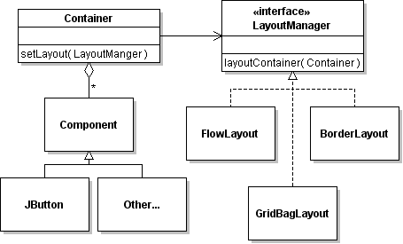
LayoutManager - what pattern?

Slide 3
LayoutManager is a Strategy
Strategy Pattern
Name in Pattern | Name in this Example
Content | Container
Strategy | LayoutManager
Concrete Strategy | FlowLayout, GridBagLayout, ..
setStrategy | setLayout( LayoutManager )
doWork( ) | layoutContainer( )

Slide 4
Benefit of LayoutManager
What are the benefits of separating LayoutManager from the container classes?
Why don't we put the layout code inside each container?

Slide 5
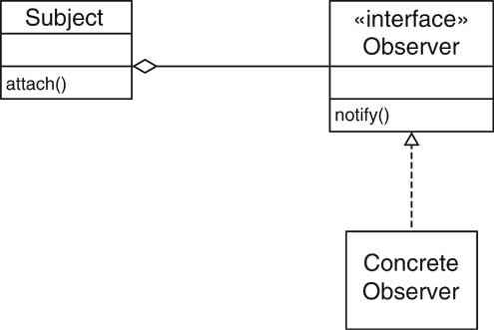
Observer Pattern
Name In Observer Pattern Name in Swing graphics
Subject
Observer
Concrete Observer
attach( )
notify( )

Slide 6
Observer Pattern
Name In Observer Pattern Name in Swing graphics
Subject JButton, JMenuItem, JCheckBox
Observer ActionListener
Concrete Observer your class implementing ActionListener
attach( ) addActionListener( observer )
notify( ) actionPerformed( )

