Slide 1
Design Patterns
James Brucker

Slide 2
Reusable Ideas
Developers reuse knowledge, experience, & code
Application Level
reuse a project design & code of a similar project
Design Level
apply known design principles and design patterns
Logic Level
apply known algorithms to implement some behavior
Method Implementation Level
use programming idioms for common tasks

Slide 3
A Programming Idiom
Problem: process every element of an array...
Idiom:
1. initialize result
2. loop over the array
3. process each element of the array
// add the values of all the coupons we have sold...
Coupon [ ] coupons = ...
double total = 0; // initialize
for( int k=0; k<coupons.length; k++ ) { // loop
total += coupons[k].getTotal(); // process each one
}

Slide 4
An Algorithm
Problem:
find the shortest path from nodes A to B in a graph
Solution:
apply Dykstra's Shortest Path algorithm

Slide 5
Reusable Code
Requirement:
sort a List of Persons by last name. Ignore case.
Solution:
Write a Comparator and use Collections.sort
List<Person> people = manager.getPeople( );
Comparator<Person> compByName = new Comparator<>() {
public int compare(Person a, Person b) {
return a.getLastname().compareToIgnoreCase(
b.getLastname());
}
};
java.util.Collections.sort( people, compByName );

Slide 6
Reusable Code
Requirement:
record activity & events of our program in a file,
so we have a record of what the program has done and any problems that occur.
Solution:
Use the open-source Log4J or slf4j framework.
public class Purse {
private static final Logger log =
Logger.getLogger(Purse.class);
public boolean insert(Money m) {
if (m == null) log.error("argument is null");
else log.info("inserting " + m);

Slide 7
Logger Output
Log File:
You control where logging is output, and how much detail is recorded. Config file: log4j.properties.
Example:
6:02:27 Purse insert INFO inserting 10 Baht
6:03:00 Purse insert INFO inserting 20 Baht
6:03:10 Purse insert ERROR argument is null
6:03:14 Purse withdraw INFO withdraw 10 Baht
Class and Method
message
Severity

Slide 8
What is a Design Pattern?
A situation that occurs over and over, along with a reusable design of a solution

Slide 9
Format for Describing a Pattern
Pattern Name: Iterator
Context
We need to access elements of a collection.
Motivation (Forces)
We want to access elements of a collection without the need to know the underlying structure of the collection.
Solution
Each collection provides an iterator with methods to get the next element and check for more elements.
Consequences
Application is not coupled to the collection. Collection type can be changed w/o changing the application.

Slide 10
Diagram for Iterator
<<interface>>
Iterator<T>
hasNext( ): bool
next( ): T
ConcreteIterator
hasNext( ): bool
next( ): T

Slide 11
Examples of Iterator
What Iterators have you used?

Slide 12
How do you Get an Iterator?
Context:
We want to create an Iterator without knowing the class of the group of objects.
Forces:
We don't want the code to be coupled to a particular collection. We want to always create iterators in the same way, regardless of the group of objects it refers to or how the Iterator is actually created.
Collection<String> stuff = Foo.makeCollection( );
Iterator<String> iterator = stuff.iterator( );

Slide 13
Solution: Define a Factory Method
A factory method is a method that creates other objects.
<<interface>>
Iterable<T>
iterator( ):
Iterator<T>
<<interface>>
Iterator<T>
hasNext( ): bool
next( ): T
creates
Collection
iterator()
ConcreteIterator
creates

Slide 14
Structure of Iterator Pattern
access elements of
Application
Collection
iterator( ): Iterator
Iterator
hasNext( ): bool
next( ): Element
creates
ConcreteIterator
cursor
hasNext( ): bool
next( ): Element
Data Source

Slide 15
Example
List<String> list = new ArrayList<>( );
list.add( "apple" );
. . . // add more elements
Iterator<String> iter = list.iterator( );
while( iter.hasNext( ) ) {
System.out.println( iter.next() );
}

Slide 16
for-each Loop uses Iterable
The Java "for each" loop accepts any Iterable object.
for(Object x: iterable_object) {
// do something with x
}
Iterator iter = iterable_object.iterater();
while( iter.hasNext() ) {
Object x = iter.next( );
// do something with x
}

Slide 17
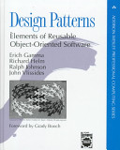
Design Patterns - Gang of Four book
The "Gang of Four"
The first book to popularize the idea of software patterns:
Gamma, Helm, Johnson, Vlissides
Design Patterns: Elements of Reusable Object-Oriented Software. (1995)

Slide 18
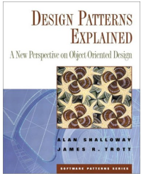
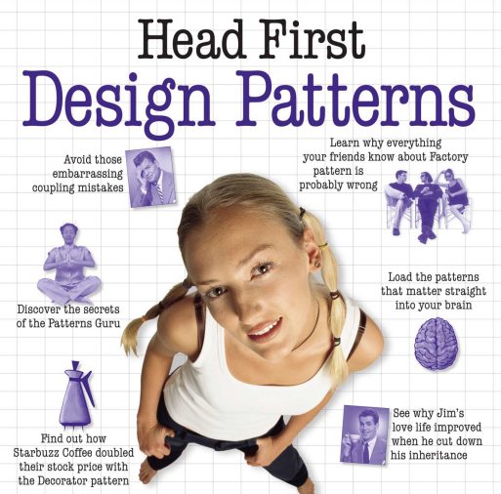
Good Design Patterns Books
Good for Java programmers
Design Patterns Explained, 2E (2004)
by Allan Shallow & James Trott
also wrote: Pattern Oriented Design.
Head First Design Patterns (2004)
by Eric & Elizabeth Freeman
Visual & memorable examples,
code is too simple.

Slide 19
Structure of Patterns in
Gang of Four book
Name of Pattern
Intent
what the pattern does.
Motivation
Why this pattern. When to apply this pattern
Structure
Logical structure of the pattern. UML diagrams.
Participants and Collaborators
What are the elements of the pattern? What do they do?
Consequences
The benefits and disadvantages of using the pattern.

Slide 20
Iterator Pattern
Pattern Name: Iterator
Context
We need to access elements of a collection.
Motivation (Forces)
We want to use or view elements of a collection without the need to know the underlying structure of the collection.
Solution
Each collection provides an iterator with methods to check for more elements and get the next element.

Slide 21
Design Patterns To Know
1. Iterator
2. Adapter
3. Factory Method
4. Decorator
5. Singleton
6. Strategy - Layout Manager, used in a Container
7. State
8. Command
9. Observer
10. Facade

Slide 22
Categories of Patterns
Creational - how to create objects
Structural - relationships between objects
Behavioral - how to implement some behavior

Slide 23
Situations (Context) not Patterns
Don't memorize pattern names.
Learn the situation and the goals (forces) that motivate the solution.

Slide 24
Adding New Behavior
Situation:
we want to add some new behavior to an existing class
Forces:
1. don't want to add more responsibility to the class
2. the behavior may apply to similar classes, too
Example:
Scrollbars

Slide 25
Changing the Interface
Situation:
we want to use a class in an application that requires interface A. But the class doesn't implement A.
Forces:
1. not appropriate to modify the existing class for the new application
2. we may have many classes we need to modify
Example:
change an Enumeration to look like an Iterator

Slide 26
Convenient Implementation
Situation:
some interfaces require implementing a lot of methods. But most of the methods aren't usually required.
Forces:
1. how can we make it easier to implement interface?
2. how to supply default implementations for methods?
Example:
MouseListener (6 methods), List (24 methods)

Slide 27
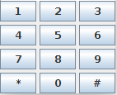
A Group of Objects act as One
Situation:
we want to be able to use a Group of objects in an application, and
the application can treat the whole group like a single object.
Forces:
There are many objects that behave similarly. To avoid complex code we'd like to treat as one object.
Example:
KeyPad in a mobile phone app.

Slide 28
Creating Objects without Knowing Type
Situation:
we are using a framework like OCSF.
the framework needs to create objects.
how can we change the type of object that the framework creates?
Forces:
1. want the framework to be extensible.
2. using "new" means coupling between the class and the framework.
Example:
JDBC (Java Database Connection) creates connections for different kinds of databases.

Slide 29
Do Something Later
Situation:
we want to run a task at a given time (in the future)
Forces:
we don't want our "task" to be responsible for the schedule of when it gets run.
This situation occurs a lot, so we need a reusable solution.
Example:
We're writing a digital clock. We want an alarm to sound at a specified time.

