Slide 1
Containers and Components
A GUI has many components in containers.
Use add to put component in a container.
A container is also a component; so a container may contain other containers.
add(component)
container
component
component
add(...)
add(component)
container
container
component
component
component
component

Slide 2
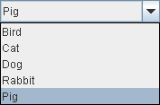

Layout Managers
A container uses a Layout Manager to manage the position and size of components.
Container
layoutManager
contains
*
Component
layout components
LayoutManager

Slide 3
Why a layout manager?
Demo:
compare a Java application and Visual C# application when resizing a window.
In Java, the layout manager will rearrange or resize components.
In Visual C#, the components disappear.

Slide 4
Layout Managers
Classic Layout Managers are:
  BorderLayout (default for JFrame)
  FlowLayout (default for JPanel)
  BoxLayout
  GridLayout
  GridBagLayout
  CardLayout
  SpringLayout

Slide 5
add Layout Manager
Use setLayout( ) to assign a Layout Manager:
frame.setLayout( new FlowLayout( ) );
panel.setLayout( new GridLayout(3,4) );

Slide 6
Customizing a Layout
Some layout managers give you control over the layout.
FlowLayout, BorderLayout - set space between components
GridBagLayout - almost unlimited control
static final int GAP = 8;
FlowLayout layout = new FlowLayout( );
layout.setVGap( GAP );
layout.setHGap( GAP );

Slide 7
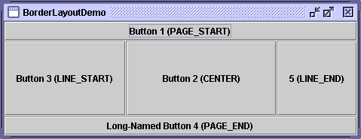
BorderLayout
BorderLayout divides the container into 5 zones.
use: container.add( component , WHERE );
If a zone is not used, other zones expand to use the space. CENTER gets the most space.
NORTH
WEST
CENTER
EAST
SOUTH
JButton button1 = new JButton("Button 1");
frame.add( button1, BorderLayout.EAST );

Slide 8

FlowLayout
"flows" the components into the available space.
preserves the original (or requested) size of each component.
components are added left to right, in order.
  container.setLayout( new FlowLayout( ) );
  JButton button1 = new JButton( "Button 1" );
  JButton button2 = new JButton( "Button 2" );
  container.add( button1 );
  container.add( button2 );

Slide 9
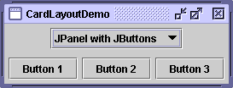
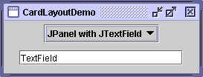
CardLayout
CardLayout lets you have different sets of components displayed at different times.
One card is displayed at a time.
Use next( ), first(), last() to change the displayed card.
  frame.setLayout( new CardLayout( ) );
  // add buttons and panels to the cards
  contentpane.add( button1 );
  contentpane.add( button2 );

Slide 10
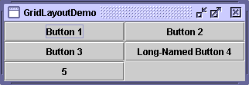
GridLayout
specify a grid size (rows,cols) in constructor.
Components are added to a grid, in the order that they are added.
GridLayout makes all components have same size.
frame.setLayout( new GridLayout(3, 2) ); // (rows,cols)
// add buttons to the grid
frame.add( button1 );
frame.add( button2 );
frame.add( button3 );

Slide 11
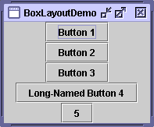
BoxLayout
BoxLayout puts components in a single row or column.
It does not resize components.
It allows different forms of component alignment.
container.setLayout( /* vertical box layout */
new BoxLayout(container, BoxLayout.Y_AXIS) );
container.add( button1 );
container.add( button2 );

Slide 12

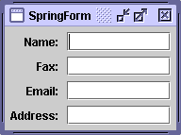
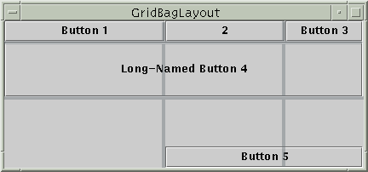
GridBagLayout and SpringLayout
GridBagLayout and SpringLayout give you more control over the layout and sizing of components.
can control margins, free space distribution, etc.

Slide 13
Newer Layout Managers
GroupLayout - treat several components as a group, so they can all have the same size or alignment. Horizontal and vertical layouts specified separately.
FormLayout - layout a form containing labels and input areas in rows and columns, nicely aligned. It provides build-in data validators. Layout can be specified in text instead of Java code. FormLayout is a free, open-source component from
http://www.jgoodies.com/freeware/libraries/forms/
AbsoluteLayout - put everything exactly where you say
(like in VisualStudio)

Slide 14
Have a JFrame or Be a JFrame?
Two styles of defining a UI class using JFrame:
public class SwingExample {
private JFrame frame;
...
public SwingExample( ) {
frame = new JFrame( );
frame.setDefaultCloseOperation( ... );
public class SwingExample extemds JFrame {
...
public SwingExample( ) {
this.setDefaultCloseOperation( ... );
initComponents( );
"this" object is a JFrame. Don't create another one!!

Slide 15
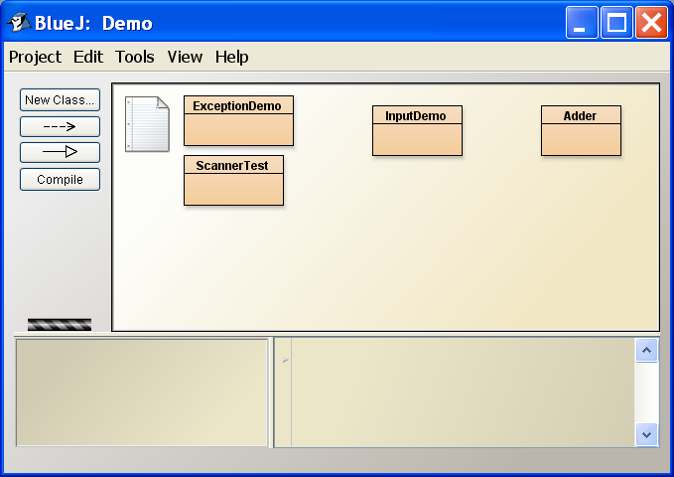
Nested Container Example
Container with a row of buttons (buttons based on user prefs)
text component
Container with 2 components inside

Slide 16
Lightweight Containers
A lightweight container is one that is not a window.
You must place it inside another container.
Cannot be drawn on screen by itself.
JPanel simple rectangular area - most common
JTabbedPane - multiple panels with a tab on top
JSplitPane
JInternalFrame - like a JFrame inside a JFrame

Slide 17
Nesting Containers
Example: a panel containing a text field and a button
JTextField textfield = new JTextField(12);
JButton button = new JButton("Login");
JPanel panel = new JPanel( );
panel.add( textfield );
panel.add( button );
Nesting: put the JPanel inside a JFrame
JFrame frame = new JFrame( );
frame.add( panel );

Slide 18
Benefit of LayoutManager
What are the benefits of separating LayoutManager from the container classes?
Why don't we put the layout code inside each container?

