Slide 1
GROUP 2
Professor: Renuka
Team members:
Gideon Akomeng: 610530
Vo Nguyen: 610507
Shine Gendy: 610547

Slide 2
Agenda
USECASE MODEL
CLASS MODEL
SEQUENCE MODEL
Checkout
Add a copy
Validation rules in ui
Extra (1,2)
SCI

Slide 3
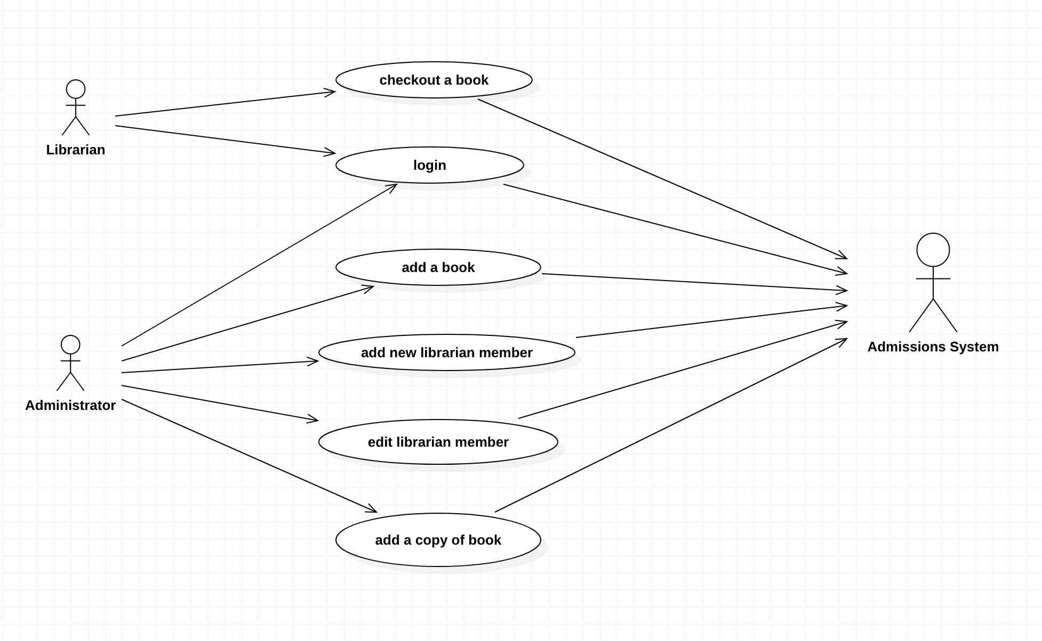
1. Usecase diagram

Slide 4
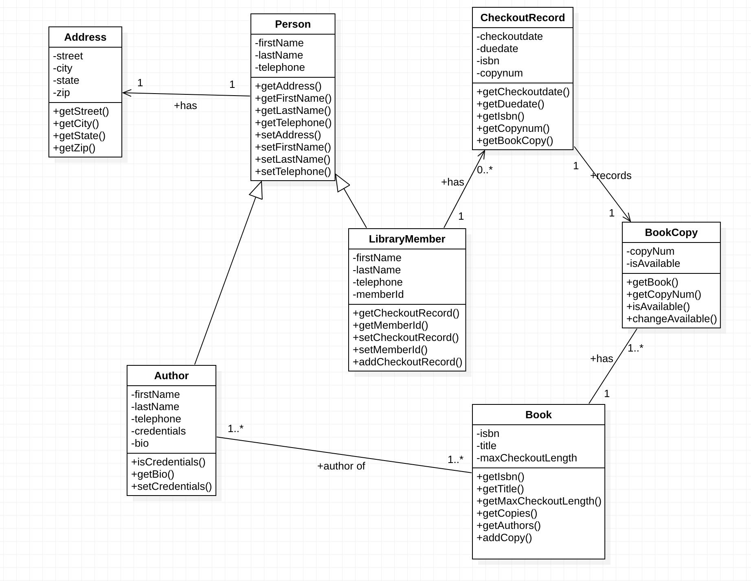
2. CLASS diagram

Slide 5
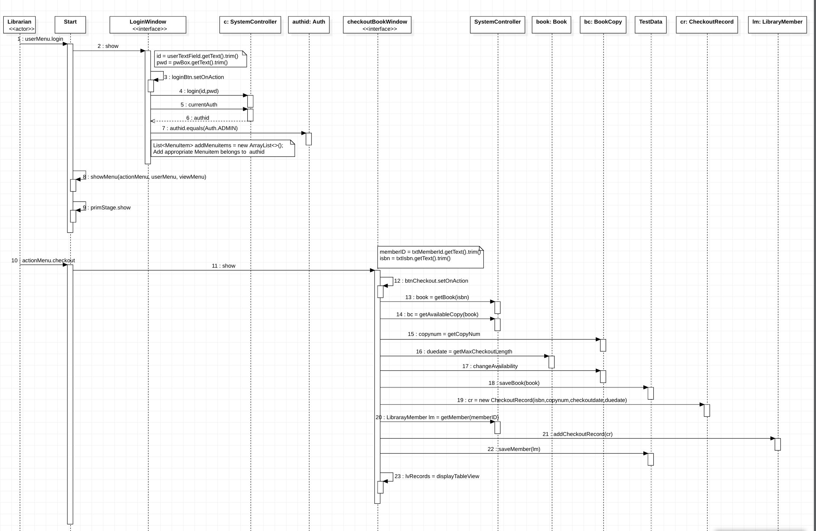
3. Sequence diagram - checkout

Slide 6
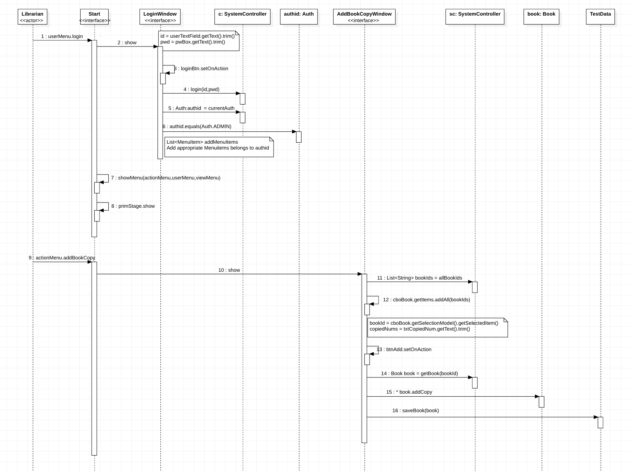
3. Sequence diagram – Add a copy

Slide 7
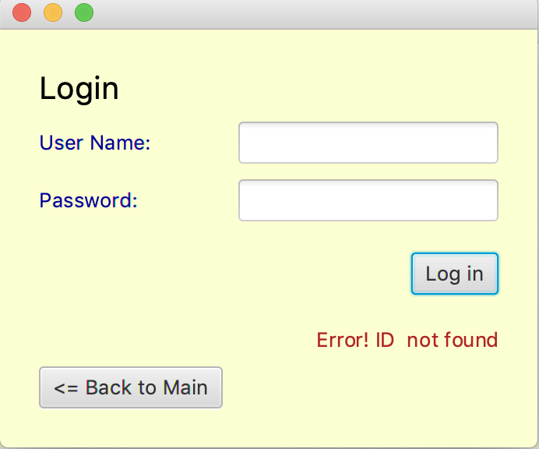
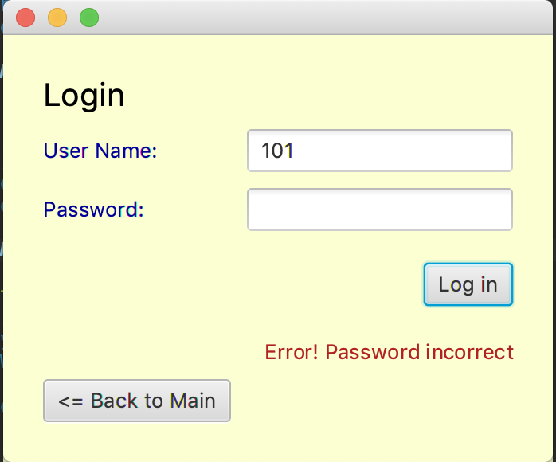
4. Validation : login

Slide 8
4. Validation

Slide 9
5. EXTRA

Slide 10
6. SCI
Principle #3 “life is found in layers” : when we applied into application , we split the problem into smaller layer/object classes to solve problem
Principle #4 “outer depends on inner”: create interface as an outer interface with user , to store that information we use inner class to create object

Slide 11
Thank you

