Slide 1
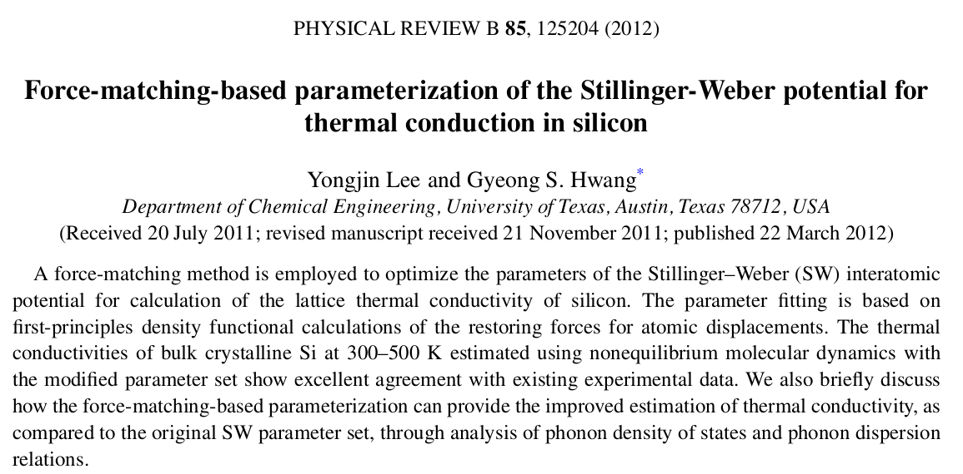

Slide 3







Predicting Si Thermal Conductivity

Slide 4

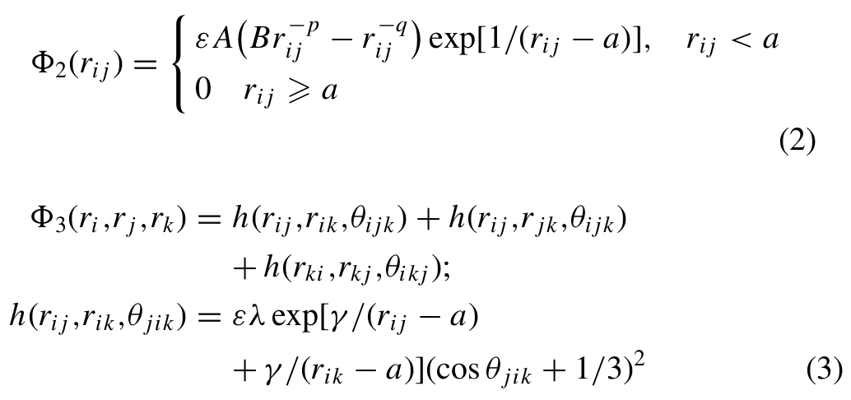
SW 2 and 3-Body

Slide 5
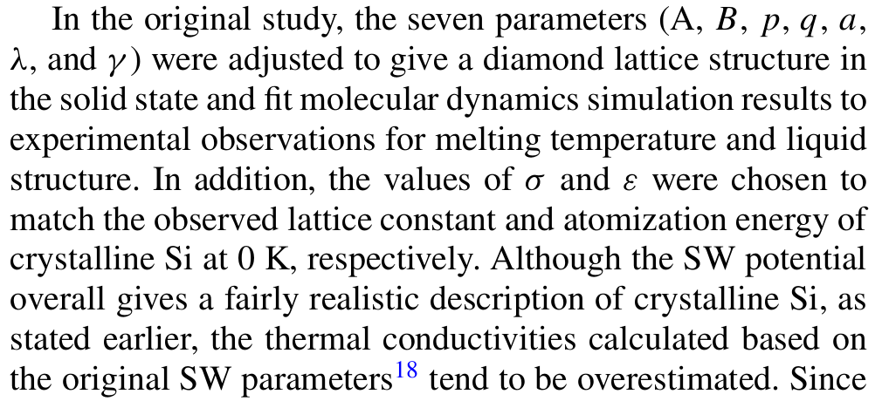
SW Original Fitting

Slide 6
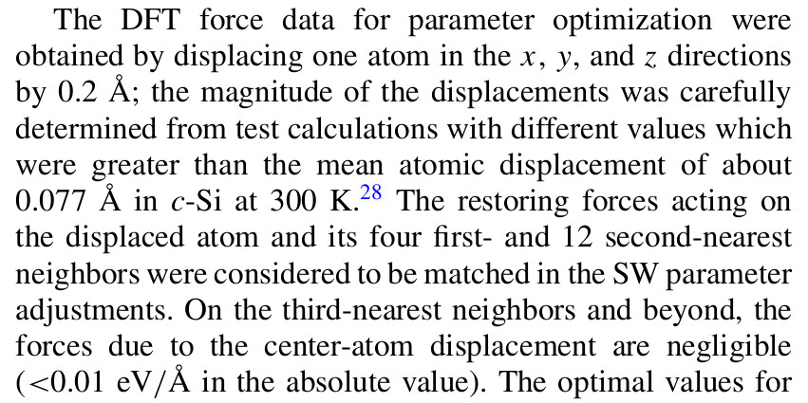

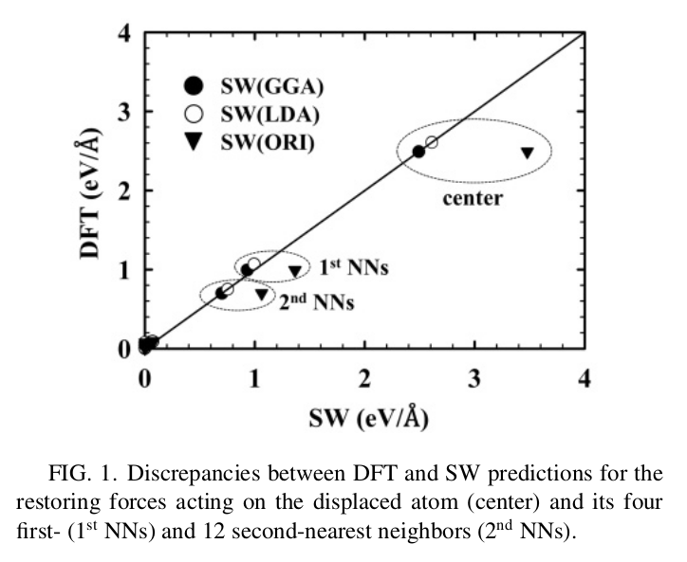
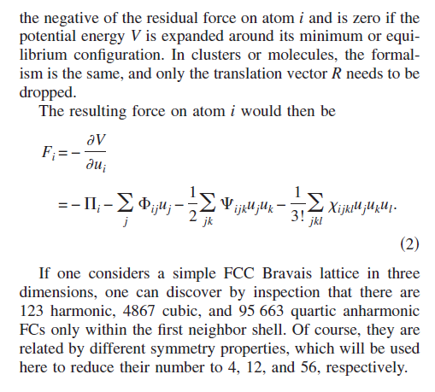
Force-Matching Method

Slide 7
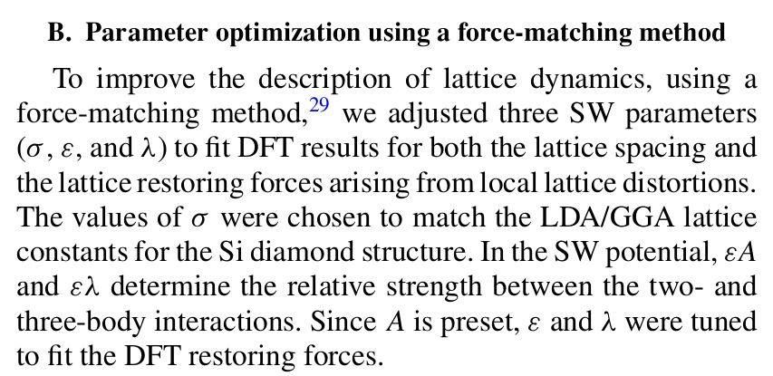
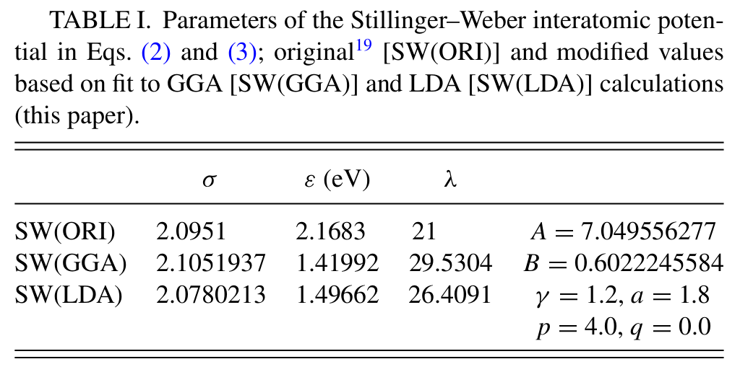

Re-Fit SW

Slide 8

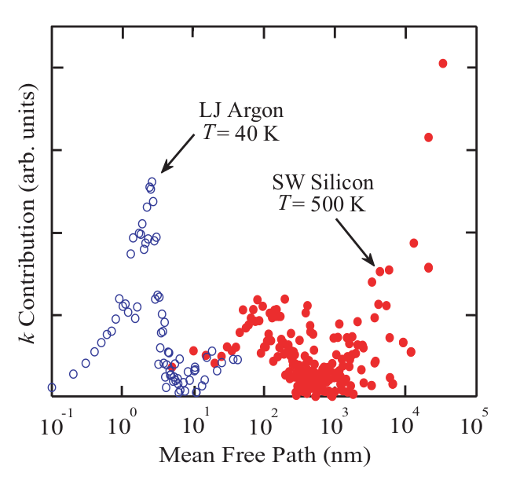
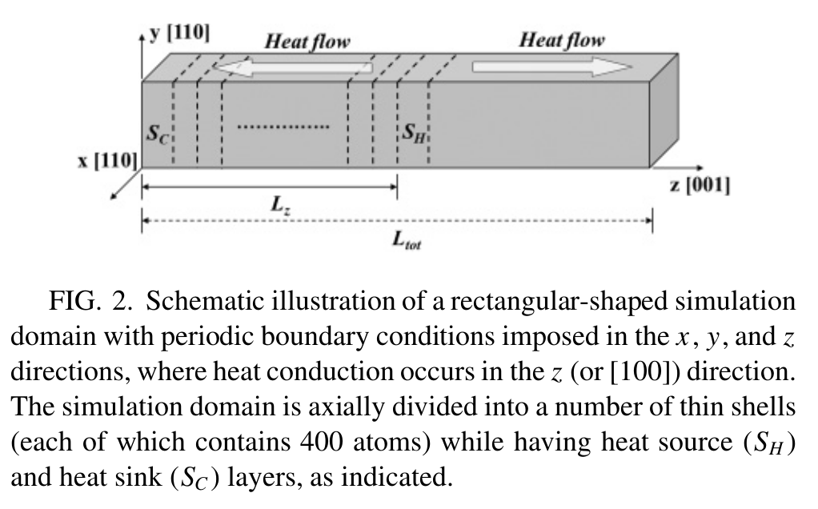
NEMD Simulation
PHYSICAL REVIEW B 81, 214305 ͑2010͒

Slide 9
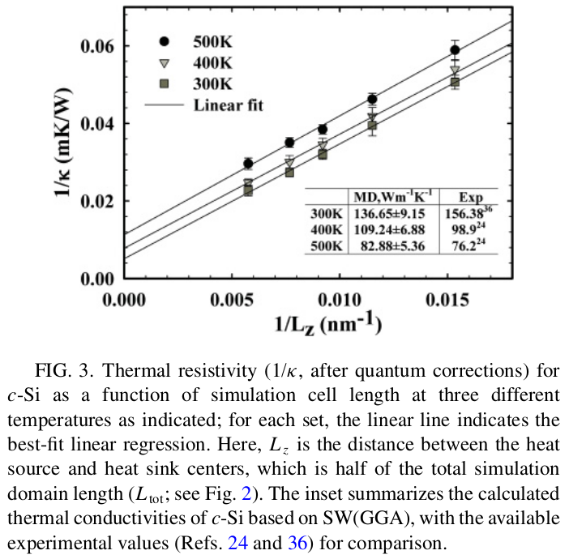

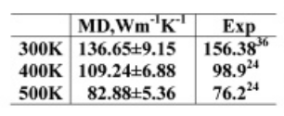
Finite-Size Extrapolation

Slide 10
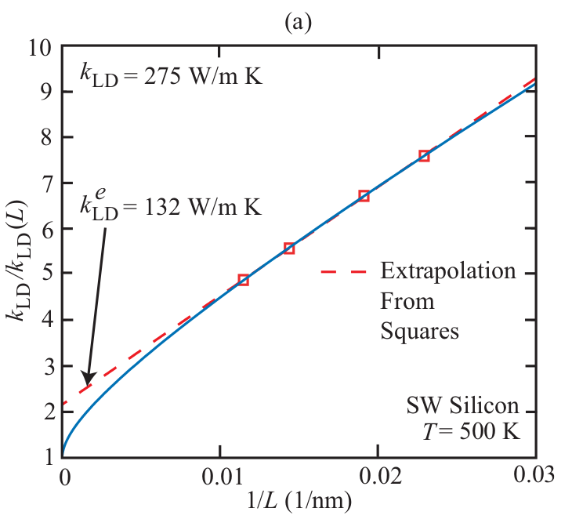
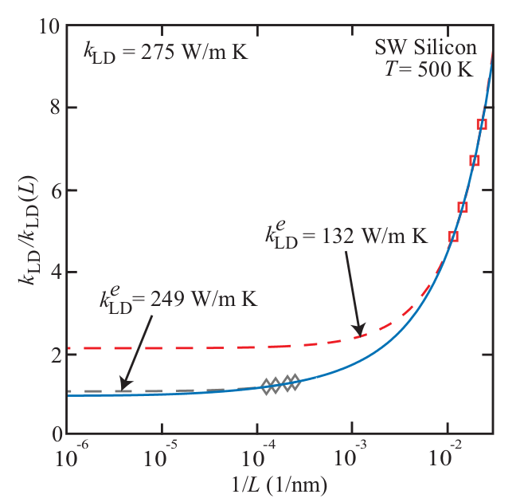
Finite-Size Extrapolation?
PHYSICAL REVIEW B 81, 214305 ͑2010͒

Slide 11


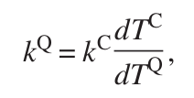
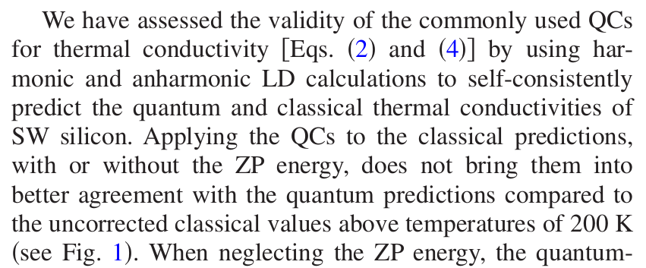
Quantum Corrections?
Quantum Corrected

Slide 12


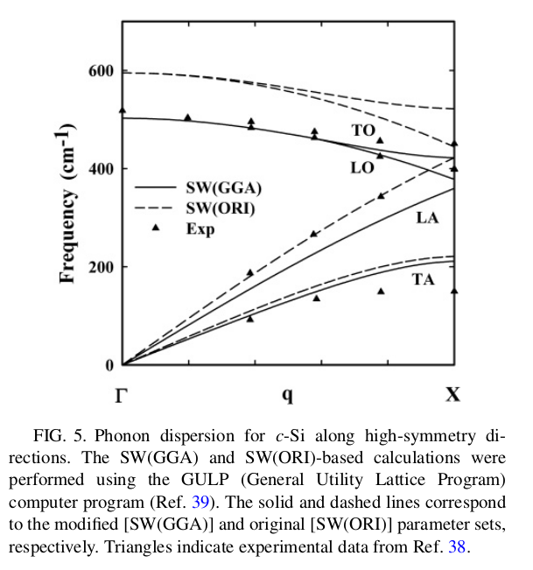
Si Dispersion
ALD 3-phonon

Slide 13
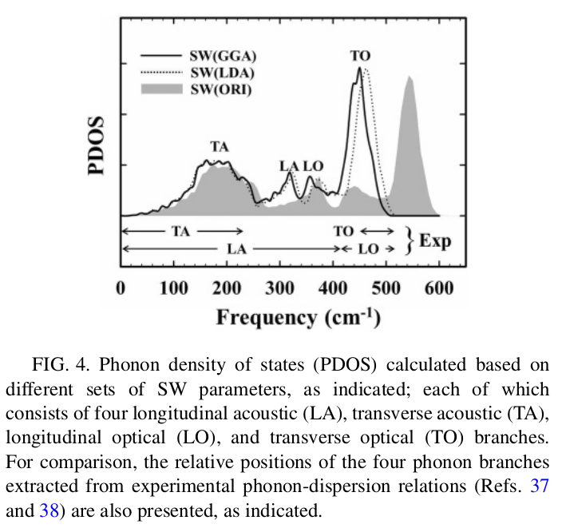
Harmonic Frequencies
- No carrier-level analysis

