Slide 1
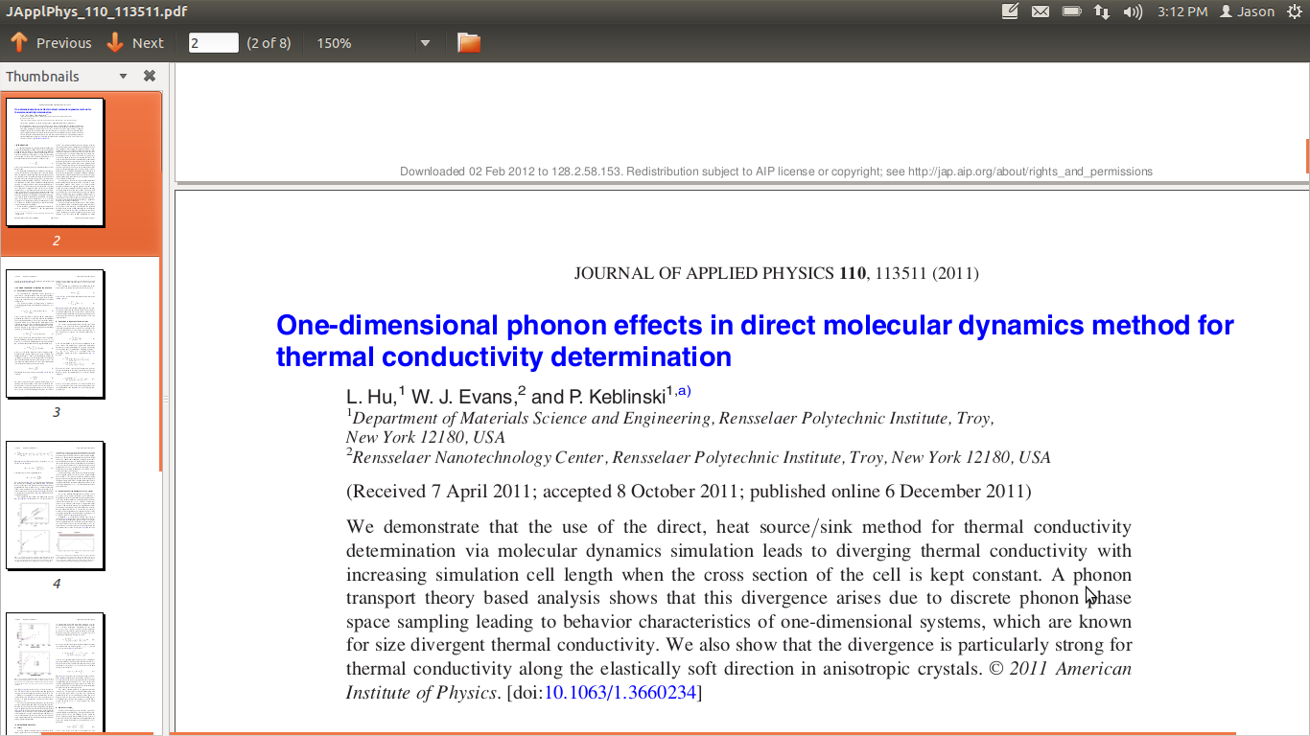
11/28/2011
1

Slide 2
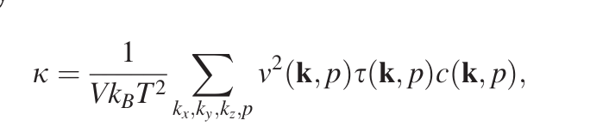
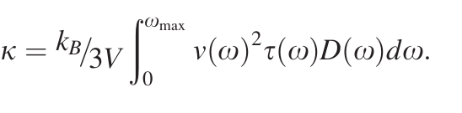
Phonon Modes
Sum over all modes
Continuum Limit
2

Slide 3

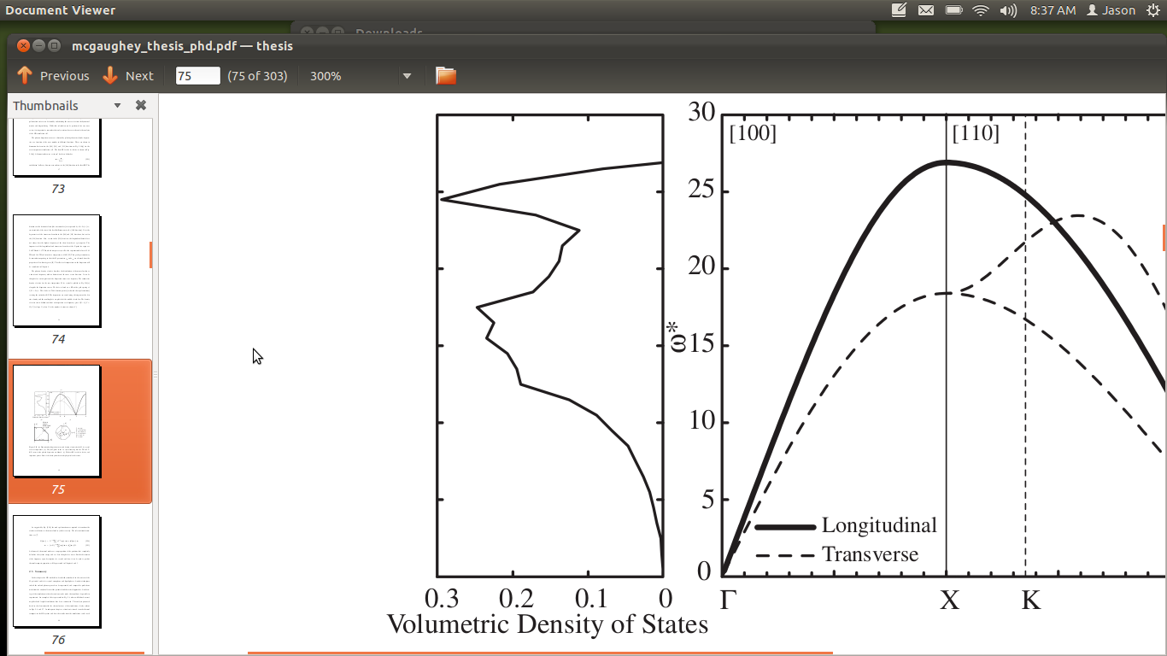
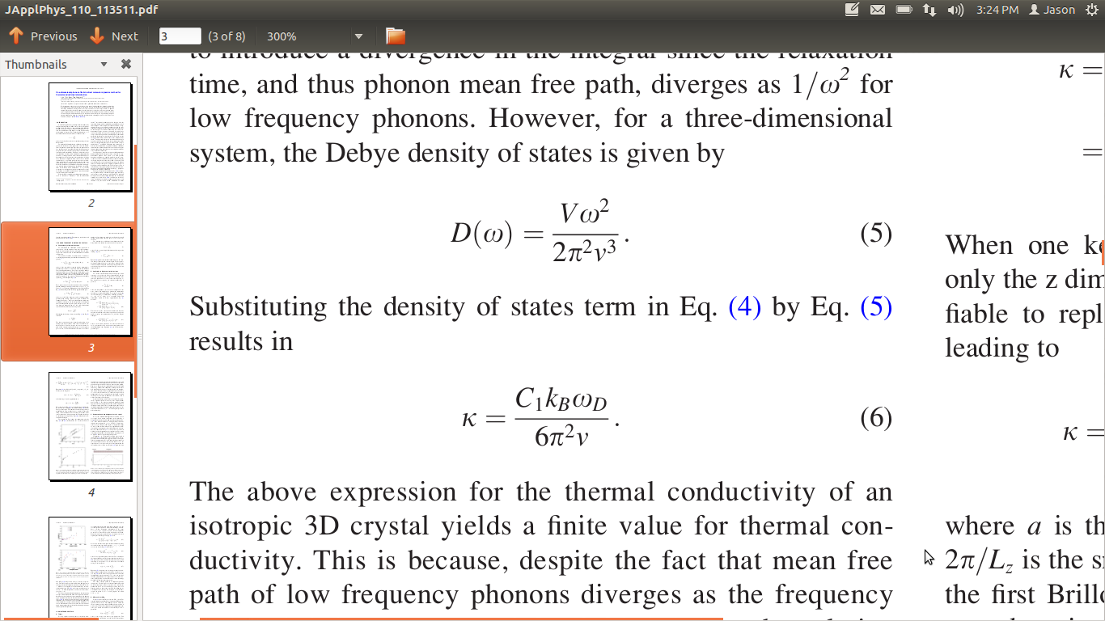
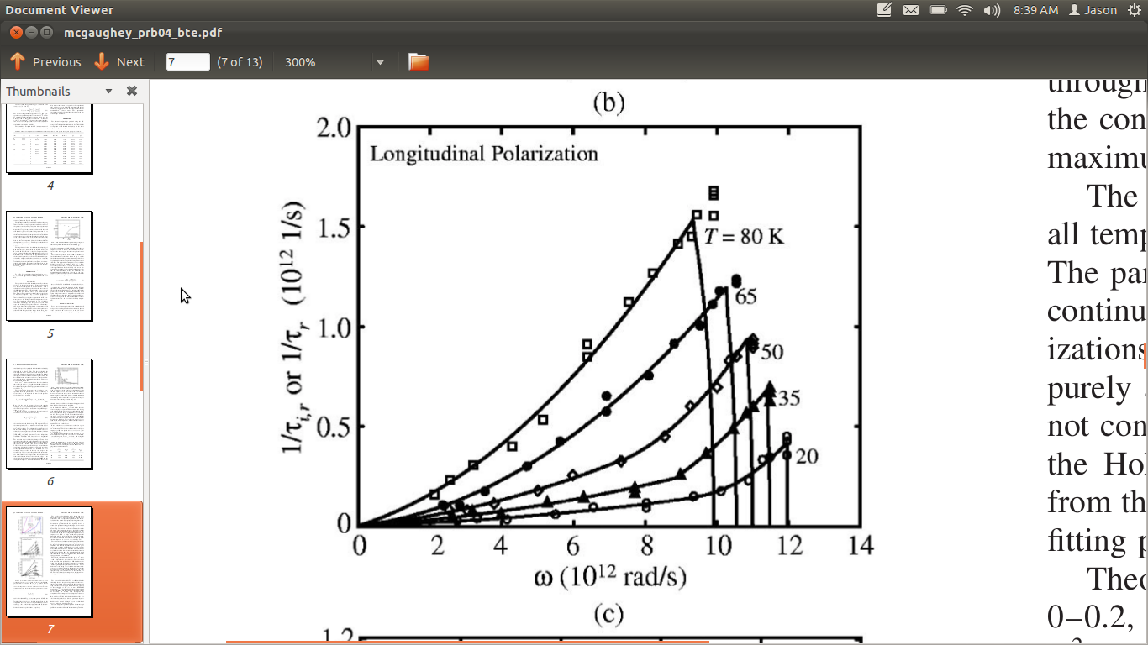
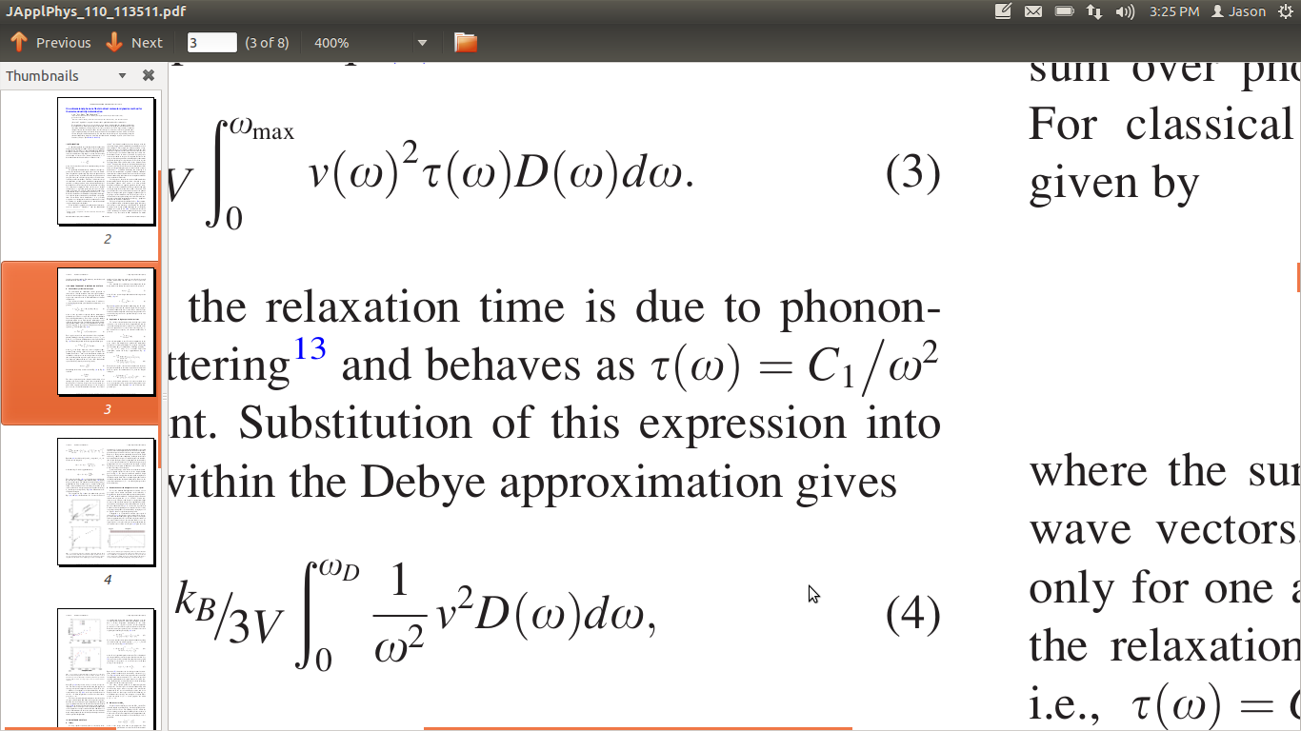
3D Isotropic Crystal
Debye approximation
DOS
Umklapp scattering
3
PHYSICAL REVIEW B 69, 094303 ͑2004͒

Slide 4
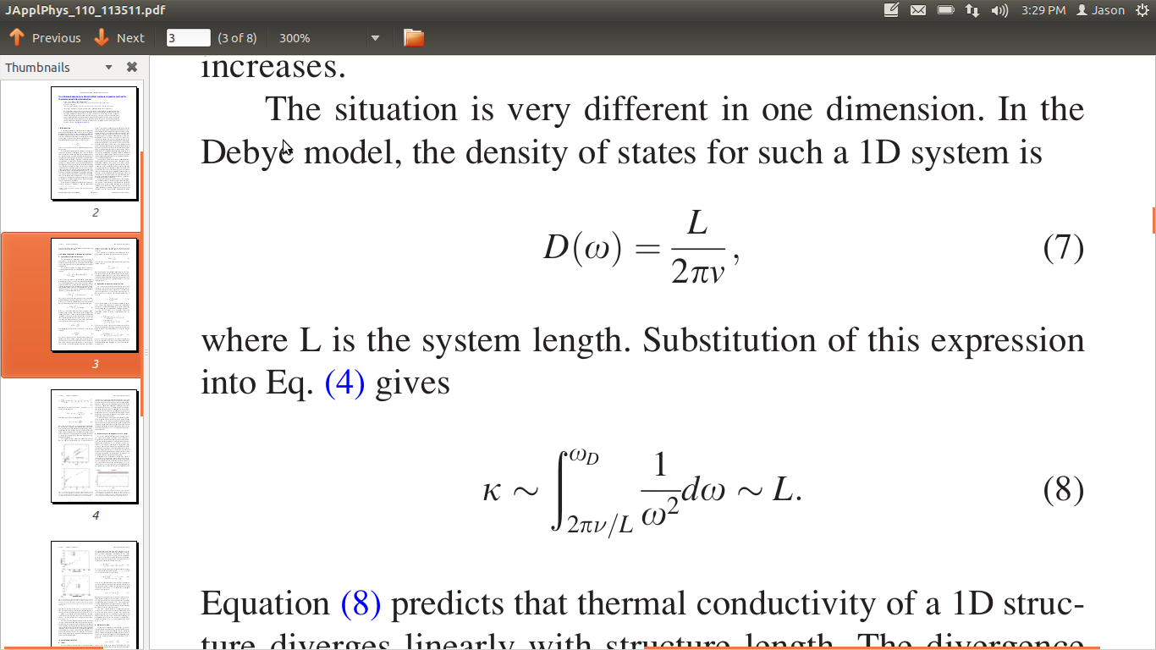
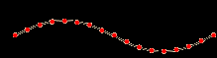
1D Crystal
1D DOS is divergent with length
Umklapp scattering?
1D DOS is divergent with length = thermal conductivity divergent
4

Slide 5
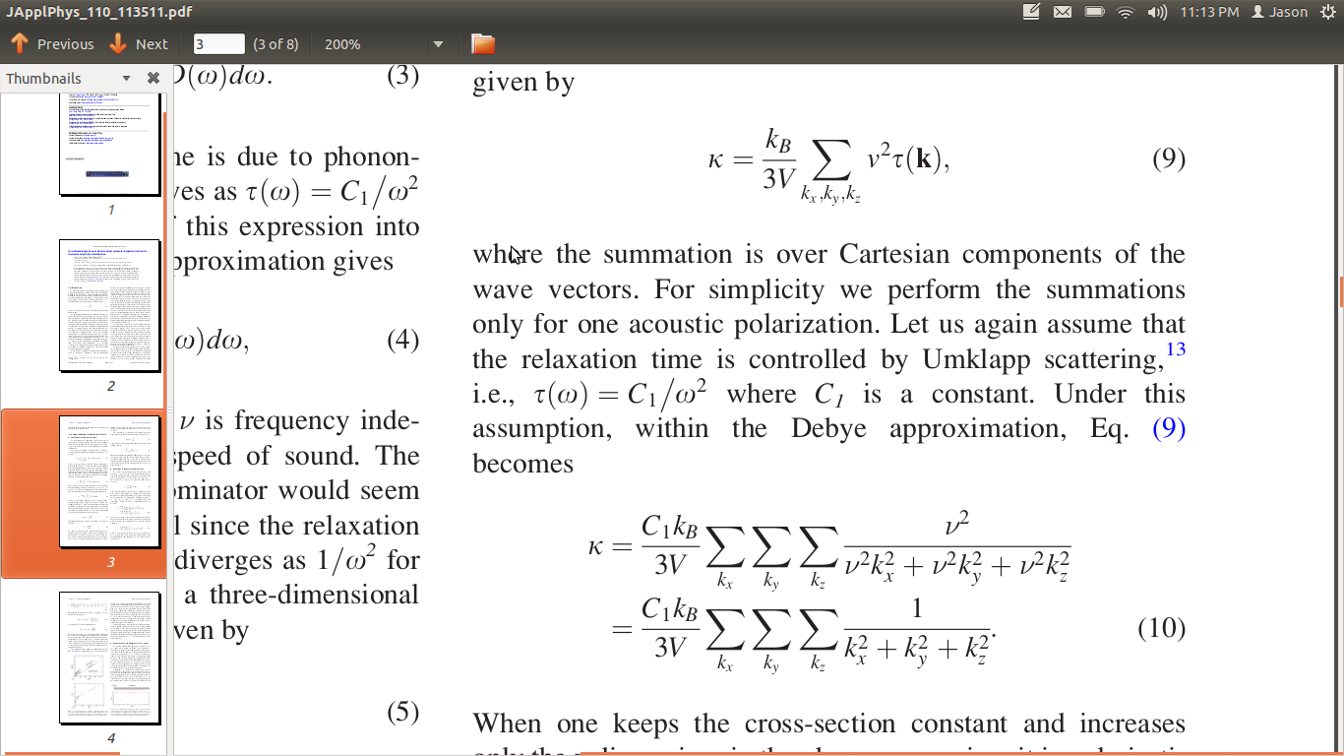
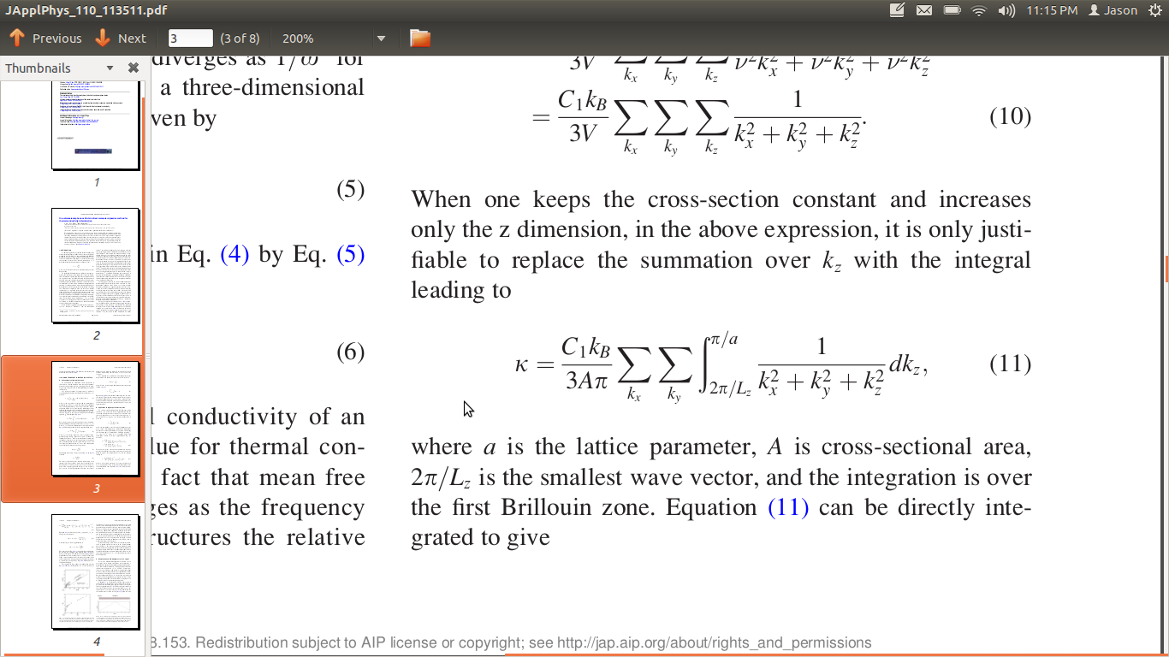
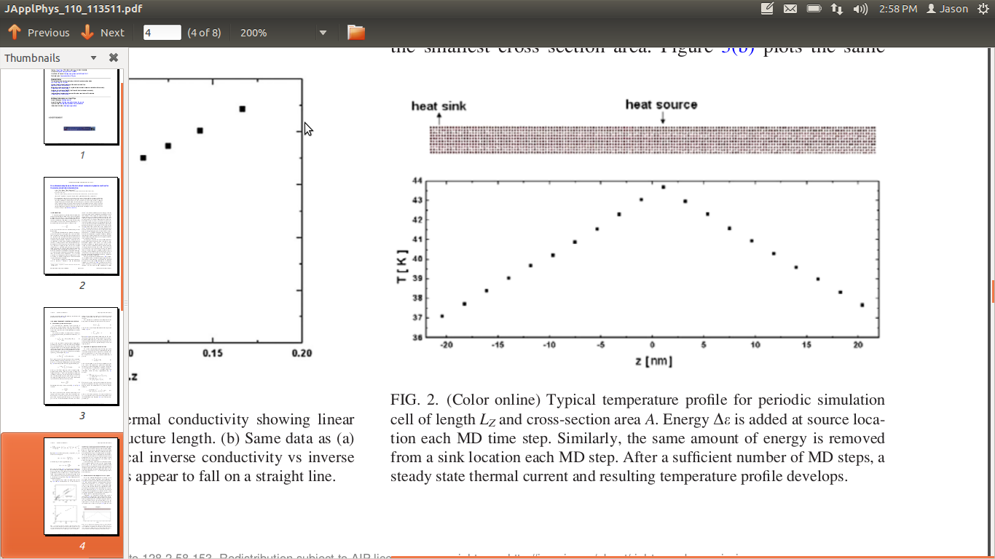
3D Isotropic Crystal with aspect ratio
Sum over allowed wavevectors
Debye approximation and Umklapp scattering
System with “aspect ratio”
5

Slide 6
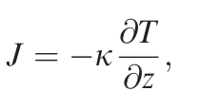
NEMD
Simulation with high aspect ratio
Thermal conductivity from Fourier Law
6

Slide 7
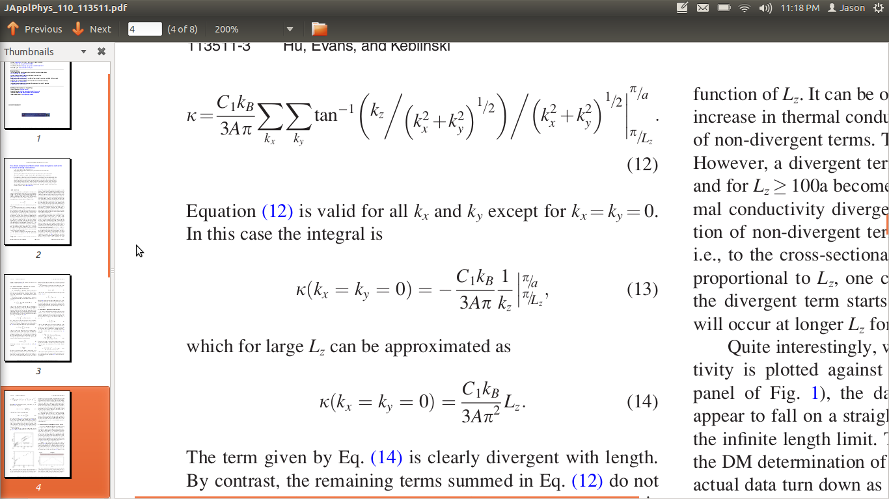
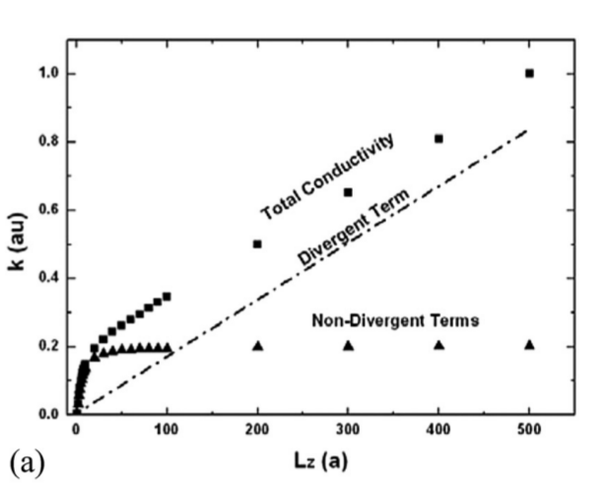
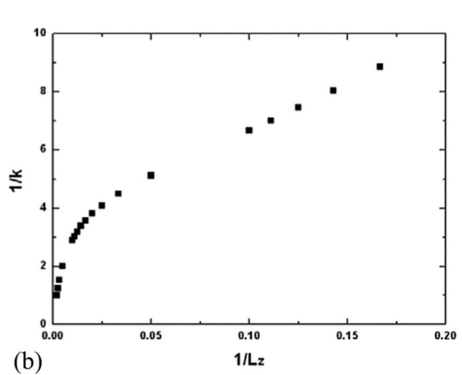
NEMD results
Non-Divergent Terms
Divergent Term
7

Slide 8
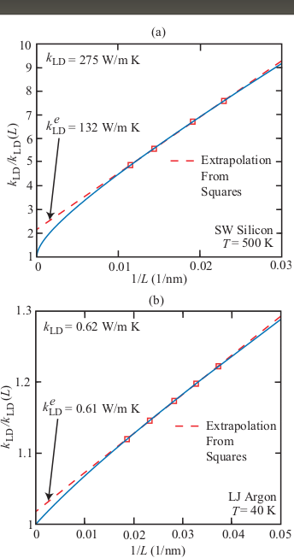
NEMD results
8
PHYSICAL REVIEW B 81, 214305 ͑2010͒

Slide 9
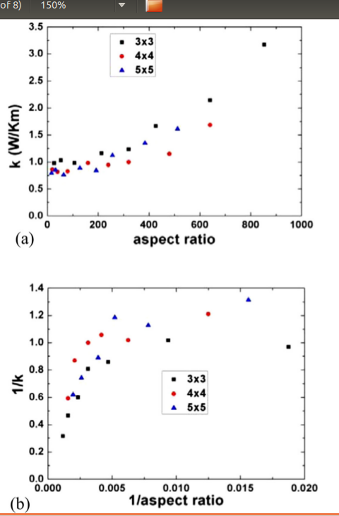
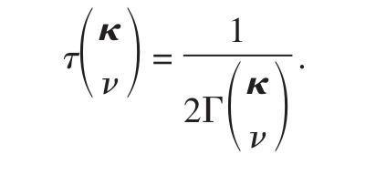
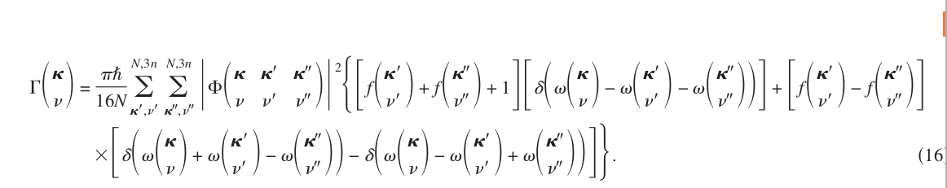
NEMD results
Divergent term
Phonon lifetime from Anharmonic Lattice Dynamics
9
PHYSICAL REVIEW B 79, 064301 ͑2009͒

Slide 10
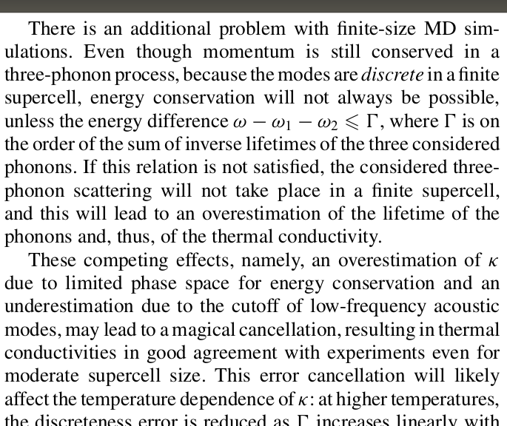
Finite Simulation effect
Phonon lifetime from Anharmonic Lattice Dynamics
10
PHYSICAL REVIEW B 84, 085204 (2011)
PHYSICAL REVIEW B 79, 064301 ͑2009͒

Slide 11
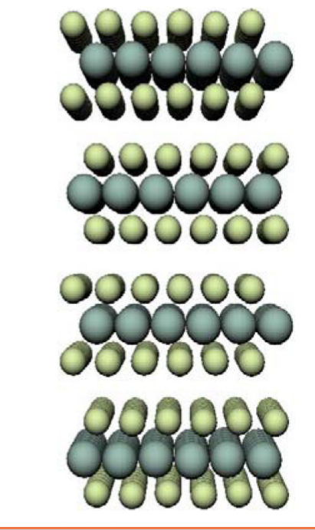
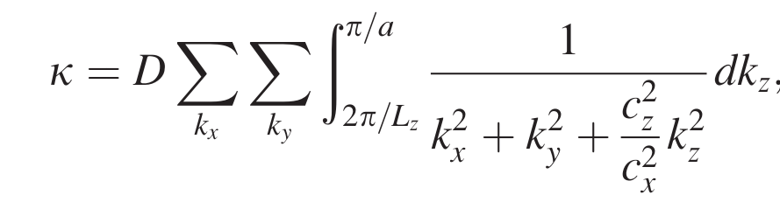
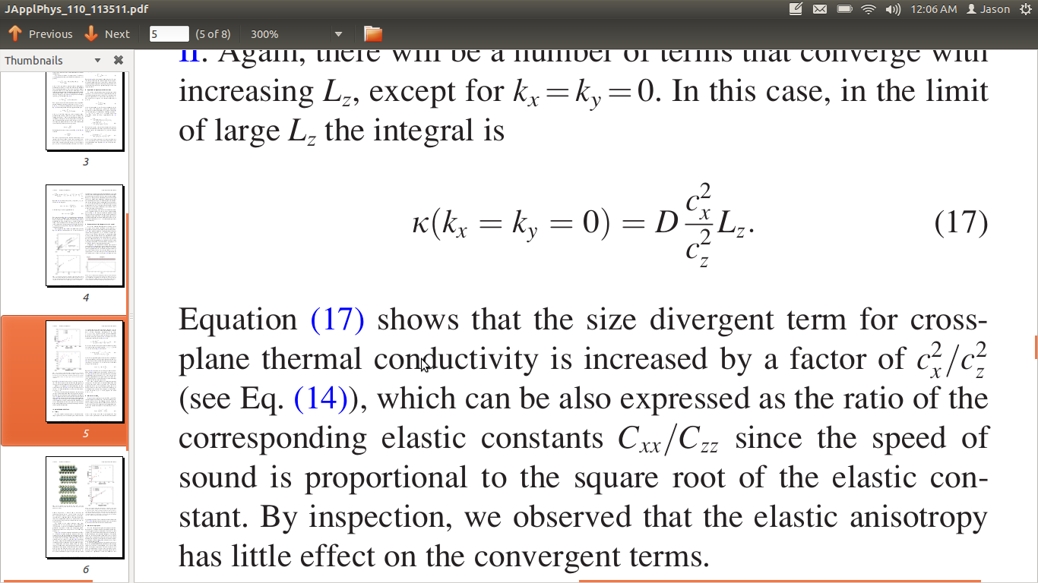
3D Anisotropic Crystal
WSe2
Anisotropic crystal continuous in z
Divergent term
11

Slide 12
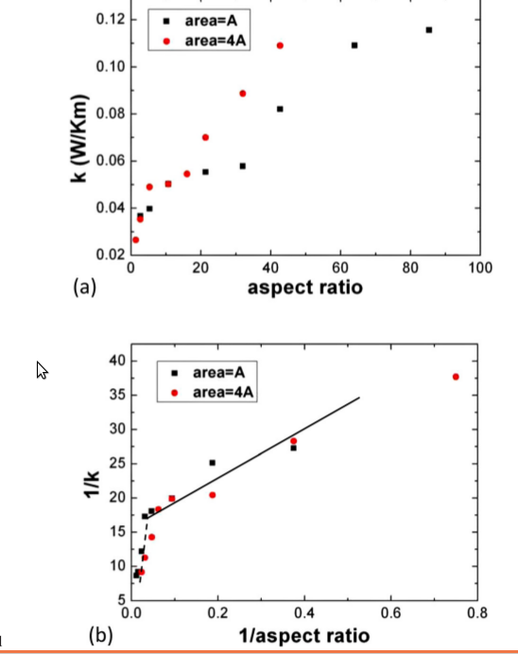
3D Anisotropic Crystal
WSe2
Divergent term
12

Slide 13
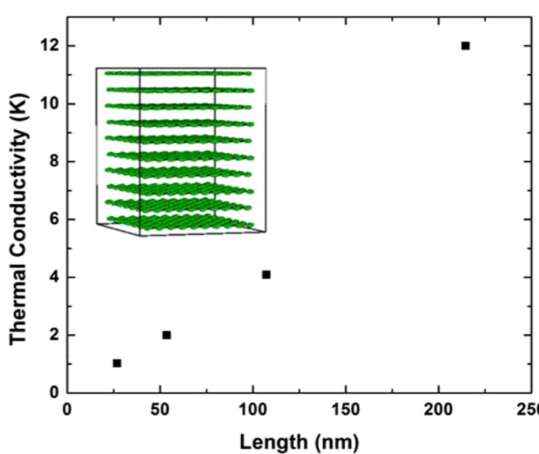
3D Anisotropic Crystal
Graphite
Divergent term
Graphite interplane interactions are much weaker than WSe2
13

Slide 14
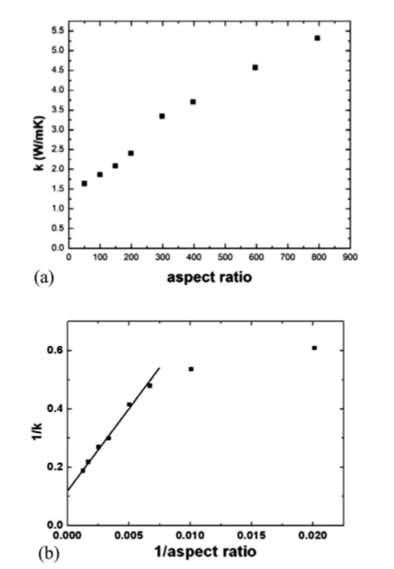
1D LJ nanowire
Divergent term
1D chains do not have divergent conductivities
LJ nanowire
14

