Slide 1
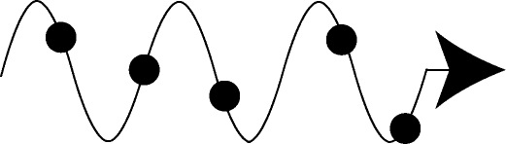
Comparison of Spectral Energy Methods for Predicting Phonon Properties
Jason Larkin, Alex Massicotte, Joe Turney, and Alan McGaughey
Department of Mechanical Engineering
Carnegie Mellon University, Pittsburgh PA
Cristina Amon
Department of Mechanical & Industrial Engineering
University of Toronto, Toronto ON
ASME 2012 3rd MNHMT Conference
Atlanta GA, March 6, 2012

Slide 2
Phonon Formula for Thermal Conductivity

Slide 3
Heat Capacity and Group Velocity
Harmonic lattice dynamics calculations give phonon frequencies
Group velocity is slope of phonon dispersion curve.
Silicon
Lines: Experimental, Points: Quantum Calculations

Slide 4
Lifetimes are Harder
Anharmonic lattice dynamics calculations
Quantum effects naturally incorporated
Force constants from an empirical potential or DFT
Frequencies and mode shapes from harmonic LD
Capture up to three-phonon interactions (good for low temperatures)
Complicated theoretical framework and calculations
Normal mode decomposition (MD simulation)
Captures full anharmonicity
Need frequencies and mode shapes from harmonic LD
MD simulation is classical (good for high temperatures)
“Spectral Energy Density” (MD Simulations)
Similar to normal mode decomposition, but mode shapes not needed
Turney et al., PRB 79, 064301 (2009)
Thomas et al., PRB 81, 081411(R) (2010).

Slide 5





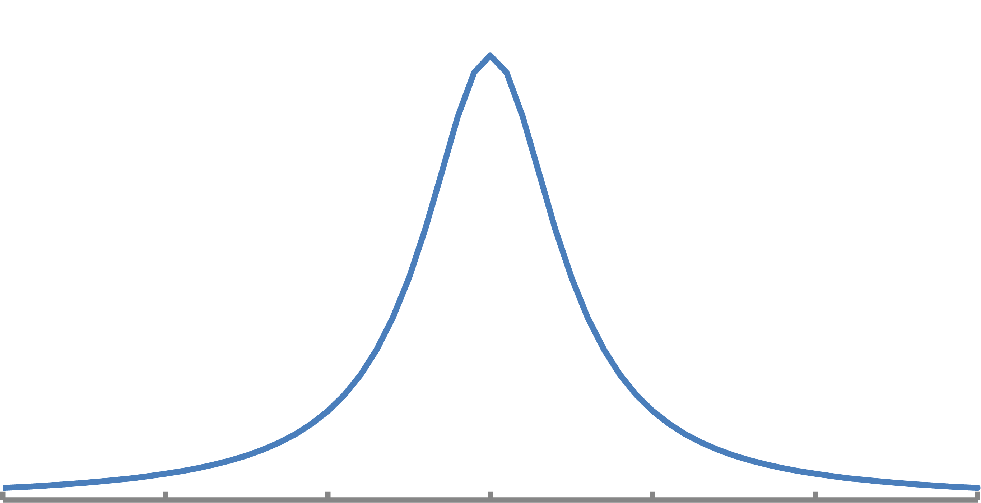
Normal Mode Decomposition
1. Equilibrium MD simulations provide atomic velocities.
2. Project velocities onto phonon modes from lattice dynamics calculations.
3. Auto-correlation and Fourier transform of phonon kinetic energy.
4. Extract phonon lifetime.
Ladd et al., PRB 34, 5068 (1986),
McGaughey and Kaviany, PRB 69, 094308 (2004).

Slide 6
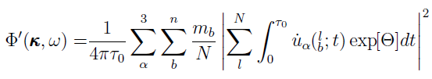

“Spectral Energy Density”
1. Equilibrium MD simulations provide atomic velocities.
2. Auto-correlation and Fourier transform of phonon velocities.
3. Extract phonon lifetime.
Thomas et al., PRB 81, 081411(R) (2010).

Slide 7
Case Study: Lennard-Jones Argon
N = 2048
Conventional unit cell
2²⁰ time steps
Velocities every 2⁵ time steps
Full Brillouin zone
T = 5, 20, 40 K
LAMMPS + Matlab

Slide 8
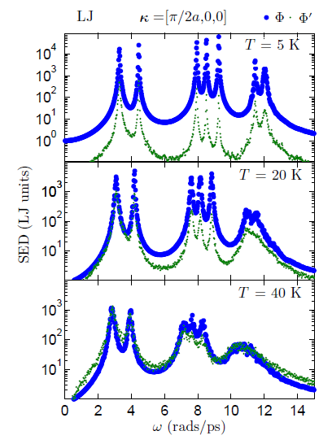
Kinetic Spectral Energy

Slide 9
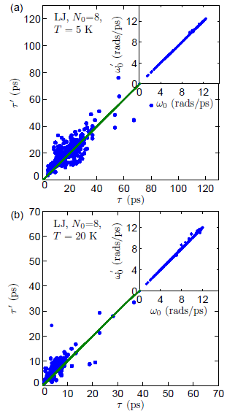
Frequencies and Lifetimes
Frequencies show good agreement.
Large scatter in lifetimes
No systematic error
Similar for LJ@40K, Si, CNT

Slide 10
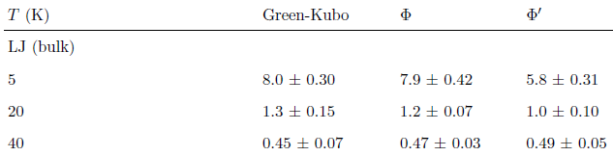
Thermal Conductivity
Normal mode decomposition & Green-Kubo agree at all temperatures.
“Spectral Energy Density” shows deviations at 5 & 20 K
Similar for Si at 500 K
40 K agreement is by coincidence

Slide 11
Recommendations
Normal mode decomposition technique is formally correct and makes predictions consistent with other methods.
“Spectral energy density” does not capture all the spectral energy
Can predict phonon dispersion
Not recommended for lifetimes
Acknowledgements: John Thomas, Jun Shiomi, Xiulin Ruan, Bo Qiu
Support: AFOSR FA95501010098

