Slide 1
Predicting Phonon Properties using Ab Initio Anharmonic Lattice Dynamics

Slide 3
Si Computational Cost vs. Benefits

Slide 4
Relevant Length Scales
Electron, Phonon MFP and heat transport.
Behavior of semiconductors

Slide 5
Thermoelectric Si nanowires
Electron, Phonon MFP are used to manipulate ZT figure of merit.

Slide 6
Harmonic Frequencies

Slide 7
Interfaces
Behavior of harmonic interfaces:
Acoustic MM, diffuse MM
Behavior of anharmonic interfaces:
Behavior of specularity, roughness, amorphization, etc.

Slide 8
Amophous
Mean free path of AF modes about ½ the “wavelength” of that mode. Calculate D_i and use the u_rms to estimate what the MFP is as if cv^2tau.
What if you turn off channels of heat in a given direction?

Slide 9
Amophous
Mean free path of AF modes about ½ the “wavelength” of that mode. Calculate D_i and use the u_rms to estimate what the MFP is as if cv^2tau.
What if you turn off channels of heat in a given direction?

Slide 10
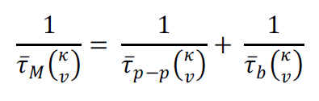


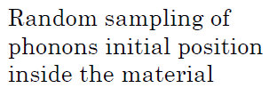


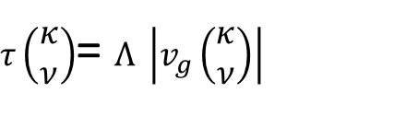


From Ankit…
$τ\left(\begin{matrix}κ \\ ν\end{matrix}\right)$= $Λ \left|v_{g}\left(\begin{matrix}κ \\ ν\end{matrix}\right)\right|$
$$Λ$$
L $≈Λ$
$$Λ_{eff}=\min{(}Λ_{p−p},Λ_{p−b})$$

Slide 11

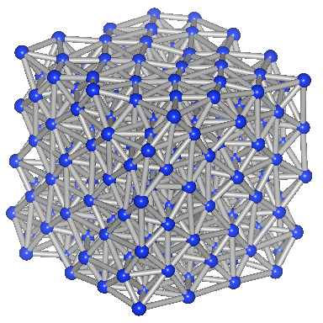
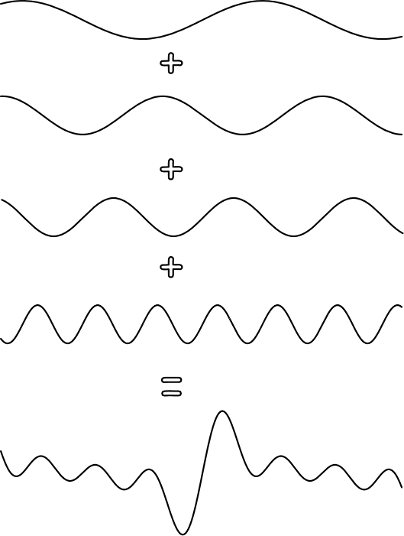
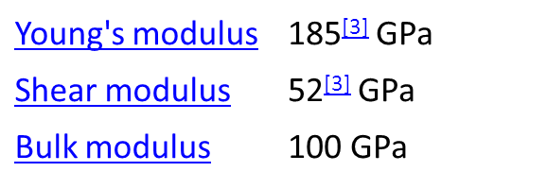
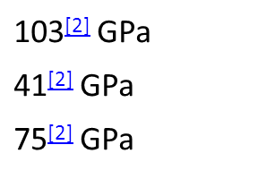
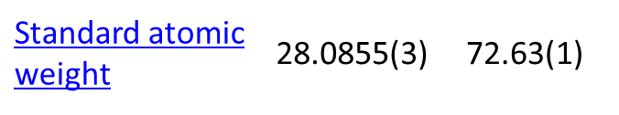
Phonons
m_{atom}
k_{spring}
Lattice vibrations (Phonons) are travelling waves:
Waves that can exist depend on system size.
When system is very large (bulk)…
=
m_{atom}
k_{spring}
Vibrational Frequencies in Si > Ge
Useful for:
Crystalline materials
Disordered materials
Interfaces
Si Ge

Slide 12
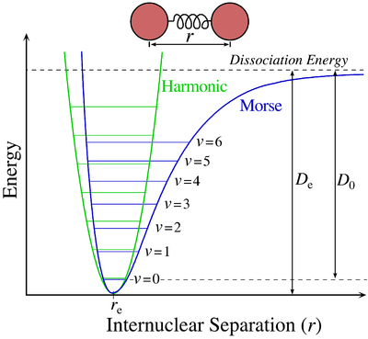
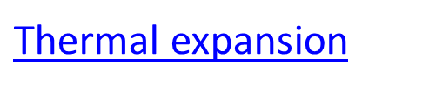
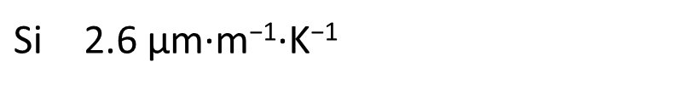
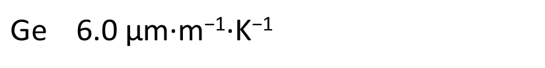


Phonons
m_{atom}
k_{spring}
Phonons are lattice vibrations:
Waves that can exist depend on system size.
When system is very large (bulk)…
$$F∝kr+αr^{2}+εr^{3}+…$$
$$F∝kr+αr^{2}+perturbation…$$
Actual atomic interactions are non-linear.
Interactions in a solid are mostly harmonic with anharmonic perturbation.

Slide 13
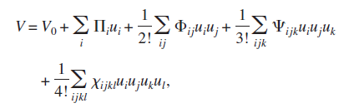
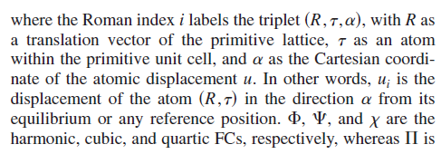
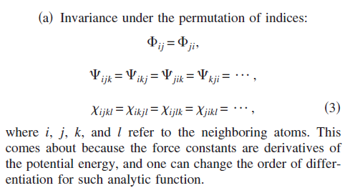

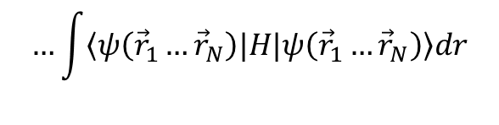

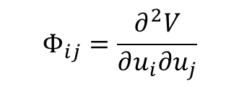



Force Constants
$$V=V_{0}+\sum_{i}{Π_{i}u_{i}}+\frac{1}{2!}\sum_{ij}{Φ_{ij}u_{i}u_{j}}+\frac{1}{3!}\sum_{ijk}{Ψ_{ijk}u_{i}u_{j}u_{k}}+\frac{1}{4!}\sum_{ijkl}{Ω_{ijkl}u_{i}u_{j}u_{k}u_{l}}+…$$
$$u_{j}$$
$$u_{l}$$
$$…\int{\left\langle ψ\left({\vec{r}}_{1}…{\vec{r}}_{N}\right)|H|ψ\left({\vec{r}}_{1}…{\vec{r}}_{N}\right)\right\rangle dr}$$
$τ\left(\begin{matrix}κ \\ ν\end{matrix}\right)$= $Λ \left|v_{g}\left(\begin{matrix}κ \\ ν\end{matrix}\right)\right|$
$$u_{i}$$
$$u_{k}$$
Harmonic force constants: under harmonic approximation phonons don’t interact so lifetimes and thermal conductivity are infinite (in a perfect infinite size crystal).
$$Φ_{ij}=\frac{∂^{2}V}{∂u_{i}∂u_{j}}$$

Slide 14
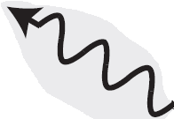
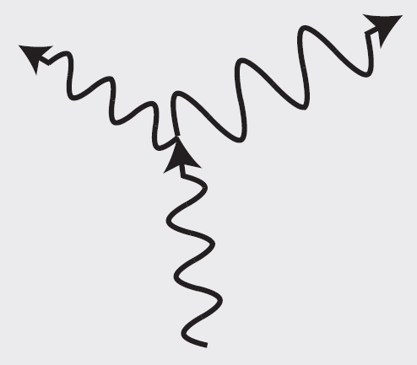
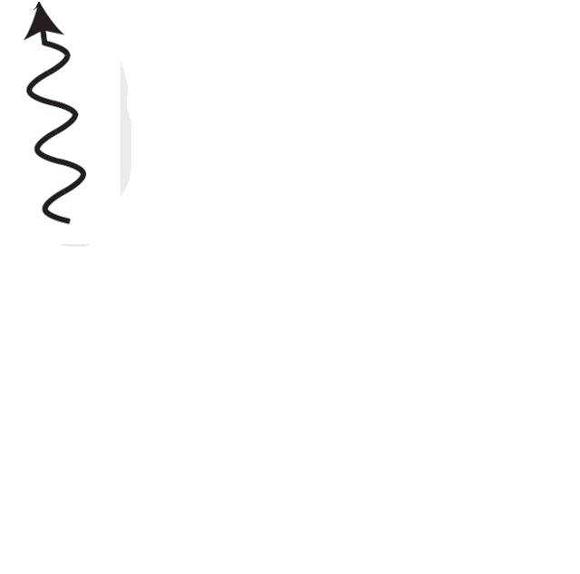
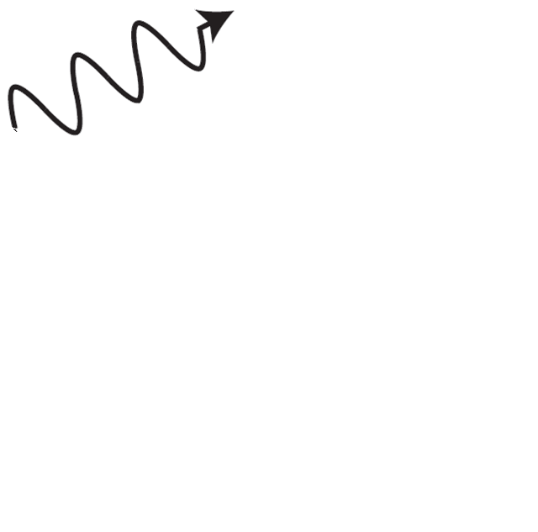
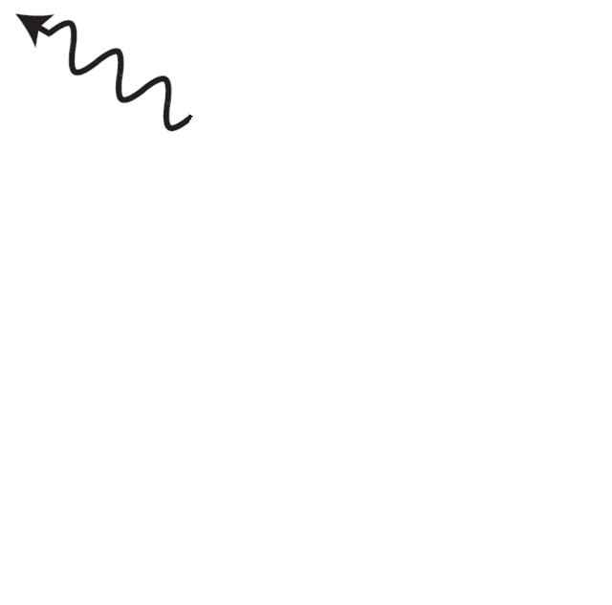
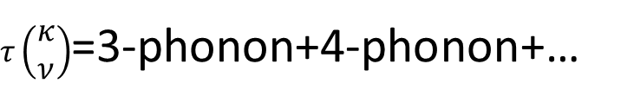
Phonon Lifetimes
m_{atom}
k_{spring}
Phonon Interactions:
$τ\left(\begin{matrix}κ \\ ν\end{matrix}\right)$=3-phonon+4-phonon+…
Increasing Temperature
Waves that can exist depend on system size.
When system is very large (bulk)…
$$V=V_{0}+\sum_{i}{Π_{i}u_{i}}+\frac{1}{2!}\sum_{ij}{Φ_{ij}u_{i}u_{j}}+\frac{1}{3!}\sum_{ijk}{Ψ_{ijk}u_{i}u_{j}u_{k}}+\frac{1}{4!}\sum_{ijkl}{Ω_{ijkl}u_{i}u_{j}u_{k}u_{l}}+…$$
3-phonon
4-phonon

Slide 15
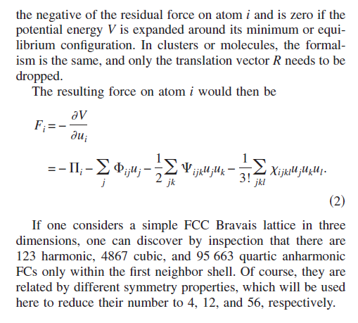
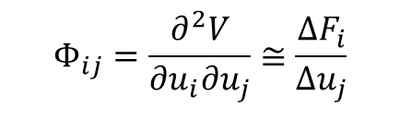
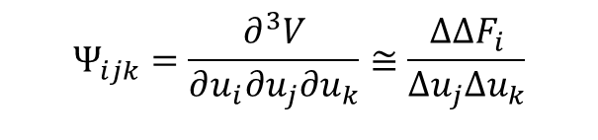


Force Constants
$$F_{i}=−\frac{∂V}{∂u_{i}}=−Π_{i}−\sum_{j}{Φ_{ij}u_{j}}−\frac{1}{2!}\sum_{ijk}{Ψ_{ijk}u_{j}u_{k}}−\frac{1}{3!}\sum_{ijkl}{Ω_{ijkl}u_{j}u_{k}u_{l}}−…$$
Molecular Dynamics:
$$F_{i}=ma_{i}$$
Lattice Dynamics:
$$Φ_{ij}=\frac{∂^{2}V}{∂u_{i}∂u_{j}}≅\frac{{ΔF}_{i}}{Δu_{j}}$$
Harmonic (HLD): Phonons, frequencies, group velocities
$$Ψ_{ijk}=\frac{∂^{3}V}{∂u_{i}∂u_{j}∂u_{k}}≅\frac{{ΔΔF}_{i}}{Δu_{j}Δu_{k}}$$
Anharmonic (ALD): Phonon lifetimes

Slide 16
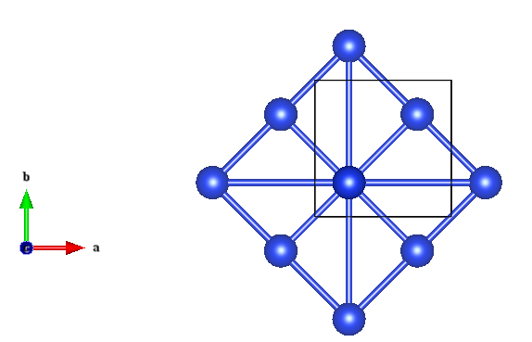
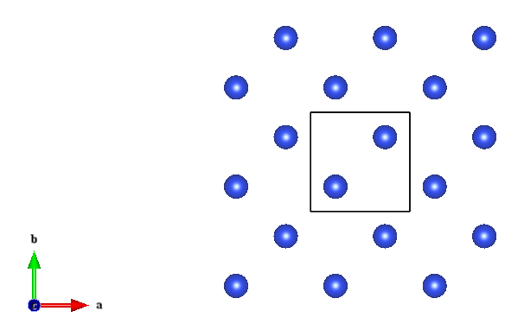


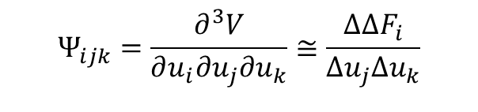

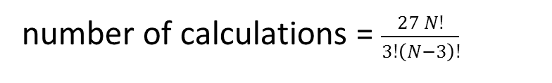

- Forces must be calculated for small displacements.
Calculating Force Constants
$$Ψ_{ijk}=\frac{∂^{3}V}{∂u_{i}∂u_{j}∂u_{k}}≅\frac{{ΔΔF}_{i}}{Δu_{j}Δu_{k}}$$
Phonon lifetimes
$$N$$
$$u_{k}$$
number of calculations = $\frac{27 N!}{3!\left(N−3\right)!}$
$$u_{i}$$
$$u_{j}$$

Slide 17






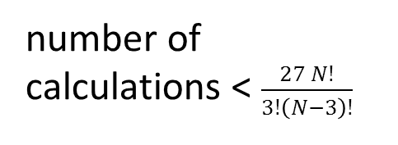

- By recognizing crystal symmetries, there is a huge savings in computational cost.
Calculating Force Constants
$$Ψ_{ijk}=\frac{∂^{3}V}{∂u_{i}∂u_{j}∂u_{k}}≅\frac{{ΔΔF}_{i}}{Δu_{j}Δu_{k}}$$
Phonon lifetimes
$$Ψ→S→Ψ_{}^{′}$$
number of calculations < $\frac{27 N!}{3!\left(N−3\right)!}$
$$u_{k}$$
$$u_{i}$$
$$u_{k}$$
$$u_{j}$$
$$u_{j}$$
$$u_{i}$$

Slide 18


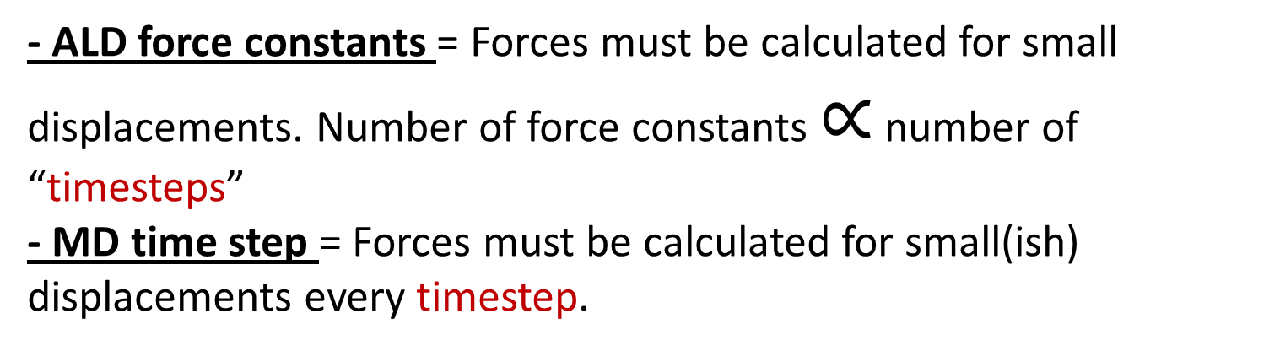
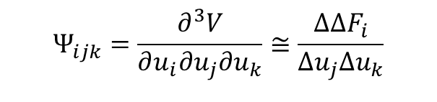
- ALD force constants = Forces must be calculated for small displacements. Number of force constants $∝$ number of “timesteps” - MD time step = Forces must be calculated for small(ish) displacements every timestep.
Ab Initio (Quantum) ALD vs. MD
$$Ψ_{ijk}=\frac{∂^{3}V}{∂u_{i}∂u_{j}∂u_{k}}≅\frac{{ΔΔF}_{i}}{Δu_{j}Δu_{k}}$$
$$F_{i}=ma_{i}$$
$$F_{i}=−\frac{∂E}{∂R_{i}}=−\left\langle ψ\left|\frac{∂H}{∂R_{i}}\right|ψ\right\rangle$$
For Quantum (DFT):
-Si, 500 atom structure 1 minute
MD cost = (NUMBER_STEPS) X (COST PER STEP)
( 10*longest_lifetime(ps) ) / (timestep (ps) ) X (computer cost per step)
= ( 10*100 ps) / (0.005 ps) X ( 1 min / step) = 33300 hours
Cost of ALD 1st NN cost = 4.5 hours
2nd NN cost = 367 hours

Slide 19
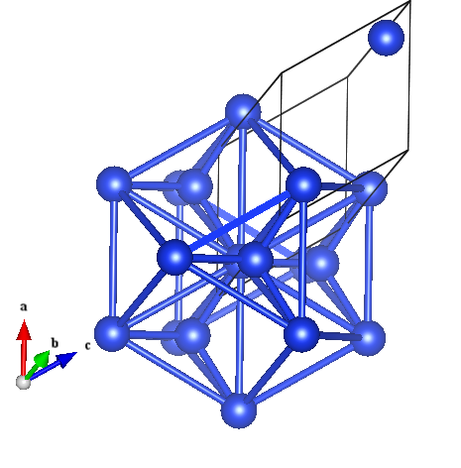
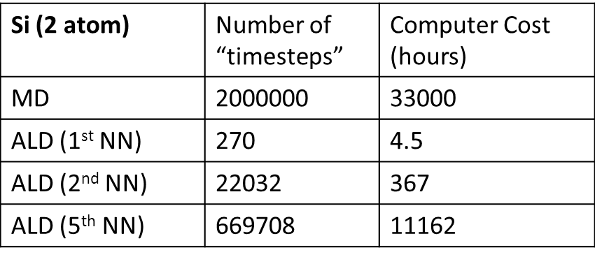
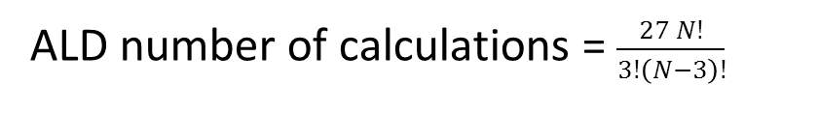
-These are computational costs for ALD without applying crystal symmetries.
Cost of ALD vs. MD using DFT
Si longest_lifetime ~ 100 ps
ALD number of calculations = $\frac{27 N!}{3!\left(N−3\right)!}$
MD cost = (NUMBER_STEPS) X (COST PER STEP)
( 10*longest_lifetime(ps) ) / (timestep (ps) ) X (computer cost per step)
= ( 10*100 ps) / (0.005 ps) X ( 1 min / step) = 33300 hours
ALD expensive for systems w/ long-range interactions, but usually cheaper than MD.
MD does not include quantum statistical effects

Slide 20
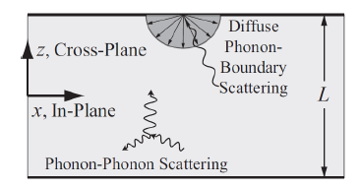

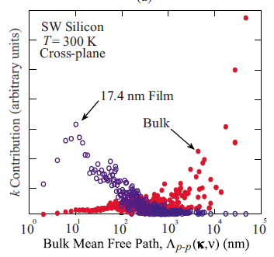
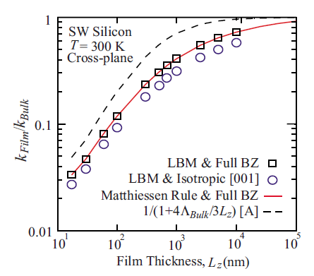
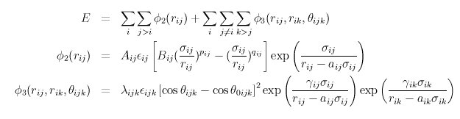
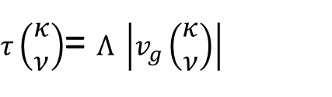
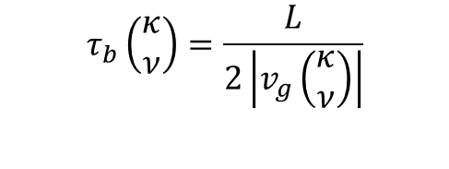
ALD Predicts Phonon Properties
Simulation: Classical vs. Quantum
Fitted function(al)s using Ab-Initio, expriment, intuition, etc
No fitting, different “environments” naturally accounted for
Simulation Expense
DFT
3 steps/min/128cpu = 0.023 steps/min/cpu
$$τ_{b}\left(\begin{matrix}κ \\ ν\end{matrix}\right)=\frac{L}{2\left|v_{g}\left(\begin{matrix}κ \\ ν\end{matrix}\right)\right|}$$
Stillinger-Weber
6E4 steps/min/4 cpu = 15000 steps/min/cpu
$τ\left(\begin{matrix}κ \\ ν\end{matrix}\right)$= $Λ \left|v_{g}\left(\begin{matrix}κ \\ ν\end{matrix}\right)\right|$
J. Appl. Phys. 108, 113524 2010

Slide 21
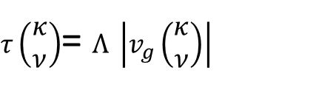


Ankit’s Work using ALD Phonon Properties
Simulation: Classical vs. Quantum
$τ\left(\begin{matrix}κ \\ ν\end{matrix}\right)$= $Λ \left|v_{g}\left(\begin{matrix}κ \\ ν\end{matrix}\right)\right|$
Fitted function(al)s using Ab-Initio, expriment, intuition, etc
No fitting, different “environments” naturally accounted for
Simulation Expense
DFT
3 steps/min/128cpu = 0.023 steps/min/cpu
Stillinger-Weber
6E4 steps/min/4 cpu = 15000 steps/min/cpu
$$Λ$$
L $≈Λ$

Slide 22
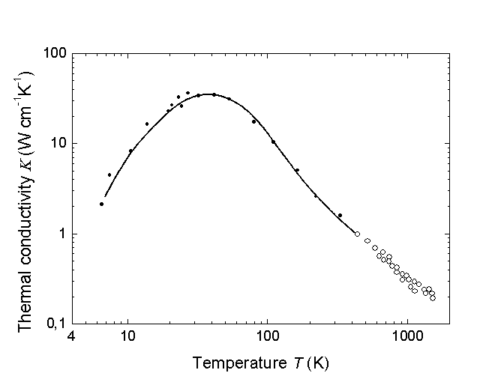
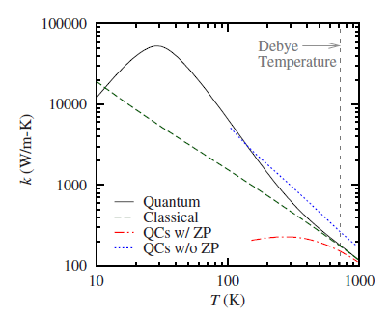
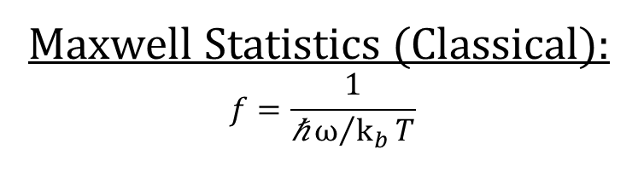
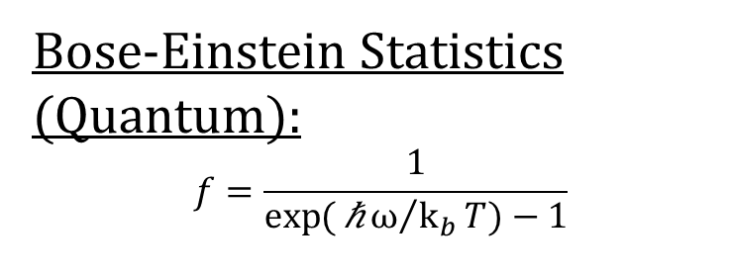
ALD Includes Quantum Effects
Simulation: Classical vs. Quantum
Si Experiment
Fitted function(al)s using Ab-Initio, expriment, intuition, etc
No fitting, different “environments” naturally accounted for
Simulation Expense
DFT
3 steps/min/128cpu = 0.023 steps/min/cpu
Glassbrenner, C. J. and G. A. Slack, Phys. Rev. 134, 4A (1964) A1058-A1069.
Bose-Einstein Statistics (Quantum):
$$f=\frac{1}{\exp{(}\text{ℏ}ω/{k_{b}}T)−1}$$
Si Simulation
Stillinger-Weber
6E4 steps/min/4 cpu = 15000 steps/min/cpu
Maxwell Statistics (Classical):
$$f=\frac{1}{\text{ℏ}ω/{k_{b}}T}$$
PHYSICAL REVIEW B 79, 224305 2009

Slide 23
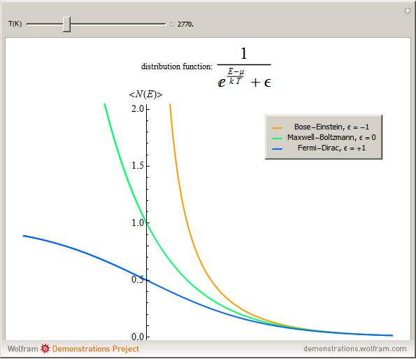
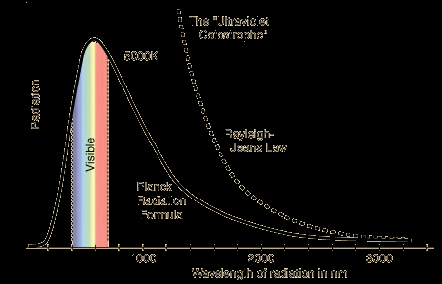
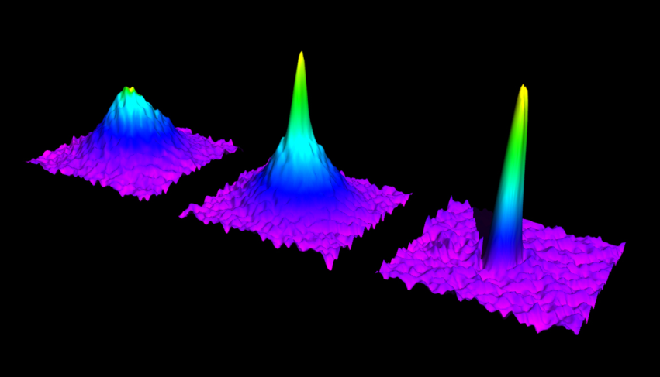
Phonons are Bosons
There are other things that are Bosons as well:
Photons
Composite particles (He4) (superfluid):
http://demonstrations.wolfram.com/BoseEinsteinFermiDiracAndMaxwellBoltzmannStatistics/

Slide 25


Slide 26
Force Constants Constraints

Slide 27
Bulk Modulus involves strain of total cell.
This strain energy can be related to the acoustic group velocity.
For short wavelength, there is a lot of strain energy/length. Lots of atoms are displaced from equilibirum. One reason why phonon energy is hbar omega
What kind of phonon mode involve the whole cell getting bigger? Gamma point phonons.

Slide 28



Slide 29




Slide 30


From Ankit…

