Slide 1
Thermal Conductivity Predictions for Nanostructures by Phonon Free Path Sampling
Ankit Jain

Slide 2
Introduction
Bulk Material:
-Phonon-phonon scattering
Techniques like Lattice Dynamics Method
Nanostructures:
-Phonon-phonon and phonon boundary scattering
-Matthiessen rule

Slide 3
Matthiessen Rule
Based on average phonon properties
Assumes independence of scattering mechanisms
Irregular geometries and specular scattering:

Slide 4
Alternative Approach
Sampled from Poisson distribution
Random sampling of phonons initial position inside the material

Slide 5
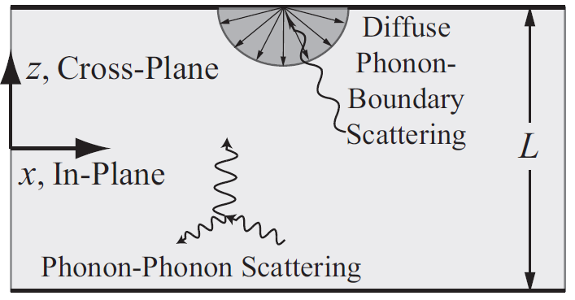
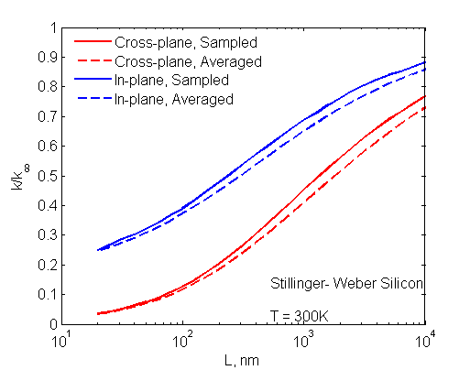
Results: Thin Film
Thermal conductivity predictions for thin film

Slide 6
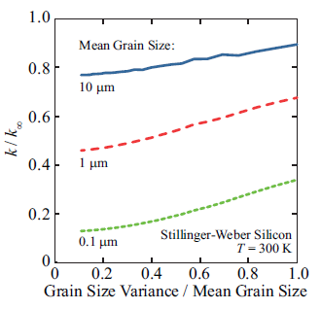
Results: Polycrystalline Material
Thermal conductivity predictions for polycrystalline material with spherical grains

Slide 7
Future work
Porous thin films with cylindrical holes
Understanding Lattice Dynamics calculations for generating bulk phonon properties

Slide 8
Thank You

