Slide 1
Temperature of Groups in LAMMPS
Simon Lu
3/12/2012

Slide 2
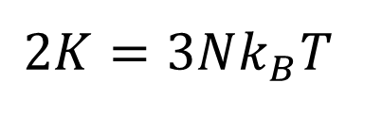
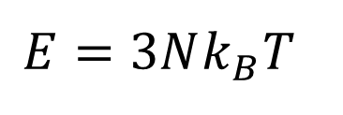
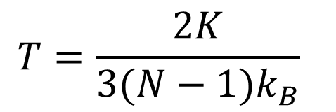
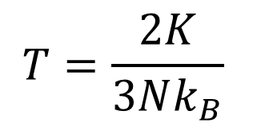
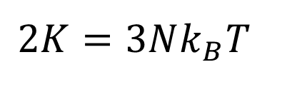
Equipartition
For a classical collection of N particles (no zero-point energy, integrate over states) with harmonic interactions (only quadratic terms in energy), we have
We make the assumption that kinetic and potential energy equally divide the total energy
Gives the usual relation
Or
$$E=3Nk_{B}T$$
$$2K=3Nk_{B}T$$
$$2K=3Nk_{B}T$$
$$T=\frac{2K}{3Nk_{B}}$$
$$T=\frac{2K}{3(N−1)k_{B}}$$
Momentum not conserved
Momentum conserved

Slide 3
In LAMMPS
Want to compute the temperature of a group of atoms in LAMMPS. Use statement
compute ID group-ID temp
LAMMPS website indicates the computation will be done as
Note division by N, not (N-1). This is exactly what we want: typically momentum is not conserved in a particular group. But it’s not what actually happens.
“The temperature is calculated by the formula KE = dim/2 N k T, where KE = total kinetic energy of the group of atoms (sum of 1/2 m v^2), dim = 2 or 3 = dimensionality of the simulation, N = number of atoms in the group, k = Boltzmann constant, and T = temperature.”

Slide 4
Experiment
Direct method NEMD simulation of LJ argon around 50 K, 40 atomic layers thick.
Divide sample into 24, 12, 6, and 3 groups, and run for each configuration.
Record the temperature in each group using compute group temp.
Compare the temperatures for different groupings of equivalent atoms.
q
Sample

Slide 5
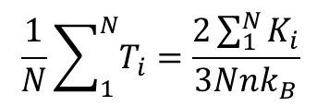
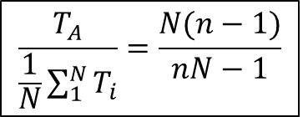
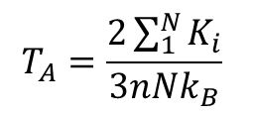
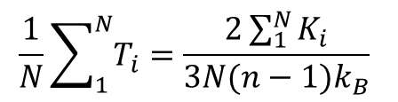
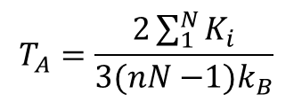
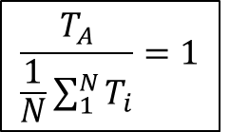
What is Expected
A
A is a group composed of N groups of n atoms each. Consider the ratio of the computed temperature of A versus the arithmetic mean of the computed temperatures of its component groups.
1
2
3
N
. . .
If LAMMPS uses n instead of (n-1) :
$$T_{A}=\frac{2\sum_{1}^{N}{K_{i}}}{3nNk_{B}}$$
$$\frac{1}{N}\sum_{1}^{N}{T_{i}}=\frac{2\sum_{1}^{N}{K_{i}}}{3Nnk_{B}}$$
$$\frac{T_{A}}{\frac{1}{N}\sum_{1}^{N}{T_{i}}}=1$$
If LAMMPS uses (n-1) instead of n :
$$T_{A}=\frac{2\sum_{1}^{N}{K_{i}}}{3(nN{−1)k}_{B}}$$
$$\frac{1}{N}\sum_{1}^{N}{T_{i}}=\frac{2\sum_{1}^{N}{K_{i}}}{3N(n−1)k_{B}}$$
$$\frac{T_{A}}{\frac{1}{N}\sum_{1}^{N}{T_{i}}}=\frac{N(n−1)}{nN−1}$$

Slide 6
Conclusion
LAMMPS compute group temp seems to use (N-1) instead of N
Most people don’t get any inconsistency because all group sizes are the same
Workarounds:
Multiply output temperatures by ratio (N-1)/N
Output kinetic energy directly
Use molecules

