Slide 1
DU BAO BIEN DONG THUC HIEN (REALIZED VOLATILITY)
Co phieu VN30 — Danh gia Salesforce Moirai2 & Graph Neural Network
Du lieu: VN30, 2019-2026 | Test set: 2026-01-05 -> 2026-04-07 (62 ngay, 30 co phieu, 1,860 cap)
Luan van tot nghiep — 2026-05-16
HCMUS — Khoa Cong nghe Thong tin

Slide 2
Tong Quan Nghien Cuu
Muc tieu, du lieu, cau hoi nghien cuu
Muc Tieu
Du Lieu & Thiet Ke
Danh gia Moirai2 (foundation model) cho du bao RV tren VN30
So sanh: embedding vs IQR quantile spread vs HAR-RV (classical)
Can thiep gi cua foundation model mang lai gia tri cho bai toan nay?
Tim cach thu hep khoang cach giua neural models va HAR-RV
30 co phieu VN30, OHLCV daily, ~2,500 ngay (2019-2026)
Train: full history per-stock HOAC batch 2,896 mau (tat ca stocks)
Test: 62 ngay giao dich, 01/2026-04/2026 = 1,860 cap (date, stock)
Nhan (label): RV h=20 = std(log-return, next 20 ngay)
Metrics danh gia: MAE, R2, Pearson_r, QLIKE
12 Mo Hinh Duoc Danh Gia (3 nhom chinh)
Classical baselines: HAR-RV (OLS per-stock), LSTM (per-stock), GARCH(1,1) (MLE per-stock)
Moirai2 zero-shot: (A) Embedding 384-dim → MLP/GNN (B) IQR = q(0.9) - q(0.1) lam proxy RV
Neural (walk-forward): MLP+Moirai2, GNN+Moirai2 [ham chuan du lieu 30 mau/buoc]
Neural (batch): MLP(RV6), GNN(RV6), MLP(Moirai2+RV6), GNN(Moirai2+RV6), MLP/GNN(Moirai2+RV3)

Slide 3
Kien Truc Thi Nghiem — Tong The Pipeline
Ba nhanh song song: Classical | Moirai2+Neural | GARCH
VN30 OHLCV Data — 30 co phieu | ~2,500 ngay giao dich (2019-2026) | Close price daily
▼
Log Returns: r_t = log( Close_t / Close_{t-1} )
↙
↓
↘
RV Features (6-dim)
Moirai2-Small (FROZEN, 11.4M params)
GARCH(1,1)
log(RV_d) log(RV_w) log(RV_m)
log(RV_q=60d) corr_vnindex
jump_ratio
(Corsi 2009 + mo rong)
Context 200 ngay → 14 patches → Decoder Transformer
Output A: Embedding 384-dim (patch cuoi cung, pos -2)
Output B: IQR = q(0.9) - q(0.1) [zero-shot proxy RV]
MLE per-stock
s^2_t = w + a*e^2_{t-1}
+ b*s^2_{t-1}
(benchmark truyen thong)
▼
▼
▼
BEST
HAR-RV (OLS) / LSTM
MLP / GNN (batch or walk-forward)
GARCH(1,1)
Per-stock, full history (~2,500 mau/stock)
HAR: 3 tham so OLS (BLUE estimator)
MAE: 0.0010 / 0.0011 R2: 0.971 / 0.967
Input: Emb(384)+RV3/RV6 | IQR zero-shot | RV6 only
Batch 2,896 mau | Walk-fwd 30 mau/buoc
MAE: 0.0066-0.0143 R2: -1.86 to +0.28
MLE per-stock
MAE: 0.0071 R2: +0.159
▼
Realized Volatility Prediction | h = 20 ngay = std(log-return, next 20 ngay)

Slide 4
Kien Truc Moirai2 — Hai Che Do Su Dung
Frozen decoder-only transformer: (A) Embedding extraction vs (B) IQR zero-shot
Log Return Series — 200 observations (context window) — daily frequency
▼
Patcher: 200 obs / patch_size=16 → 13 context patches + 1 MASK token = 14 patches
▼
P1
P2
P3
P4
P5
P6
P7
P8
P9
P10
P11
P12
P13
MASK
13 context patches (causal attention)
← predict
▼
Decoder-only Transformer (causal masked attention, 11.4M params) — FROZEN trong toan bo thi nghiem
↙
↘
Approach A — Embedding Extraction
Approach B — IQR Quantile Spread (Zero-shot)
Lay hidden state tai patch cuoi cung (pos -2: last_context)
Kich thuoc: 384-dim per stock per window
→ Dung lam node features cho MLP / GNN
Ket qua: median|corr(emb, RV)| = 0.128
Them vao RV6: MAE tang 8% (them nhieu!)
Lay output du bao: QuantileForecast (9 quantile levels)
q0.1, q0.2, q0.3, ..., q0.9 (exact, khong sampling)
IQR_t = q(0.9) - q(0.1) [80% prediction interval width]
Scale: IQR x 0.442 ≈ RV (mean(RV)/mean(IQR))
Pearson_r = 0.557 — bang MLP trained (r=0.551)!
Embedding weak — domain gap (no equity pretraining)
IQR competitive — uncertainty calibration hoat dong!

Slide 5
Ket Qua — Tat Ca 12 Mo Hinh
Test set: 62 ngay x 30 co phieu = 1,860 cap | sap xep theo MAE tang dan
Mo hinh
Training
Features
MAE
R2
Pearson_r
QLIKE
Best:
HAR-RV (OLS) ***
Full/stock
RV_d,w,m
0.0010
+0.971
0.985
0.012
MAE↓
0.0010
R2↑
+0.971
r↑
0.985
QLIKE↓
0.012
HAR-RV
wins all
LSTM ***
Full/stock
same
0.0011
+0.967
0.983
0.012
MLP (RV6 only) **
Batch 2896
6 RV ext.
0.0066
+0.278
0.551
0.328
Moirai2 IQR (zero-shot)
Khong
q0.9-q0.1
0.0067+
+0.161
0.557
—
GARCH(1,1)
Per-stk MLE
—
0.0071
+0.159
0.535
0.301
MLP (Moirai2+RV6)
Batch
390-dim
0.0072
+0.065
0.505
0.259
Batch GNN (Moirai2+RV3)
Batch
387-dim
0.0074
+0.041
0.357
0.399
Batch MLP (Moirai2+RV3)
Batch
387-dim
0.0078
-0.137
0.425
0.290
GNN (RV6 only) **
Batch
6 RV ext.
0.0084
-0.194
0.396
0.328
GNN (Moirai2+RV6)
Batch
390-dim
0.0091
-0.519
0.377
0.345
WalkFwd MLP+Moirai2
Walk-fwd
387-dim
0.0121
-1.077
0.239
1.444
WalkFwd GNN+Moirai2
Walk-fwd
387-dim
0.0143
-1.856
0.117
1.898
*** Per-stock full history training (~2,500 mau/stock, OLS 3 params) ** Batch 2,896 mau chung 30 stocks
+ MAE sau scale correction (IQR x 0.442); raw MAE = 0.0323 | Bold = best per metric
Walk-fwd = 30 mau/buoc (nut that training) | Batch = 2,896 mau tong

Slide 6
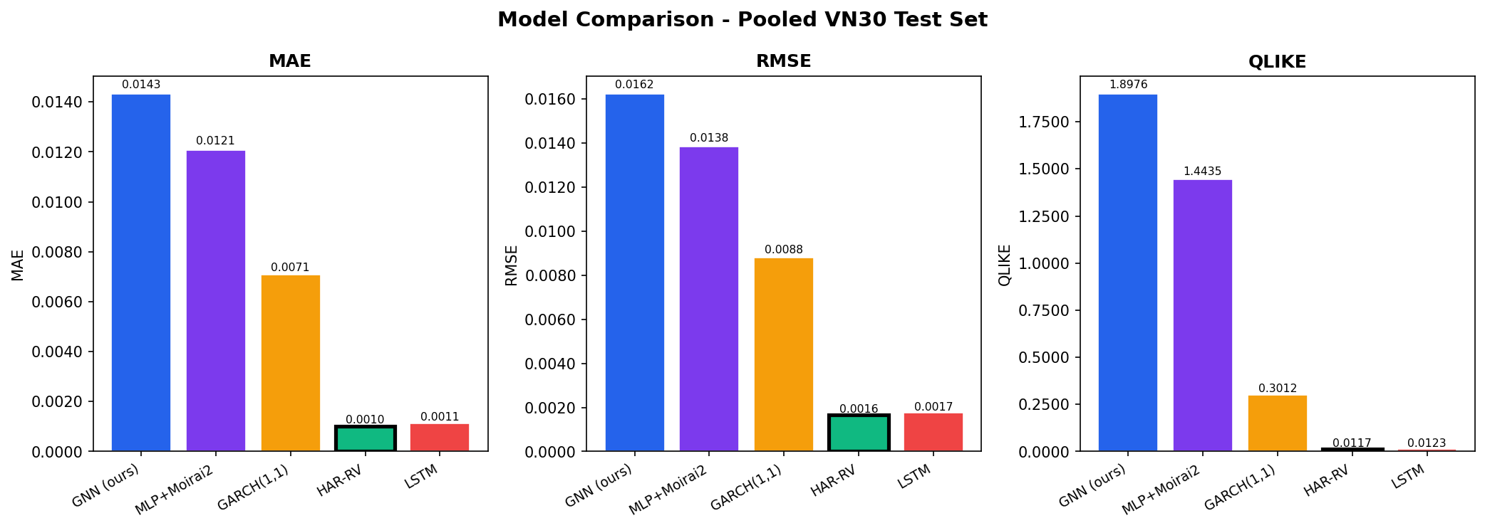
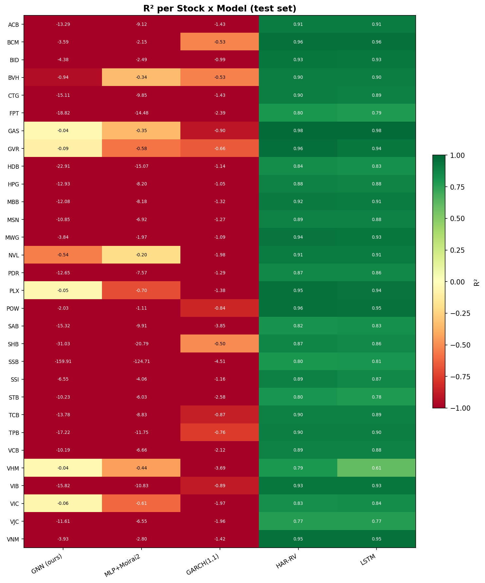
Ket Qua — Truc Quan Hoa
Trai: MAE/RMSE/QLIKE so sanh 5 mo hinh chinh | Phai: R2 per stock x model
Chi HAR-RV va LSTM co R2 > 0 tren tat ca 30 co phieu (xanh la). Walk-fwd models: R2 am (do).

Slide 7
Finding 1 — Che Do Training La Nut That Chinh (H2)
Walk-forward vs Batch: chenh lech 35-48% MAE
Walk-Forward (che do cu)
Batch Training (cai thien)
30 samples / gradient step
(30 stocks x 1 ngay giao dich)
MLP: MAE = 0.0121
GNN: MAE = 0.0143
Ly do: data starvation
Moi window chi them 1 ngay
Model khong the hoc duoc patterns
2,896 samples toan bo (tat ca stocks)
(30 stocks, chung weights)
MLP: MAE = 0.0066 (-45%)
GNN: MAE = 0.0084 (-41%)
Gop toan bo lich su 30 stocks
Hoc duoc patterns chung
Nhung van it hon HAR ~30x
vs
HAR-OLS: ~75,000 cap hoc (2,500 ngay x 30 stocks, fit rieng tung stock) vs Neural batch: ~97 mau/stock (2,896/30 shared)
=> Gap 6.5x MAE la co cau truc — khong the giai quyet chi bang architecture phuc tap hon

Slide 8
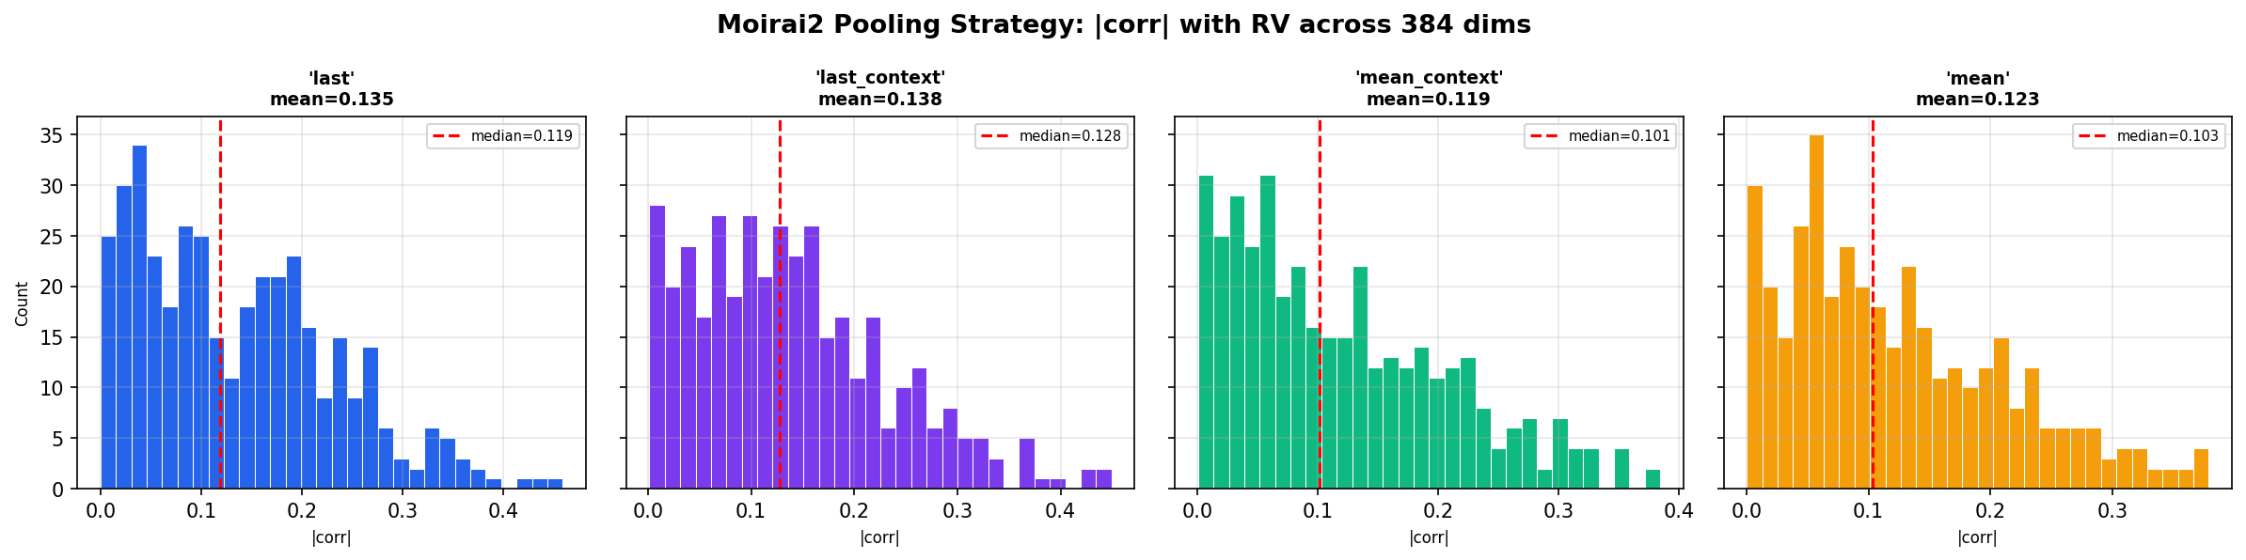
Finding 2 & 3 — Embedding Them Nhieu | RV6 > RV3
Domain gap giai thich tai sao median|corr(embedding,RV)|=0.128; RV6 giam 15% MAE
Finding 2 — Embedding Moirai2 Them Nhieu (+8-9%)
Mo hinh
Features
MAE
MLP (RV6 only)
6-dim RV
0.0066
MLP (Moirai2+RV6)
390-dim
0.0072 (+8.4%)
GNN (RV6 only)
6-dim RV
0.0084
GNN (Moirai2+RV6)
390-dim
0.0091 (+8.1%)
Finding 3 — RV6 (6-dim) tot hon RV3 (3-dim): -15% MAE
Feature
Cong thuc
Nguon
log(RV_d)
std(r, 1 ngay)
Corsi 2009
log(RV_w)
mean(RVd, 5 ngay)
Corsi 2009
log(RV_m)
mean(RVd, 22 ngay)
Corsi 2009
log(RV_q)*
mean(RVd, 60 ngay)
Mo rong HAR
corr_vnindex*
Pearson(stk,VNI,60d)
Risk he thong
4 chien luoc pooling Moirai2 — tat ca deu yeu (median|corr| max 0.128)
jump_ratio*
max(RVd-RVw,0)/RVd
B-N&S 2004
* 3 features mo rong ngoai HAR goc (RV_d, RV_w, RV_m)
Nguyen nhan co cau: Moirai2 chua bao gio thay equity/RV data trong pretraining

Slide 9
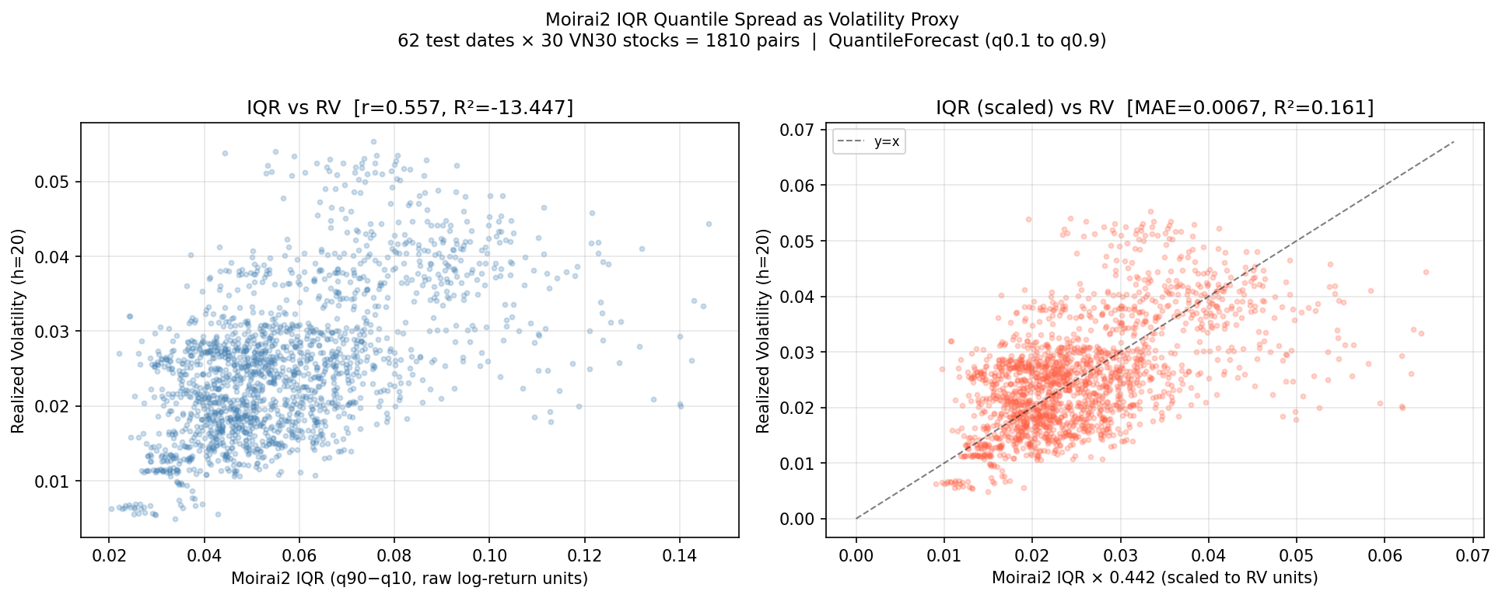
Finding 5 — Moirai2 IQR: Zero-Shot Competitive
IQR = q(0.9)-q(0.1) bat duoc volatility clustering — khong can training, khong can features
IQR_t = q(0.9) - q(0.1) of 1-step-ahead return forecast → proxy for RV
Phuong phap
Pearson_r
MAE
Training can
Moirai2 IQR (zero-shot)
0.557
0.0067*
Khong co
MLP (RV6, batch)
0.551
0.0066
2,896 mau
Embedding median|corr|
0.128
—
—
HAR-RV (OLS)
0.985
0.0010
~2,500/stock
IQR khong can training, khong can feature engineering
Pearson_r IQR (0.557) = 4.4x cao hon embedding (0.128)
Scale factor 0.442 ≈ mean(RV)/mean(IQR)
=> IQR o log-return units, lon hon RV ~2.26x
Model hoc duoc heteroscedasticity (vol clustering)
du pretraining khong co equity/RV data
* raw MAE = 0.0323; sau scale x0.442 = 0.0067
Trai: IQR raw vs RV (r=0.557, R2=-13.4) | Phai: IQR scaled vs RV (MAE=0.0067)

Slide 10
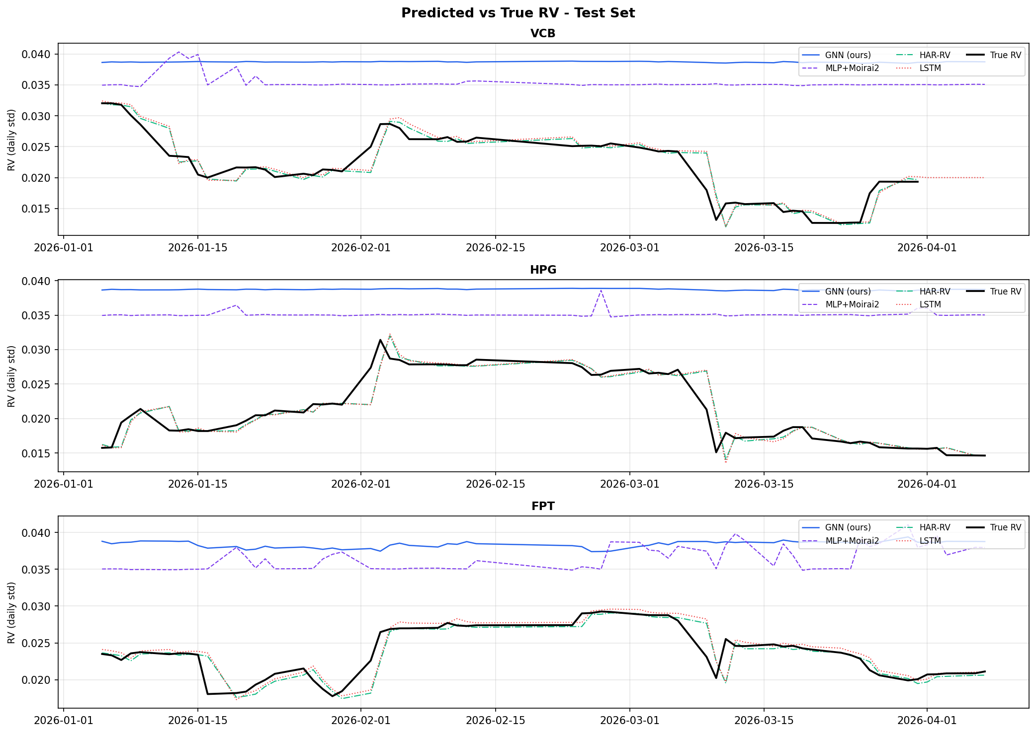
Finding 6 — Khoang Cach 6.5x voi HAR-RV La Co Cau Truc
HAR-RV theo sat true RV; neural models (walk-fwd) phang; batch models nhieu
Tai sao HAR-RV vuot troi?
Per-stock OLS: 2,500 mau x 30 stocks (fit rieng)
Chi 3 tham so: [beta_d, beta_w, beta_m]
MAE=0.0010 R2=+0.971 Pearson_r=0.985
OLS = BLUE Estimator (Gauss-Markov theorem)
Khong the co linear model nao tot hon
voi cung du lieu
Neural batch: ~97 mau/stock (2,896/30)
=> MLP(RV6): MAE=0.0066 [gap 6.5x]
Giai phap (lau dai):
HAR-RS: them asymmetry, van OLS
GNN+HAR: exploit cross-stock spillover
Mo rong data: them stocks, them nam
VCB, HPG, FPT: HAR-RV (xanh la) bam sat true RV (den). Walk-fwd models: phang; LSTM: ok.

Slide 11
Tai Sao Moirai2 Embedding Yeu? — Phan Tich Pretraining Data
GIFT-Eval Pretrain corpus: 4.5M series, 230B diem — khong co equity data thuc su
Dataset
Tan suat
So series
Noi dung thuc su (giai thich chi tiet)
M4 Daily
Daily
4,227
Business/macro competition — mot so stock, khong co Asian equity
M4 Monthly
Monthly
48,000
Kinh te vi mo, demographic, industry sectors
M1/M3
Mix
~3,000
Macro + business forecasting competition tong hop
FRED-MD
Monthly
107
Federal Reserve macro indicators (CPI, lai suat, employment) — chi My
Bitcoin
Daily
18
Crypto price — DUY NHAT daily price series (khong phai stock equity)
NN5
Daily
111
ATM cash withdrawal UK — bi label nham 'Econ/Fin', KHONG phai stock
GoDaddy
Monthly
3,135
Domain registration business data — khong lien quan den stock
Ket Luan — Domain Gap La Nguyen Nhan Co Cau:
KHONG co equity/stock market data thuc su — chi 18 series Bitcoin daily trong 4.5M series
KHONG co Asian market data — toan bo corpus la US/EU-centric (FRED-MD, M4 competition)
KHONG co realized volatility series — Moirai2 chua bao gio thay RV labels trong pretraining
=> Embedding 384-dim phan anh macro trend/seasonality patterns, KHONG phai second-moment structure cua stock vol
=> Day la giai thich co cau cho median|corr(embedding, RV)| = 0.128 tren tat ca 384 chieu

Slide 12
Ket Luan
5 insights chinh tu thi nghiem VN30 Volatility Forecasting
(1) Domain gap la nguyen nhan co cau
Moirai2 pretrain tren macro/business data (M4, FRED-MD). Khong co equity/Asian/RV data. Embedding encode macro trend, khong phai second-moment structure => median|corr|=0.128.
(2) Training regime la nut that chinh
Walk-forward (30 mau/buoc) → Batch (2,896 mau): giam 35-48% MAE. Training regime quan trong hon kien truc model.
(3) HAR-RV (OLS) van la benchmark champion
R2=0.971 vs best neural R2=0.278. Gap 6.5x MAE la co cau: OLS per-stock 2,500+ mau, 3 params, BLUE estimator.
(4) IQR zero-shot — phat hien dac biet cua luan van
Moirai2 IQR (q0.9-q0.1) dat Pearson_r=0.557 = MLP trained (r=0.551). Uncertainty calibration hoat dong du domain gap — model hoc duoc heteroscedasticity.
(5) Embedding Moirai2 them nhieu khi co RV features
MLP(Moirai2+RV6) MAE tang 8.4% vs MLP(RV6). 384-dim return embedding 'nhan chim' 6-dim RV signal — hai khong gian feature orthogonal voi nhau.

Slide 13
Huong Cai Thien Tiep Theo
SOTA research 2024-2025: HAR-RV co the bi vuot voi dieu kien phu hop
HAR-RS (Semivariance)
De, 1-2 gio
Uu tien 1
Thay the HAR-OLS bang semivariance decomposition: RV+ (return duong) va RV- (return am). Van la OLS, 5 tham so thay vi 3. Bat duoc leverage effect (downside vol du bao tot hon upside). Patton & Sheppard (2015): nhat quan vuot HAR o h=5,10,22 ngay — phu hop voi h=20 cua thi nghiem. ~10 dong code.
GNN + QLIKE Loss
Vua, 1-2 ngay
Uu tien 2
GNNHAR (Zhang et al., IJF 2025): GNN+QLIKE giam 13% MSE vs HAR tren US equity. Hien tai GNN dung MSE — doi sang QLIKE giup xu ly heteroskedasticity tot hon. Them cross-stock correlation graph tu daily returns. Khong can intraday data.
Foundation Model Fine-tuning
Dai han
Uu tien 3
arxiv 2505.11163 (May 2025): TimesFM + incremental fine-tuning vuot HAR-RV thong ke (DM test) tren 21 chi so toan cau. Co the ap dung tuong tu cho Moirai2 voi LoRA adapter tren VN30 log-returns. Risk: phuc tap, co the ngoai pham vi luan van.

