Slide 1

An overview of data pre-processing, visualisation and modelling
Stroke Patient Healthcare using Deep Learning

Slide 2
Contents
Objective | Provide a concise summary of the project goals and objectives
Project Overview | Outline the structure and scope of the project
Milestone 1 | Includes data collection, cleaning, and preprocessing steps
Milestone 2 | Data visualization phase retrieving patterns and trends.
Milestone 3 | Data encoding techniques and building models to data
Milestone 4 | Tuning the models and evaluating various scores
Model Final Evaluation | Present an assessment of the final model’s performance, including strengths and limitations
Final Insights | Summarize the key conclusions drawn from the project and its outcomes

Slide 3
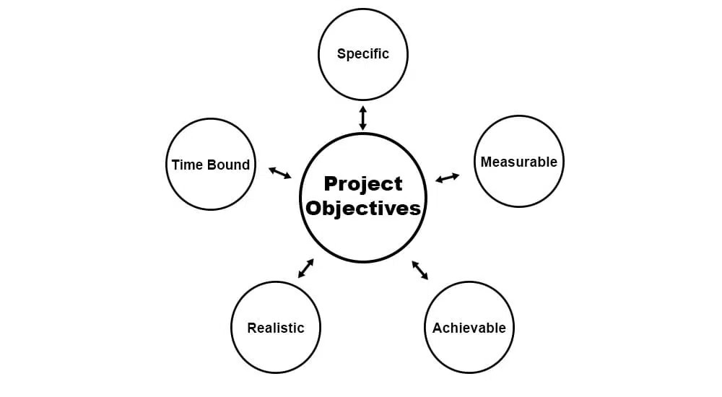
Objective of the project
The goal of this project is to study healthcare data to find patterns and build a model that can predict health risks, like strokes. It uses data analysis, charts, and machine learning to give helpful insights and accurate predictions.

Slide 4
Project Overview
It follows four steps for progression from data exploration to model building
Data Pre-Processing
Data Visualisation
1
2
Data Encoding
ML models
3
4

Slide 5
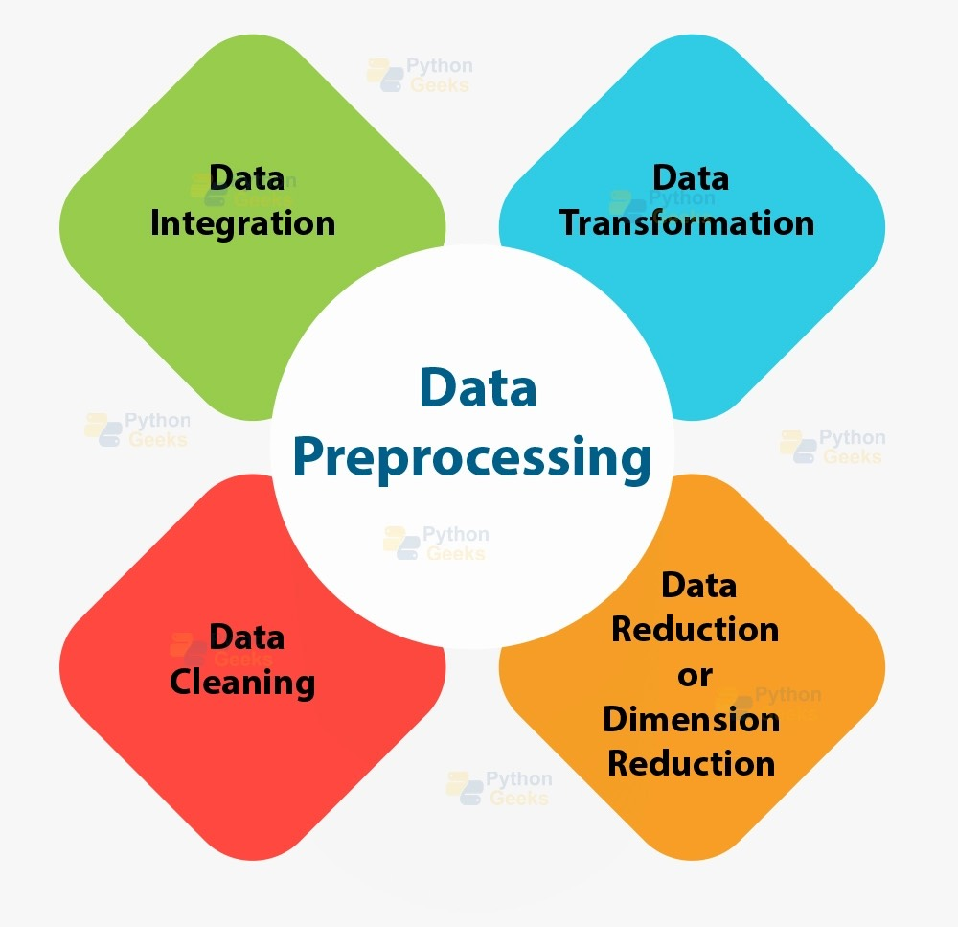
1
Data Pre-Processing

Slide 6
Dataset Characteristics
The dataset contains 5110 rows and 12 columns
We have columns like "gender", "ever_married", "work_type", "residence_type" and "smoking_status" contain string values, which are represented using the "object" datatype in this data frame
The columns like "age", "avg_glucose_level", "bmi" to be of float datatype
The columns like "id", "heart_disease", "hypertension", "stroke" to be of int datatype.

Slide 7
Exploratory Analysis Summary
df.describe(): Key numerical features like age, glucose levels, and BMI are shown in wide range.
df.describe(include=object): The dataset consists of a majority of females, with 2,994 female participants compared to 2,116 males in terms of gender.
df.isnull().sum(): The bmi column has 201 missing values, rest of columns have 0 missing values.
df.ever_married.unique(): array([‘Yes’,’No’],dtype=object), refers to two unique attributes present in ever_married column which are ‘yes’ and ‘no’.

Slide 8
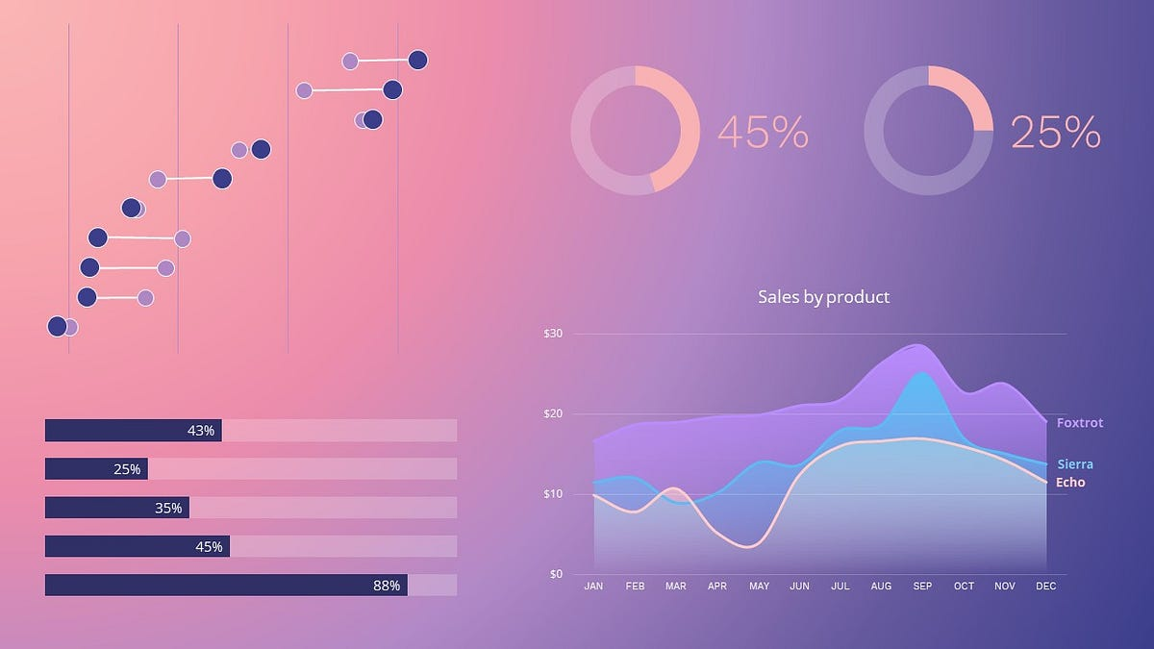
2
Data Visualisation

Slide 9
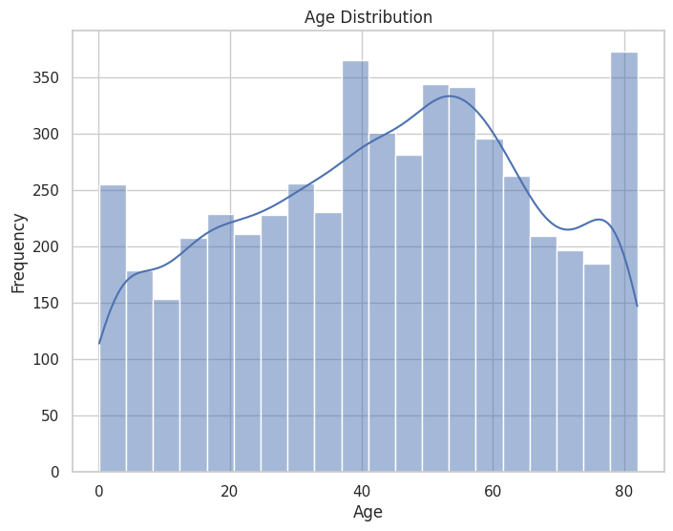
Data visualization is the practice of representing data through visuals like charts, graphs, and plots to make complex information easier to understand and analyze. It helps uncover patterns, trends, and outliers in the data, making it a vital tool for data analysis, decision-making, and effectively communicating insights.
Histogram for Age Distribution
Most people in the dataset are adults, with a high number of individuals aged between 40 and 80.
The dataset includes more middle-aged and elderly individuals, which may influence the analysis if age is a significant factor in stroke risk.

Slide 10
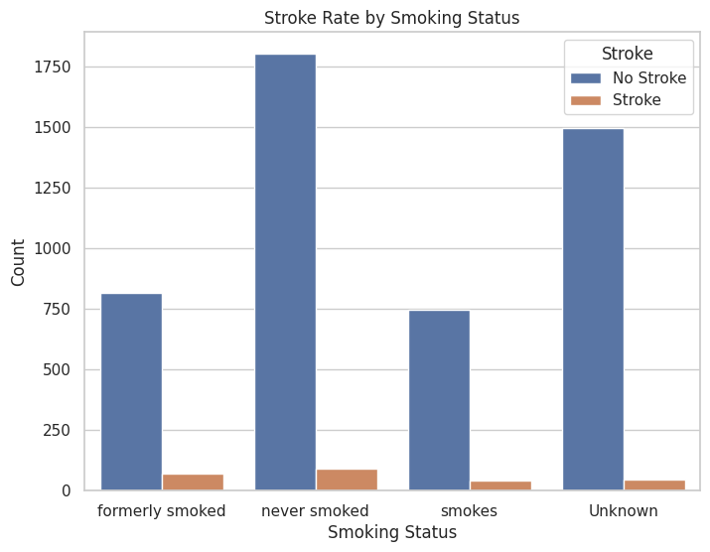
Bar char of stroke rates by smoking status
Individuals who are current or former smokers seem to have a higher stroke rate compared to those who have never smoked.
Smoking could be a contributing factor to stroke risk, supporting existing health advice that encourages quitting smoking for better health.

Slide 11
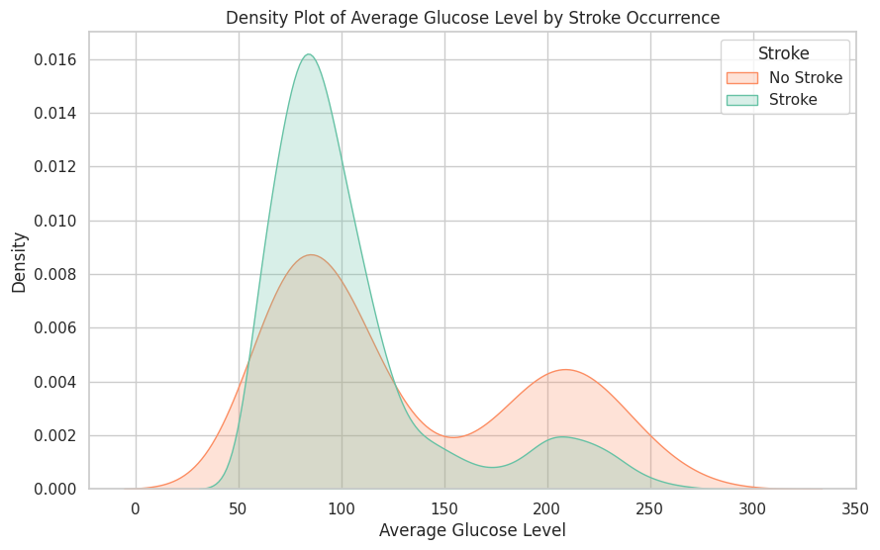
Density plot of avg_glucose_level grouped by stroke occurrence
Glucose Levels in Stroke and No-Stroke Groups: People without a stroke (orange) mostly have lower glucose levels, around 70-100. People with a stroke (green) tend to have slightly higher glucose levels, peaking around 100, with some even reaching 200-250.
Higher Glucose Levels and Stroke: The stroke group has more cases with high glucose levels (above 150). This suggests that higher glucose might be linked to a higher risk of stroke.

Slide 12
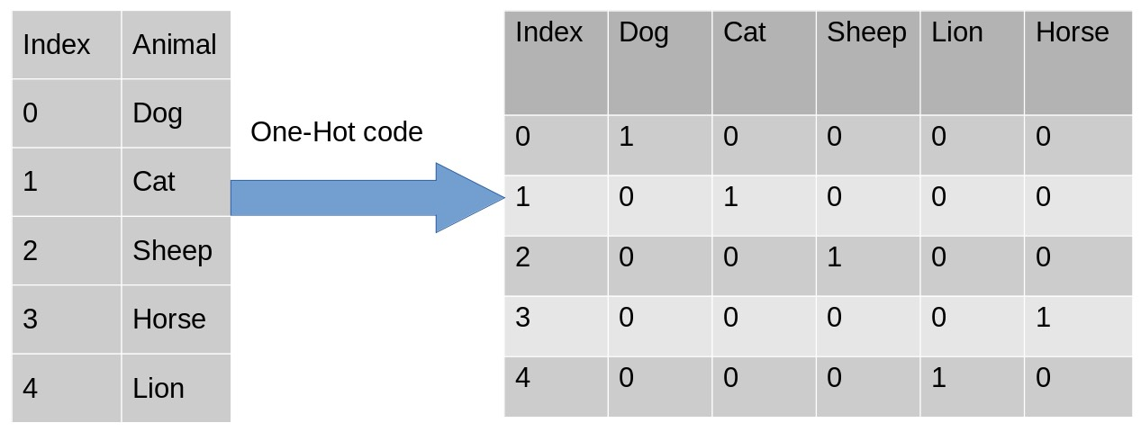
3
Data Encoding

Slide 13
Data encoding is the process of converting categorical data into numerical formats so that machine learning algorithms can interpret it.
Residence_type column is converted into 0-Rural and 1-Urban
Work_type column is converted into work_type_Govt_job, work_type_Never_worked, work_typed_Private, work_type_self-employed
Smoking_status column is converted into smoking_status_Unknown, smoking_status_formerlysmoked, smoking_status_neversmoked, smoking_status_smoked.
Gender column is converted to 0-Female, 1-Male

Slide 14
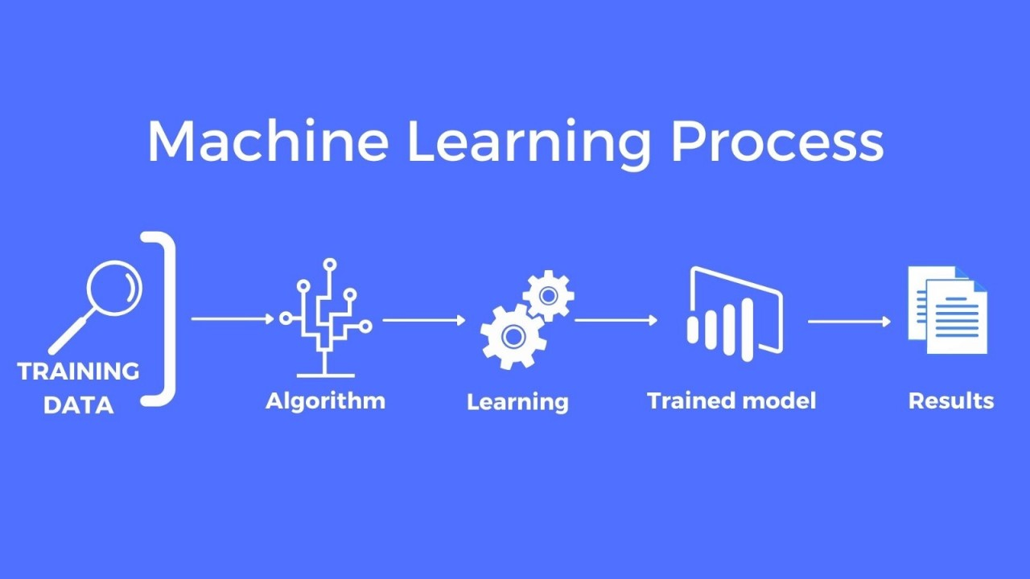
4
Machine Learning Models

Slide 15
Machine Learning
Machine Learning (ML) models are algorithms that enable computers to learn patterns from data and make predictions or decisions without being explicitly programmed.
Linear Regression
Lasso Regression
Ridge Regression
Logistic Regression

Slide 16
Preprocessing and Data Preparation for learning models
Data Cleaning
Feature Engineering
Feature Selection
Data Tranformation
Train-Test-split

Slide 17
Model Performance Summary
Linear Regression
Lasso Regression
It has R^2 score of 22.75 and accuracy of 9.1
It has R^2 score of 23.75 and accuracy of 0.94

Slide 18
Model Performance Summary
Ridge Regression
Logistic Regression
It has R^2 score of 22.7594 and accuracy of 9.1002
It has R^2 score of 24.63 and accuracy of 93.9

Slide 19
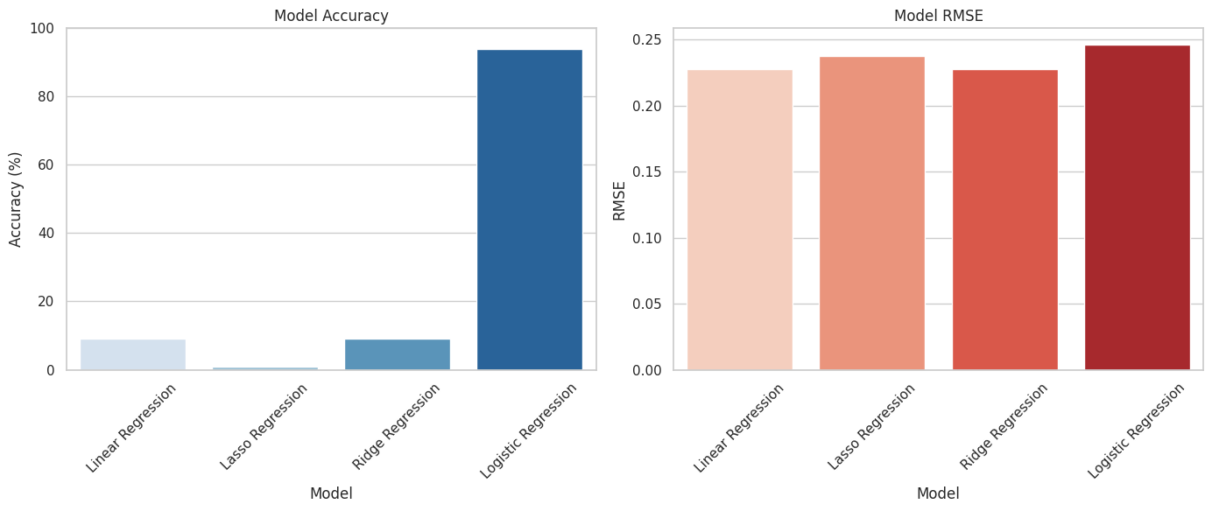
Visualising Different Models

Slide 20
Observations:
Different Models for Different Tasks:
Logistic Regression is designed for classification problems, where you predict categories (like "yes" or "no"), such as whether someone had a stroke or not.
Linear Regression, Ridge, and Lasso are designed for predicting continuous values (like age or temperature) and are better suited for regression tasks.
Why Logistic Regression is Better for Classification:
Logistic Regression works well on binary classification tasks (two outcomes), so it gives high accuracy for problems like predicting stroke vs. no stroke.

Slide 21
Precision, Recall, F1 score & Accuracy

Slide 22
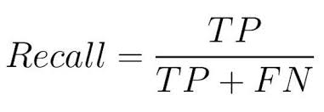
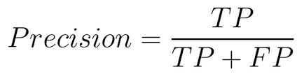
Confusion Matrix
Precision(P)
Recall(R)
Measures how many predicted “Stroke” cases are correct.
Measures how many actual “Stroke” cases are correctly identified

Slide 23
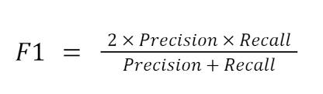
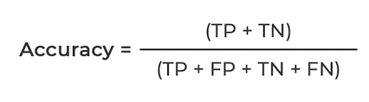
Confusion Matrix
F1 Score
Accuracy
Harmonic mean of Precision and Recall, providing a balance between both
Overall correctness of the predictions.

Slide 24
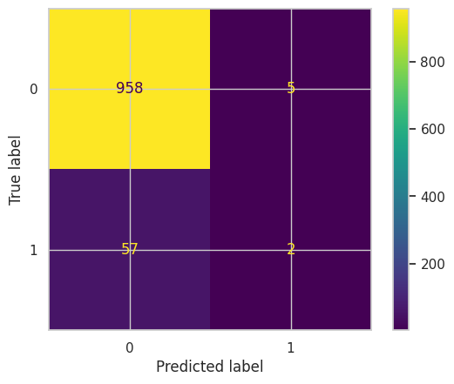
Logistic Regression Evaluations
Precision of 0.28
Recall of 0.033
F1 score of 0.060
Accuracy of 93.93
High accuracy but very low recall and F1 scores, indicating poor minority class detection.

Slide 25
Is the Dataset Biased or not?
Bias in Dataset
Class Imbalance:
The dataset has a high bias towards non-stroke cases, which could lead to models being overly confident in predicting the majority class.
Data Gaps:
Missing bmi values could introduce bias if not handled properly.

Slide 26
Is the Dataset Biased or not?
Tackling Bias
Handling Class Imbalance:
Undersampling: Randomly remove samples from the majority class to balance the dataset.
Addressing Missing Data:
Use imputation strategies (e.g., mean, median, or regression imputation) to fill missing bmi values.
Evaluation Metrics:
Use metrics like F1-score, precision-recall curves, to assess the model's performance

Slide 27
Final Insights
Class Imbalance: Most cases in the dataset are "No Stroke" (95%), with only 5% being "Stroke," causing bias towards the majority class.
Impact on Performance: The model shows high accuracy but struggles to detect strokes effectively due to this imbalance.
Better Metrics: Metrics like recall and F1-score are more useful than accuracy for evaluating stroke detection.
Steps Taken: Data cleaning, visualizations, and modeling helped improve the model's performance.

Slide 28
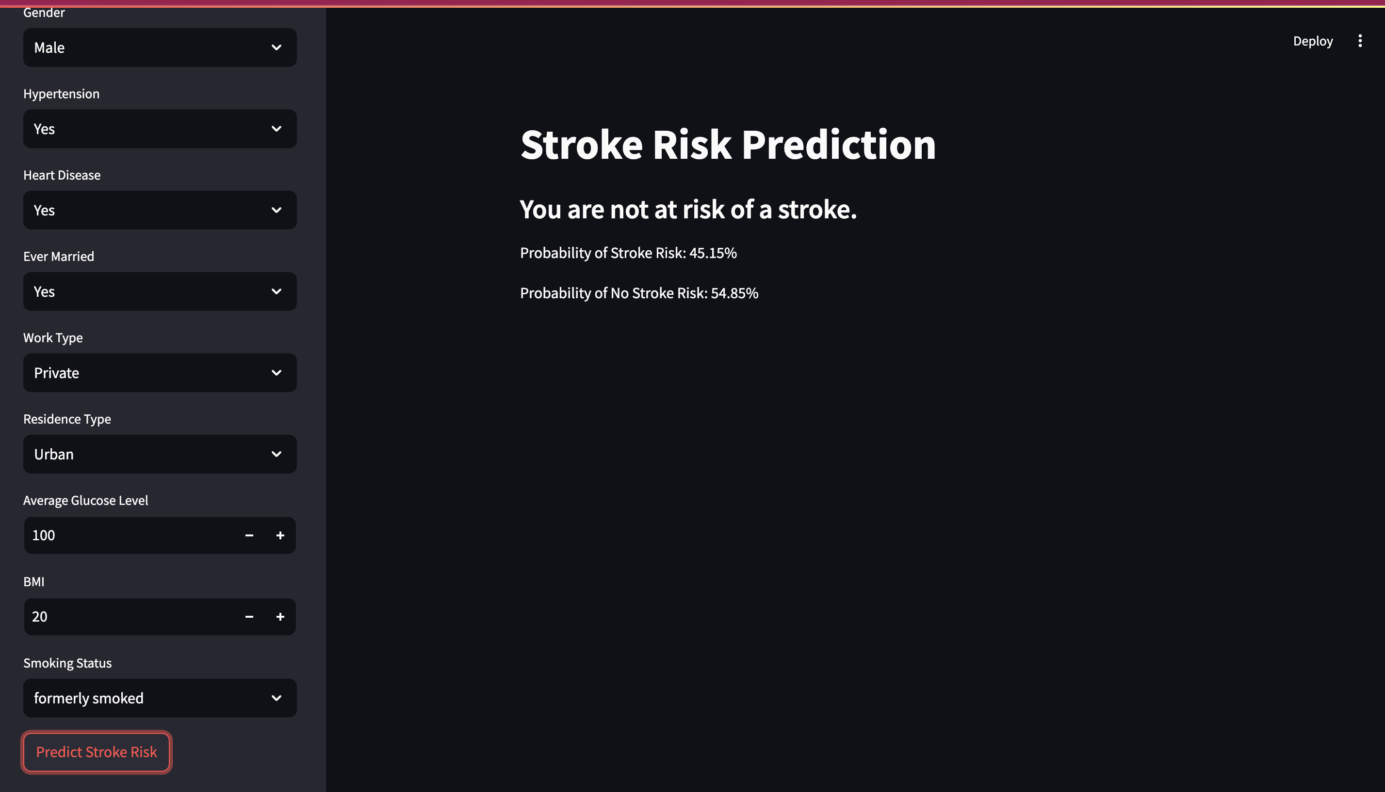
STREAMLIT DESIGN

Slide 29
THANK YOU
Tulasiram Nimmagadda

