Slide 1
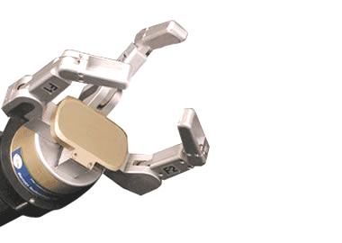
initial contact
approach
(preshape)
stable grasp
grasp
lift
discard
re-approach
release
record grasp/
sensor data
back to zero
position
return

