Slide 1
DATA GENIUS: Machine Learning Engineer Test
Ngoc - Tram Nguyen

Slide 2
Developing Product Sales Prediction Model
Test Case Study for ML Engineer: Dr. Thêm Official Store on Shopee + Data Description: Sales data over a three-week period (10/03/2024 – 31/03/2024)
+ Issues: Small dataset size, missing information, limited data fields.
+ Requirements: Develop a model that predicts the number of products sold in the upcoming periods.
EDA
Training and Evaluating
Preprocessing

Slide 3
PREPROCESSING
·
Find and fill missing value (discount)
Feature selection: Remove features not useful (shopid, shop_location, status, name)
Feature engineering: Create new feature from exist features (revenue)
Convert to datetime format for time feature (Date)
Goal: Clean Data

Slide 4
EDA (Exploratory Data Analysis)
Overview of the distribution of data
 | itemid | liked_count | cmt_count | shop_rating | historical_sold | price | rating_count | rcount_with_context | Date
count | 3.867000e+03 | 3867.000000 | 3867.000000 | 3867.000000 | 3867.000000 | 3.867000e+03 | 3867.000000 | 3867.000000 | 3867
mean | 1.466942e+10 | 12234.599948 | 2032.896302 | 4.931021 | 7035.889061 | 2.451592e+10 | 2032.798293 | 1210.578485 | 2024-03-20 16:10:47.944142592
min | 1.985670e+09 | 0.000000 | 0.000000 | 4.930905 | 0.000000 | 9.000000e+08 | 0.000000 | 0.000000 | 2024-03-10 00:00:00
25% | 5.481377e+09 | 130.000000 | 55.000000 | 4.930969 | 225.000000 | 1.125000e+10 | 55.000000 | 25.000000 | 2024-03-15 00:00:00
50% | 1.823627e+10 | 16565.000000 | 198.000000 | 4.931027 | 673.000000 | 2.050000e+10 | 198.000000 | 107.000000 | 2024-03-21 00:00:00
75% | 2.215632e+10 | 18615.500000 | 909.500000 | 4.931054 | 3643.500000 | 3.490000e+10 | 909.500000 | 494.000000 | 2024-03-26 00:00:00
max | 2.591996e+10 | 71117.000000 | 106400.000000 | 4.931238 | 322223.000000 | 1.199000e+11 | 106413.000000 | 64046.000000 | 2024-03-31 00:00:00
std | 8.170483e+09 | 10035.877379 | 8781.247212 | 0.000066 | 27425.013404 | 1.760156e+10 | 8782.279788 | 5334.233921 | NaN

Slide 5
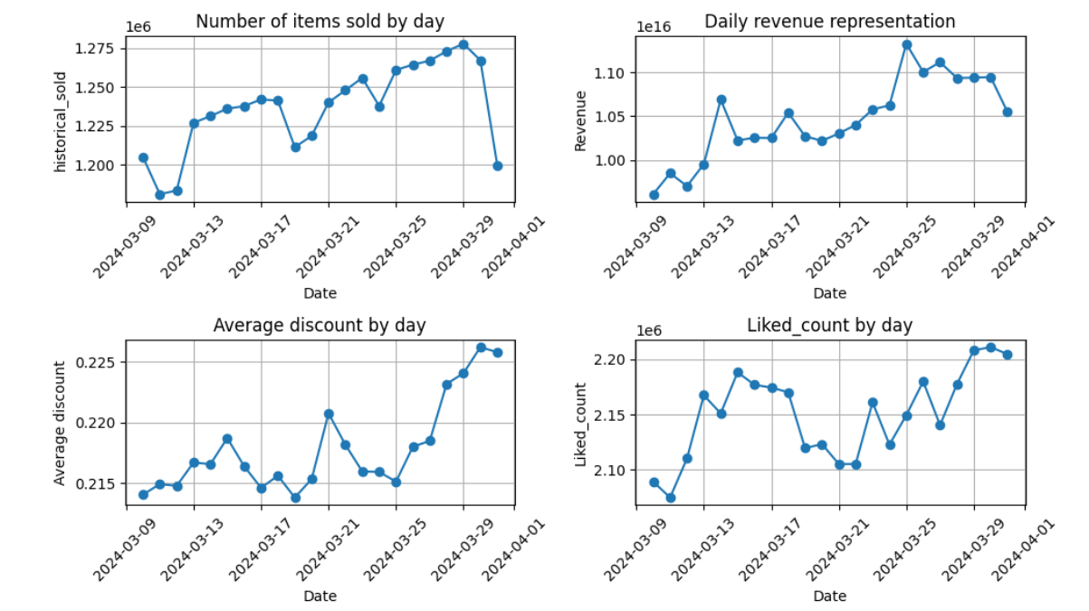
EDA (Exploratory Data Analysis)
EDA (Exploratory Data Analysis)

Slide 6
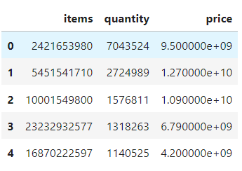
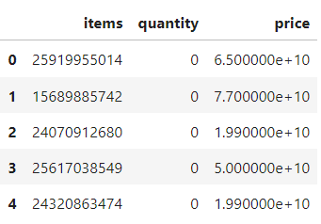
EDA (Exploratory Data Analysis)
Top 5 Most Sold Items
Top 5 Least Sold Items

Slide 7
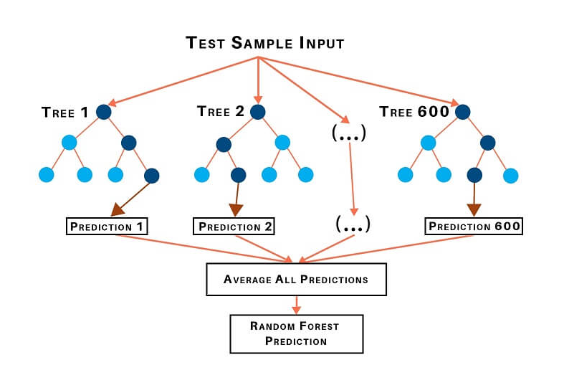
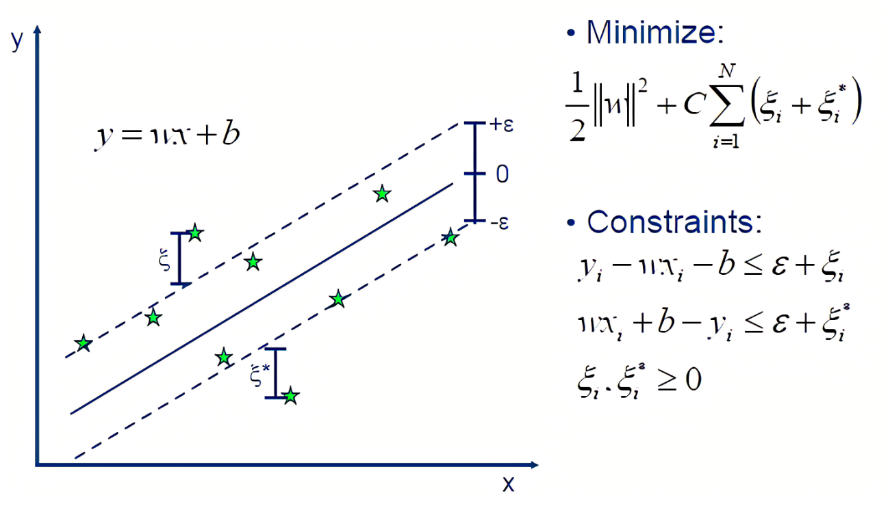
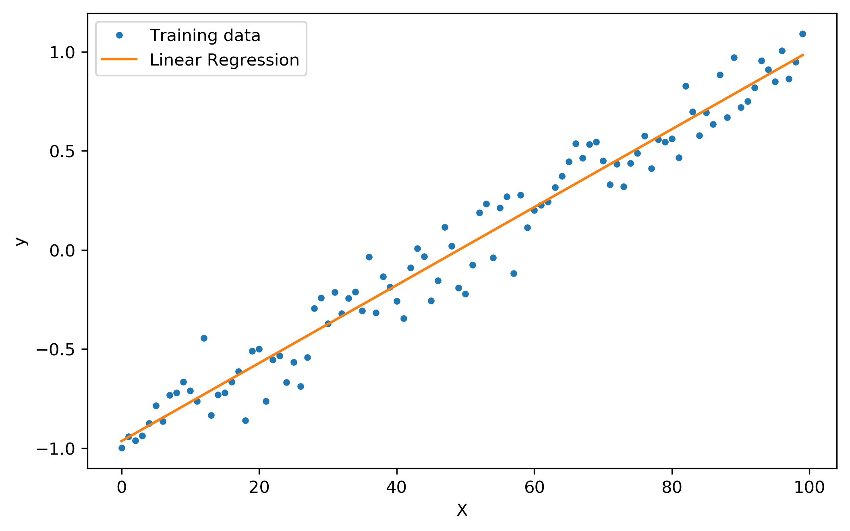



PROPOSE MODEL AND EVALUATE
Random Forest Regression
Support Vector Regression
Linear Regression

Slide 8
CHECK OVERFITING
=> REGULARIZATION TECHNIQUE
Ridge Regression (L2 regularization) | Lasso Regression (L1 regularization)
RMSE = 0.033 | RMSE = 0.030

Slide 9
CONCLUSION
Small data should use machine learning models for forecasting is reasonable.
Perform preprocessing to clean data and EDA to visualize data effectively.
Among three recommended methods (Random forest Regression, SVR and Linear Regression), Linear Regression has the best forecast results.
Implement overfitting prevention techniques with regularization technique (Ridge and Lasso Regression).
Besides, some technique such as feature selection, feature important or add data from review data (26/03/2019-16/04/2024) also can improve model learning performance.

Slide 10
THANK YOU FOR LISTENING

