Slide 1
EKLIPSE: AI Engineer Test
Ngoc - Tram Nguyen

Slide 2
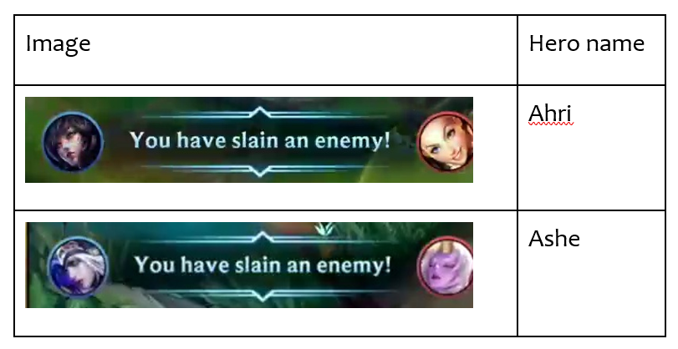
Exercise 1 – Hero Name Recognition: Predict the hero names on the left side of the message bar

Slide 3

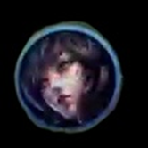




Two Modules
· Preprocess: (OpenCV)
Crop image to get hero image on the left side.
Detect circle include hero face (Remove background or circle/square detect).
Result:
Classification:
Image Processing
(Template Matching, SIFT,...)
Deep Learning Model (YOLO,…)
Templates
Accuracy
Input image
Ahri
Graves
Gwen
Output
98%
2%
14%
Ahri
…

Slide 4

Exercise 2 – Highlight Moment Detection System by Capturing goal moment in FIFA₂₃
· Processing in audio:
Use audio detection for key word such as (wow, bravo, yeah… or loud sound, scream high frequency). Create a break points for 5-10s to highlight.
Problem: Noise, audience voice)
Processing in image frame in video:
Detect the goal score box and check score change. Get highlight 5-10s.
Problem: goal score box is covered by commend and disappear too fast

Slide 5
THANK YOU FOR LISTENING

