Slide 1
CPSC 351
Operating Systems Concepts
CPU Scheduling

Slide 2
Agenda
Basic Concepts
Introduction to CPU Scheduling
CPU Scheduling Algorithms
Thread Scheduling

Slide 3
Basic Concepts: CPU Scheduling
CPU is one of the primary computer resource
CPU scheduling – selecting the next process for execution on the CPU once the current process leaves the CPU idle
The goal of CPU scheduling is to maximize the degree of multiprogramming i.e., having some process running at all times
The success of CPU scheduling depends on an observed property of the processes:
CPU execution
I/O waiting

Slide 4
CPU-I/O Burst Cycle
Processes alternate between CPU bursts (executing on the CPU) and I/O bursts (performing I/O)
load store
add store
read from file
CPU burst
Wait for I/O
I/O Burst
store increment index
write to file
CPU Burst
Wait for I/O
I/O Burst
load store
add store
read from file
CPU Burst
Wait for I/O
I/O Burst

Slide 5
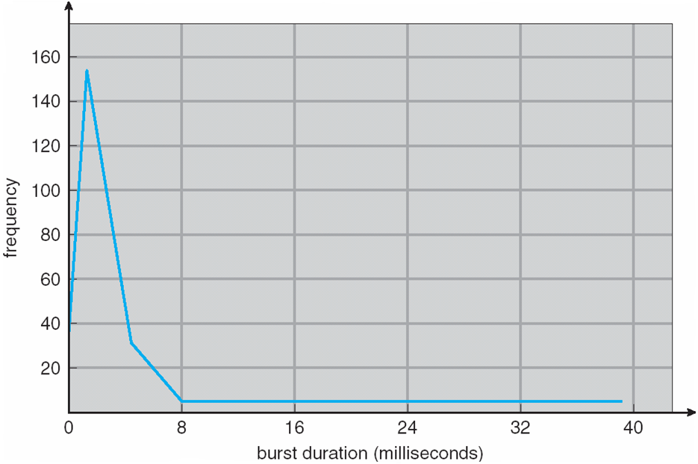
Histogram of CPU-burst Times
An I/O-bound program typically has many short CPU bursts
A CPU-bound program might have a few long CPU bursts
Notes:
- durations of CPU bursts vary greatly from process to process and from computer to computer, they tend to have a frequency curve similar
curve is generally characterized as exponential or hyperexponential, with a large number of short CPU bursts and a small number of long CPU bursts
An I/O-bound program typically has many short CPU bursts. A CPU-bound program might have a few long CPU bursts. This distribution can be important in the selection of an appropriate CPU-scheduling algorithm

Slide 6
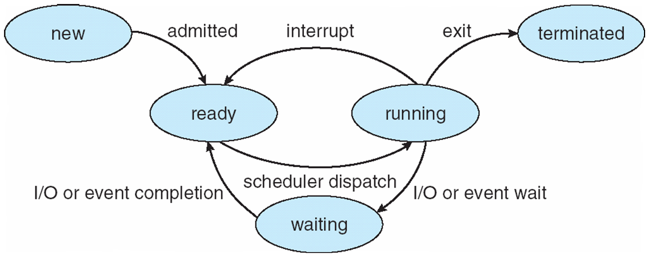
CPU Scheduler - Short-Term Scheduler
Selects a process from the processes in memory that are ready to execute and allocates the CPU to the process
CPU scheduling decisions occur when
When a process switches from the running to the waiting state
Result of an I/O request or an invocation of wait() for the termination of a child process
When a process switches from the running to the ready state
When a process switches from the waiting state to the ready state
When a process terminates
Scheduling under 1 and 4 is nonpreemptive (Windows 3.x)
All other scheduling is preemptive
Windows 95 and up
Mac OSX
Notes:
For 1 and 4, no choice in terms of scheduling: if a new process exists in the ready queue, it must be selected for execution
For 2 and 3, preemptive scheduling
Consider access to shared data
Consider preemption while in kernel mode
Consider interrupts occurring during crucial OS activities

Slide 7
Preemptive vs Non-preemptive Scheduling
Non-preemptive scheduling: once a process gets the CPU, it runs to completion and cannot be interrupted until
Process terminates
Process switches to the waiting state
Preemptive scheduling: process executing on the CPU can be interrupted in order to make way for another process
Race conditions when data are shared among processes
Affect the design of the operating-system kernel
Notes:
Race conditions – consider the case of two processes that share data. While one process is updating the data, it is preempted so that the second process can run. The second process then tries to read the data, which are in an inconsistent state
Design of OS kernel - processing of a system call may changing important kernel data (I/O queues). Certain operating systems, including most versions of UNIX, deal with this problem by waiting either for a system call to complete or for an I/O block to take place before doing a context switch.
This design is not appropriate for supporting real-time computing where tasks must complete execution within a given time frame

Slide 8
Dispatcher
A module that gives control of the CPU to the process selected by short-term scheduler
Switches the context
Switches to user mode
Jumps to the proper location in the program to restart that program
Invoked during every process switch
should be as fast as possible
Dispatcher latency: the time it takes for the dispatcher to stop one process and start another – should be minimized!

Slide 9
Scheduling Criteria
Performance metrics of scheduling algorithms
CPU utilization: keeping the CPU as busy as possible
Throughput: number of processes that complete their execution per time unit
Turnaround time: how long does it take to execute a process
Waiting time: the amount of time the process spends waiting in the ready queue
Response time: amount of time it takes from when a request was submitted until the first response is produced
Scheduling Algorithm Optimization Criteria
Maximize CPU utilization & throughput
while
minimize turnaround time, waiting time & response time
Notes:
Turnaround time = Sum of the periods spent waiting to get into memory, waiting in the ready queue, executing on the CPU, & doing I/O

Slide 10
Scheduling Algorithms
First-Come First-Served (FCFS)
Shortest-Job-First (SJF)
Priority Scheduling
Round Robin (RR)
Multilevel Queue & Multilevel Feedback Queue

Slide 11
First-Come First-Served (FCFS)

Slide 12
First-Come First-Served (FCFS) Scheduling
The process that requests the CPU first is allocated the CPU first
FCFS policy is easily managed with a FIFO queue
Process | Burst Time (millisecs)
P₁ | 24
P₂ | 3
P₃ | 3
Suppose the processes arrive in the order: P₁, P₂, P₃
Scheduling chart (shows starting and ending times)
P₁
P₂
P₃
0
24
27
30
Waiting times: 0 for P₁, 24 for P₂, and 27 for P₃
Average waiting time: (0 + 24 + 27) / 3 = 17 ms

Slide 13
First-Come First-Served (FCFS) Scheduling (cont)
Suppose the processes arrive in the order: P₂, P₃, P₁
Scheduling chart for this schedule
P₂
P₃
P₁
0
3
6
30
Waiting times: 0 for P₂, 3 for P₃, and 6 for 1
Average waiting time: (6 + 0 + 3) / 3 = 3 ms
Process | Burst Time (millisecs)
P₁ | 24
P₂ | 3
P₃ | 3
Advantages: simple to implement and understand
Disadvantages:
Average waiting time is often quite long
Convoy effect: short process waiting behind a long process
Many I/O-bound processes wait for one long CPU-bound ➔ lower CPU and device utilization
Non-preemptive: once the CPU is allocated to a process, that process keeps the CPU until it requests I/O or terminates
Notes:
Assume we have one CPU-bound process and many I/O-bound processes. As the processes flow around the system, the following scenario
may result. The CPU-bound process will get and hold the CPU. During this time, all the other processes will finish their I/O and will move into the ready queue, waiting for the CPU. While the processes wait in the ready queue, the I/O devices are idle. Eventually, the CPU-bound process finishes its CPU burst and moves to an I/O device. All the I/O-bound processes, which have short CPU bursts, execute quickly and move back to the I/O queues. At this point, the CPU sits idle. The CPU-bound process will then move back to the ready queue and be allocated the CPU. Again, all the I/O processes end up waiting in the ready queue until the CPU-bound process is done.

Slide 14
Shortest-Job-First (SJF)

Slide 15
Shortest-Job-First (SJF) Scheduling
Associates with each process the length of its next CPU burst
Uses these lengths to schedule the process with the shortest time
Can either be preemptive or nonpreemptive
Process | Burst Time (millisecs)
P₁ | 6
P₂ | 8
P₃ | 7
P₄ | 3
Example (non-preemptive)
Scheduling chart:
P₄
P₁
P₃
P₂
0
3
9
16
24
Waiting time: 3 for P₁, 16 for P₂, 9 for P₃, 0 for P₄
Average waiting time: (3 + 16 + 9 + 0) / 4 = 7ms (10.25 ms with FCFS)

Slide 16
Shortest-Job-First (SJF) Scheduling - Preemptive
Preemptive, will interrupt the currently executing process
Process | Arrival Time | Burst Time (millisecs)
P₁ | 0 | 8
P₂ | 1 | 4
P₃ | 2 | 9
P₄ | 3 | 5
Scheduling chart:
P₁
P₂
P₄
P₁
P₃
0
1
5
10
17
26
Average waiting time: [(10-1) + (1-1) + (17-2) + (5-3)]/4 = 26/4 = 6.5 ms
Also called shortest-remaining-time-first

Slide 17
SJF Pros & Cons, Next CPU Bust
Advantage: is optimal – gives minimum average waiting time for a given set of processes
Disadvantages: we can only estimate the length of the next CPU request – a difficult task!
One way to estimate the CPU burst of the process is to use exponential averaging
t_{n} = actual length of n^{th} CPU burst
= most recent information
τ_{n+1} = predicted value for the next CPU burst
τ_{n} stores the past history
α, 0 ≤ α ≤ 1
controls the relative weight of recent and past history
in the prediction
Define: τ_{n+1} = α t_{n} + (1 - α) τ_{n}
Commonly set α to ½

Slide 18
Examples of Exponential Averaging
Τ_{n+1} = α t_{n} + (1 - α) τ_{n}
α = 0
τ_{n+1} = τ_{n}
Recent history does not count
α = 1
τ_{n+1} = α t_{n}
Only the actual last CPU burst counts
Expand the formula
τ_{n+1} = α t_{n}+(1 - α) α t_{n} ₋₁ + … +(1 - α )^{j} α t_{n} _{-j} + … + (1 - α )^{n +1} τ₀
α and (1 - α) ≤ 1 ➔ each successive term has less weight than its predecessor

Slide 19
Priority Scheduling

Slide 20
Priority Scheduling
A priority number (integer) is associated with each process
The CPU is allocated to the process with the highest priority
Can be preemptive or non-preemptive
Process | Priority | Burst Time (millisecs)
P₁ | 3 | 10
P₂ | 1 | 1
P₃ | 4 | 2
P₄ | 5 | 1
P₅ | 2 | 5
Example: All processes arrive at the same time
Assume: smallest integer ≡ highest priority
P₂
P₅
P₁
P₃
P₄
0
1
6
16
18
19
Average waiting time: (P₁ + P₂ + P₃ + P₄ + P₅) / 5 =
(6 + 0 + 16 + 18 + 1) / 5 = 8.2 ms

Slide 21
Priority Scheduling (cont)
Preemptive priority scheduling will preempt the CPU if the newly arrived process has a higher priority than the currently running process
Non-preemptive priority scheduling will simply put the new process at the head of the ready queue
Problem ≡ Starvation – low priority processes may never execute (if system crashes) or will eventually be run when system is lightly loaded
Rumor: when MIT shutdown the IBM 7094 in 1973, they found a low-priority process that has been submitted in 1967 and had not yet run!
Aging solution: gradually increase the priority of processes that wait in the system for a long time
Notes:
Aging solution example
- For example, if priorities range from 127 (low) to 0 (high), the system could increase the priority of a waiting process by 1 every 15 minutes
- Eventually, even a process with an initial priority of 127 would have the highest priority in the system and would be executed
- Thus, it would take no more than 32 hours for a priority-127 process to age to a priority-0 process

Slide 22
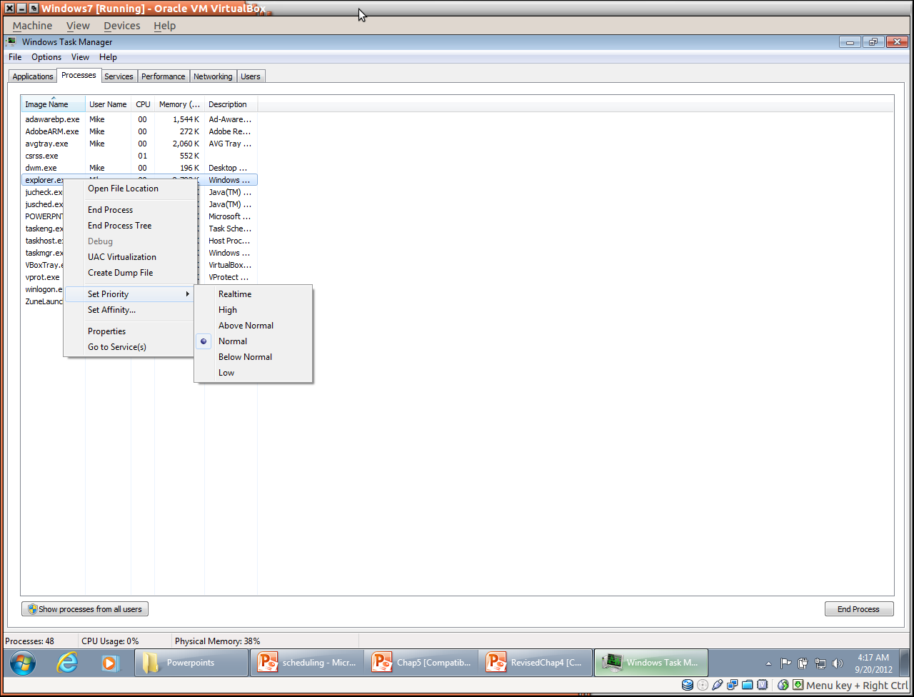
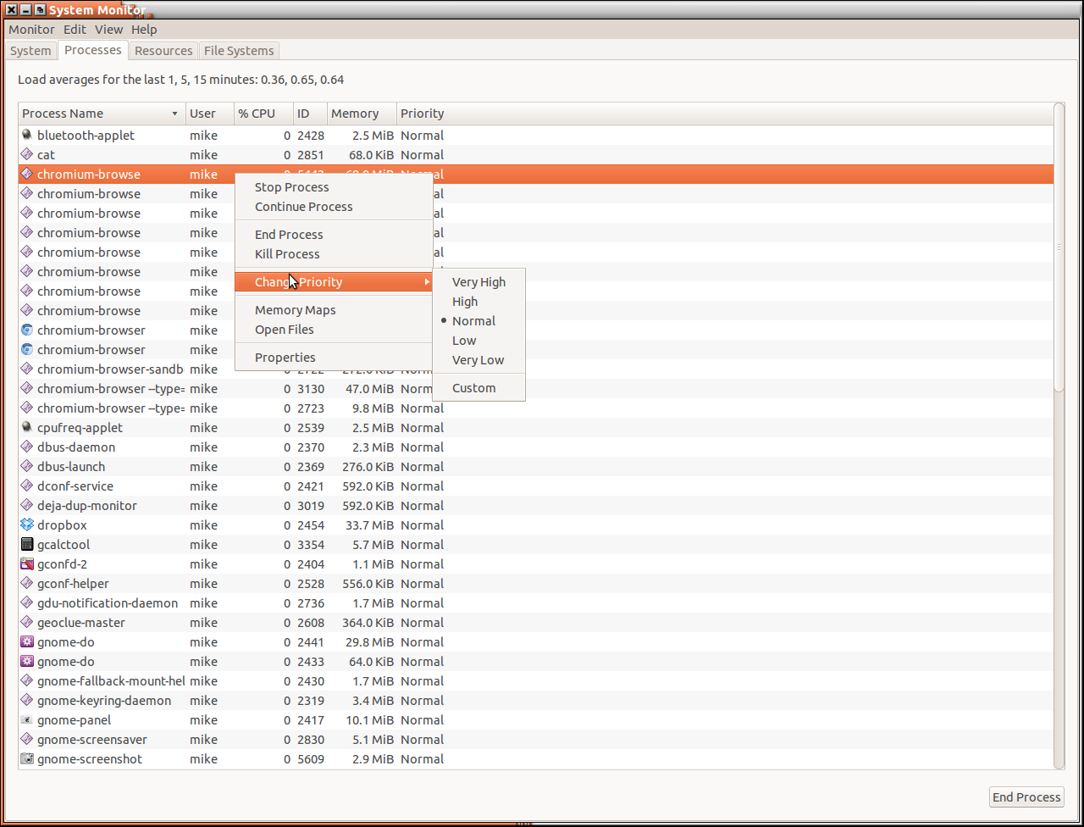
Process priorities in Windows
Process priorities in Ubuntu Linux

Slide 23
Priorities in Linux
Each process has a nice value specifying its priority
Nice values range between -20 and 19
Lower values indicate higher priority
Setting nice values
Example: start program ls with nice value of 19
nice –n 19 ls
Example: change nice value of already running process with id 1234, to 15
renice 15 –p 1234

Slide 24
Round Robin

Slide 25
Round Robin (RR)
Each process gets a small unit of CPU time (time quantum q), usually 10-100 milliseconds. After this time has elapsed, the process is preempted and added to the end of the ready queue
Given n processes and time quanta of q, Each process waits no longer than (n – 1) * q time units
Each process gets 1/n of the CPU time in chunks of at most q time units at once
Timer interrupts every quantum to schedule next process
Performance is sensitive to the choice of the time quantum
Very large: RR degenerates to first-come first-serve
Very small: q must be large in comparison to context switch latency, otherwise overhead is too high

Slide 26
Round Robin Example with Time Quantum = 4 millisecs
Process | Burst Time (millisecs)
P₁ | 24
P₂ | 3
P₃ | 3
Gantt chart
P₁
P₂
P₃
P₁
P₁
P₁
P₁
P₁
0
4
7
10
14
18
22
26
30
Waiting time: P₁ waits for 6 (= 10 - 4), P₂ waits for 4, and P₃ waits for 7
Average waiting time: 17/3 = 5.66

Slide 27
Time Quantum and Context Switch Time
Assume Process time = 10
Quantum
Context Switches
12
0
6
1
6
1
9
0
1
2
3
4
5
6
7
8
9
10
How a smaller time quantum increases context switches

Slide 28
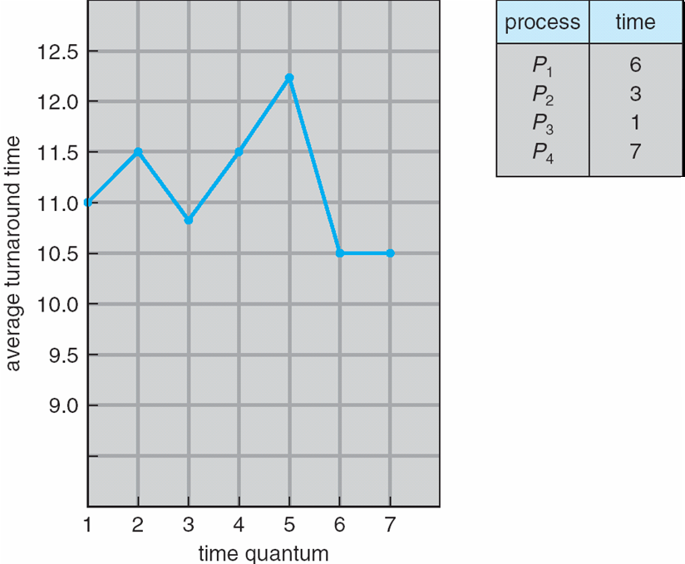
Turnaround Time Varies With The Time Quantum
Process | Time
P₁ | 6
P₂ | 3
P₃ | 1
P₄ | 7
Average turnaround time of a set of processes does not necessarily improve as the time-quantum size increases
Generally, the average turnaround time can be improved if most processes finish their next CPU burst in 1 quantum
Example:
Given 3 processes of 10 time units each and a quantum of 1, the turnaround time is 29
Increasing the quantum to 10, reduces the turnaround time to 20

Slide 29
Multilevel Queue and Multilevel Feedback Queue

Slide 30
Multilevel Queue
Partitions the ready queue into several separate queues
Processes are permanently assigned to queues, generally based on some property of the process such as memory size, priority, or type
Each queue has its own scheduling algorithm
Example: foreground queue scheduled by RR while background queue scheduled by FCFS
Scheduling must be done among the queues
Fixed priority preemptive scheduling
Serve all from foreground then from background ➔ possibility of starvation
Time slice – each queue gets a certain amount of CPU time which it can schedule amongst its processes
80% to foreground in RR
20% to background in FCFS

Slide 31
Multilevel Queue Scheduling Example
Highest priority
System processes
Interactive processes
Interactive editing processes
Batch processes
Student processes
Lowest priority
Each queue has absolute priority over lower-priority queues
No process in the batch queue could run unless the queues for system processes, interactive processes, and interactive editing processes were all empty
If an interactive editing process entered the ready queue while a batch process was running, the batch process would be preempted

Slide 32
Multilevel Feedback Queue
Similar to multilevel queue scheduling, but the process can move between queues
Multilevel queue scheduler is defined by the following parameters
Number of queues
Scheduling algorithms for each queue
Method used to determine when to upgrade a process
Method used to determine when to demote a process
Method used to determine which queue a process will enter when that process needs service

Slide 33
Multilevel Feedback Queue Example
3 queues
Q₀ – RR with time quantum 8 milliseconds
Q₁ – RR time quantum 16 milliseconds
Q₂ – First-Come First-Served
Scheduling:
A new process enters queue Q₀ which uses round robin with quantum of 8
When it gets the CPU, the job receives 8 milliseconds of running time
If it does not finish in 8 milliseconds, the job is moved to queue Q₁ which uses round robin with quantum of 16
At Q₁, the job receives additional 16 milliseconds
If it still does not complete, it is preempted and moved to queue Q₂ which uses FCFS scheduling
Quantum = 8
Quantum = 16
FCFS
Notes:
The idea is to separate processes according to the characteristics of their CPU bursts
If a process uses too much CPU time, it will be moved to a lower-priority queue
This scheme leaves I/O-bound and interactive processes in the higher-priority queues
In addition, a process that waits too long in a lower-priority queue may be moved to a higher-priority queue
➔ This aging approach prevents starvation

Slide 34
Thread Scheduling

Slide 35
Pthreads

Slide 36
Review of Threads
Multithreading is multitasking within a single process
Example: A word processing program has separate threads:
A thread for displaying graphics
Another thread for reading in keystrokes from the user
Another thread for performing spelling and grammar checking in the background
Threads can be user level or kernel level
User threads supported and managed by some thread library without intervention from OS
Kernel threads supported and managed directly by OS
Relationship exists between user threads and kernel threads
Many-to-one maps many user threads to a single kernel thread
One-to-one maps a single user thread to a single kernel thread
Many-to-many maps many user threads to smaller or equal number of kernel threads

Slide 37
Thread Scheduling: Pthreads
User-level and kernel-level threads are scheduled differently
Many-to-one and many-to-many models, thread libraries schedule user-level threads to run on a light weight process (LWP) – a virtual processor on which the thread can be scheduled to run
Process-contention scope (PCS): User thread of a process competes for execution on a LWP with other user threads of the same process
Kernel decides which kernel-level thread to schedule onto a CPU and uses System-contention scope (SCS)
Competition for the CPU with SCS scheduling takes place among all threads in the system
Kernel thread executing user threads of a particular process competes for execution on the physical CPU with other kernel threads executing user threads of the same process
Notes:
Thread library schedules user threads onto available LWPs ➔ do not mean that the threads are actually running on a CPU
- That would require the operating system to schedule the kernel thread onto a physical CPU

Slide 38
Pthreads API
Pthreads API enables the developers to specify either PCS or SCS during thread creation
PTHREAD_SCOPE_PROCESS: schedules threads using PCS scheduling
PTHREAD_SCOPE_SYSTEM: schedules threads using SCS scheduling
On many-to-many systems
PTHREAD SCOPE PROCESS policy schedules user-level threads onto available LWPS
Number of LWPs is maintained by the thread library
PTHREAD SCOPE SYSTEM policy creates and binds an LWP for each user-level thread
Can be limited by OS – Linux and Mac OS X only allow PTHREAD_SCOPE_SYSTEM

Slide 39
Pthreads API (cont)
Pthread provides two functions for getting and setting the contention scope policy:
pthread_attr_setscope(pthread_attr_t *attr, int scope)
pthread_attr_getscope(pthread_attr_t *attr, int *scope)
where
attr is the pointer to the attribute set for the thread
scope for pthread_attr_setscope is either PTHREAD SCOPE SYSTEM or PTHREAD SCOPE PROCESS
scope for pthread_attr_getscope is the pointer to an integer value that will be set to the current value of the contention scope
A nonzero value is returned if an error occurs

Slide 40
Pthreads: Contention Scope
#include <pthread.h>
#include <stdio.h>
#define NUM_THREADS 5
int main(int argc, char *argv[]) {
int i;
pthread_t tid[NUM THREADS];
pthread_attr_t attr;
// Get the default attributes
pthread_attr_init(&attr);
//Set the scheduling algorithm to
//PROCESS or SYSTEM
pthread_attr_setscope(&attr,
PTHREAD_SCOPE_SYSTEM);
// Create the threads
for (i = 0; i < NUM _THREADS; i++)
pthread_create(&tid[i], &attr, runner, NULL);
// Now join on each thread
for (i = 0; i < NUM_THREADS; i++)
pthread_join(tid[i], NULL);
}
//Each thread will begin control in this function
void *runner(void *param) {
printf("I am a thread\n");
pthread exit(0);
}

Slide 41
Multiple-Processor Scheduling
CPU scheduling is more complex when multiple CPUs are available
Homogeneous processors within a multiprocessor
Asymmetric multiprocessing:
One (the master server) handles all scheduling, I/O processing, and other system activities
All other processors only execute user code
Advantage: only one processor accesses the system data structures – don’t need to worry about data sharing issues
Symmetric multiprocessing (SMP): each processor is self-scheduling, all processes in common ready queue, or each has its own private queue of ready processes
Processor affinity: process has affinity for processor on which it is currently running
Soft affinity: a process can migrate between processors
Hard affinity: a process cannot migrate between processors
Notes:
symmetric multiprocessing (SMP)
If multiple processors trying to access and update a common data structure, the scheduler must be programmed carefully and must ensure that two separate
processors do not choose to schedule the same process and that processes are not lost from the queue
Processor affinity
Data most recently accessed by the process populate the cache for the processor
If the process migrates to another processor. The contents of cache memory must be invalidated for the first processor, and the cache for the second
processor must be repopulated. Because of the high cost of invalidating and repopulating caches
- Most SMP systems try to avoid migration of processes from one processor to another ➔ instead attempt to keep a process running on the same processor

Slide 42
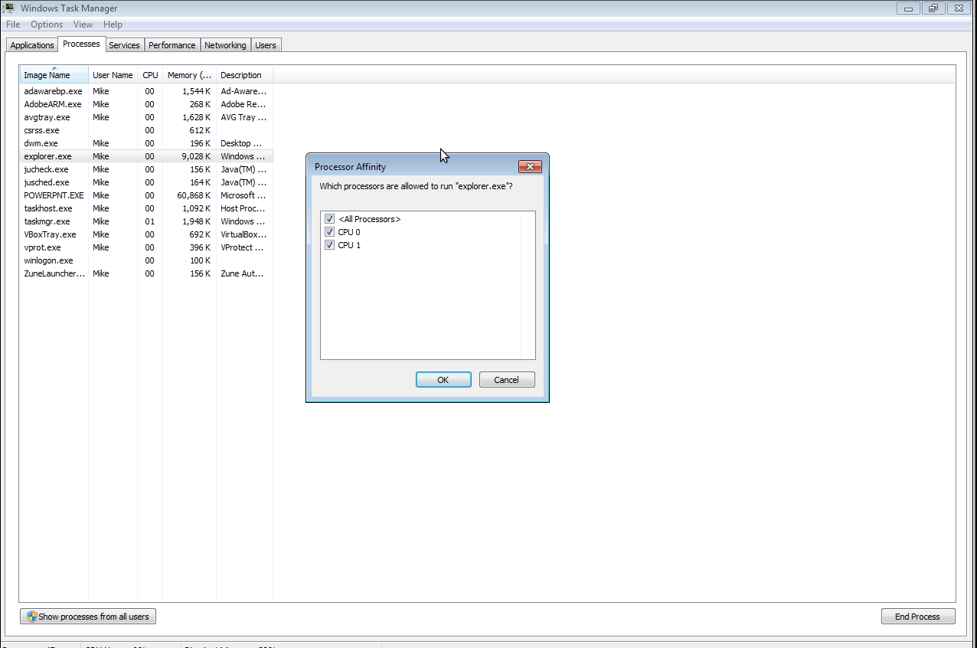
Process affinities in Windows

Slide 43
CPU Scheduling on NUMA Systems
Non-Uniform memory access systems (NUMA) comprises combined CPU and memory boards
CPUs on the board can access the memory on that board with less latency than on the other boards
Scheduling goal: schedule a process on the CPU attached to the memory bank containing the process data
CPU
CPU
Slow
Access
Fast Access
Fast Access
Memory
Memory
Computer

Slide 44
Multiple-Processor Scheduling – Load Balancing
On SMP systems, important to keep the workload balanced among all processors for efficiency
Load balancing attempts to keep workload evenly distributed
2 general approaches for load balancing
Push migration – periodic task checks load on each processor, and if found pushes task from overloaded CPU to other CPUs
Pull migration – idle processors pulls waiting task from busy processor
Load balancing often counteracts the benefits of processor affinity

Slide 45
References
Operating System Concepts, 9th Edition, Abraham Silberschatz, Peter Baer Galvin, Greg Gagne
Chapter 6

