Slide 1
CPSC 351
Operating Systems Concepts
Process Synchronization Part II

Slide 2
Agenda
Classical Problems in Synchronization
Problems with Semaphores
Monitors
Operating System Examples

Slide 3
Classical Problems in Synchronization
Bounded buffer
Readers-writers
Dining philosophers

Slide 4
Classical Problems of Synchronization
Illustrate the challenges and caveats of process synchronization
Used to test newly proposed synchronization schemes
Classical problems:
The bounded buffer problem
The readers-writers problem
The dining philosophers problem

Slide 5
Bounded-Buffer Problem

Slide 6
Producer Consumer Race Condition Problem
Bounded buffer implementation (a wrap-around buffer)
Store the following variables in shared memory
#define BUFFER_SIZE 10
typedef struct {
. . .
} item;
item buffer[BUFFER_SIZE];
int counter = 0; // Keeps track of the # of available slots
int in = 0; // First empty position in “buffer”
int out = 0; // First full position in “buffer”
// The buffer is empty when in == out
// The buffer is full when ((in+1) % BUFFER_SIZE) == out

Slide 7
Producer Consumer Race Condition Problem (cont)
Producer code
while (true)
{
/* do nothing -- no free buffers */
while (counter == BUFFER_SIZE);
// Produce an item
…..
// Save the produced item
buffer[in] = next_produced;
// Compute the next free index
in = (in + 1) % BUFFER_SIZE;
counter++;
}
Consumer code
while (true)
{
// No items to consume
while (counter == 0);
// Consume an item
next_consumed = buffer[out];
// Compute the index of the next
// item to consume
out = (out + 1) % BUFFER SIZE;
counter--;
}
Shaded area ➔ portion of buffer is occupied

Slide 8
Producer Consumer Race Condition Problem (cont)
Machine code for updating the counter
Producer code:
PI₁. register₁ = counter
PI₂. register₁ = register₁ + 1
PI₃. counter = register₁
Consumer code:
CI₁. register₂ = counter
CI₂. register₂ = register₂ - 1
CI₃. counter = register₂
PI = producer instruction
CI = consumer instruction
Concurrent execution of the statements above, may correspond to many different sequential executions
Final value of the counter depends on the order of execution

Slide 9
Producer Consumer Race Condition Problem (cont)
Producer code:
PI₁. register₁ = counter
PI₂. register₁ = register₁ + 1
PI₃. counter = register₁
Consumer code:
CI₁. register₂ = counter
CI₂. register₂ = register₂ - 1
CI₃. counter = register₂
PI = producer instruction
CI = consumer instruction
PI₁: producer: register₁ = counter {register₁ = 5}
PI₂: producer: register₁ = register₁ + 1 {register₁ = 6}
CI₁: consumer: register₂ = counter {register₂ = 5}
CI₂: consumer: register₂ = register₂ - 1 {register₂ = 4}
PI₃: producer: counter = register₁ {counter = 6 }
CI₃: consumer: counter = register₂ {counter = 4}
What if the order of PI₃ and CI₃ is swapped?

Slide 10
Producer Consumer Race Condition Problem (cont)
Producer code:
PI₁. register₁ = counter
PI₂. register₁ = register₁ + 1
PI₃. counter = register₁
Consumer code:
CI₁. register₂ = counter
CI₂. register₂ = register₂ - 1
CI₃. counter = register₂
PI = producer instruction
CI = consumer instruction
PI₁: producer: register₁ = counter {register₁ = 5}
PI₂: producer: register₁ = register₁ + 1 {register₁ = 6}
CI₁: consumer: register₂ = counter {register₂ = 5}
CI₂: consumer: register₂ = register₂ - 1 {register₂ = 4}
CI₃: consumer: counter = register₂ {counter = 4}
PI₃: producer: counter = register₁ {counter = 6 }
The value of counter is now 6 (4 in the previous slide)!

Slide 11
The Bounded Buffer Problem
A pool of n buffers
Two processes
A producer process adds buffers to the pool
A consumer process removes buffers from the pool
Semaphores
mutex
Enforces mutual exclusion to the buffer pool (only one process can access the pool at a time)
Initialized to 1
empty
Counts the number of available buffers
Initialized to n
full
Counts the number of full buffers
Initialized to 0

Slide 12
The Bounded Buffer Problem (cont)
// Producer code
do {
… // Produce an item
…
wait (empty);
wait (mutex);
…
// Add the item to the buffer
..
signal (mutex);
signal (full);
} while (TRUE);
// Consumer code
do {
wait (full);
wait (mutex);
…
// Remove an item from buffer
…
signal (mutex);
signal (empty);
…
// Consume the item in the buffer
…
} while (TRUE);
wait(S) {
//Do nothing
while( S <= 0);
S--;
}
signal(S) {
S++;
}

Slide 13
Readers-Writers Problem

Slide 14
The Readers Writers Problem
A shared database – a data set that is shared among a number of concurrent processes
Two sets of processes
Readers: only read the data set; they do not perform any update
Writers: may read or modify the database
Multiple readers to read shared data at the same time ➔ no issue
If writer updates shared data while readers or some other writers access the shared data at the same time ➔ chaos may arise!
How do we synchronize accesses to the database?
Writers must have exclusive access to the shared database while writing to the database

Slide 15
Inefficient Solution for Readers-Writers Problem
// Reader code
do {
wait (mutex);
…
// Read database
..
signal (mutex);
} while (TRUE);
// Writer code
do {
wait (mutex);
…
// Write database
..
signal (mutex);
} while (TRUE);
Readers should not be waiting for other readers

Slide 16
First Readers-Writers Problem
Requirements:
Readers should not be waiting for other readers
Readers should not be kept waiting unless a writer has already obtained access permission to update shared data
Readers share the following data structures:
read count variable keeps track of how many readers read shared data
int read count = 0
mutex is used for mutual exclusion when read count is updated
semaphore mutex = 1
rw mutex is common to both reader and writer processes and used for mutual exclusion for writers
semaphore rw mutex = 1

Slide 17
First Readers-Writers Problem (cont)
// Reader code
do {
wait (mutex);
read_count++;
if (read_count == 1)
wait(rw_mutex);
signal (mutex);
…
// Read database
…
wait (mutex);
read count--; if (read_count == 0)
signal(rw_mutex);
signal(mutex);
} while (TRUE);
// Writer code
do {
wait (rw_mutex);
…
// Write to database
…
signal (rw_mutex);
} while (TRUE);
read_count: # of readers
rw_mutex: mutual exclusion for writers
mutex: mutual exclusion for updating read_count
Notes:
- If a writer is in the critical section and n readers are waiting, then one reader is queued on rw mutex, and n − 1 readers are queued on mutex
- Observe that, when a writer executes signal(rw mutex), may resume the execution of either the waiting readers or a single waiting writer. The selection is made by the scheduler

Slide 18
Readers-Writers Problem Variations
First variation – no readers kept waiting unless writer has permission to use shared object
Second variation – once writer is ready, it performs the write ASAP
If a writer is waiting to access the object, no new readers may start reading
Both may have starvation leading to even more variations
Problem is solved on some systems by kernel providing reader-writer locks
More useful in applications
Where processes are easily identified as readers or writers
With more readers than writers
More overhead with reader–writer locks than with semaphores or mutual-exclusion locks
Notes:
A solution to either problem may result in starvation. In the first case, writers may starve; in the second case, readers may starve
Problem is solved on some systems by kernel providing reader-writer locks
Reader requests the reader–writer lock in read mode
Writer modifies shared data must request the lock in write mode
Readers are permitted to concurrently acquire a reader–writer lock in read mode, but only one writer can acquire exclusive access lock for writing
Reader-writer locks are more useful in applications
Where processes are easily identified as readers or writers
With more readers than writers because reader– writer locks generally require more overhead to establish than semaphores or mutual-exclusion locks

Slide 19
Dining-Philosophers Problem

Slide 20
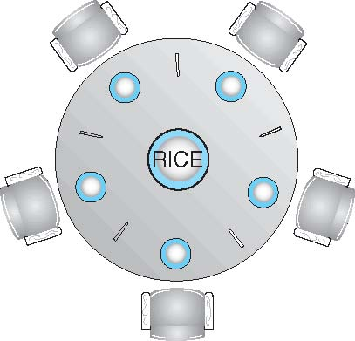
The Dining-Philosophers Problem
Five philosophers sit around a table with a chopstick is placed between each of the two philosophers
Each philosopher
Has a rice bowl in front of her/him
Spends his/her life alternating between thinking and eating
Never interacts with his/her colleagues
Can pick up closest chopsticks one at a time
When hungry, picks up two closest chopsticks, eats, and puts down the chopsticks

Slide 21
The Dining-Philosophers Problem (cont)
A classical synchronization problem ➔ must allocate resources among processes, without deadlocks and starvation
5 philosophers case
Shared data ➔ Bowl of rice (data set)
Challenges
How do we prevent each philosopher from starving?
How do we prevent deadlocks?

Slide 22
Dining-Philosophers Problem: Semaphore Based Solution
Chopstick as semaphore
chopstick[5] initialized to 1
Philosophers
Grab sticks with wait() on the corresponding semaphore
Release sticks with signal() on the corresponding semaphore
// Philosopher code
do {
wait(chopstick[i]);
wait(chopstick[(i+1) % 5]);
. . .
// Eat
. . .
signal(chopstick[i]);
signal(chopstick[(i+1) % 5] );
. . .
// Think
. . .
} while (TRUE);
Ensures that no two neighbors are eating, BUT may create a deadlock
if each philosopher picks up one stick simultaneously

Slide 23
Dining-Philosophers Problem: Deadlock Handling
Allow at most 4 philosophers to be sitting simultaneously at the table
Do not allow a philosopher to pick up a stick, unless both sticks are available
Asymmetric solution:
Odd philosophers first pick up the left stick and then the right stick
Even philosophers first pick up the right stick and then the left stick
Use monitors

Slide 24
Problems with Semaphores
Semaphore usage is very error-prone
All processes share a semaphore variable mutex (initialized to 1)
signal(mutex);
…
//critical section ➔
// more than 1 process!
…
wait(mutex);
wait(mutex);
…
//omits signal
// may result in a deadlock!
wait(mutex);
…
//result in a deadlock!
…
wait(mutex);
// omits wait
//mutual exclusion violated!
…
wait(mutex);
Solution: use a high-level synchronization construct called monitor

Slide 25
Monitors

Slide 26
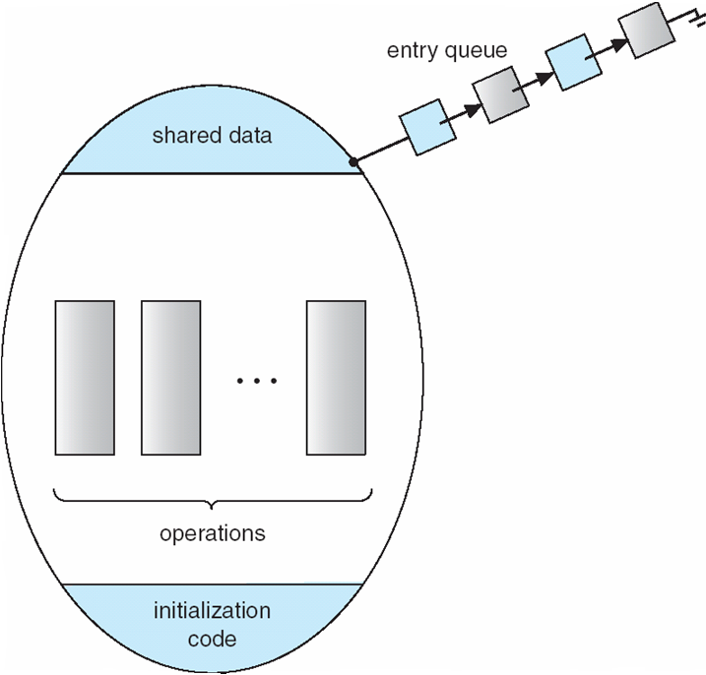
Monitors
A high-level abstraction that provides a convenient and effective mechanism for process synchronization
A programming language construct encapsulating a set of programmer-defined:
Operations (functions)
Shared data on which the operations operate
Only one process at a time may execute inside the monitor
Notes:
Abstract data type, internal variables only accessible by code within the procedure
programmers can put a monitor lock on any object. In particular, for something like a linked list, programmers can lock all linked lists with one lock, or have one lock for each list, or have one lock for each element of each list.

Slide 27
Monitor Characteristics
Local data variables are accessible only by the monitor’s procedures and not by any external procedure
Process enters monitor by invoking one of its procedures
Only one process may be executing in the monitor at a time
Notes:
The chief characteristics of a monitor are the following:
1. The local data variables are accessible only by the monitor’s procedures and
not by any external procedure.
2. A process enters the monitor by invoking one of its procedures.
3. Only one process may be executing in the monitor at a time; any other processes
that have invoked the monitor are blocked, waiting for the monitor to become available.
The first two characteristics are reminiscent of those for objects in object-oriented software. Indeed, an object-oriented OS or programming language can readily implement a monitor as an object with special characteristics.
By enforcing the discipline of one process at a time, the monitor is able to provide a mutual exclusion facility. The data variables in the monitor can be accessed by only one process at a time. Thus, a shared data structure can be protected by placing it in a monitor. If the data in a monitor represent some resource, then the monitor provides a mutual exclusion facility for accessing the resource.
To be useful for concurrent processing, the monitor must include synchronization tools. For example, suppose a process invokes the monitor and, while in the
monitor, must be blocked until some condition is satisfied. A facility is needed by which the process is not only blocked but releases the monitor so that some other process may enter it. Later, when the condition is satisfied and the monitor is again available, the process needs to be resumed and allowed to reenter the monitor at the point of its suspension.

Slide 28
Monitor pseudo code
monitor monitor_name
{
// Shared variable declarations
procedure P₁ ( . . . ) {
. . .
}
procedure P₂ ( . . . ) {
. . .
}
.
.
.
initialization code ( . . . ) {
. . .
}
}
Compiler ensures that only one process executes inside the monitor at any one time

Slide 29
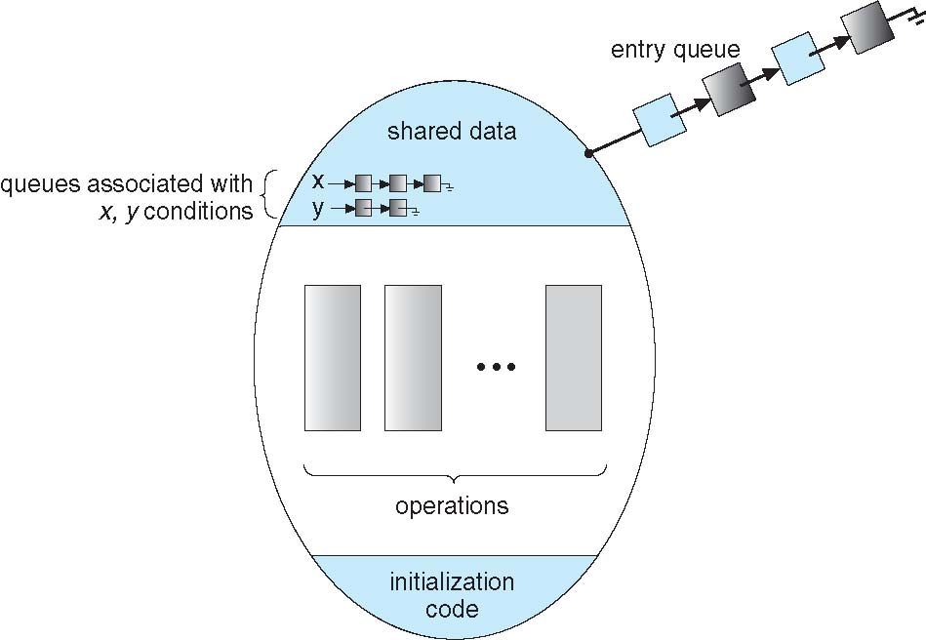
Condition Variables
Allowing only one process inside the monitor is restrictive
what if the process inside the monitor cannot proceed?
Solution: let the process suspend itself, and allow another process enter the monitor
Condition variable: enables the process to suspend itself until some condition holds. Condition variable x supports two operations
x.wait(): a process that invokes the operation is suspended until x.signal()
x.signal(): resumes a process (if any) that invoked x.wait()
If no no process is suspended, then signal() has no effect
Revised monitor schematic

Slide 30
Monitors: Solving the Dining Philosophers Problem
monitor dp
{
enum {THINKING, HUNGRY,
EATING}
state[5] ;
condition self[5] ;
void pickup(int i) {
state[i] = HUNGRY;
test(i);
if (state[i] ! = EATING)
self[i].wait();
}
void putdown(int i) {
state[i] = THINKING;
test((i + 4) % 5);
test((i + 1) % 5);
}
void test(int i) {
if ((state[(i + 4) % 5] != EATING) &&
(state[i] == HUNGRY) &&
(state[(i + 1) % 5] ! = EATING)) {
state[i] = EATING;
self[i].signal();
}
}
initialization_code() {
for (int i = 0; i < 5; i++)
state[i] = THINKING;
}
}
Notes:
1. Philosopher i can set the variable state[i] = EATING only if her two neighbors are not eating:(state[(i+4) % 5] != EATING) and (state[(i+1) % 5] != EATING)
2. Philosopher i delays herself when she is hungry but is unable to obtain the chopsticks she needs

Slide 31
Monitors: Solving the Dining Philosophers Problem (cont)
pickup(i): called by philosopher i when he wants to eat
void pickup(i) {
state[i] = HUNGRY; // Set philosopher’s state to hungry
test(i); // Are any of neighbors eating?
if (state[i] ! = EATING) // If a neighbor is eating, wait for
self[i].wait(); // neighbor to finish, and putdown the chopsticks
}
When called from pickup(i), test(i) will
Check whether philosopher i hungry (when called from pickup(i) i’s state will always be hungry)
Check whether none of i’s neighbors are eating
If 1 and 2 are true, then i’s state will be set to EATING
Otherwise, i’s state will be unchanged, and i will wait on condition variable condition[i] (self[i].wait()) for both neighbors to stop eating

Slide 32
Monitors: Solving the Dining Philosophers Problem (cont)
void putdown(int i): called by philosopher i when he is done eating and wants to put down the chopsticks
void putdown(int i) {
state[i] = THINKING; // I am done eating. Back to thinking
test((i + 4) % 5); // Tell my first neighbor that I am done eating
test((i + 1) % 5); // Tell my second neighbor that I am done eating
}
When called from putdown(i), test(i) will
Check if i’s first neighbor (neighbor (i + 4) % 5) is hungry
Check if none of (i + 4) % 5 neighbors are eating
If 1 and 2 are true, then (i + 4) % 5 state is set to eating and the neighbor is allowed to eat
Both sticks are now available, and (i + 4) % 5 may eat now if hungry
Do same thing for i’s second neighbor (i + 1) % 5

Slide 33
Monitors: Solving the Dining Philosophers Problem (cont)
void test(int i)
void test(int i) {
if ((state[(i + 4) % 5] != EATING) && // Is my first neighbor eating?
(state[i] == HUNGRY) && // Am I hungry?
(state[(i + 1) % 5] ! = EATING)) // Is my second neighbor eating.
{
state[i] = EATING; // i can eat now!
self[i].signal(); // If i is waiting in pickup(i), on
// self[i].wait(), then wake him up.
}
}
Why we need self[i].signal()?
When called by philosopher i in pickup(i), the line has no effect
When called from putdown(i), self[i].signal() may wake up i’s neighbor who is hungry and waiting to pickup i’s chopstick, in pickup()

Slide 34
Monitors: Solving the Dining Philosophers Problem Example
Example: consider the following sequence of events
5 Philosophers sit themselves around the table
Philosopher 1 picks up chopsticks and starts eating
Philosopher 0 (1’s neighbor) tries to eat
Philosopher 1 finishes eating and puts down his chopsticks

Slide 35
Monitors: Solving the Dining Philosophers Problem Example (cont)
Step 1: 5 philosophers sit themselves around a table
initialization_code() {
for (int i = 0; i < 5; i++)
state[i] = THINKING;
}
}
Initially, all philosophers are thinking

Slide 36
Monitors: Solving the Dining Philosophers Problem Example (cont)
Step 2: Philosopher 1 picks up sticks and starts eating
state[1] = HUNGRY
test(1)
state[(1 + 4) % 5] != EATING is true
state[(1 + 1) % 5] != EATING is true
state[i] == HUNGRY is true
Hence, state[1] = EATING
self[1].signal() (has no effect)
state[1] != EATING is false
Since philosopher 1 is eating, the philosopher does not need to wait to eat
void pickup(int i) {
state[i] = HUNGRY;
test(i);
if (state[i] ! = EATING)
self[i].wait();
}
void test(int i) {
if ((state[(i + 4) % 5] !=
EATING) &&
(state[i] == HUNGRY) &&
(state[(i + 1) % 5] ! =
EATING)) {
state[i] = EATING;
self[i].signal();
}
}

Slide 37
Monitors: Solving the Dining Philosophers Problem Example (cont)
Step 3: Philosopher 0 (1’s neighbor) tries to eat
state[0] = HUNGRY
Test(0)
state[(0 + 4) % 5] != EATING is true
state[(0 + 1) % 5] != EATING is false
neighbor 1 is currently eating
state[0] != EATING is true
state[0].wait()
0 waits for 1 to finish and put down the chopsticks
void pickup(int i) {
state[i] = HUNGRY;
test(i);
if (state[i] ! = EATING)
self[i].wait();
}
void test(int i) {
if ((state[(i + 4) % 5] !=
EATING) &&
(state[i] == HUNGRY) &&
(state[(i + 1) % 5] ! =
EATING)) {
state[i] = EATING;
self[i].signal();
}
}

Slide 38
Monitors: Solving the Dining Philosophers Problem Example (cont)
Step 4: Philosopher 1 finishes eating and puts down the sticks
putdown(1)
state[1] = THINKING
test((1 + 4) % 5) // = 0
state[(0 + 4) % 5] != EATING is true
state[(0 + 1) % 5] != EATING is true
state[0] == HUNGRY is true
Recall: 0 is hungry but previously was unable to grab sticks because 1 was eating
0 is currently waiting on variable condition[0] in pickup()
void pickup(int i) {
state[i] = HUNGRY;
test(i);
if (state[i] ! = EATING)
self[i].wait();
}
void test(int i) {
if ((state[(i + 4) % 5] !=
EATING) &&
(state[i] == HUNGRY) &&
(state[(i + 1) % 5] ! =
EATING)) {
state[i] = EATING;
self[i].signal();
}
}
void putdown(int i) {
state[i] = THINKING;
test((i + 4) % 5);
test((i + 1) % 5);
}

Slide 39
Monitors: Solving the Dining Philosophers Problem Example (cont)
Step 4: Philosopher 1 finishes eating and puts down the sticks
putdown(1)
Repeat the same procedure on 1’s other neighbor, (1+1) % 5 = 2
However, nothing happens, because 2 is not hungry
void pickup(int i) {
state[i] = HUNGRY;
test(i);
if (state[i] ! = EATING)
self[i].wait();
}
void test(int i) {
if ((state[(i + 4) % 5] !=
EATING) &&
(state[i] == HUNGRY) &&
(state[(i + 1) % 5] ! =
EATING)) {
state[i] = EATING;
self[i].signal();
}
}
void putdown(int i) {
state[i] = THINKING;
test((i + 4) % 5);
test((i + 1) % 5);
}

Slide 40
Monitors: Solving the Dining Philosophers Problem Summary
Each philosopher i invokes the operations pickup() and putdown() in the following sequence
DiningPhilosophters.pickup(i);
EAT
DiningPhilosophers.putdown(i);

Slide 41
Operating System Synchronization Examples
Windows
Linux
Pthreads

Slide 42
Windows Synchronization
A multithreaded kernel that provides support for real-time applications and multiple processors
Uses interrupt masks to protect access to global resources on uniprocessor systems
Uses spinlocks on multiprocessor systems
Spinlocking-thread will never be preempted
Provides dispatcher objects to synchronize threads based on different mechanisms including mutexes, semaphores, events, and timers
Events
An event acts much like a condition variable
Timers notify one or more thread when time expired

Slide 43
Linux Synchronization
Prior to kernel Version 2.6, Linux was a nonpreemptive kerne
Version 2.6 and later, fully preemptive
Provides
Semaphores
atomic integers
spinlocks
reader-writer versions of both
On single-cpu system, spinlocks replaced by enabling and disabling kernel preemption
Notes:
Spinlocks are used in the kernel only when a lock is held for a short duration. When a lock must be held for a longer period, semaphores or mutex locks are appropriate for use.

Slide 44
Pthreads Synchronization
Pthreads API is available at the user level and is not part of any particular kernel
Pthreads API is OS independent
Provides
mutex locks
condition variable
Non-portable extensions include
read-write locks
spinlocks
Notes:
Mutex locks represent the fundamental synchronization technique used with Pthreads

Slide 45
References
Operating System Concepts, 9th Edition, Abraham Silberschatz, Peter Baer Galvin, Greg Gagne
Chapter 5

