Slide 1
CPSC 351
Operating Systems Concepts
Pthreads

Slide 2
Pthreads Scheduling

Slide 3
Review of Threads
Multithreading is multitasking within a single process
Example: A word processing program has separate threads:
A thread for displaying graphics
Another thread for reading in keystrokes from the user
Another thread for performing spelling and grammar checking in the background
Threads can be user level or kernel level
User threads supported and managed by some thread library without intervention from OS
Kernel threads supported and managed directly by OS
Relationship exists between user threads and kernel threads
Many-to-one maps many user threads to a single kernel thread
One-to-one maps a single user thread to a single kernel thread
Many-to-many maps many user threads to smaller or equal number of kernel threads

Slide 4
Thread Scheduling: Pthreads
User-level and kernel-level threads are scheduled differently
Many-to-one and many-to-many models, thread libraries schedule user-level threads to run on a light weight process (LWP) – a virtual processor on which the thread can be scheduled to run
Process-contention scope (PCS): User thread of a process competes for execution on a LWP with other user threads of the same process
Typically done via priority set by programmer
Kernel decides which kernel-level thread to schedule onto a CPU and uses System-contention scope (SCS)
Competition for the CPU with SCS scheduling takes place among all threads in the system
Systems using the one-to-one model schedule threads using only SCS
Notes:
Thread library schedules user threads onto available LWPs ➔ do not mean that the threads are actually running on a CPU
- That would require the operating system to schedule the kernel thread onto a physical CPU

Slide 5
Pthreads API
Pthreads API enables the developers to specify either PCS or SCS during thread creation
PTHREAD_SCOPE_PROCESS: schedules threads using PCS scheduling
PTHREAD_SCOPE_SYSTEM: schedules threads using SCS scheduling
On many-to-many systems
PTHREAD SCOPE PROCESS policy schedules user-level threads onto available LWPS
Number of LWPs is maintained by the thread library
PTHREAD SCOPE SYSTEM policy creates and binds an LWP for each user-level thread
Can be limited by OS – Linux and Mac OS X only allow PTHREAD_SCOPE_SYSTEM

Slide 6
Pthreads API (cont)
Pthread provides two functions for getting and setting the contention scope policy:
pthread_attr_setscope(pthread_attr_t *attr, int scope)
pthread_attr_getscope(pthread_attr_t *attr, int *scope)
where
attr is the pointer to the attribute set for the thread
scope for pthread_attr_setscope is either PTHREAD SCOPE SYSTEM or PTHREAD SCOPE PROCESS
scope for pthread_attr_getscope is the pointer to an integer value that will be set to the current value of the contention scope
A nonzero value is returned if an error occurs

Slide 7
Pthreads: Contention Scope
#include <pthread.h>
#include <stdio.h>
#define NUM_THREADS 5
int main(int argc, char *argv[]) {
int i;
pthread_t tid[NUM THREADS];
pthread_attr_t attr;
// Get the default attributes
pthread_attr_init(&attr);
//Set the scheduling algorithm to
//PROCESS or SYSTEM
pthread_attr_setscope(&attr,
PTHREAD_SCOPE_SYSTEM);
// Create the threads
for (i = 0; i < NUM _THREADS; i++)
pthread_create(&tid[i], &attr, runner, NULL);
// Now join on each thread
for (i = 0; i < NUM_THREADS; i++)
pthread_join(tid[i], NULL);
}
//Each thread will begin control in this function
void *runner(void *param) {
printf("I am a thread\n");
pthread exit(0);
}

Slide 8
Multiple-Processor Scheduling
CPU scheduling is more complex when multiple CPUs are available
Homogeneous processors within a multiprocessor
Asymmetric multiprocessing:
One (the master server) handles all scheduling, I/O processing, and other system activities
All other processors only execute user code
Advantage: only one processor accesses the system data structures – don’t need to worry about data sharing issues
Symmetric multiprocessing (SMP): each processor is self-scheduling, all processes in common ready queue, or each has its own private queue of ready processes
Processor affinity: process has affinity for processor on which it is currently running
Soft affinity: a process can migrate between processors
Hard affinity: a process cannot migrate between processors
Notes:
symmetric multiprocessing (SMP)
If multiple processors trying to access and update a common data structure, the scheduler must be programmed carefully and must ensure that two separate
processors do not choose to schedule the same process and that processes are not lost from the queue
Processor affinity
Data most recently accessed by the process populate the cache for the processor
If the process migrates to another processor. The contents of cache memory must be invalidated for the first processor, and the cache for the second
processor must be repopulated. Because of the high cost of invalidating and repopulating caches
- Most SMP systems try to avoid migration of processes from one processor to another ➔ instead attempt to keep a process running on the same processor

Slide 9
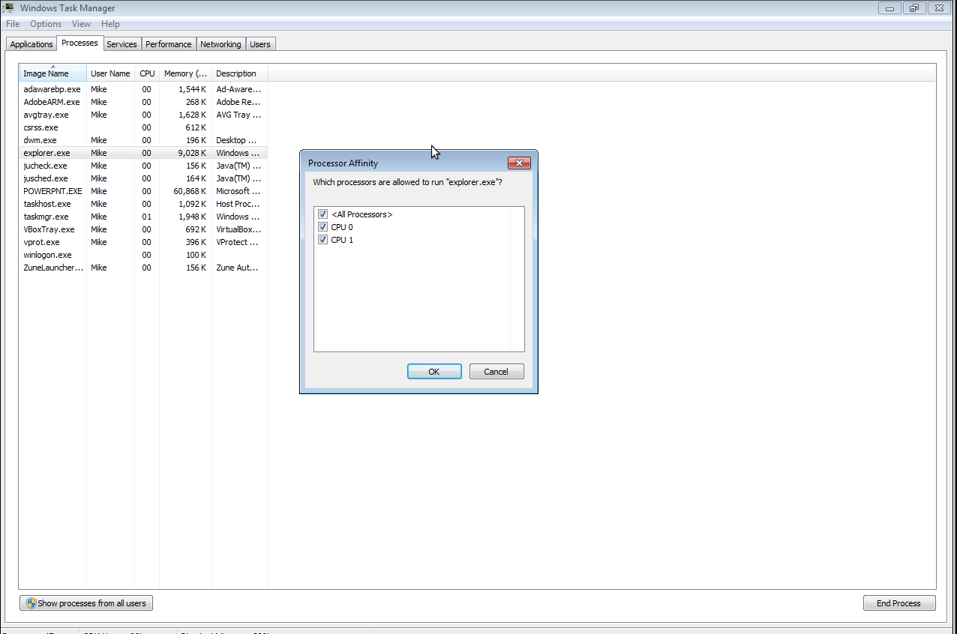
Process affinities in Windows

Slide 10
CPU Scheduling on NUMA Systems
Non-Uniform memory access systems (NUMA) comprises combined CPU and memory boards
CPUs on the board can access the memory on that board with less latency than on the other boards
Scheduling goal: schedule a process on the CPU attached to the memory bank containing the process data
CPU
CPU
Slow
Access
Fast Access
Fast Access
Memory
Memory
Computer

Slide 11
Multiple-Processor Scheduling – Load Balancing
On SMP systems, important to keep the workload balanced among all processors for efficiency
Load balancing attempts to keep workload evenly distributed
2 general approaches for load balancing
Push migration – periodic task checks load on each processor, and if found pushes task from overloaded CPU to other CPUs
Pull migration – idle processors pulls waiting task from busy processor
Load balancing often counteracts the benefits of processor affinity

Slide 12
Synchronization
Pthreads
Semaphores Condition Variables

Slide 13
Pthreads Synchronization
Pthreads API is available at the user level
Not part of any particular kernel
Pthreads provides
mutex locks (fundamental synchronization technique)
condition variables
read–write locks
#include <pthread.h>
/* data type for mutex locks */
pthread_mutex_t mutex;
/* create the mutex lock */
pthread_mutex_init(&mutex, NULL);
passing NULL as a second parameter ➔ initialize the mutex to its default attributes
Notes:
mutex lock is used to protect critical sections of code—that is, a thread acquires the lock before entering a critical section and releases it upon exiting the critical section
Pthreads uses the pthread mutex t data type for mutex locks

Slide 14
Pthreads Mutex Acquisition and Release
Acquire the mutex with pthread_mutex_lock()
Release the mutex with pthread mutex_unlock()
pthread_mutex_lock(&mutex); /* acquire the mutex lock */
/* Critical section */
pthread_mutex_unlock(&mutex); /* release the mutex lock */
Notes:
If the mutex lock is unavailable when pthread mutex lock() is invoked, the calling thread is blocked until the owner invokes pthread mutex unlock()

Slide 15
Semaphores

Slide 16
Pthreads with Semaphores
Not part of the Pthreads standard
Belongs to the POSIX SEM extension
Two types of semaphores
Named semaphore has an actual name in the file system and can be shared by multiple unrelated processes
Unnamed semaphores can only be used by threads within the same process
#include <semaphore.h>
sem_t sem;
/* Create the semaphore and initialize it to 1 */
sem_init(&sem, 0, 1);
Arguments:
A pointer to the semaphore
A flag indicating the level of sharing
0 ➔ semaphore are shared only by threads belonging to process created it
Non-zero ➔ allow other processes to access the semaphore
The semaphore’s initial value

Slide 17
sem_wait & sem_post
/* acquire the semaphore */
sem_wait(&sem);
/* critical section */
/* release the semaphore */
sem_post(&sem);

Slide 18
Condition Variables

Slide 19
Pthreads Condition Variables
pthread_mutex_lock(&mutex); /* acquire the mutex lock */
if (Condition C is not true)
//Critical section
Atomically unlock the mutex and go to sleep
When woken up, atomically lock the mutex and proceed
pthread_mutex_unlock(&mutex); /* release the mutex lock */
Condition variables allow threads to sleep inside critical sections
Allow a thread to atomically release the lock protecting the critical section and go to sleep
Notes:
mutex lock is used to protect critical sections of code—that is, a thread acquires the lock before entering a critical section and releases it upon exiting the critical section
Pthreads uses the pthread mutex t data type for mutex locks

Slide 20
Declaring and Initializing Pthreads Condition Variable
Declaration
pthread_cond_t condVar;
Initialization
Static: pthread_cond_t condVar = PTHREAD_COND_INITIALIZER (sets default attributes)
Dynamic: pthread_cond_init (&condVar, &attr)
pthread_cond_t * condVar – the condition variable to initialize
pthread_condattr_t *attr – condition variable attributes (if want default attributes, leave as NULL)
pthread_cond_init() must be followed by pthread_cond_destroy(&condVar) which deallocates the condition variable

Slide 21
Sleeping on a Condition Variable
pthread_cond_wait(&condVar, &mutex)
pthread_cond_t condVar – the condition variable on which to sleep
pthread_mutex_t mutex: the mutex protecting condition variable from race conditions (will see later why a mutex is needed)
Calling pthread_cond_wait() will
Suspend the caller thread
Unlock the mutex (if locked)
If another thread calls pthread_cond_signal(&condVar)
mutex will be locked
The awakened thread continues executing with the line following pthread_cond_wait()

Slide 22
Basic Usage
Assume mutex mutex and condition variable condVar
Waiting on a condition variable
pthread_mutex_lock(&mutex);
while(some condition C does does not hold)
pthread_cond_wait(&condVar, &mutex);
pthread_mutex_unlock(&mutex);
Waking up a thread (called by another thread)
pthread_mutex_lock(&mutex);
if (condition C is true)
pthread_cond_signal(&condVar);
pthread_mutex_unlock(&mutex);
Key idea: mutex protects the condition variable from race conditions

Slide 23
Why Lock Mutex Before pthread_cond_wait/signal?
Key idea: mutex protects the condition variable from race conditions
Example: assume that we omit mutexes (cannot do in practice)
Sleeper thread
while(Condition C is not true)
pthread_cond_wait(&condVar, &mutex);
Waking up a thread (called by another thread)
if (condition C is true)
pthread_cond_signal(&condVar);

Slide 24
Why Lock Mutex Before pthread_cond_wait/signal? (cont)
Suppose we omit mutexes
Time
//Thread 1
while (Condition C is not true)
pthread_cond_wait(&condVar,&mutex);
Meanwhile condition C changes
to true…
//Thread 2
if(condition C is true)
pthread_cond_signal(&condVar);
Thread 1 checks condition C and sees that it’s not true
Condition C changes to true
Thread 2 checks if condition C and sees that it’s now true
Thread 2 signals the condition variable (nobody is waiting on it, so the signaling has no effect)
Thread 1 goes to sleep on the condition variable
Problem: Thread 1 misses the signal!

Slide 25
Why Lock Mutex Before pthread_cond_wait/signal? (cont)
Now with mutexes…
Time
1. Thread 1 grabs the mutex
// Thread 1
pthread_mutex_lock(&mutex);
while(Condition C is not true)
pthread_cond_wait(&condVar,
&mutex);
pthread_mutex_unlock(&mutex);
Meanwhile condition C changes
to true…
// Thread 2
pthread_mutex_lock(&mutex);
if(condition C is true)
pthread_cond_signal(&condVar);
pthread_mutex_unlock(&mutex);

Slide 26
Why Lock Mutex Before pthread_cond_wait/signal? (cont)
2. Condition C changes
Time
Now with mutexes…
//Thread 1
pthread_mutex_lock(&mutex);
while(Condition C is not true)
pthread_cond_wait(&condVar,
&mutex);
pthread_mutex_unlock(&mutex);
Meanwhile condition C changes
to true…
//Thread 2
pthread_mutex_lock(&mutex);
if(condition C is true)
pthread_cond_signal(&condVar);
pthread_mutex_unlock(&mutex);

Slide 27
Why Lock Mutex Before pthread_cond_wait/signal? (cont)
Time
Now with mutexes…
//Thread 1
pthread_mutex_lock(&mutex);
while(Condition C is not true)
pthread_cond_wait(&condVar,
&mutex);
pthread_mutex_unlock(&mutex);
Meanwhile condition C changes
to true…
//Thread 2
pthread_mutex_lock(&mutex);
if(condition C is true)
pthread_cond_signal(&condVar);
pthread_mutex_unlock(&mutex);
3. Thread 2 attempts to grab the mutex but is blocked because Thread 1 already grabbed the mutex

Slide 28
Why Lock Mutex Before pthread_cond_wait/signal? (cont)
Now with mutexes…
Time
// Thread 1
pthread_mutex_lock(&mutex);
while(Condition C is not true)
pthread_cond_wait(&condVar,
&mutex);
pthread_mutex_unlock(&mutex);
Meanwhile condition C changes
to true…
// Thread 2
pthread_mutex_lock(&mutex);
if (condition C is true)
pthread_cond_signal(&condVar);
pthread_mutex_unlock(&mutex);
4. Thread 1 calls pthred_cond_wait() which sends Thread 1 to sleep and unlocks the mutex

Slide 29
Why Lock Mutex Before pthread_cond_wait/signal? (cont)
Now with mutexes…
Time
// Thread 1
pthread_mutex_lock(&mutex);
while(Condition C is not true)
pthread_cond_wait(&condVar,
&mutex);
pthread_mutex_unlock(&mutex);
Meanwhile condition C changes
to true…
// Thread 2
pthread_mutex_lock(&mutex);
if(condition C is true)
pthread_cond_signal(&condVar);
pthread_mutex_unlock(&mutex);
5. Because Thread 1 released the mutex, Thread 2 proceeds sees the condition C is true, and signals the condition variable on which Thread 1 is sleeping

Slide 30
Why Lock Mutex Before pthread_cond_wait/signal? (cont)
Now with mutexes…
Time
//Thread 1
pthread_mutex_lock(&mutex);
while(Condition C is not true)
pthread_cond_wait(&condVar,
&mutex);
pthread_mutex_unlock(&mutex);
Meanwhile condition C changes
to true…
//Thread 2
pthread_mutex_lock(&mutex);
if(condition C is true)
pthread_cond_signal(&condVar);
pthread_mutex_unlock(&mutex);
6. When the signal is received, pthread_cond_wait() locks the mutex and wakes up Thread 1

Slide 31
References
Operating System Concepts, 9th Edition, Abraham Silberschatz, Peter Baer Galvin, Greg Gagne
Chapter

