Slide 1
Implementation of One class SVM for handwritten digit recognition
IIT2015032 Rohan MR
IIT2015039 Nishant Verma
IIT2015042 Raghav Saboo
IIT2015045 Harsh Vardhan

Slide 2
Problem Statement
Generate Datasets of hand written digits and use One class SVM for classification. Further use Dimension reduction algorithms to extract common and important features.

Slide 3




Steps used in Dataset Generation
1 Create image data
We have generated data of 4 handwritten digits namely 0,6,8,9.

Slide 4

2 Resize the original image to 50 X 50 pixel image.

Slide 5

3 Digit Extraction from the image.

Slide 6

4 The cropped image was again upscaled to 50 x 50 pixel image

Slide 7
Feature Extraction from the generated image
Important features were extracted from the generated image. We took 4 X 50 ie 200 features out of 50 X 50 pixel size image.

Slide 9
One class Classification
In machine learning , one-class classification, also known as unary classification or class-modelling, tries to identify objects of a specific class amongst all objects, by learning from a training set containing only the objects of that class. This is different from and more difficult than the traditional classification problem, which tries to distinguish between two or more classes with the training set containing objects from all the classes.

Slide 10
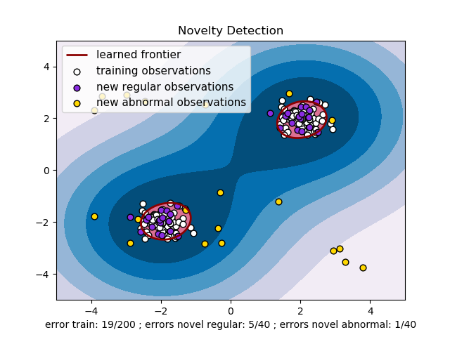
One Class Support Vector Machine
One class SVM is used for one class classification.

Slide 11
Results
Training data Size | Testing data size | Accuracy
742 (digit 0) | 2689 | 99.2%
604 (digit 6) | 2689 | 98.7%
632 (digit 8) | 2689/1947(non 0) | 72.8%/97.4%
711 (digit 9) | 2689/1947(non 0) | 79.2%/90.9%

