Slide 1

T06: API & Contract Testing
Group 07
Members:
Tran Tri Nhan
Cao Tran Ba Dat
Nguyen An Nghiep

Slide 2
Agenda
API and Contract Testing: What & Why
Tools for API and Contract Testing
API Testing live demo
Seminar activity

Slide 3
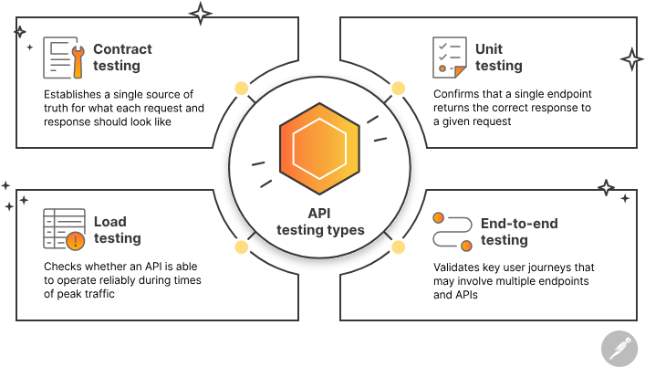
Introduction to API Testing
API Testing
What is API Testing?
API Testing is a process that confirms an API is working as expected. There are several types of API tests, and each one plays a distinct role in ensuring that the API's functionality, security, and performance remain reliable.
Why do we need API Testing?
Early Bug Detection (Shift-Left): Tests backend logic as soon as endpoints are built, long before the UI is ready.
Speed & Cost Efficiency: Execution is significantly faster than UI testing, reducing maintenance effort and test automation costs.
Broader Test Coverage: Easily simulates edge cases, malicious inputs, and system failure responses that are hard to trigger via UI.
What if we DON'T have API Testing?
Critical logic and security vulnerabilities remain undetected, significantly increasing debugging complexity during UI integration. Consequently, minor backend modifications can unexpectedly break frontend functionality.

Slide 4
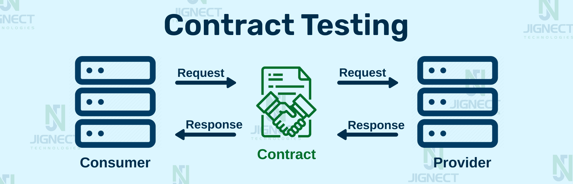
Introduction to Contract Testing
Contract Testing
What is Contract Testing?
Contract testing is a technique that verifies the data agreement (Contract) on requests and responses between a service consumer and a service provider, without requiring full end-to-end environment setups.
Why do we need API Testing?
Ideal for Microservices: Ensures dozens of independent services communicate smoothly without data mismatch.
Decoupled Testing: Allows Consumers and Providers to test their integrations independently without relying on flaky shared environments.
Instant Catch of Breaking Changes: Automatically flags schema changes (e.g., renamed fields, missing parameters) before code hits production.
What if we DON'T have API Testing?
Everything works fine in isolated local environments, but breaks during integration testing due to payload mismatches. Integration environments become the ultimate bottleneck, severely delaying releases.

Slide 5

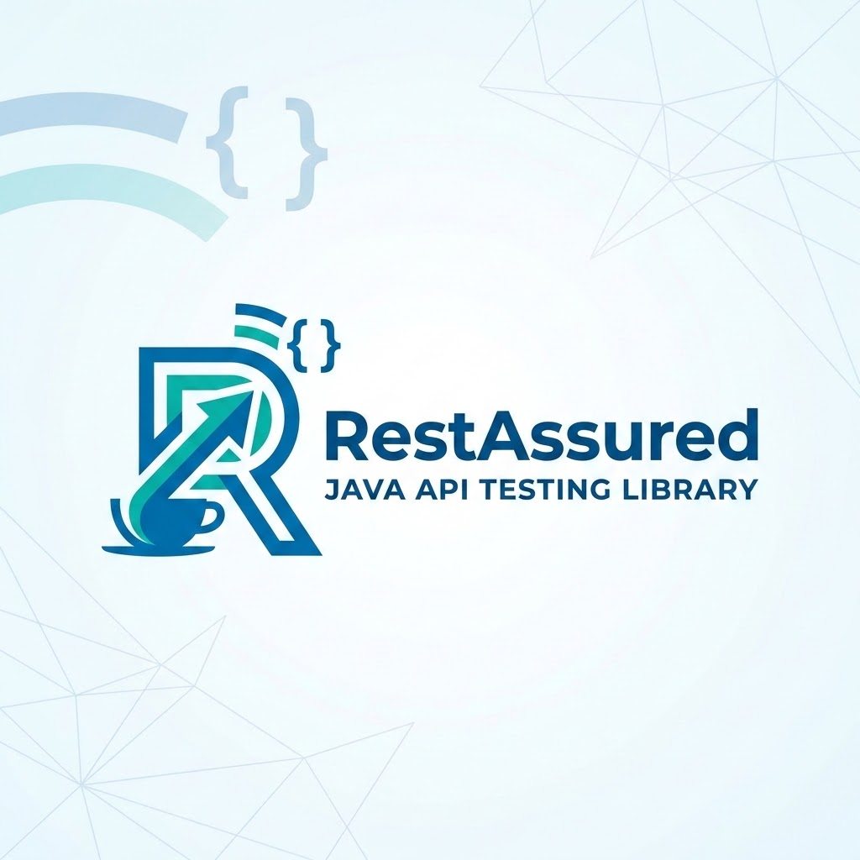
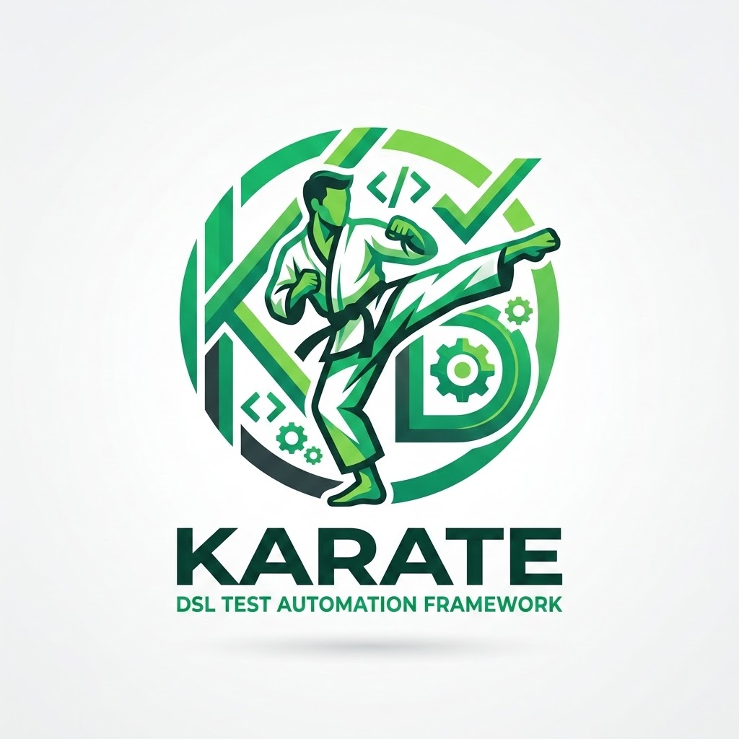
Introduction to Postman
Postman: A Powerful Tool for API Testing
What is Postman?
A leading popular platform that helps build, develop, and test APIs easily and intuitively.
Core Features
Create & Send Requests: Supports REST, GraphQL, gRPC, WebSocket...
Manage Collections: Group, organize, and share API requests.
Criteria
Postman
RestAssured
Karate
Learning Curve
Easy
(Intuitive UI, Low-code)
Hard
(Requires Java/Coding)
Medium
(Uses Gherkin syntax)
Cost
Freemium
(Paid for Team/Ent.)
Free
(Open Source)
Free
(Open Source)
Advanced Testing & Integration
Automated Testing: Built-in JS script execution environment to write test cases (Pre-request scripts & Tests).
CI/CD Integration: Run automated tests in pipeline via Postman CLI or Newman tool.
Community Support
Very large
Rich documentation
Large
Especially Java teams
Growing strongly
Active QA/QC adoption

Slide 6
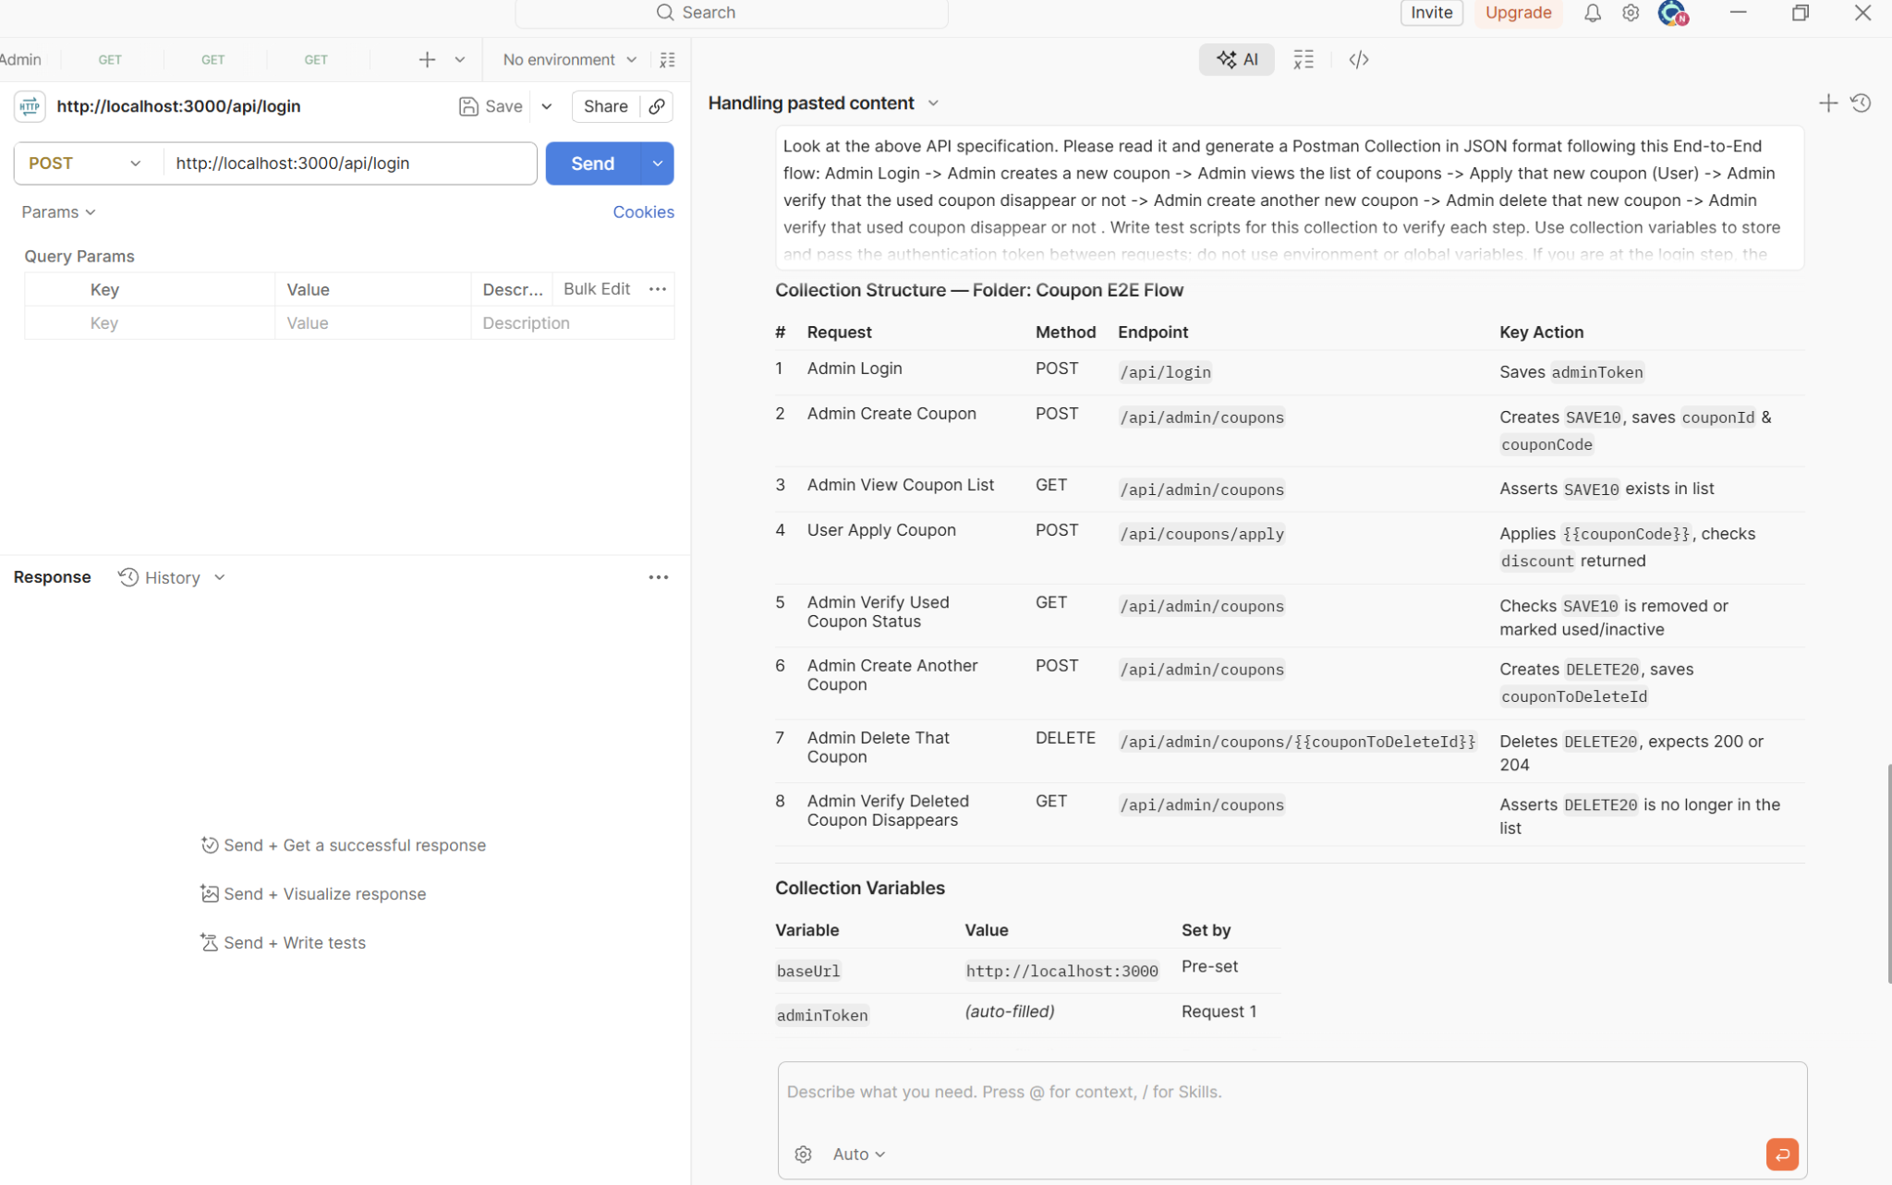
AI in Postman (Postbot)
Postbot: AI Assistant for API Testing
What is Postbot?
An AI assistant integrated directly into Postman, helping to automate and simplify API-related tasks.
Auto-generate Tests
Describe in natural language prompts to automatically write test code snippets (e.g., status checks, variable saving).
Auto-documentation
Instantly create detailed descriptions, parameters, and structured examples based on raw API data.
Visualize Data
Transform dry, complex JSON response payloads into intuitive, beautiful charts and tables with a single command.
Debugging Support
Analyze failures instantly and get smart recommendations (Quick Fix) to successfully run your API requests.

Slide 7

Brief Introduction to Pact (Contract Testing)
Pact: Guaranteeing API Compatibility
What is Pact?
Pact is the leading open-source tool today for Consumer-Driven Contract Testing.
Core Role & Benefits
Replaces slow and expensive integrated (End-to-End) tests with fast, independent unit tests.
Helps the Consumer (API caller) and Provider (API provider) agree on a shared "Contract".
Ensures both sides remain compatible, preventing breaking changes to the API without prior notice.
Key Takeaway
By verifying the contract independently on both sides, Pact detects breaking API changes instantly without deploying complete end-to-end environments.

Slide 8
Live demo
What will be covered:
End-to-end scenario on coupon flow with Postman
CI with Postman & GitHub Actions
Collection and test scripts scaffold with AI assistance

Slide 9
API Testing Activity
Postman activity:
Run endpoints manually.
Copy auth data between requests.
Add negative-case assertions.
Catch hidden validation bugs.
AI activity:
Prompt AI with API docs.
Generate collection and tests.
Review and run generated tests.
Reuse saved variables automatically.

Slide 10
API Testing Activity
Review questions:
What is a common failure mode when using Postman for API testing? How do we avoid it?
What are the common hallucinations of AI when creating new collections and test scripts?

Slide 11
Q & A

Slide 12
Thank you for participating

