Slide 1

Grade 4
english
By Mr Stefano

Slide 2
Grade 4 english

Slide 3



Grade 4 english
Unit 1
Start
CHAPTERS
Exercises
Unit 1
Unit 1
Unit 2
Unit 2
Unit 3
Unit 3
Unit 4
Unit 4
Unit 5
Unit 5
Unit 6
Unit 6

Slide 4
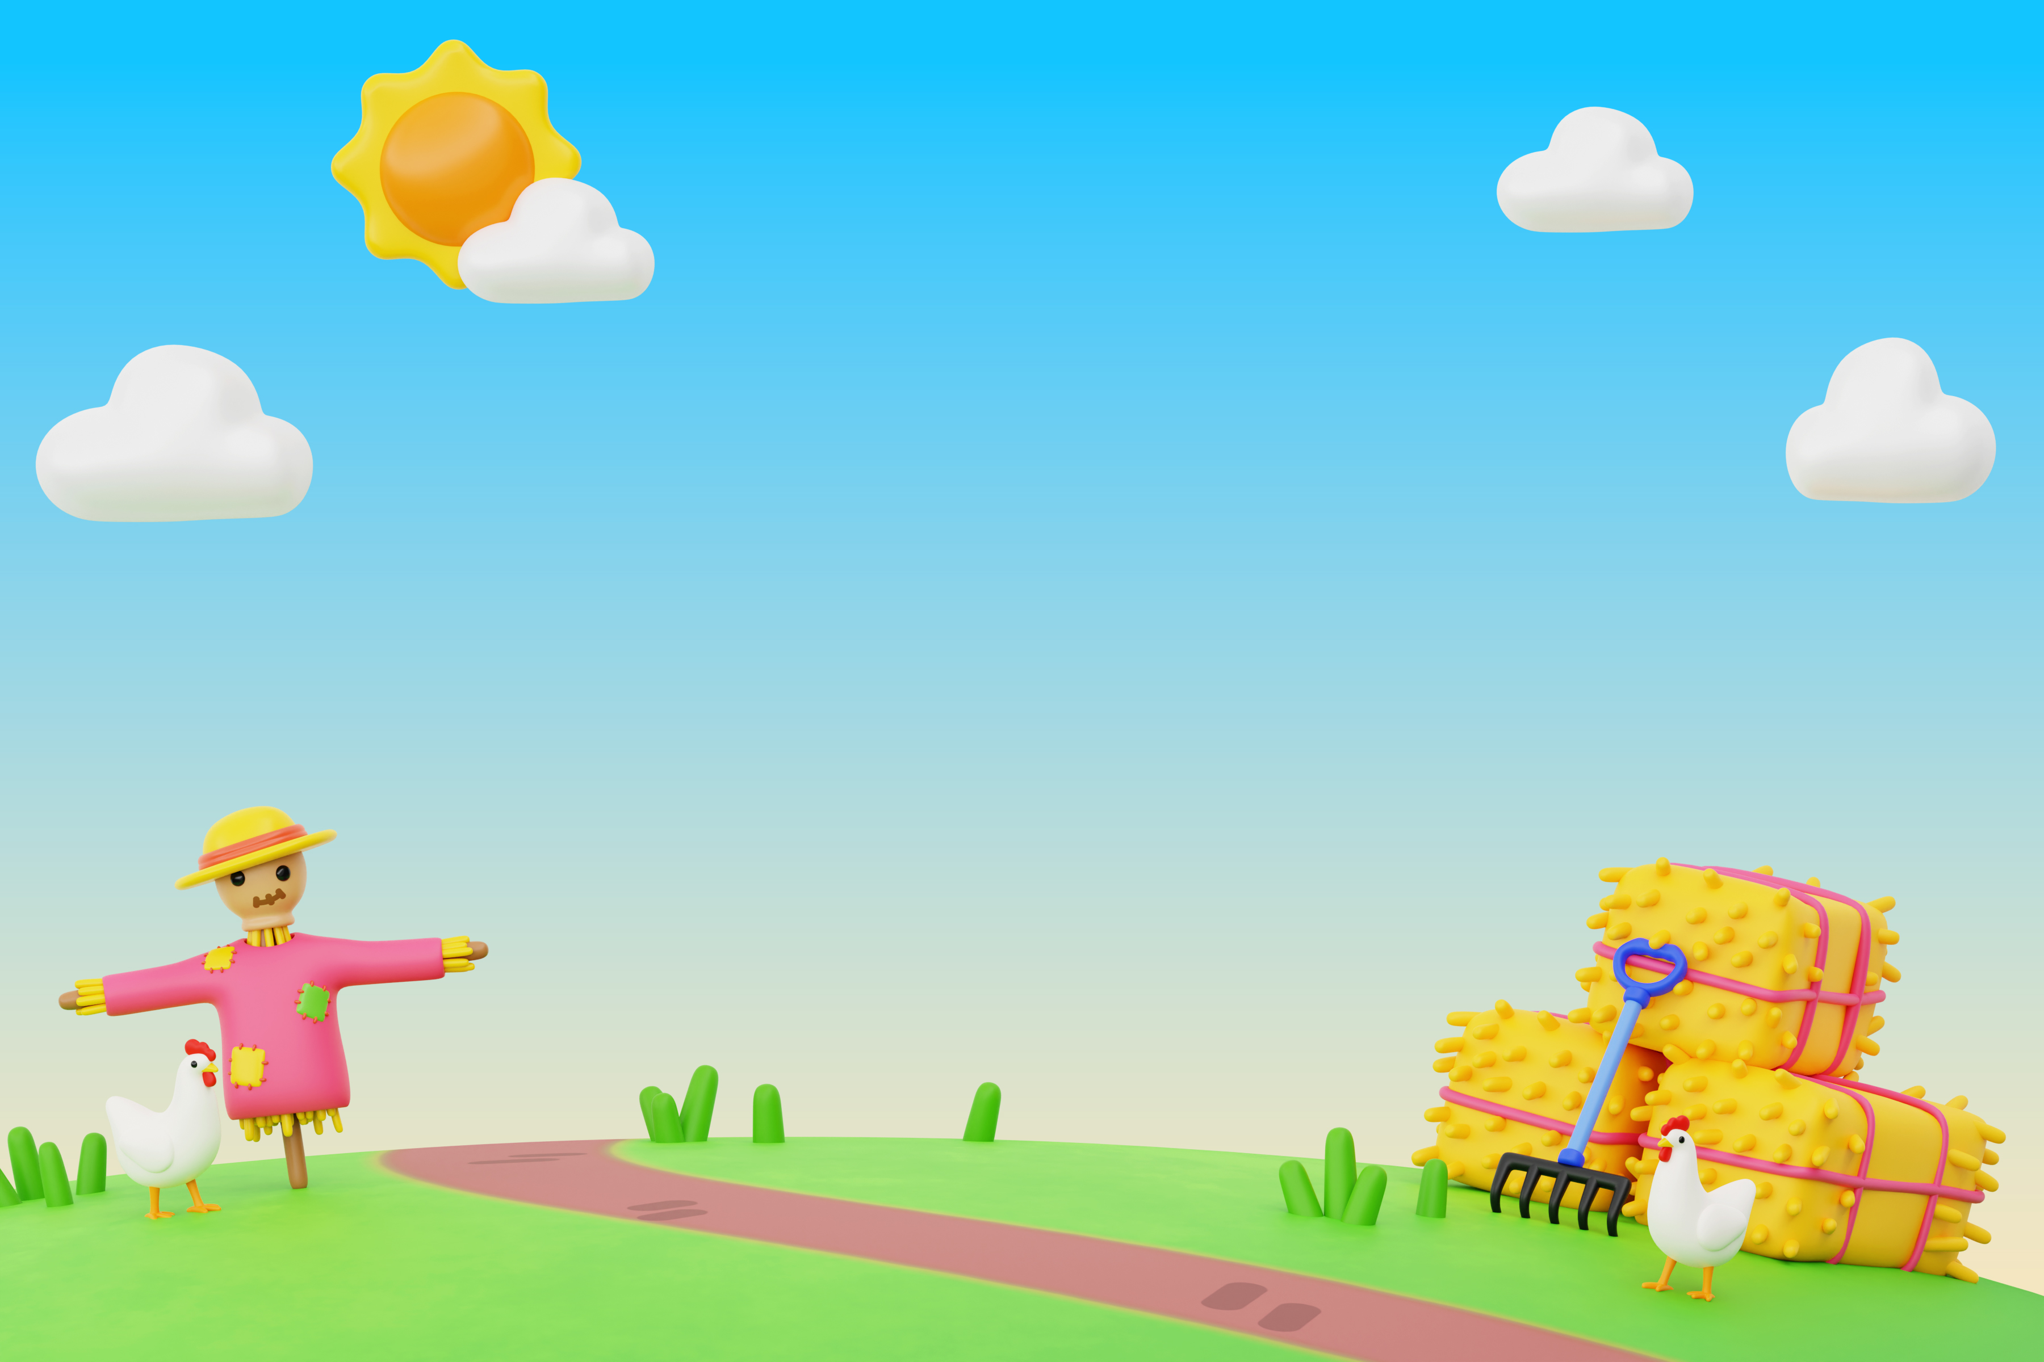
Grade 5 English
Chapters
Videos
Start
Exercises

Slide 5
Grade 5 English
Chapters
Exercises
Videos

Slide 6
Start
Grade 5 English
Chapters
Exercises
Videos
Unit 1
Unit 1
Unit 1
Unit 2
Unit 2
Unit 2
Unit 3
Unit 3
Unit 3
Unit 4
Unit 4
Unit 4
Unit 5
Unit 5
Unit 5
Unit 6
Unit 6
Unit 6
Unit 9

Slide 7
Grade 5 English
Start
Grade 5 English
Chapters
Unit 1
Unit 2
Exercises
Videos
Unit 3
Unit 4
Unit 5
Unit 6
Unit 9

Slide 8
Grade 5 English
Start
Grade 5 English
Exercises
Unit 1
Unit 2
Chapters
Videos
Unit 3
Unit 4
Unit 5
Unit 6

Slide 9
Grade 5 English
Start
Grade 5 English
Videos
Unit 1
Unit 2
Chapters
Exercises
Unit 3
Unit 4
Unit 5
Unit 6

