Slide 1
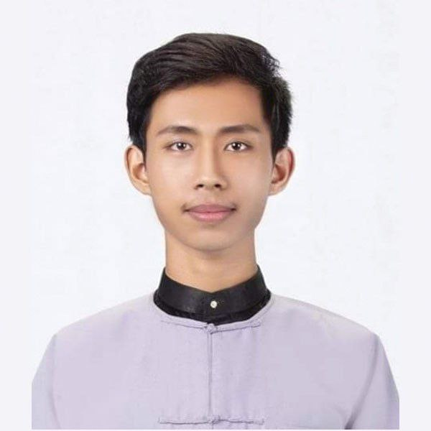
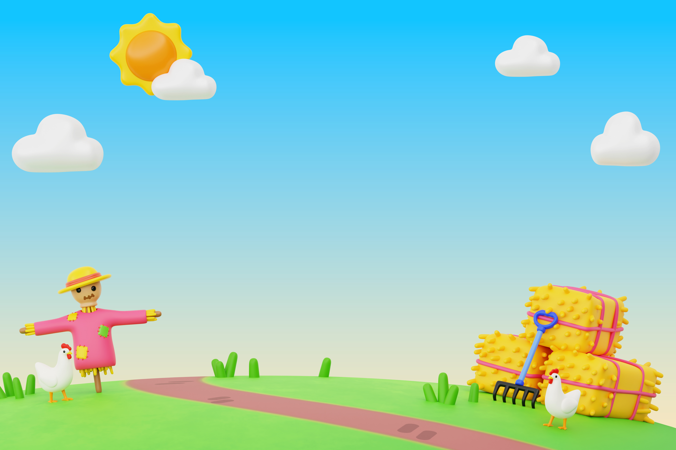


Click to learn about me!
Grade 5 English
Chapters
Videos
By Mr Stefano.
Start
Exercises

Slide 2
Grade 5 English
Click to learn about me!
By Mr Stefano.
Lessons
Exercises
Videos

Slide 3

Start
Grade 5 English
Lessons
Exercises
Videos
Regular and Irregular Verbs
Frequency Adverbs
Frequency Adverbs
Simple Past Tense
Future Tense
Future Tense
Making Comparisons
Modal Verbs
Making Comparisons
Modal Verbs
Modal Verbs
Making Comparisons
Present Simple
Present Simple
Present Continuous
Frequency Adverbs
Present Continuous
Simple Past Tense
Simple Past Tense
Simple Present
Regular & Irregular Verbs
Regular & Irregular Verbs
Have got / has got

Slide 4
Exercise
Frequency Adverbs.
1. You ___ eat your vegetables if you want to grow strong.
should
2. ___ I go to the bathroom please?
could
3. He ___ play football professionally when he was young.
could
4. It’s very cloudy. It ___ rain later today.
could
5. We ___ be quiet in the library.
must
6. If I had more time, I ___ help you with your homework.
would
7. She ___ play the piano very well.
can
8. You ___ wear a helmet when riding a bike to be safe.
must

Slide 5
Exercise
Making Comparisons.
1. My house is ___ than yours.
bigger
2. Of all the runners, Maria was the ___.
fastest
3. This math problem is ___ than the one we did yesterday.
harder
4. Elephants are ___ than lions.
larger
5. That was the ___ movie I have ever seen!
most exciting
6. My backpack is ___ than yours.
heavier
7. Today is ___ than yesterday.
colder
8. Out of the three brothers, Sam is the ___ at football.
best

Slide 6
Exercise
Future Tense.
1. I ___ do my homework after dinner.
will
2. She ___ visit her cousin next weekend. It’s already planned.
is going to
3. It’s very cold today. I think it ___ snow.
will
4. We ___ have pizza for lunch. Mom said so this morning.
are going to
5. Don’t worry, I ___ help you carry your bag.
will
6. They ___ watch a movie tonight. It’s already on their schedule.
are going to
7. The team ___ win the game! They look ready.
will
8. Watch out! That glass ___ fall!
is going to

Slide 7
Exercise
Present Simple.
1. She ___ to school every day.
goes
2. I ___ my homework after dinner.
do
3. The sun ___ in the east.
rises
4. My friends ___ soccer on Saturdays.
play
5. He always ___ his teeth before bed.
brushes
6. We ___ breakfast at 7:00 AM.
have
7. It ___ a lot in the rainy season.
rains
8. Lucy and I ___ in the same class.
are

Slide 8
Exercise
Present Continuous.
1. I ___ a book right now.
am
2. She ___ watching TV in the living room.
is
3. They ___ playing outside.
are
4. We ___ eating lunch at school.
are
5. The dog ___ sleeping on the couch.
is
6. My brother and I ___ doing our homework.
are
7. Look! The baby ___ crying.
is
8 .You ___ talking very loudly!
are

Slide 9
Exercise
Simple Past Tense.
1. I ___ my lunch at 1 PM. (have)
ate
2. She ___ a beautiful picture yesterday. (paint)
painted
3. We ___ to the zoo last weekend. (go)
went
4. He ___ the door before he left. (close)
closed
5. They ___ a new game last night. (play)
played
6. My dad ___ me with my homework. (help)
helped
7. The dog ___ loudly at the mailman. (bark)
barked
8. We ___ a movie after dinner. (watch)
watched

Slide 10
Exercise
Regular & Irregular Verbs.
1. What is the past tense of jump?
| jump | jumping | jumped | jumpt |
2. What is the past tense of run?
| runned | ran | run | running |
3.What is the past tense of clean?
| cleaned | cleant | clened | cleaning |
4. What is the past tense of fly?
| flied | flew | flying | flyed |
5. What is the past tense of laugh?
| laugh | laught | laughed | laughing |
6. What is the past tense of eat?
| eated | ate | eaten | eating |
7. What is the past tense of walk?
| walkt | walked | walken | walking |
8. What is the past tense of see?
| seed | seen | saw | see |

