Slide 1

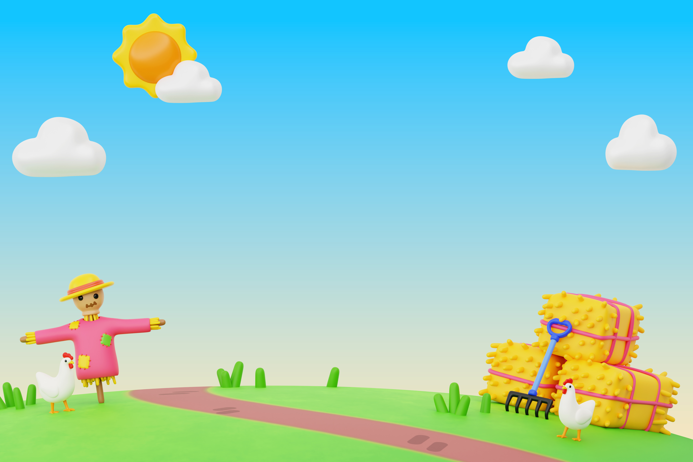


Click to learn about me!
Grade 5 English
Chapters
Videos
By Mr Stefano.
Start
Exercises

Slide 2
Grade 5 English
Click to learn about me!
By Mr Stefano.
Lessons
Exercises
Videos

Slide 3

Start
Grade 5 English
Lessons
Exercises
Videos
Regular and Irregular Verbs
Unit 1
Unit 1
Simple Past Tense
Unit 2
Unit 2
Modal Verbs
Unit 3
Unit 3
Making Comparisons
Unit 4
Unit 4
Frequency Adverbs
Unit 5
Unit 5
Simple Present
Unit 6
Unit 6
Have got / has got

