Slide 1

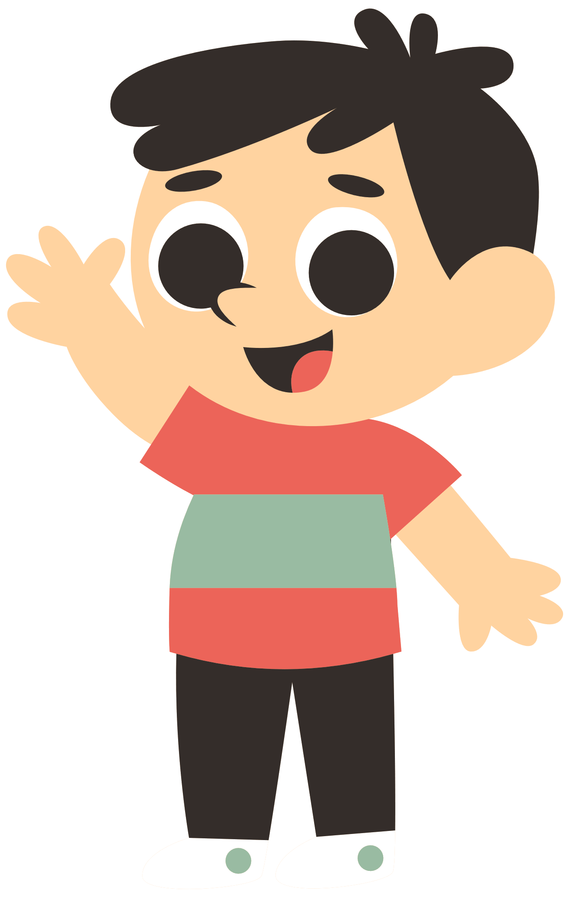
Regular and irregular verbs
GRAMMAR PRESENTATION BY MR. STEFANO

Slide 2


What is regular verb?
Regular verbs have a fixed and set pattern.

Slide 3


What is regular verb?
When a verb ends in a vowel,
bake
bake
baked
When a verb ends in a consonant,
ask
ask
asked

Slide 4

What is regular verb?
Present Tense:
“I work in this company.”
Past Tense:
“I worked in this company.”
Past Participle:
“I have worked at a lot of companies.”

Slide 5

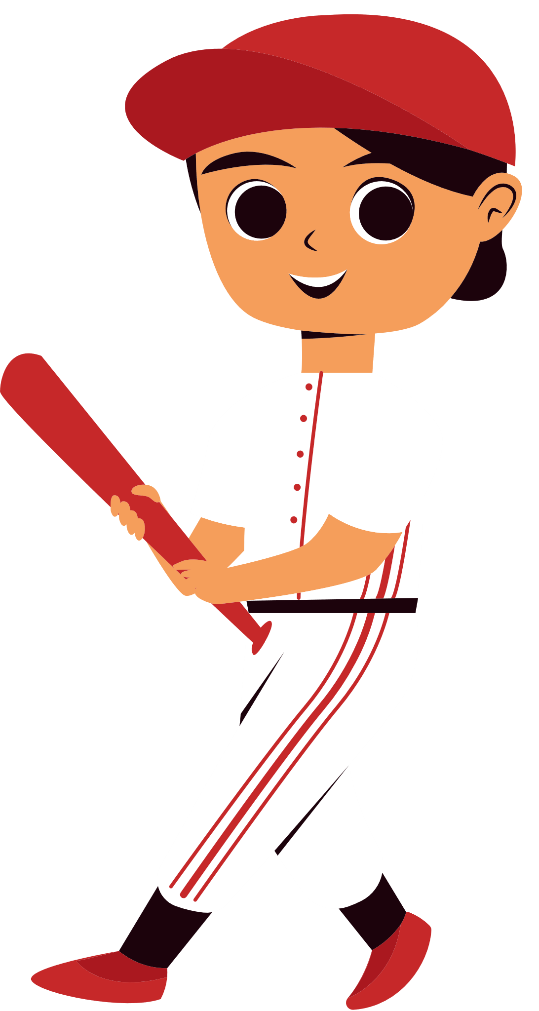
What is irregular verb?
Irregular verbs do not have a fixed and set pattern.

Slide 6


What is irregular verb?
RUN ran
Eat ate
Think thought

Slide 7

What is irregular verb?
Some will not change at all.
cUt cut

Slide 8
Quiz time !
The boy at the table.
sat
sitted
satted

Slide 9
Quiz time !
The boy at the table.
sat
sat
sitted
satted

Slide 10
Quiz time !
Ella under the table.
hid
hidded
hiding

Slide 11
Quiz time !
Ella under the table.
hid
hid
hidded
hiding

Slide 12
Quiz time !
Miss Smith me a joke.
told
telled
tolded

Slide 13
Quiz time !
Miss Smith me a joke.
told
told
telled
tolded

Slide 14
Quiz time !
Can you the puppy please?
hold
holded
helded

Slide 15
Quiz time !
Can you the puppy please?
hold
hold
holded
helded

Slide 16
Quiz time !
My mom her friend.
ranged
rang
runged

Slide 17
Quiz time !
My mom her friend.
rang
ranged
rang
runged

Slide 18
Quiz time !
Jane a big rainbow.
seed
saw
sawed

Slide 19
Quiz time !
Jane a big rainbow.
saw
seed
saw
sawed

Slide 20
Quiz time !
Daddy he loves me.
sayed
saided
said

Slide 21
Quiz time !
Daddy he loves me.
said
sayed
saided
said

Slide 22
Quiz time !
Ally the bed.
maded
made
maked

Slide 23
Quiz time !
Ally the bed.
made
maded
made
maked

