Slide 1
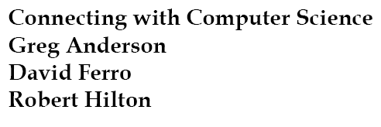
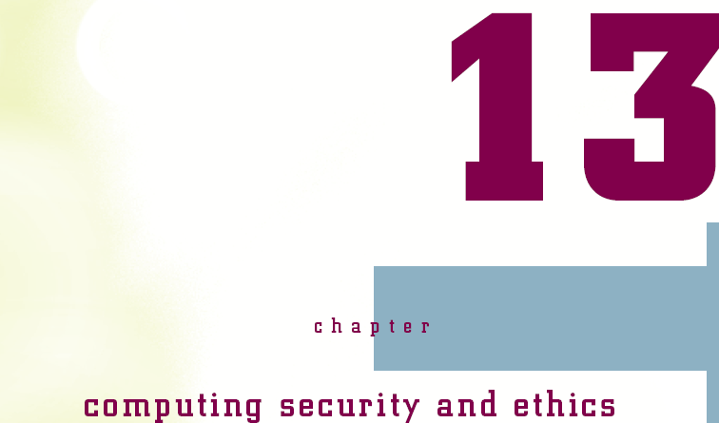


Slide 2
Objectives
Learn why today almost everyone is a computer operator
Learn about the predecessors of modern computer hardware and software
Trace the development of computer hardware and software through several generations
Connecting with Computer Science

Slide 3
Objectives (continued)
Learn that sometimes good ideas flop and bad ones survive
Meet some interesting figures—some famous, some infamous, some wealthy, and some obscure
See some issues facing modern computing
Connecting with Computer Science

Slide 4
Why You Need to Know About the History of Computing
Computers are everywhere
  Communication device
  Tool for artists, architects, and designers
  Information archive
  Entertainment device
  Trains, planes, automobiles
What caused the revolution?
What lies ahead?
Connecting with Computer Science

Slide 5
Ancient History – Thẻ tính toán
Origins of computer in ancient Assyria
  Tablets with arithmetic/trigonometric solutions
  Math solves societal and personal problems
Drivers of mathematical development
  Property ownership and the need to measure
  Vertical construction and the pyramids
  Navigation and the need to control time
Computers do math
Connecting with Computer Science
Notes:
Tablet: Thẻ,phiến, viên
Pyramid: hình chóp, kim tự tháp

Slide 6
Pascal and Leibniz
Start the Wheel Rolling
Abacus: Bàn toán - www.computersciencelab.com/ComputerHistory/History.htm
Paper, wood, stone, papyrus tables, abacuses as “computers”
1622: invention of slide rule , 1642: invention of mechanical calculator by Blaise Pascal, 1694: Leibniz Wheel expands arithmetic operations
Connecting with Computer Science
Notes:
Abacus: bàn toán
Papyrus: cói, giấy

Slide 7
Joseph Jacquard
Ngày nay còn thấy ở các nhà dệt chăn vải (Hốc Môn)
Invents programmable loom in 1801
  Jacquard loom weaves patterns in fabric -
  Allows input and storage of parameters
  Selection pins oriented with punch cards
  Similarities with player piano
Concept of the stored program
Connecting with Computer Science
Notes:
Loom: khung
Fabric: vải
Pin: kim
Punch card: thẻ đục lỗ

Slide 8
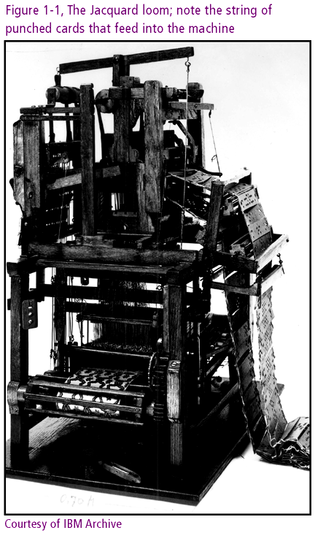
Connecting with Computer Science

Slide 9
Charles Babbage
Invents Difference Engine in 1823
  Device adds, subtracts, multiplies, divides
Designs Analytical Engine
  Components of modern computer
    Input and output devices, memory and CPU
  Not built due to lack of funds
Collaborates with Ada Lovelace Byron
  Attribution of program loop concept
  Ada programming language namesake
Connecting with Computer Science

Slide 10
Herman Hollerith
Invents electromechanical counter in 1880s
  Serves tabulation role in 1890 US census
  Machine uses punch cards as input
  Single-purpose machine
Company created around technology becomes IBM
  IBM rolls out multi-purpose Mark I in 1944
  Mark I rapidly made obsolete by vacuum tubes
Connecting with Computer Science
Notes:
Tabulation: Trình bầy, sắ[p xếp
Census: cuộc điều tra dân số

Slide 11
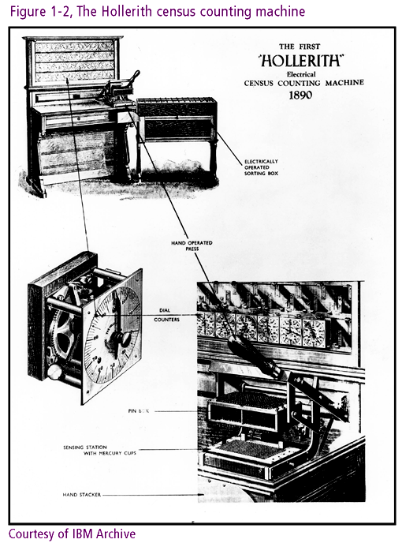
Connecting with Computer Science

Slide 12
Progression of
Computer Electronics
Charles Sanders Peirce extends work of Boole
  Electric switches emulate the true/false conditions of Boolean algebra
  Benjamin Burack implements concepts in 1936 logic machine
John Atanasoff and Clifford Berry build computer using vacuum tubes
World War II as developmental turning point
Connecting with Computer Science

Slide 13
Wartime Research Drives
Technological Innovation
Military need: trajectory tables for weapons testing
  U.S. Navy Board of Ordinance helps fund Mark I
  U.S. Army funds ENIAC (Electronic Numerical Integrator and Computer)
ENIAC runs 1000 times faster than Mark I
ENIAC and Mark I too late to assist in war effort
Connecting with Computer Science
Notes:
Trajectory : đạn đạo

Slide 14
ENIAC and EDVAC
ENIAC’s overhead
  Loud and large at 30 tons: fills a huge basement
  18,000 vacuum tubes need constant attention
  6,000 switches need for arithmetic operations
ENIAC’s strengths
  Performs arithmetic and logic operations
  Made multi-purpose with symbolic variables
ENIAC’S other weaknesses
  Could not modify program contents
  Had to be programmed externally
Connecting with Computer Science

Slide 15
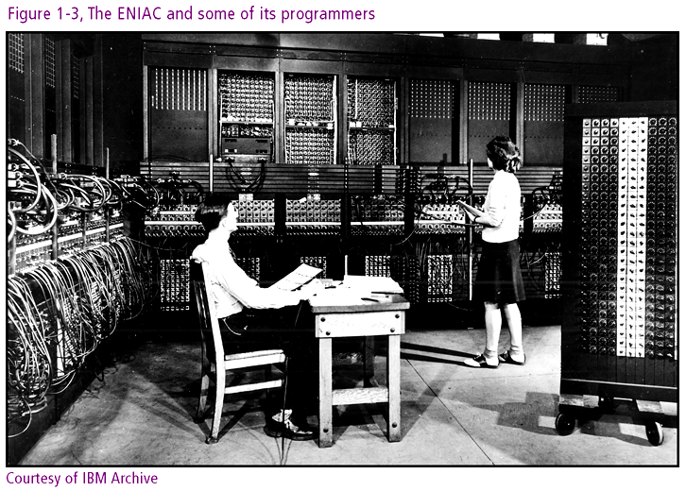
Connecting with Computer Science

Slide 16
ENIAC AND EDVAC (continued)
EDVAC (Electronic Discrete Variable Automatic Computer) created in 1944
  Recognized as the Von Neumann machine
  Superior model for descendant computers
  Operation governed by program in memory
  Programs could be modified
  Stored program concept: programs reusable
The British response: Colossus
  Colossus helps crack German U-boat Enigma code
  All machines destroyed by 1960s
Connecting with Computer Science

Slide 17
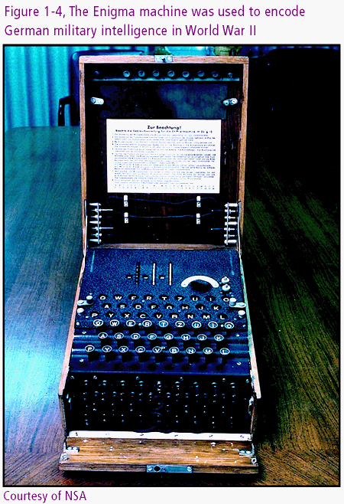
Connecting with Computer Science

Slide 18
The Computer Era Begins:
The First Generation
1950s: First Generation for hardware and software
  Vacuum tubes worked as memory for the machine
  Data written to magnetic drums and magnetic tapes
  Paper tape and data cards handled input
  The line printer made its appearance
Software separates from hardware and evolves
  Instructions written in binary or machine code
  Assembly language: first layer of abstraction
  Programmers split into system and application engineers
Connecting with Computer Science

Slide 19
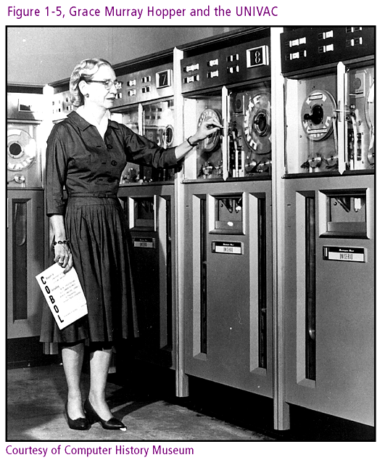
Connecting with Computer Science

Slide 20
UNIVAC
UNIVAC: first commercially viable computer
  UNIVersal Automatic Computer
  US Census Bureau is first customer
  Faces skepticism from Howard Aiken, Mark I builder
UNIVAC and the 1952 Presidential election
  Successfully predicts outcome during CBS broadcast
  Quickly adopted by all major news network
Connecting with Computer Science
Notes:
Viable: tồn tại, sống được
Cesus Bureau: Uỷ ban Dân số

Slide 21
IBM (Big Blue)
IBM dominates mainframe market by the 1960s
  Strong sales culture
  Controlled 70 percent of the market
IBM vision
  Sharp focus on a few products
  Leverage existing business relationships
  Introduce scalable (and hence flexible) systems
  Lease systems with 10 to 15 year life spans
Connecting with Computer Science
Notes:
Dominate: thống trị
Leverage: thúc đẩy
Scalable: co dãn
Lease: cho thuê

Slide 22
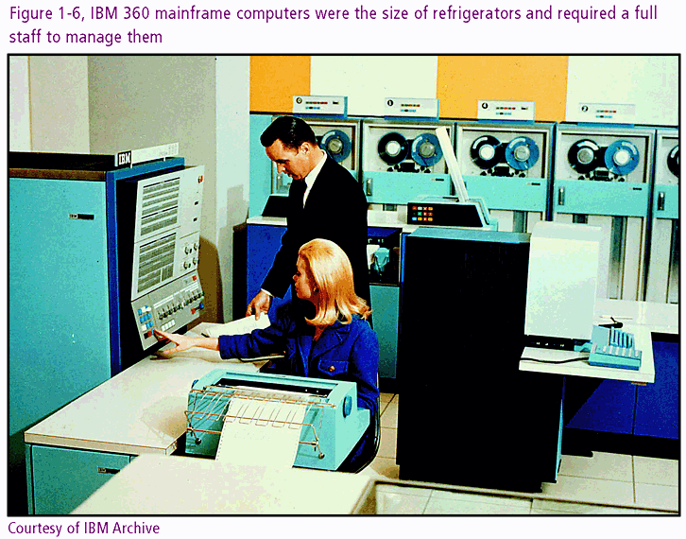
Connecting with Computer Science

Slide 23
Transistors in the
Second Generation
Software Innovations
  Assembly language limitations
  Appearance of high-level languages: FORTRAN, COBOL, LISP
Hardware Development
  Transistor replaces vacuum tube
  RAM becomes available with magnetic cores
  Magnetic disks support secondary storage
Connecting with Computer Science

Slide 24
Circuit Boards in the Third Generation
Integrated Circuits(IC) or Chips
  Miniaturized circuit components on board
  Semiconductor properties
  Reduce cost and size
  Improve reliability and speed
Operating Systems (OS)
  Program to manage jobs
  Utilize system resources
  Allow multiple users
Connecting with Computer Science

Slide 25
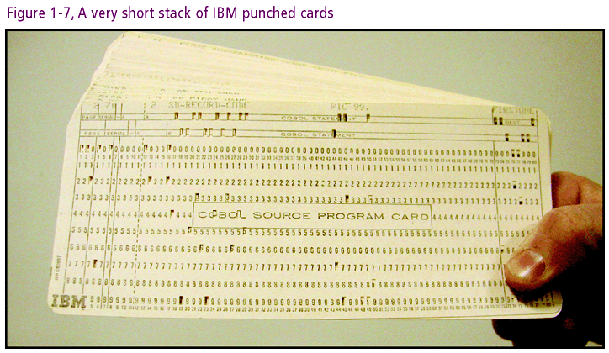
Connecting with Computer Science

Slide 26
Time-Sharing
Allocates system resources to multiple users
  Input with long paper rolls instead of punch cards
  Productivity gains offset by increased response time
General purpose machines broaden appeal
Programmers gear software toward end user
  Distinctions between application level and OS level
  Statistical and accounting programs hide implementation details
Connecting with Computer Science
Notes:
Appeal: sự kháng cáo, yêu cầu
Gear: hướng … đến …

Slide 27
Living in the ‘70s with the Fourth Generation
The era of miniaturization
  LSI chips contain up to 15,000 circuits
  VLSI contain 100,000 to 1 million circuits
Moore’s Law
  Circuit density doubles every 1.5 years
  Memory capacity and speed rise while costs drop
Minicomputer industry grows
Microcomputer makes appearance
Connecting with Computer Science

Slide 28
The Personal
Computer Revolution
Causes
  Hardware vision of engineers
  Iconoclastic software developers seeking challenges
  Electronic hobbyists realizing a dream
The role of will
  Components previously developed
  Social and economic support
Connecting with Computer Science
Notes:
Revolution: cuộc cách mạng, 1 vòng
Iconoclastic: thuộc sự đả phát các thánh tượng
Hobbyist: người có sở thích riêng

Slide 29
Intel
The Intel 4004 chip
  4004 transistors aboard
  Accrues greater functionality
  Precursor to central processing unit (CPU)
Gary Kildall writes OS for Intel microprocessor
Software and hardware become separate commodities
Connecting with Computer Science
Notes:
Accrue: đổ dồn về
Precursor: tiền thân
Commodity“: mặt hàng

Slide 30
The Altair 8800
Development spurred by Popular Electronics
Ed Roberts reports on the Altair 8800
  Kit based on Intel 8080
  Generates 4000 orders within three months
Altair 8800 features
  I/O similar to ENIAC’s
  Open architecture provides adaptability
  Portable
Connecting with Computer Science
Notes:
Spur (v): khuyến khích, thúc giục

Slide 31
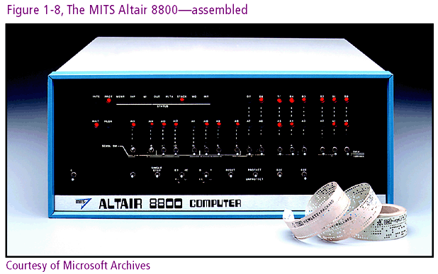
Connecting with Computer Science

Slide 32
Enter Bill Gates,
Paul Allen, and Microsoft
Gates and Allen develop a BASIC interpreter
  High level language for microcomputer programmers
Briefly associate with MITS
Form Micro-Soft company in 1975
Connecting with Computer Science

Slide 33
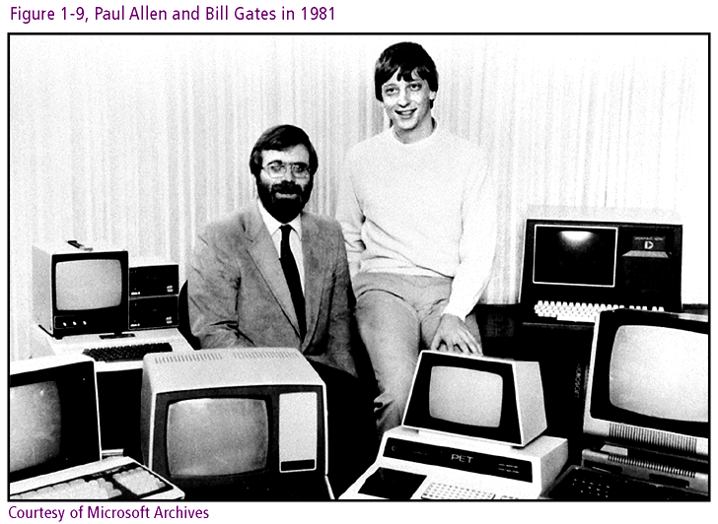
Connecting with Computer Science

Slide 34
The Microcomputer
Begins to Evolve
Microcomputer’s profitability lures more players
  Enter Radio Shack, IMSAI, Sphere and others
Altair’s bus becomes S100 industry standard
MITS stumbles (Micro Instrumentation and Telemetry Systems ,makers of the Altair 8800)
  Links prices of faulty hardware to BASIC
  Develops new model incompatible with 8080
1977
  MITS sold off
  Hardware companies introduce competing models
Connecting with Computer Science
Notes:
Profitability: lợi ích
Lure: quyến rũ
Stumble: sai lầm, lỗi lầm

Slide 35
An Apple a day…
1976: Steve Jobs and Steve Wozniak offer Apple I
1977: Apple II developed and released
  Based on Motorola 6502 processor
  Gains respect in industry as well as among hobbyists
  Promotes application development
VisiCalc spreadsheet program
  Drives Apple II sales
  Earns new title: killer app
  Draws attention of wider business community
Connecting with Computer Science

Slide 36
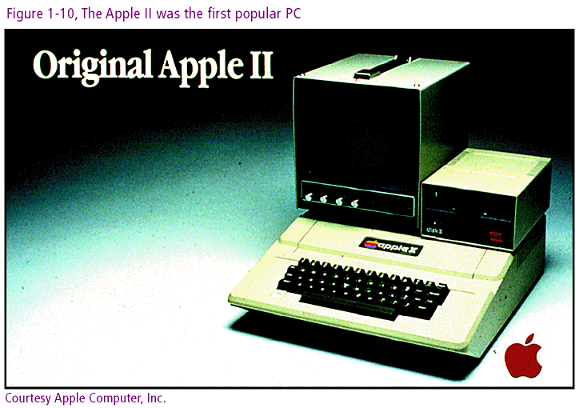
Connecting with Computer Science

Slide 37
IBM Offers the PC
IBMS builds a microcomputer with new ways
  Adopts the Intel 8088 off the shelf
  Uses a non-proprietary CPU
  Create approachable documentation
  Offer open architecture
New product name: personal computer (PC)
PC sold through retail outlets
Connecting with Computer Science
Notes:
Offer: cung cấp, tạo cơ hội, dâng hiến
Retail outlet: cửa hàng bán lẻ

Slide 38
MS-DOS
(Microsoft Disk Operating System)
IBM chooses Microsoft to develop OS
Microsoft introduces MS-DOS
  Based on Kildall’s 8 bit CP/M (Control Program/Monitor)
  Runs on 16 bit CPU (Intel 8088)
  Prevails over competition
IBM calls operating system PC-DOS
Connecting with Computer Science
Notes:
Prevail: thắng thế, phổ biến

Slide 39
The Apple Macintosh
Raises the Bar
Steve Jobs visits Xerox PARC
  Alto: graphics, menus, icons, windows, mouse
  Observes functioning Ethernet network
  Learns about hypertext
Jobs succeeds with Xerox ideas
  Picks up where Xerox, focused on copiers, leaves off
  Incorporates many Palo Alto components in Macintosh
1984: Macintosh unveiled
  Graphical user interface (GUI)
  Mouse: point-and-click and ease-of-use
Connecting with Computer Science
Notes:
Unveil: công bố

Slide 40
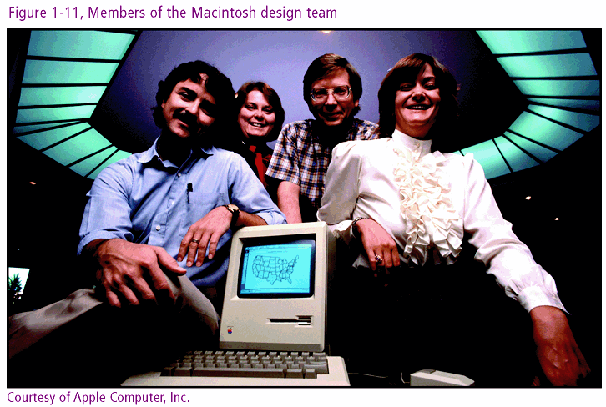
Connecting with Computer Science

Slide 41
Other PCs (and One Serious OS
Competitor) Begin to Emerge
Microsoft two-fold argument to IBM
  Adapt open architecture concept to OS
  Allow Microsoft freedom to license its OS
Microsoft answers Apple
  Windows 3.1 incorporates Mac’s GUI features
  Competing PC clones appear with Microsoft’s OS
Microsoft leverages position
  OS presence drive application software sales
  Sales synergies and licensing give 90 % of PC pie
Connecting with Computer Science
Notes:
Emerge: nổi lên
Leverage: lực đẩy
Synergy: hiệp lực, điều phối

Slide 42
The Latest Generation (Fifth)
Parallel computing
  Aka parallel architecture
  CPUs joined for simultaneous task execution
Three approaches
  SIMD (single instruction, multiple data) stream
  MIMD (multiple instruction, multiple data) stream
  Internetworking
Uses
  Control web pages, databases, networks
  Mathematical modeling and scientific research (Cray, a supercomputer company)
Connecting with Computer Science
Notes:
Aka: Also known as

Slide 43
The Internet
ARPA origins of new communication system presented by (1960s) U.S. Department of Defense
  Resource sharing, Common protocols , Fault tolerance
1969: ARPANET born ((Address Resolution Protocol Net)
  Consisted of (4) computers at (4) locations
  Different systems linked with Interface Message Processor (IMP)
ARPANET grows rapidly
  Protocols allow easy entry into network
  Electronic mail comprises 2/3 of network traffic
Connecting with Computer Science
Notes:
Fault tolerance- tính đề kháng lỗi

Slide 44
LANs and WANs and other ANs
The Internet as network of networks
  Wide Area Network (WAN)
  Local Area Network (LAN)
  Wireless Local Area Network (WLAN)
  Metropolitan Area Network (MAN)
  Urban Area Network (UAN)
Network technologies
  Ethernet
  Fiberoptics
  Wireless technologies
Connecting with Computer Science
Notes:
Metropolitan: thuộc thủ đô
Urban (adj): thuộc thành phố
Ethernet: phần cứng của mạng cục bộ
Fiberoptic (adj): về sợi quang học

Slide 45
Super Software and the Web
Object-oriented programming (OOP)
Computer Aided Software Engineering (CASE)
Origin of the World Wide Web (WWW)
  1990: Tim Berners-Lee develops hypertext
  Prototype browser created on NeXT computer
  Marc Andreesen and Mosaic
  Microsoft and Internet Explorer
Web components
  Web pages
  Browser
  Network technology
Connecting with Computer Science

Slide 46
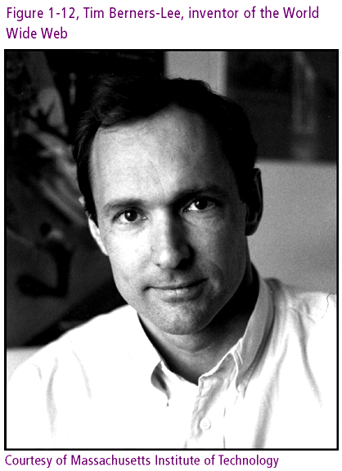
Connecting with Computer Science

Slide 47
The Microsoft Era and More
The “browser wars”
  Microsoft integrates IE browser into Windows
  Netscape opposes Microsoft: goes open source
The wars continue in court
  US government file antitrust suit against Microsoft
  By 2001 most of antitrust suit dropped or lessened
Linux OS threatens Windows
  Low cost, open source, reliability
Microsoft in perspective
  Accounts for 10 percent of world’s software
  Microsoft a small software player outside of PC
Connecting with Computer Science
Notes:
Oppose: chống đối
Antitrust: chống độc quyền
Threaten: đe doạ
Perspective: viễn cảnh

Slide 48
What About the Future?
Parallel Computing
  Massive amplification of computing power
  Can be hosted by local networks as well as Internet
Wireless networking
  Bluetooth
  Embedded or ubiquitous computing
Digitization of Economy
Privacy and security
Open source movement
Connecting with Computer Science
Notes:
Ubiquitous: tồn tại khắp nơi

Slide 49
One Last Thought
Development as a product of needs and wants
The mixture of forces driving innovation
  Commercial and physical requirements (IC)
  The need to solve a problem (Analytical Engine)
  The desire to create something new (Apple I)
  The goal of winning a war (World War II)
  The need to succeed (Bill Gates)
The evolutionary view
The purpose of historical study
  Avoid mistakes and emulate triumphs
Connecting with Computer Science
Notes:
Evolution: sự tiến hoá ( verb: evolve)
Emulate: cạnh tranh
Triumph: sự chiến thắng

Slide 50
Summary
The evolution of computers is tied to the evolution of mathematics and driven by the need to master time and space
From stone tablets to electronic machines, the computer’s chief purpose has been to manipulate mathematical and linguistic symbols
Many civilizations from the times of the ancients to the present have contributed to the development of computers and their science
Connecting with Computer Science

Slide 51
Summary (continued)
Mechanical calculators were invented in the 17th century by Pascal and Leibniz
The Jacquard Loom of 1801 introduced the punch card and the concept of a stored program
Charles Babbage designed a prototype of the modern computer: The Analytical Engine
Herman Hollerith incorporated punch cards in his mechanical tabulating machines
Connecting with Computer Science

Slide 52
Summary (continued)
World War II drove computer innovation in the mid-twentieth century: ENIAC, Mark I, Colossus
The EDVAC’s Von Neumann architecture has become a basic model for all later development
Progress from vacuum tubes to integrated circuits has exponentially increased the computer speed and simultaneously reduced the size and cost
The microcomputer and Internet, latter 20th century developments, have made computers ubiquitous
Connecting with Computer Science
Notes:
Ubiiquitous: co mặt khắp nơi

