Slide 1
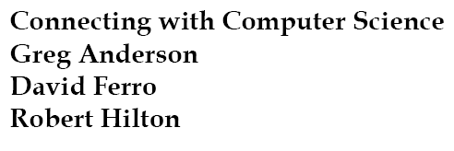


Slide 2
Objectives
Learn how computers are connected
Become familiar with different types of transmission media
Learn the differences between guided and unguided media
Learn how protocols enable networking
Connecting with Computer Science

Slide 3
Objectives (continued)
Learn about the ISO/OSI reference model
Understand the differences between network types
Learn about local area networks (LANs)
Learn about wide area networks (WANs)
Learn about wireless local area networks (WLANs)
Connecting with Computer Science

Slide 4
Objectives (continued)
Learn about network communication devices
Learn how WANs use switched networks to communicate
Learn how devices can share a communication medium
Learn about DSL, cable modems, and satellite communications
Connecting with Computer Science

Slide 5
Why You Need to Know About...
Networks
Networks connect computers and peripheral devices
  Effectively an extension of the system bus
  TCP/IP protocols at the core
Networks are central to all forms of computing
  E-commerce, research, communication
Computer scientists and networking
  Fundamental knowledge
Connecting with Computer Science

Slide 6
Connecting Computers
Linking computers via system bus impractical (không thực tế)
  PCI bus has 98 wires
  Remote connection virtually impossible
Connection problem solved with networks
  Medium, such as wire, carries electric signal
  Communications protocol (TCP/IP) manages process
Connecting with Computer Science

Slide 7
Transmission Medium
Transmission medium: material that conducts electrical and/or electromagnetic signals
Transmission media rated in four different ways:
  Bandwidth: medium speed measured in bits/second
  Signal-to-noise ratio: = 10 log₁₀ (signal/noise)
  Bit error rate: percentage of incorrect bits to total number of bits in unit time
  Attenuation (sự giảm tín hiệu): signal weakening over distance because of medium’s impedance.
Connecting with Computer Science

Slide 8
Transmission Medium (continued)
Two general transmission medium types
  Guided: physical media such as copper wire
  Unguided: air and space that carry electromagnetic signals
Connecting with Computer Science

Slide 9
Guided Media
Two broad categories
  Copper wire
    Shielded and unshielded twisted pair
    Coaxial cable (coax)
  Fiber-optic cable
    Uses glass and light to transmit signals
Connecting with Computer Science

Slide 10
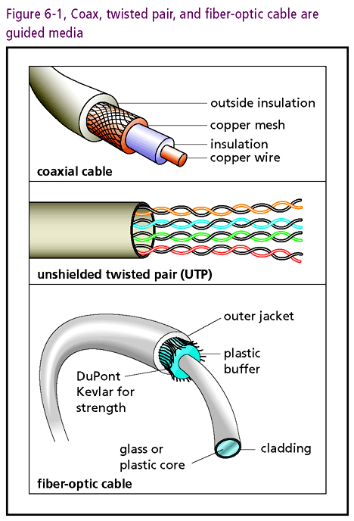
Connecting with Computer Science
Notes:
Cladding: lớp sơn phủ

Slide 11
Guided Media (continued)
Copper Wire: Coax and Twisted Pair
  Coaxial cable (coax)
    Copper surrounded by metal shield to reduce noise
    Support bandwidths up to 600 MHz
    Examples: 10Base2 and 10Base5
  Twisted Pair (TP)
    Dampens effects of inductance
    Two types: shielded and unshielded (UTP)
    UTP more popular than shielded twisted pair or coax
Connecting with Computer Science
Notes:
Dampen: làm ẩm ướt, sự ẩm ướt
Inductance: độ tự cảm

Slide 12
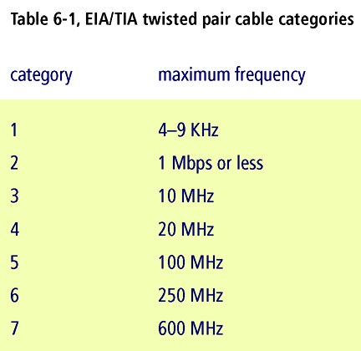
Connecting with Computer Science

Slide 13
Guided Media (continued)
Impedance: attenuates (suy giảm) signals in copper wires
Fiber-optic cables
  Glass fibers guide light pulses
  Less susceptible to attenuation than copper wires
  Principle of inductance does not apply
  Bandwidth hundreds of times faster than copper wire
  Economies of scale are lowering manufacturing cost
Connecting with Computer Science
Notes:
Susceptible : dễ bị ảnh hưởng
Inductance: độ tự cảm

Slide 14
Unguided Media:
Wireless Technologies
Benefits of wireless technology
  Eliminate cabling costs
  Device mobility or portability
Basis of wireless technology: radio waves
  Radios, cell phones, walkie-talkies (máy bộ đàm), garage door openers, and microwave ovens share same basis
Connecting with Computer Science

Slide 15
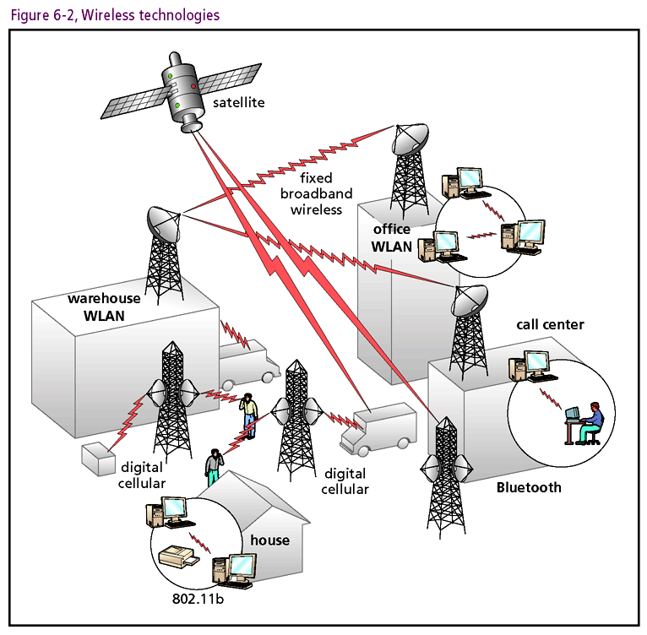
Connecting with Computer Science

Slide 16
Unguided Media: Wireless Technologies (continued)
Radio wave manipulation
  Electronic signal amplified
  Signal then transmitted as electromagnetic wave
  Receiving antenna converts back to electronic signal
  Transmission occurs at many different frequencies
Industry standards (based on 2.4 GHz range)
  IEEE 80211 series: most common
  Bluetooth: short range: 3" to 328 ' (mice, keyboards, printers, other I/O devices)
Connecting with Computer Science

Slide 17
Unguided Media: Wireless Technologies (continued)
Light transmission
  Infrared light (tia hồng ngoại) also used over short distances
  Capable of speeds up to 4 Mbps
  Requires clear line of sight between sender/receiver
  Used in mice, keyboards, PDAs, cell phones, notebook computers, other portable devices
Connecting with Computer Science

Slide 18
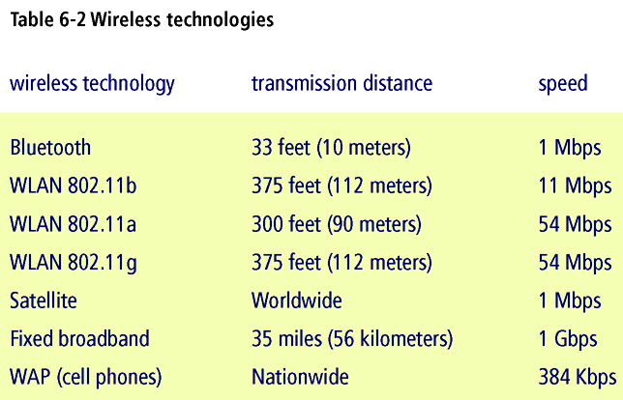
Connecting with Computer Science

Slide 19
Protocols
Protocols: set of rules facilitating communication
  Example: classroom questioning
  Timing diagrams organize interchange
Many machine protocols
  Provide for orderly flow of information transfer
  Example: TCP (Transmission Control Protocol)
    Responsible for faithful message reproduction
    Error checking and retransmission performed
Connecting with Computer Science
Notes:
Facilitate: làm thuận lợi

Slide 20
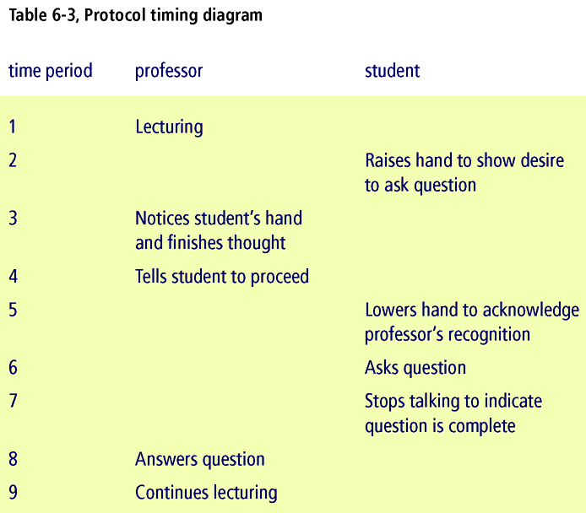
Connecting with Computer Science

Slide 21
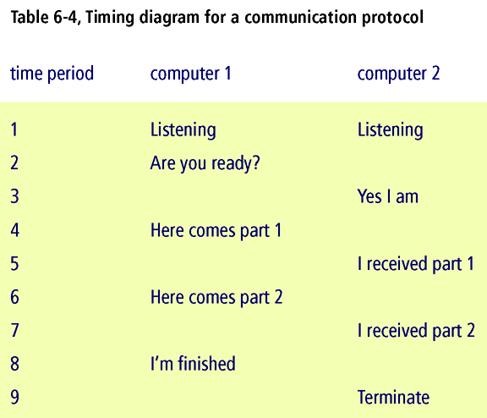
Connecting with Computer Science

Slide 22
ISO/OSI Reference Model
Conceptual model with seven discrete layers
  Physical: defines specifications for physical link
  Data Link: provides for data transit, physical addressing and notification, ordered frames delivery, and flow control
  Network: provides connectivity and path selection. Also responsible for assigning addresses to messages
Connecting with Computer Science

Slide 23
ISO/OSI Reference Model (continued)
  Transport: guarantees delivery of datagrams. Also responsible for fault detection, error recovery, and flow control
  Session: establishes, maintains, terminates sessions
  Presentation: has format responsibilities such as translation, formatting, and syntax selection
  Application: provides network access
Connecting with Computer Science

Slide 24
ISO/OSI Reference Model (continued)
Layers defined by two components
  Protocol Data Unit (PDU)
  Header: layer and message information
Message transfer
  Originates in application
  Enhanced by each layer as passed up stack Physical layer places on transmission medium
  Receiving node dismantles in reverse mode
Modularity: simplifies redesign and modification
Connecting with Computer Science
Notes:
Dismantle: gỡ bỏ

Slide 25
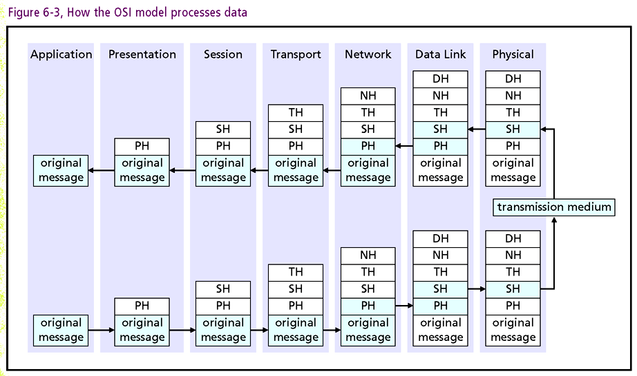
H: header, Presentation, Session, Transport, Network, Datalink, Physical
Connecting with Computer Science

Slide 26
Network Types
Classify according to size and proximity (gần nhau về mặt không gian)
LAN (local area network)
  Small number of computers in close proximity
  Usually confined (hạn chế) to building or complex
  Typically connected with copper wiring
  WLAN (wireless local area network)
WAN (wide area network)
  Connect LANs and WLANs (wider geography)
Connecting with Computer Science

Slide 27
Network Types (continued)
MAN (metropolitan area network)
  Spans city or metropolitan area
Distinctions between types
  Not hard and fast
  Internet sometimes classified as WAN
Connecting with Computer Science

Slide 28
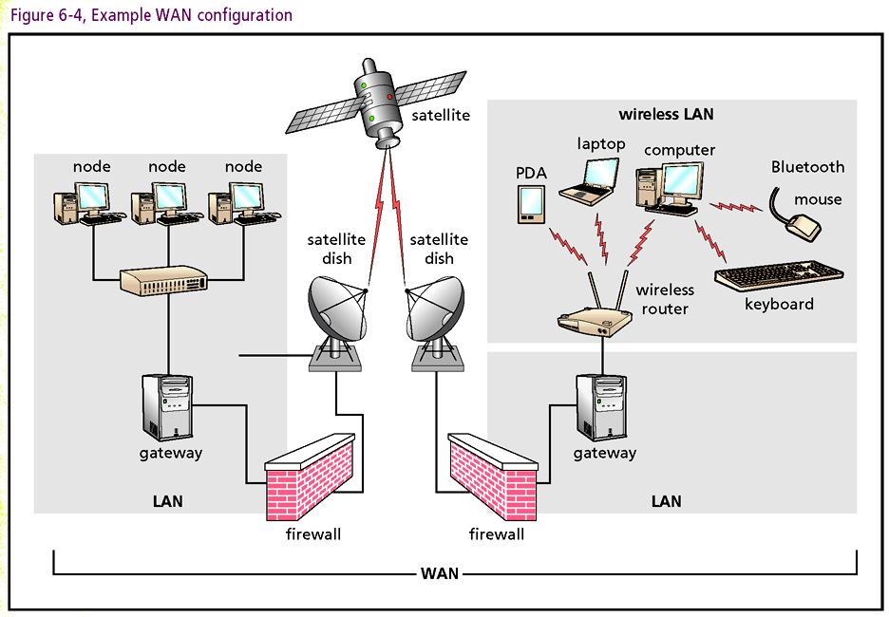
Connecting with Computer Science

Slide 29
LAN Topologies
Network configurations often called network topologies
Node: Computer attached to network
  Each node has a unique network address
Three basic LAN topologies
  Ring: connects computers in a loop with cable
  Star: computers connected to hub (central point)
  Bus: configured like a system bus on a computer (most popular)
Connecting with Computer Science
Notes:
Topology: một ngành hình học

Slide 30
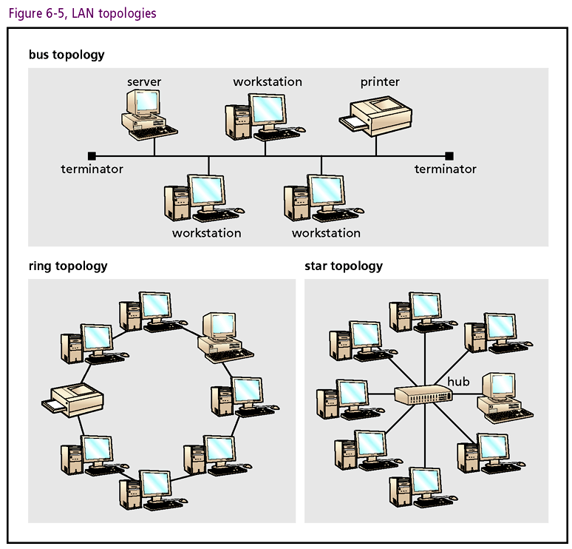
Connecting with Computer Science

Slide 31
LAN Communication Technologies
Ethernet
  Widely used technology that has become industry standard
  Based on a bus topology
  Can be wired in a star pattern (star/bus) topology
  Original Ethernet transferred data at 10 Mbps
  Fast Ethernet, transfers data at 100 Mbps
  Gigabit Ethernet transfers data from 1 to 10 Gbps
Connecting with Computer Science

Slide 32
LAN Communication Technologies (continued)
Token ring
  Second most popular LAN technology
  Uses a ring topology
  Controls access to the network by passing token
  Capable of data transfer of 4 or 16 Mbps
FDDI (Fiber Distributed Data Interface) and ATM (Asynchronous Transfer Mode): fastest and most expensive LAN technologies
Connecting with Computer Science

Slide 33
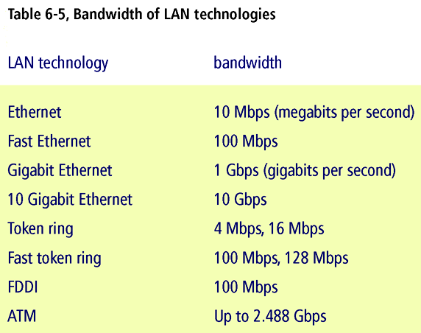
Connecting with Computer Science

Slide 34
Network Communication Devices
LANs and WLANs are joined to form WANs
WANs are joined to form more complex WANs
Present devices used to created connectivity
  Network interface cards, repeaters, hubs, switches, bridges, gateways, routers, and firewalls
Connecting with Computer Science

Slide 35
NIC (network interface card)
NIC
  Physical link between computer and network
  Located in expansion slot on mother board or card slot in notebook
  Includes external port
  Each NIC has 48-bit address (physical or MAC address -Media Access Control)
Connecting with Computer Science

Slide 36
Repeater
Repeater
  Solves attenuation problem
  Amplifies signal along cable between nodes
  Does not change signal
Connecting with Computer Science

Slide 37
Hub
Hub
  Special repeater with multiple input and output ports
  Allows multiple nodes to share same repeater
Connecting with Computer Science

Slide 38
Switch
Switch
  Similar to a hub
  Unlike hub, inputs and outputs not connected
  Assumes Data Link duties (OSI Layer 2)
  Examines header, makes point-to-point connection to output addressed by packet
Connecting with Computer Science

Slide 39
Bridge
Bridge
  A switch with intelligence
  Divides networks into segments to reduce global traffic
Connecting with Computer Science

Slide 40
Gateway
Gateway
  Similar to a bridge
  Can interpret and translate different network protocols
  Can connect networks of different types
Connecting with Computer Science

Slide 41
Router
Router
  Like bridges and gateways
  Function at higher OSI layer 3
  Route traffic based on IP address assigned at Network Layer
Connecting with Computer Science

Slide 42
Firewall
Firewall
  Protect internal network or node
  May be router based
  Examines/restricts inbound and outbound traffic
  May be implemented in hardware or software
Connecting with Computer Science

Slide 43
Switched Networks
Telephone network adapted to carry digital data
Modems (modulator/demodulator): modify analog signals to represent binary data
Small bandwidth designed for range 300 to 3300 Hz
  Frequency modulation (FM –điều tần), amplitude modulation (AM –điều biên), phase modulation (PM-điều pha) boost (nâng) speed to 3Kbps
  Combine compression techniques and rearranged transitions to reach 56Kbps limit
Connecting with Computer Science

Slide 44
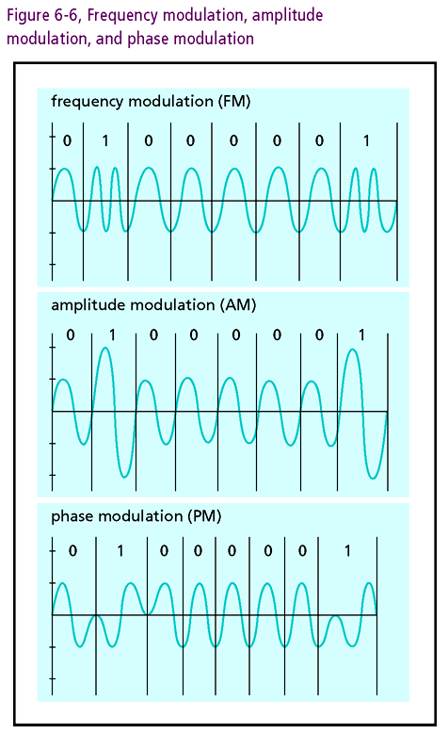
Connecting with Computer Science

Slide 45
High-Speed Wide Area Networks
Demand for higher access speeds
  Extend system bus
Copper capable of speeds up to 1.5 Mbps
  Need to lease wire bandwidth (24 channels)
  Very expensive
  Dedicated line called T1(1544 MBPS)
  T3 line consists of 28 T1 lines
Fiber-optic cables: OC lines faster than T3
Connecting with Computer Science

Slide 46
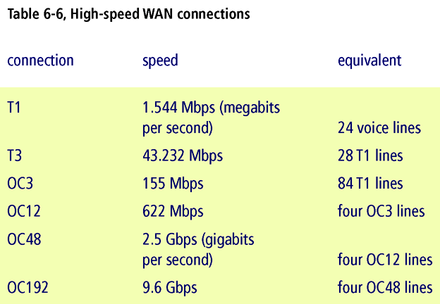
Connecting with Computer Science

Slide 47
Multiple Access
FDM (frequency division multiplexing)
  Divide bandwidth among subscribers
  Channel sustained for duration of session
  Wasteful use of resources
TDM (time division multiplexing)
  Divide bandwidth based on time
  Achieve effect speeds greater than FDM
Connecting with Computer Science
Notes:
Multiplexing: Đa hợp, kỹ thuật truyền thông phân chia khoảng tần số cho mỗi channel hoặc mỗi channel chiếm 1 time slot

Slide 48
DSL
DSL (Digital Subscriber Line)
  Combines FDM and TDM
  Divide bandwidth into 247 channels
  Allocate 4 KHz for voice, remainder for data
  Speeds range from 256 Kbps to 1.5 Mbps
  Download speeds differ from upload speeds
  Subscriber located less than 18,000 feet from station
Connecting with Computer Science

Slide 49
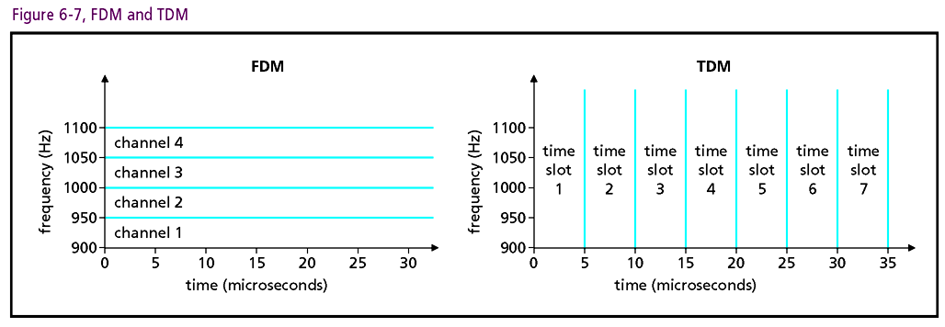
Connecting with Computer Science

Slide 50
Cable Modems
CATV Coax cable carries hundreds of channels
Channels allocated 6 MHz bandwidth
Transmit speeds up to 42 MHz
Connect Ethernet cable to modem
Use TDM technology to vary upload and download speeds
Connecting with Computer Science

Slide 51
Satellites
Satellites
  Long distance wireless technology
  Provide high speed access to users in remote locale
  Dish used to receive television signals adapted for data transmission
  Becoming an affordable alternative
Connecting with Computer Science

Slide 52
One Last Thought
Networks are integral to computers and computing
Computer scientists extensively interact with networks
Chapter 6 concepts are foundational
Connecting with Computer Science

Slide 53
Summary
Networks link computers around the world
Networks are extensions of system bus
Transmission media, set of protocols, and network devices create connectivity
Metrics for rating media: bandwidth, signal-to-noise ratio, bit error rate, and attenuation
Transmission media may be guided or unguided
Connecting with Computer Science

Slide 54
Summary (continued)
Guided media: copper wire (coax and twisted pair) and fiber-optic cables
Unguided media: air or space (wireless)
Protocols: set of rules for communication
Standards: TCP/IP and seven layered OSI model
Network Types: LANs, WLANs, WANs, MANs
Connecting with Computer Science

Slide 55
Summary (continued)
LAN topologies: ring, star, bus
LAN technologies: Ethernet, token ring, FDDI, ATM
Network devices: NIC, repeater, hub, switch, bridge, gateway, router, firewall
Switched Networks: convert analog to digital using FM, AM, PM, compression, rearranged transitions
Connecting with Computer Science

Slide 56
Summary (continued)
DSL: combines FDM and TDM to boost copper wire signals to 1.5 Mbps
Cable Modems: coax cables transmit at 1.5 to 42 Mbps
Satellite technologies: long distance wireless
Connecting with Computer Science

