Slide 1
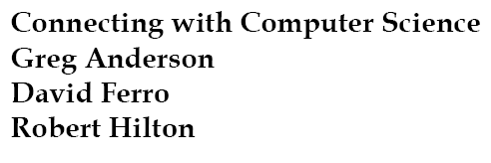


Slide 2
Objectives
Learn what the Internet really is
Become familiar with the architecture of the Internet
Become familiar with Internet-related protocols
Understand how the TCP/IP protocols relate to the Internet
Learn how IP addresses identify devices connected to the Internet
Connecting with Computer Science

Slide 3
Objectives (continued)
Learn how DHCP (Dynamic Host Configuration Protocol) can be used to assign IP addresses
Learn how routers are used throughout the Internet
Learn how a DNS (Domain Name System) server translates a URL into an IP address
Learn how port numbers are used with IP addresses to expand Internet capabilities
Learn how NAT (Network Address Translation) is used in networking
Connecting with Computer Science

Slide 4
Objectives (continued)
Learn how to determine your own TCP/IP configuration
Learn how HTML and XML are used with the World Wide Web
Learn how to develop a simple Web page using HTML
Learn how search engines make the World Wide Web more usable
Connecting with Computer Science

Slide 5
Why You Need to Know About…The Internet
Internet as revolutionary information technology
Impacts most spheres of human thought and action
  E-commerce, information exchange, embedded devices
Intersection with computer science
  Networks
  Protocols
  Server and client programs
Connecting with Computer Science

Slide 6
What is the Internet?
The Internet: global collection of LANs and WANs
Internet service provider (ISP) connects desktop to the Net
No single entity owns the Internet
  Some groups propose rules
  Other groups provide maintenance
Sum of Net activities serves the larger social good
Connecting with Computer Science

Slide 7
The Architecture of the Internet
Anatomy of a connection
  Desktop linked via modem/transceiver to LAN of ISP
  ISP switching center: called a point-of-presence (POP)
  POP connected to larger ISP with larger POP
  Larger ISP connects to national or international ISPs, called national backbone providers (NBPs)
Network equipment and protocols critical to process
Connecting with Computer Science

Slide 8
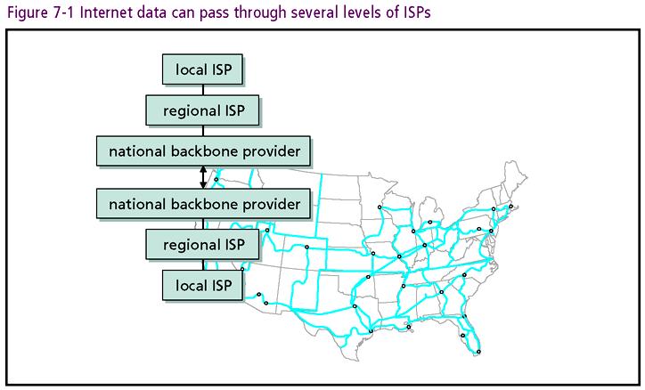
Connecting with Computer Science

Slide 9
Protocols
Protocol: set of rules that facilitate communication
Many protocols involved with the Internet
  HTTP (Hypertext Transfer Protocol)
  SMTP (Simple Mail Transfer Protocol)
  FTP (File Transfer Protocol)
Protocols especially vital for networking
Connecting with Computer Science

Slide 10
TCP and IP
TCP (Transmission Control Protocol)
  Responsible for the reliable delivery of data
  Separates data into manageable, fixed-size packets
  Establishes virtual circuit for transmission
  Manages packet sequencing
  Re-transmits packets received in error
  Header appended to data segment contains relevant information
Connecting with Computer Science

Slide 11
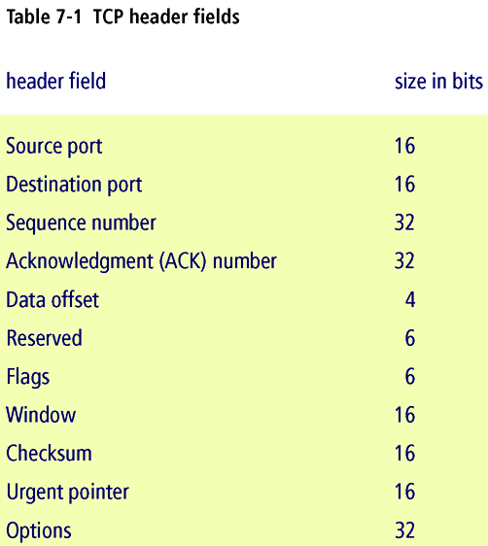
Connecting with Computer Science

Slide 12
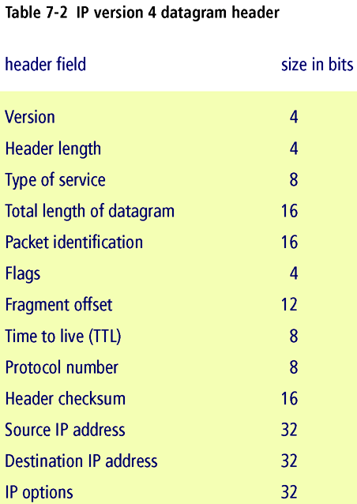
Connecting with Computer Science

Slide 13
TCP and IP (continued)
IP layer adds address header to TCP packets
  Most widespread version (IPv4) has 32 bit value
  New version of IP (IPv6) has 128-bit addresses
IPv4 address hierarchy
  First part identifies network class (A, B, C, D, E)
  Middle part identifies the host on the network
  Final part identifies the node connected to the host
Connecting with Computer Science

Slide 14
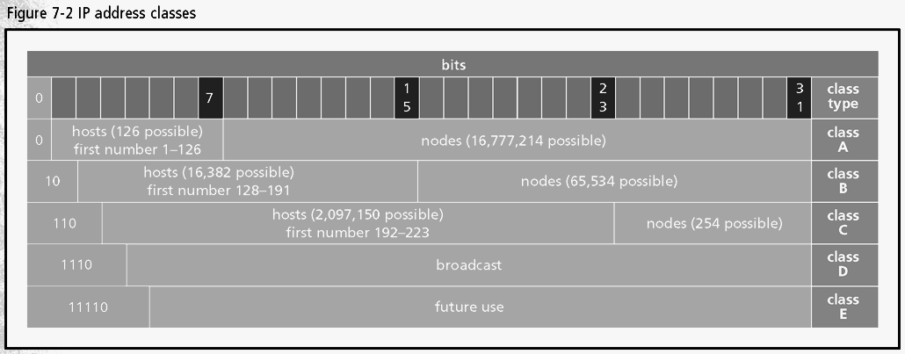
Connecting with Computer Science

Slide 15
TCP and IP (continued)
Class indicates entity size and IP address allocation
IANA (Internet Assigned Numbers Authority)
  maintains global high-level registry of IP addresses
ARIN (American Registry for Internet Numbers)
  Agency allocates IP addresses to NBPs and ISPs
ISPs allocate addresses to other ISPs and home users
IP supports subnet
Connecting with Computer Science

Slide 16
DHCP
DHCP: Dynamic Host Configuration Protocol
  Allows for automatic assignment of IP addresses
  Computer uses DHCP to get IP address from router
Flexibility for Database Administrator
  Sets up server to allocate block of addresses
  One time cost to configure computer for DHCP
Connecting with Computer Science

Slide 17
Routers
Router
  Computer linked to different communication lines
  Routes packets on to line closer to destination
  Joins networks together, including the Internet
  Monitors communication lines for congestion
  May send message packets along different paths
Routers work in a manner similar to post office
Connecting with Computer Science

Slide 18
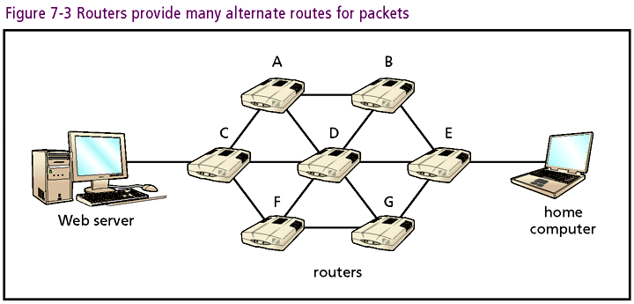
Connecting with Computer Science

Slide 19
High-Level Protocols
Suite of protocols can be compared to OSI layers
  TCP/IP spans Session, Transport, Network layers
  SMTP, HTTP, FTP “above” TCP/IP in OSI model
High-level protocols use TCP/IP to accomplish tasks
  TCP splits messages into packets, if necessary
  TCP layer adds header, forwards to IP for address
  IP sends packets to Data Link and Physical layers
Connecting with Computer Science

Slide 20
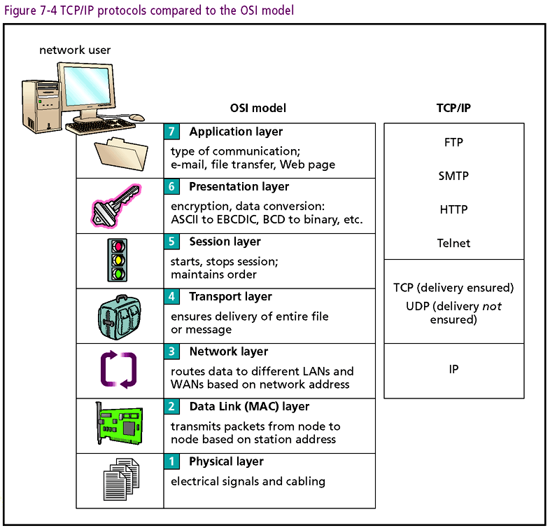
Connecting with Computer Science

Slide 21
SMTP
SMTP: Simple Mail Transport Protocol (SMTP)
  Used to send e-mail messages over the Internet
  Establishes link from e-mail client to e-mail server
  Handshaking creates parameters of communication
Receipt of e-mail handled by another protocol
  POP3 (Post Office Protocol version 3)
  IMAP (Internet Message Access Protocol)
Connecting with Computer Science

Slide 22
FTP
FTP: File Transfer Protocol
  Provides efficient transmission of data files
  Requires client and server programs (like SMTP)
  Most OSs include command-line FTP client
    Windows: type FTP at the command prompt or
    Specify server address in the IE address bar
Connecting with Computer Science

Slide 23
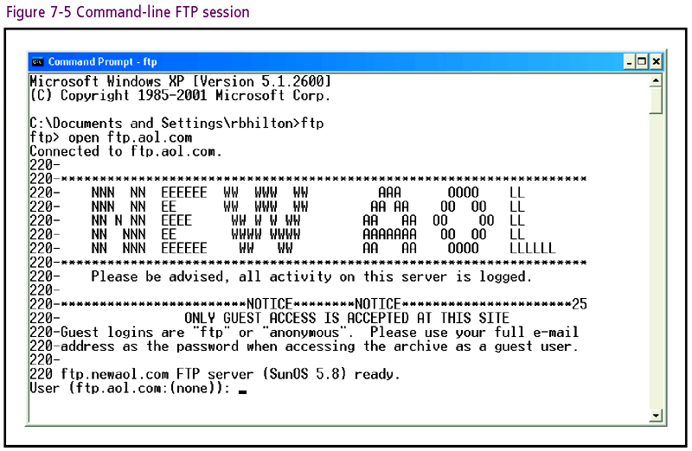
Connecting with Computer Science

Slide 24
Telnet
Telnet: Internet standard protocol for remote login to a UNIX host
  Telnet runs on top of TCP/IP
  Allows client computer remote control over host
  Most OSs include a command-line Telnet client
Connecting with Computer Science

Slide 25
HTTP
HTTP: Hypertext Transfer Protocol (HTTP)
  Developed in 1990 by Tim Berners-Lee
  Allows Web browsers and Web servers to communicate
  Central to the idea of the World Wide Web
  Example, http://www.course.com
    “http” tells browser you are retrieving Web page with Hypertext Transfer Protocol
Connecting with Computer Science

Slide 26
URLs and DNS
Development of the Domain Name System (DNS)
  Layers natural language name over IP address
  Provides user friendly interface with Internet
Uniform Resource Locator (URL)
  Consists of the domain name followed by specific folder and/or filenames
  DNS server resolves domain names from URLs into IP addresses
Connecting with Computer Science

Slide 27
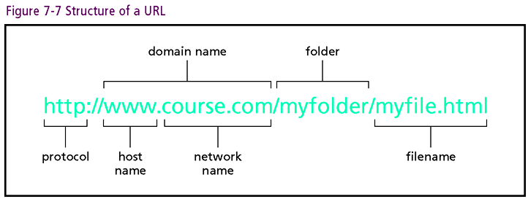
Connecting with Computer Science

Slide 28
URLS and DNS (continued)
DNS server: computer maintained by ISP
  Performs lookup on URL (Uniform Resource Locator)
  Responsible for a portion of the world’s domains
  Communicates with other DNS servers
Domain levels
  Top level domains (TLDs): .com, .edu, .gov, .net, .org
  Server at each level has knowledge of lower-level
  Example: faculty.weber.edu
Connecting with Computer Science

Slide 29
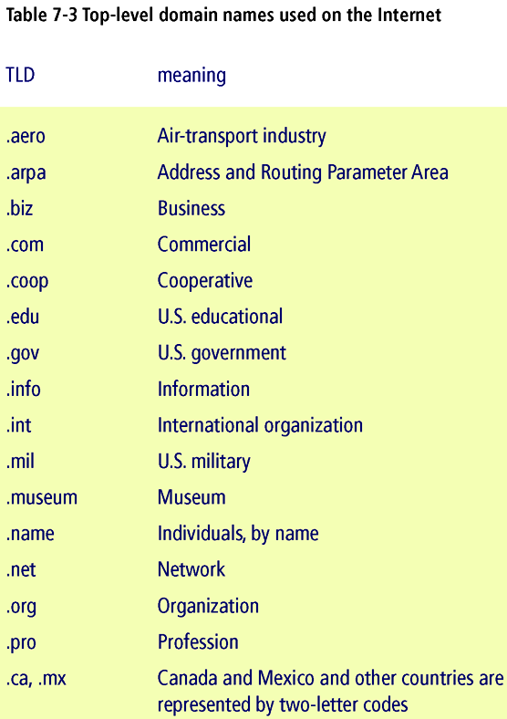
Connecting with Computer Science

Slide 30
Port Numbers
Port number: address specification below IP layer
Port functions like apartment number in address
Most protocols have a standard port number
  A possible 65,536 port numbers for each IP address
  Specify port by appending number to domain or IP address
  Example, http://192.168.2.33:8080
    192.168.2.33 specifies the IP address
    8080 specifies port number
Connecting with Computer Science

Slide 31
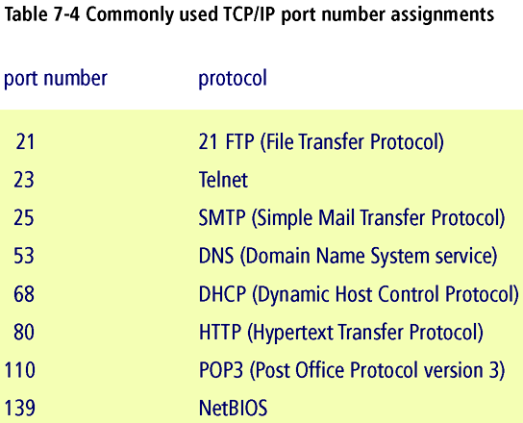
Connecting with Computer Science

Slide 32
NAT
NAT (Network Address Translation) protocol
  Multiple computers share one Internet connection
  Dependent on DHCP and port numbers
NAT structure
  Internal range: 192.168.0.0 to 192.168.255.255
  Only IP address presented to the Internet: 192.168
  Internal nodes use port number with IP address
  TCP routes messages to node with matching port
Connecting with Computer Science

Slide 33
Checking Your Configuration
Type IPCONFIG command at in console window
Screen reflects
  Current IP address
  Subnet mask
  Address of your gateway to the Internet
More information: use IPCONFIG /ALL command
Connecting with Computer Science

Slide 34
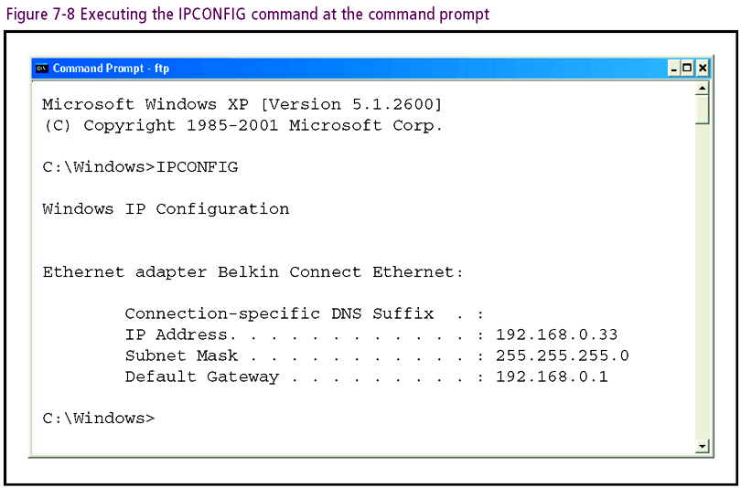
Connecting with Computer Science

Slide 35
HTML
Web page
  Largest class: text files
  Contains text information and HTML (Hypertext Markup Language) tags
HTML tags
  Formatting commands
  Browser uses tags to display graphical content
  Knowledge needed to use Web page design tools
Connecting with Computer Science

Slide 36
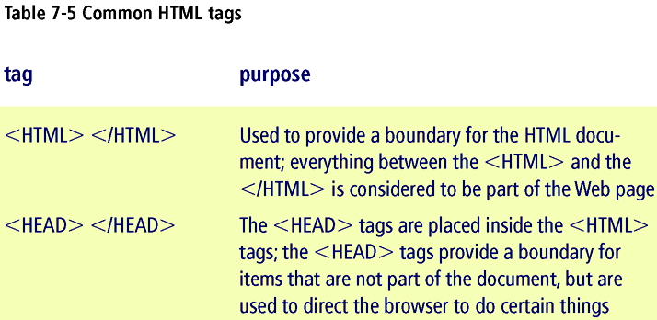
Connecting with Computer Science

Slide 37
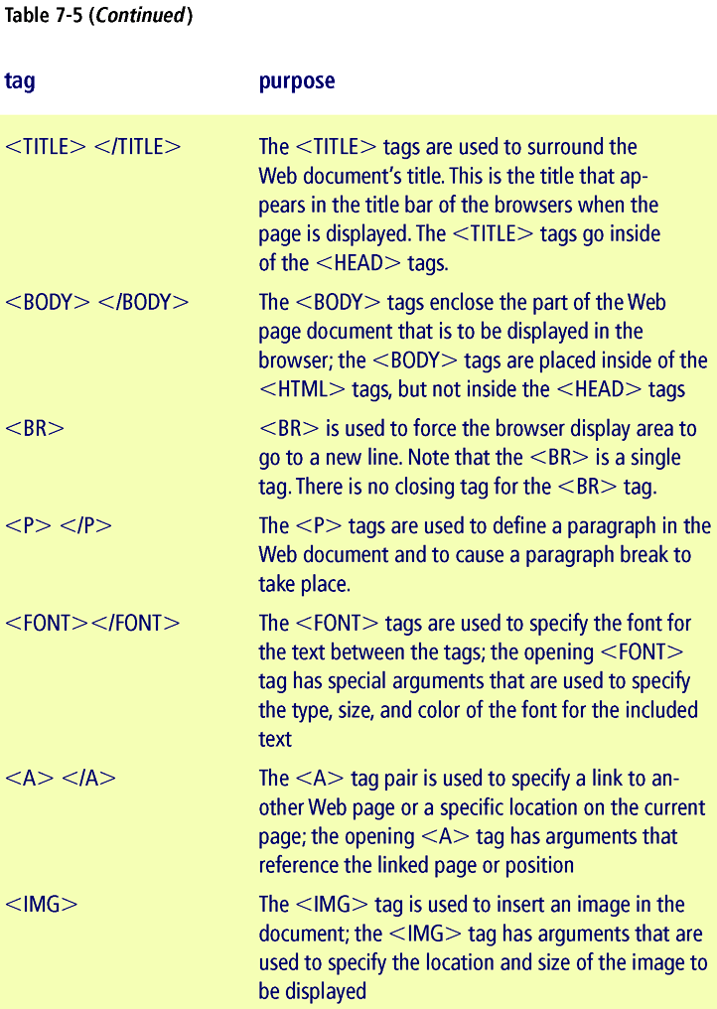
Connecting with Computer Science

Slide 38
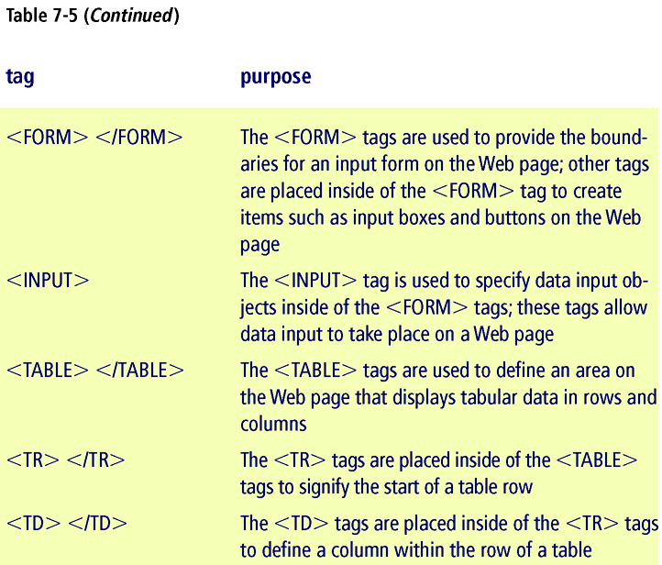
Connecting with Computer Science

Slide 39
Creating a Simple Web Page
Open Notepad window
  Type in the HTML document shown in Figure 7-9
  Save file to disk with .htm or .html extension
  Use Windows Explorer to locate file
  Browser displays document formatted in HTML code
HTML is free form and not case sensitive
Hyperlinks: connection to another page
Connecting with Computer Science

Slide 40
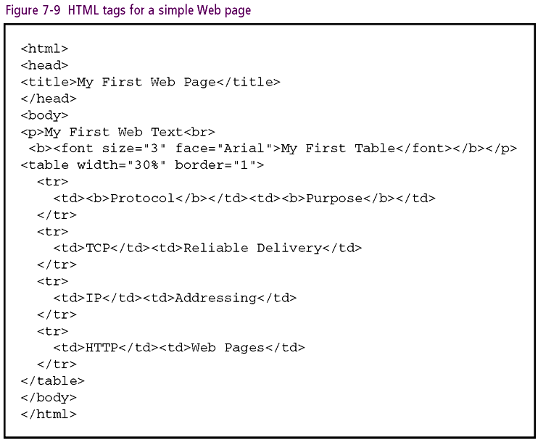
Connecting with Computer Science

Slide 41
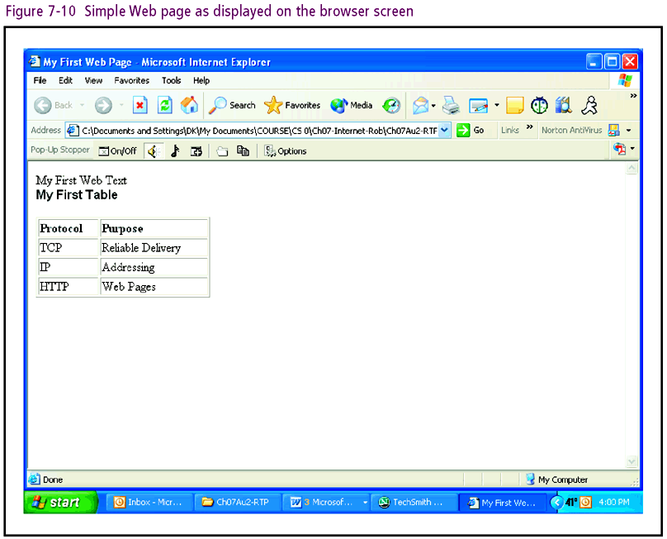
Connecting with Computer Science

Slide 42
Creating a Simple Web Page (continued)
Web Server Programs: provide dynamic Web pages
  DHTML (Dynamic Hypertext Markup Language)
  HTML/DHTML and scripting code
Completely dynamic Web pages
  CGI, ASP, JSP, PHP, and Python
Web services: program contains data used by other programs or Web pages
Connecting with Computer Science

Slide 43
XML
SGML: specification source for HTML and XML
HTML limitation: does not affect Web page content
XML (Extensible Markup Language)
  Similar to HTML in structure
  Also provides data and metadata (information about data)
  Can be used to display Web pages
  Most important use: transfer data
Connecting with Computer Science

Slide 44
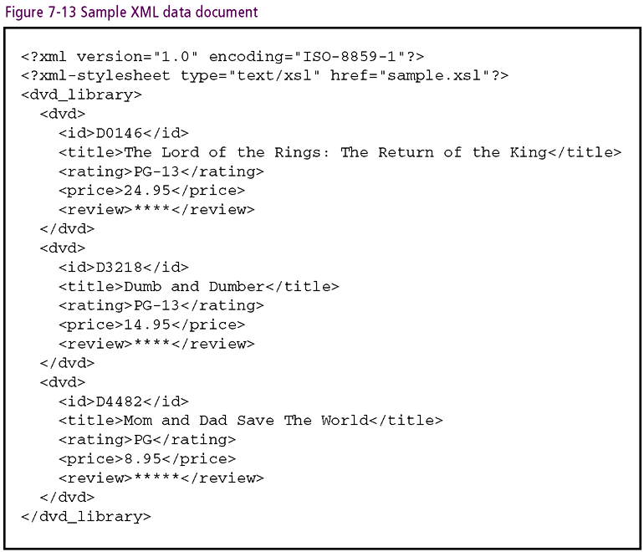
Connecting with Computer Science

Slide 45
Using the Internet
Internet as tremendous resource
Invest time to develop searching skills
  Professional, home, student life
Search engines
  Replace newsgroups as primary search vehicle
Connecting with Computer Science

Slide 46
Search Engines
Most common search method: “crawling”
  Uses program called a bot (for robot) or a spider
  Bot starts with a few pages submitted for indexing
  Indexed pages scanned for links to other Web pages
  Process continues for every retrieved page
  Index to page made from relevant words and keywords of <META> tag
Computer scientists design and maintain search engines
Connecting with Computer Science
Notes:
Crawl: bò trườn
Robot: tự động
Spider: con nhện

Slide 47
One Last Thought
The Internet has grown into global forum
  Information gathering and communication
  Entertainment and E-commerce
Some issues
  Anonymity and reliability of information
  Identity theft and virus replication
Computer scientist and Internet co-evolve
Connecting with Computer Science

Slide 48
Summary
Internet is a collection of LANs and WANs
No single entity controls the Internet
Hierarchy of ISPs and NBPs (Naming Binding Protocol) manage connections
Protocols are critical in Internet Operation
TCP/IP lies at heart of protocol suite
TCP manages data delivery
Connecting with Computer Science

Slide 49
Summary (continued)
IP provides for addressing
Every node in the Internet has a unique address
DHCP automatically assigns addresses
Routers: key hardware component of Internet
High-level protocols: HTTP, FTP, SMTP, POP3, and IMAP
Uniform resource locator (URL): specifies address
Connecting with Computer Science

Slide 50
Summary (continued)
DNS server: resolves domain name to IP number
Hypertext markup Language (HTML): language of World Wide Web
Web page: content formatted with HTML tags
Scripting Languages: generate dynamic pages
Hyperlink: connection to another Web page
Search engines: generate database of searchable Web sites
Connecting with Computer Science

