Slide 1
Chapter 6
Message Formats

Slide 2
Message Formats
Formatting letters
Formatting memos

Slide 3
Letters
Used for external communication
Used for formal internal messages to employees

Slide 4
Standard Parts of a Letter
Heading
Inside address
Salutation
Body
Complimentary close
Signature block
Reference initials

Slide 5
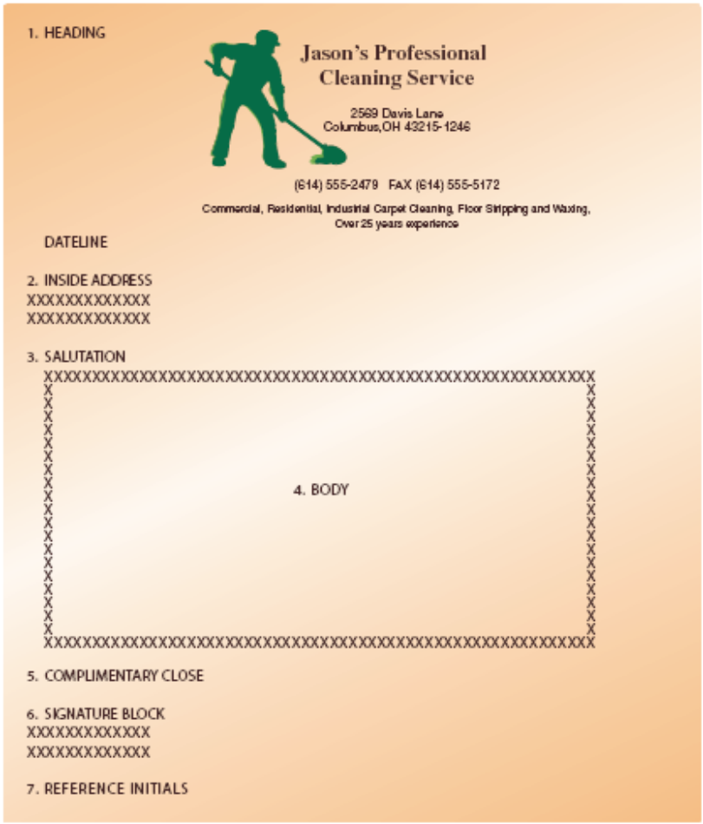
Standard Parts of a Letter

Slide 6
Heading
Letterhead or keyed return address
Date with the month spelled out

Slide 7
Inside Address
Receiver’s name and title
Company name
Street address
City, State and ZIP code

Slide 8
Salutation
Begins a double space after the inside address
Dear ________:
Should match the first line of the the inside address

Slide 9
Body
Begins a double space below the salutation
Single spaced within paragraphs and double spaced between paragraphs

Slide 10
Complimentary Close
Sincerely,
Sincerely yours,
Respectfully,
Placed a double space below the last line of the body.

Slide 11
Signature Block
Writer’s signed name
Writer’s keyed name
Writer’s Title

Slide 12
Reference Initials
Show who keyed the letter
May also show who wrote the letter if different than the person who signed it

Slide 13
Supplementary Parts of a Letter
Attention line
Subject line
Company name in signature block
Enclosure or attachment notation
Copy notation
Postscript

Slide 14
Punctuation Styles
Mixed punctuation
  colon after the salutation
  comma after the complimentary close
Open punctuation
  no punctuation after the salutation
  no punctuation after the complimentary close

Slide 15
Letter Formats
Full Block
Modified Block
Simplified

Slide 16
Personal Business Letters
Written by an individual conducting business of a personal nature
Contain the same elements as a business letter

Slide 17
Personal Business Letter Heading Format
2” top margin
Writer’s street address
Writer’s City, State, and Zip Code
Date
2” Top Margin
3245 Apple Lane
Seattle, WA 95603
June 3, 200-

Slide 18
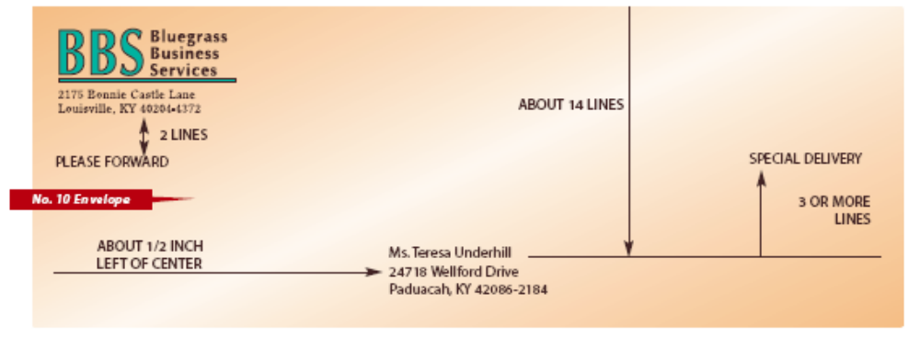
Envelopes

Slide 19
Memos and E-Mail
Memo
  Internal business communication
  Less formal and shorter than letters
E-mail
  Gradually replacing memos for internal communication
  May be used selectively for external communication

Slide 20
Memo Format
To
From
Date
Subject

Slide 21
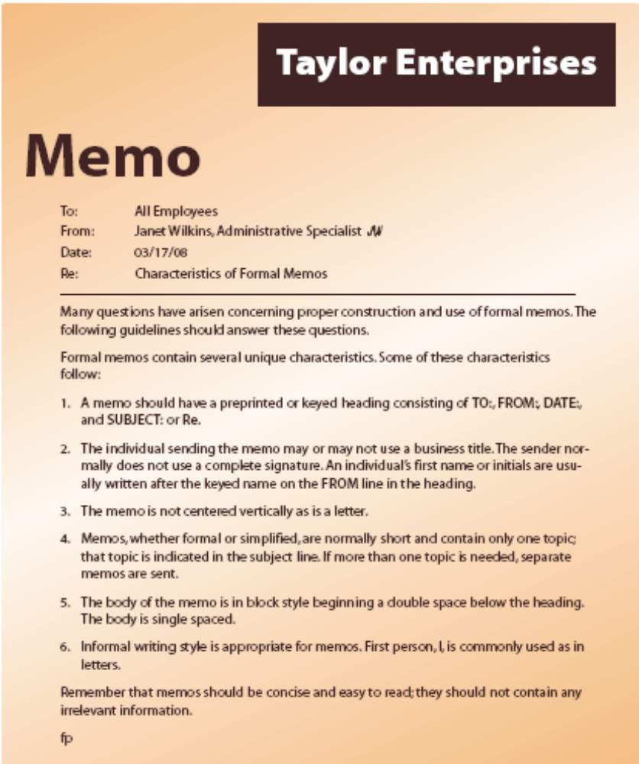
Memo Format

Slide 22
Stationery
Size
Weight
Color
Quality
Envelope Paper

