Slide 1
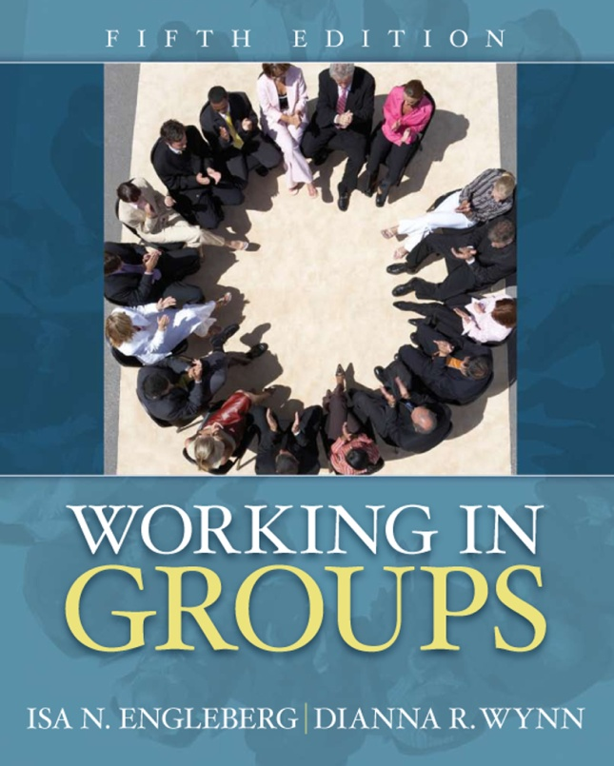
Working in Groups: 5th edition
Isa N. Engleberg
Prince George’s Community College
Dianna R. Wynn
Nash Community College
This multimedia product and its contents are protected under copyright law. The following are prohibited by law:
- any public performance or display, including transmission of any image over a network;
- preparation of any derivative work, including the extraction, in whole or in part, of any images;
- any rental, lease, or lending of the program.

Slide 2
Chapter 9:
Conflict and Cohesion in Groups

Slide 3
Conflict in Groups
Conflict
The disagreement and disharmony that occurs in groups when differences are expressed regarding group goals; member ideas, behavior, and roles; or group procedures and norms

Slide 4
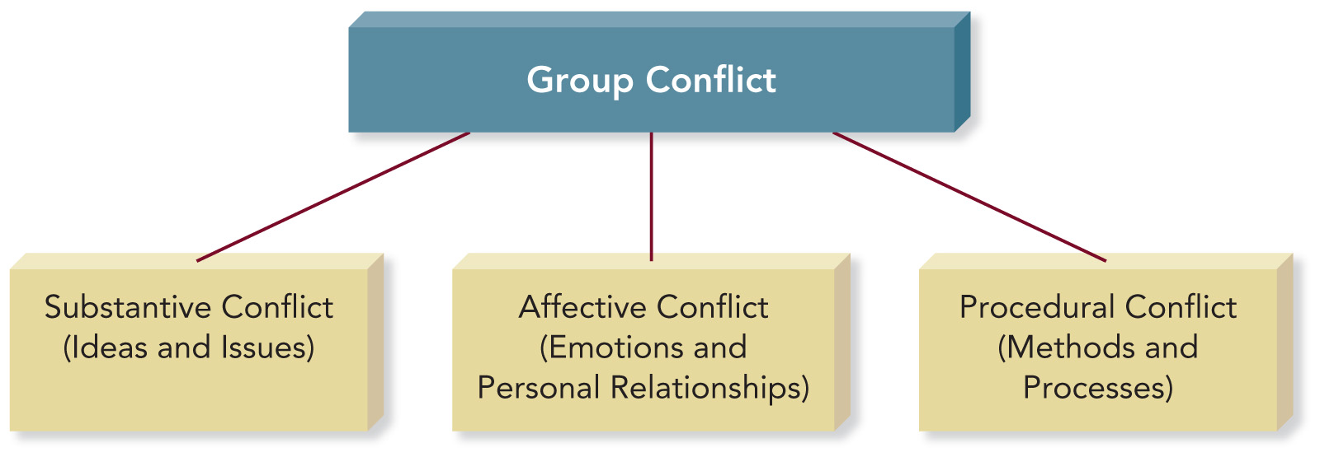
Sources of Conflict

Slide 5
Match the Types of Conflict
__ Substantive
conflict
__ Affective
conflict
__ Procedural
conflict
Members disagree about the methods or process the group uses to achieve its goals.
Member emotions are aroused by personal disagreements, personality differences, communication styles, and member beliefs and values.
Members disagree about ideas, issue analysis, and potential solutions or actions.

Slide 6
PowerPoint Quiz
Members of a civic association’s committee on community safety disagree on whether to install more expensive street lighting throughout the development. What type of conflict is the group experiencing?
  Affective
  Collaborative
  Substantive
  Competitive
  Procedural

Slide 7
Constructive/Destructive Conflict
Constructive Conflict
Group members express disagreement in a way that values everyone’s contributions and promotes the group’s goal.
  Respect others
  Focus on issues
  Other: ____________
Destructive Conflict
Group members create hostility and prevent achievement of the group’s goal.
  Insult others
  Inflexible and uncooperative
  Other: ____________

Slide 8
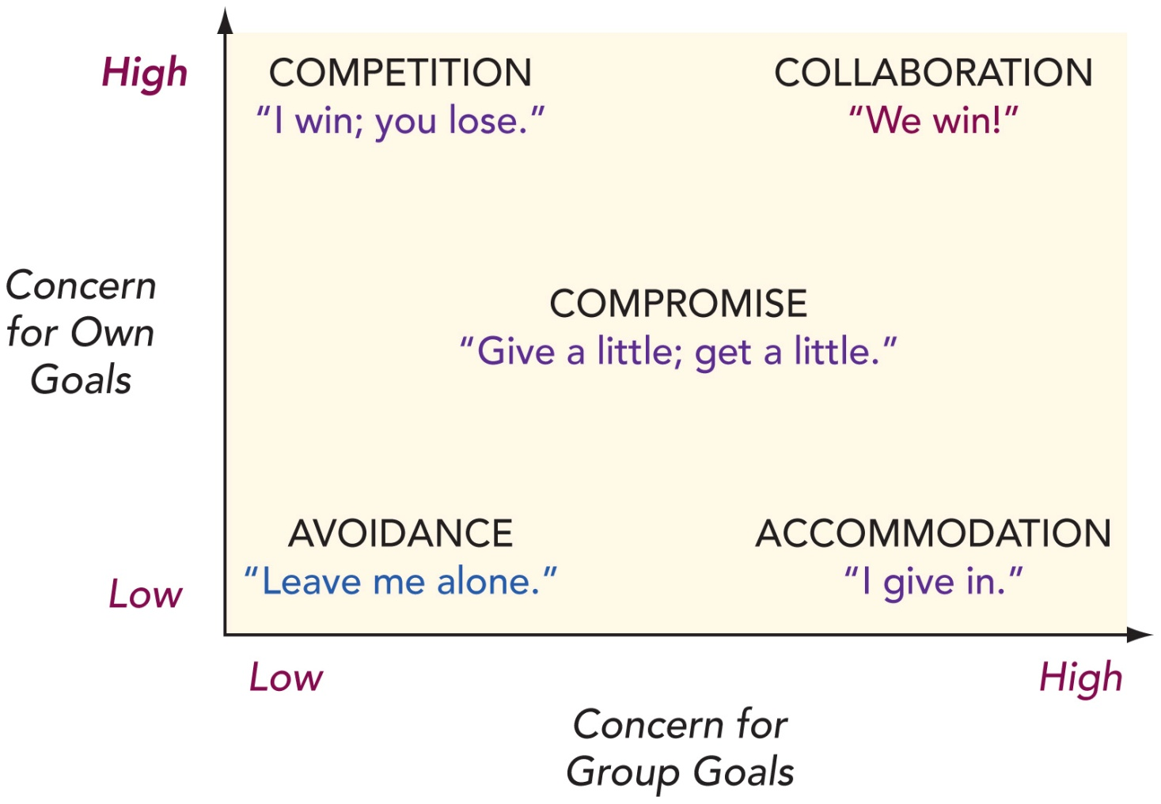
Five Basic Conflict Styles

Slide 9
Avoidance Conflict Style
Members are unable or unwilling to accomplish their own goals or contribute to achieving the group’s goal.
Avoidance fails to address the problem and can increase group tensions.

Slide 10
Accommodation Conflict Style
Members give in to other members at the expense of their own goals.
Members believe that giving in helps even when the group would benefit from more analysis and discussion.

Slide 11
Competition Conflict Style
Group members are more concerned with their own goals than with meeting the needs of the group.
Competition may be characterized by hostility, ridicule, and personal attacks.

Slide 12
Compromise Conflict Style
Members give up some goals in order to achieve others.
Members accept losses in exchange for gaining something else.
Better options may be missed if group only uses this style.

Slide 13
Collaboration Conflict Style
Members search for new solutions that will achieve both individual goals and the goals of the group.
Effective collaboration requires a lot of time and energy for discussions in which all members fully participate.

Slide 14
Choosing a Conflict Style
Criteria for Selecting a Conflict Style:
How important is the issue to you?
_______________________________
How important is it to maintain positive relationships with group members?
How much time does the group have?
_______________________________

Slide 15
PowerPoint Quiz
When a member gives in on some goals in order to achieve others, what conflict style is the member using?
  Compromise
  Collaboration
  Avoidance
  Accommodation
  Competition

Slide 16
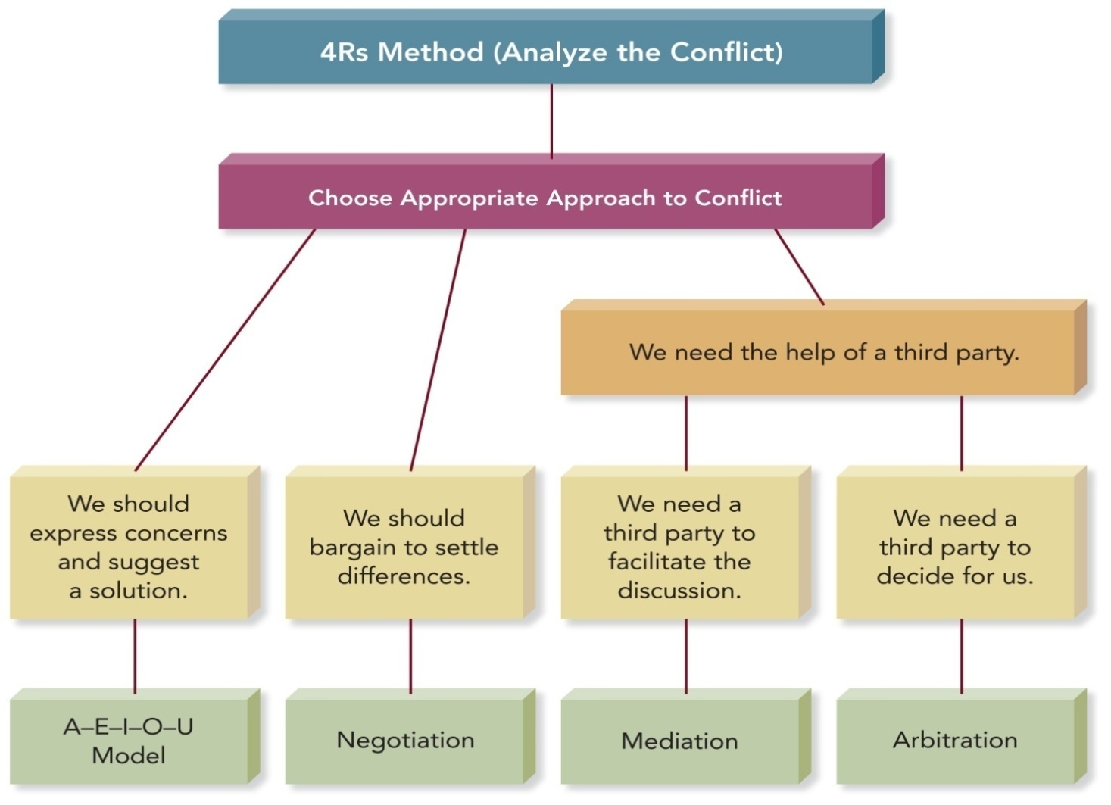
Conflict Management Strategies

Slide 17
The 4Rs Method
The 4Rs Method for Analyzing a Conflict
Reasons. What are the reasons for or causes of the conflict?
Reactions. How are group members reacting to one another?
Results. What are the consequences of the group’s current approach to the conflict?
Resolution. What are the available methods for resolving the conflict?

Slide 18
The A-E-I-O-U Method
A-E-I-O-U Method of Conflict Resolution
A – Assume other members mean well.
E – Express your feelings.
I – Identify what you want to happen.
O – Outcomes you expect are made clear.
U – A mutual Understanding is achieved.

Slide 19
Negotiation
A process of bargaining in order to settle differences or reach solutions.
Principled negotiation:
  separates people from the problem.
  focuses on group interests, not positions.
  generates a variety of possible solutions.
  insists on objective criteria.

Slide 20
Conflict Mediation
Employs the services of an impartial third party who guides, coaches, and encourages disputants through negotiation to successful resolution and agreement
William D. Kimsey, Rex M. Fuller, and Bruce C. McKinney,
Mediation and Conflict Management: General Mediation Manual

Slide 21
PowerPoint Quiz
All of the following are mediation strategies for resolving conflict constructively EXCEPT:
  Show strength and conviction by supporting your own position.
  Speak to be understood rather than win.
  Focus on your own perspective rather than criticizing others’ behavior.
  Explore ideas in new ways.
  Recognize that there are many perspectives rather than only two points of view.

Slide 22
Adapting to Differences
Culture: Members from cultures that value conformity and collectivism are less likely to express disagreement than those from cultures that place a higher value on individualism.
Gender: Women tend to avoid conflict; men and women differ in what is expected of them during conflicts.

Slide 23
Group Cohesion
Cohesion is the mutual attraction that holds members of a group together
Cohesive groups have:
High levels of interaction.
A supportive communication climate.
A desire to conform to group expectations.
The use of creative and productive approaches.
Satisfied members.

Slide 24
Enhancing Group Cohesion
  Establish a group identity and traditions.
  Emphasize teamwork.
  Recognize and reward contributions.
  Respect group members.

Slide 25
Groupthink
Groupthink
The deterioration of group effectiveness that results from in-group pressure
Highly cohesive groups are at greater risk of succumbing to groupthink.
Irving Janis identifies 8 symptoms and expressions of groupthink.

Slide 26
Groupthink Symptoms
Invulnerability: Overly confident; takes big risks
Rationalization: Makes excuses, ignores warnings
Morality: Ignores ethical and moral issues
Stereotyping Outsiders: Considers others too weak or stupid to cause trouble

Slide 27
Groupthink Symptoms
Self-Censorship: Unwilling to disagree; doubts their own concerns
Pressure on Dissenters: Pressures members to agree
Illusion of Unanimity: Believes everyone agrees
Mindguarding: Shields members from adverse information or opposition

Slide 28
Groupthink Examples
Invulnerability: ___________________
Rationalization:___________________
Morality: Secretly torturing prisoners is acceptable in these circumstances.___
Stereotyping Outsiders: ____________

Slide 29
Groupthink Examples
Self-Censorship: _________________
Pressure on Dissenters: Come on____ Crystal, you can’t fight all of us on this!
Illusion of Unanimity: _____________
Mindguarding: __________________

Slide 30
Strategies for Avoiding Groupthink
Ask all members to serve as critical evaluators.
Assign several members to work on the same problem independently.
Discuss the group’s progress with someone outside the group.
Invite an expert to join a meeting and encourage constructive criticism.
Before finalizing a decision, give members a second chance to express doubts.

