Slide 1

Working in Groups: 5th edition
Isa N. Engleberg
Prince George’s Community College
Dianna R. Wynn
Nash Community College
This multimedia product and its contents are protected under copyright law. The following are prohibited by law:
- any public performance or display, including transmission of any image over a network;
- preparation of any derivative work, including the extraction, in whole or in part, of any images;
- any rental, lease, or lending of the program.
©2010, 2007, 2003 Pearson Education, Inc.

Slide 2
Chapter 1:
Introduction to Group Communication
©2010, 2007, 2003 Pearson Education, Inc.

Slide 3
How to Succeed in Groups
Listen effectively
Understand your role
Actively contribute
Ask clear questions
Establish a professional rapport
©2010, 2007, 2003 Pearson Education, Inc.

Slide 4
How to Succeed in Groups
Communicate effectively with culturally-diverse members
Use language effectively
Convey a professional image
Resolve group conflict
Demonstrate leadership
©2010, 2007, 2003 Pearson Education, Inc.

Slide 5
Defining Group Communication
The interaction of three or more interdependent members working to achieve a common goal
©2010, 2007, 2003 Pearson Education, Inc.

Slide 6
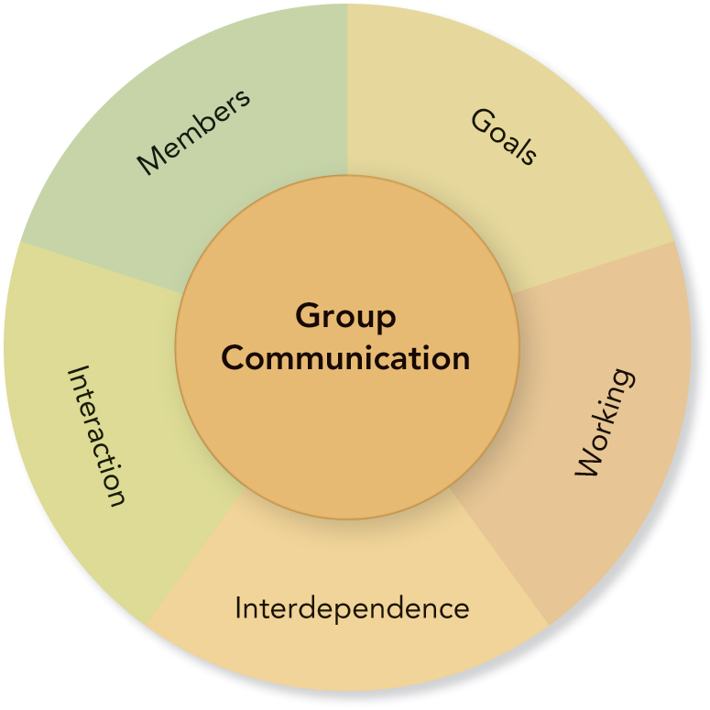
Components of Group Communication
©2010, 2007, 2003 Pearson Education, Inc.

Slide 7
Defining Group Communication
Three or more members
Why is three the minimum size for a group?
How are groups limited when there are less than 5 members?
How are groups limited when there are more than 12 members?
What is the ideal size for a problem-solving group?
©2010, 2007, 2003 Pearson Education, Inc.

Slide 8
Defining Group Communication
Interaction
Group members use verbal and nonverbal messages to generate meanings and establish relationships.
Group communication requires interaction.
©2010, 2007, 2003 Pearson Education, Inc.

Slide 9
Defining Group Communication
Common Goal
Defines and unifies a group
A clear, elevated goal:
  separates successful from unsuccessful groups
  guides action
  helps set standards
  helps resolve conflict
  motivates members
©2010, 2007, 2003 Pearson Education, Inc.

Slide 10
Defining Group Communication
Interdependence
Each group member is affected and influenced by the actions of other members.
Working
Group members work together to achieve a common goal.
©2010, 2007, 2003 Pearson Education, Inc.

Slide 11
PowerPoint Quiz
Which of the following situations best represents group communication?
  People talking about politics in an elevator
  People discussing the weather in an airport
  Parents cheering at a school soccer match
  Jury members deliberating a court case
  An audience listening to a concert
©2010, 2007, 2003 Pearson Education, Inc.

Slide 12
Communication Process:
Basic Elements
Members
Messages
Channels
Feedback
Context
Noise
©2010, 2007, 2003 Pearson Education, Inc.

Slide 13
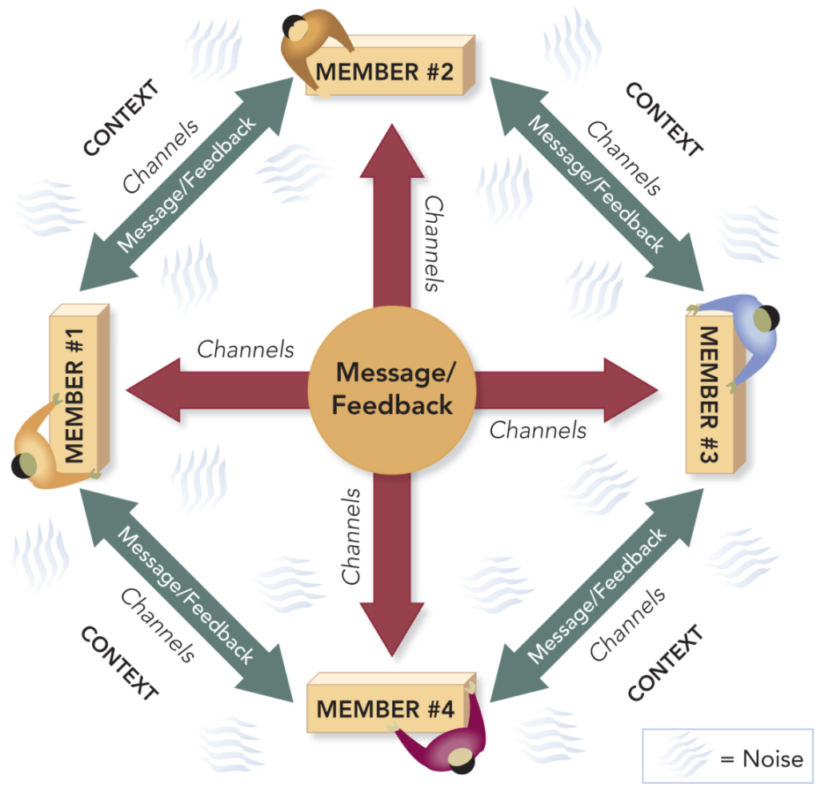
Group Communication Process
©2010, 2007, 2003 Pearson Education, Inc.

Slide 14
Group Communication Process:
Match the Concepts
A. Members
B. Messages
C. Channels
D. Feedback
E. Context
F. Noise
__ Anything that interferes with or inhibits communication
__ Ideas, information, opinions, feelings
__ Media used to share messages
__ Recognized and accepted as belonging to a group
__ Response or reaction to a message
__ The physical and psychological environment
©2010, 2007, 2003 Pearson Education, Inc.

Slide 15
Groups as Systems
Groups receive input and produce output.
Members are interdependent.
Groups have goals.
Groups are unpredictable.
Groups balance contradictory tensions.
©2010, 2007, 2003 Pearson Education, Inc.

Slide 16
Basic Types of Groups
Primary Groups
Social Groups
Self-Help Groups
Learning Groups
Service Groups
Civic Groups
Work Groups
Public Groups
©2010, 2007, 2003 Pearson Education, Inc.

Slide 17
Match the Types of Groups
A. Primary Group
B. Social Group
C. Self-help Group
D. Learning Group
Service Group
(In some cases, more than
one type may apply)
__ Alcoholics Anonymous
__ Bowling Team
__ Rotary Club
__ Boy or Girl Scout Troop
__ Church Choir
__ “Tribe” on Survivor
__ Group Counseling
©2010, 2007, 2003 Pearson Education, Inc.

Slide 18
Additional Types of Groups
Work Groups:
  Committees
  ad hoc
  standing
  task force
  Work Teams
Public Groups:
  Panel Discussion
  Symposium
  Forum
  Governance Group
©2010, 2007, 2003 Pearson Education, Inc.

Slide 19
Advantages of Working in Groups: Provide Examples
Group Performance Example: ______________
Member Satisfaction Example: ______________
Learning Example: ______________
Cultural Understanding Example: ______________
Creativity Example: ______________
Civic Engagement Example: ______________
©2010, 2007, 2003 Pearson Education, Inc.

Slide 20
Disadvantages of Working in Groups: Provide Examples
Time, Energy, Example: _____________
and Resources
Conflict Example: _____________
People Problems Example: _____________
©2010, 2007, 2003 Pearson Education, Inc.

Slide 21
Balance and Group Dialectics
Group Dialectics
The competing and contradictory components of group work
Balancing Group Dialectics
The challenge of taking a both/and rather than an either/or approach to resolving dialectic tensions in groups
©2010, 2007, 2003 Pearson Education, Inc.

Slide 22
The Opposite Proverb Is . . .
Birds of a feather flock together
He who hesitates is lost.
_____________________
_____________________
_____________________
_____________________
©2010, 2007, 2003 Pearson Education, Inc.

Slide 23
Balancing Group Dialectics
Individual Goals ↔ Group Goals
  Personal goals are compatible with group goals.
Conflict ↔ Cohesion
  Cohesive groups are committed, unified, and willing to engage in conflict.
Conforming ↔ Nonconforming
  Members value group norms, but are willing to change.
©2010, 2007, 2003 Pearson Education, Inc.

Slide 24
Balancing Group Dialectics
Task Dimensions ↔ Social Dimensions
  Members want to get the job done and also value their social relationships.
Homogenous ↔ Heterogeneous
  Members value member similarities and differences.
Leadership ↔ Followership
  Effective leadership requires loyal and competent followers.
©2010, 2007, 2003 Pearson Education, Inc.

Slide 25
Balancing Group Dialectics
Structure ↔ Spontaneity
  Members recognize the need for structured procedures and the value of creative thinking.
Engaged ↔ Disengaged
  Members expend energy and work hard, but also need rest and renewal.
Open System ↔ Closed System
  Members welcome input and interchange, but also protect the group and its work.
©2010, 2007, 2003 Pearson Education, Inc.

Slide 26
Match and Define the Dialectics
A. Individual
B. Conflict
C. Open
D. Structure
E. Conformity
F. Leadership
G. Engaged
H. Homogeneous
I. Task
___ Closed
___ Disengaged
___ Spontaneity
___ Followership
___ Heterogeneous
___ Social
___ Nonconforming
___ Cohesive
___ Group
©2010, 2007, 2003 Pearson Education, Inc.

Slide 27
Ethics and Balance
Do group members agree upon and apply standards of right and wrong to group situations and member interaction?
Do group members follow the National Communication Association Credo for Ethical Communication?
©2010, 2007, 2003 Pearson Education, Inc.

Slide 28
Apply the NCA Ethics Credo
In requesting funds for a school club, the officers exaggerate their needs and suggest that other clubs waste money.
Which ethics credo principle(s) have the officers violated?
A. We advocate truthfulness, accuracy, honesty, and reason.
We condemn communication that degrades individuals . . .
C. We accept responsibility for the short- and long-term consequences of our own communication.
D. We strive to understand and respect other communicators before evaluating and responding to their messages.
©2010, 2007, 2003 Pearson Education, Inc.

Slide 29
PowerPoint Quiz
a. select an appropriate response somewhere between two extremes.
b. select a response that benefits the most people.
c. select a response that benefits you the most.
d. select a response that is at the midpoint between two extremes.
Aristotle offered the “doctrine of the mean” as a balanced approach to ethical behavior. He advised that when you face an ethical decision, you should . . .
©2010, 2007, 2003 Pearson Education, Inc.

