Slide 1


Working in Groups: 5th edition
Isa N. Engleberg
Prince George’s Community College
Dianna R. Wynn
Nash Community College
This multimedia product and its contents are protected under copyright law. The following are prohibited by law:
- any public performance or display, including transmission of any image over a network;
- preparation of any derivative work, including the extraction, in whole or in part, of any images;
- any rental, lease, or lending of the program.

Slide 2
Chapter 12:
Planning and Conducting Meetings

Slide 3
Too Many Meetings
There are more than 11 million business meetings in the U.S. every day.
Most employees spends 15 hours per week in meetings.
Most employees attend 60 meetings a month.
Many meetings are not productive or rewarding group experiences.

Slide 4
What’ Wrong with Meetings?
The meeting was unnecessary.
The meeting wasted time.
The meeting didn’t use/follow an agenda.
________________________________.
________________________________.
________________________________.
________________________________.

Slide 5
What is a Meeting?
Meeting
A scheduled gathering of group members for a structured discussion guided by a designated chairperson

Slide 6
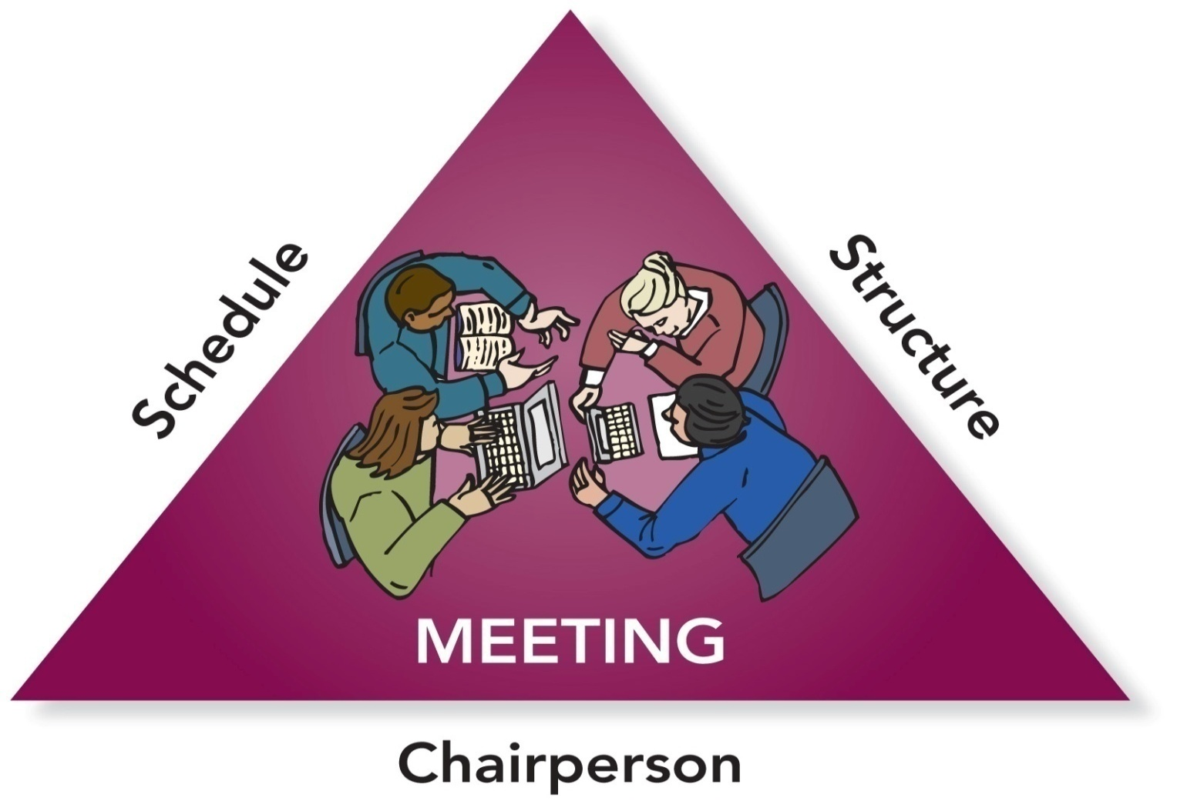
Essential Meeting Elements

Slide 7
Questions for Planning a Meeting
Why are we meeting?
Who should attend the meeting?
When should we meet?
Where should we meet?
What materials do we need?

Slide 8
PowerPoint Quiz
Which group dialectics are most relevant when planning and conducting meetings?
structure ↔ spontaneity & leadership ↔ followership.
individual goals ↔ group goals & conformity ↔ nonconformity.
heterogeneous ↔ homogeneous & conflict ↔ cohesion.
engaged ↔ disengaged & open system ↔ closed system.

Slide 9
The Need for Agendas
Agenda
The outline of items to be discussed and tasks to be accomplished during a meeting
An agenda . . .
is an organizational tool.
helps members prepare for a meeting.
is a time management tool.
provides a measure of success.

Slide 10
A Business Meeting Agenda
Purpose of Meeting
Names of Group Members—present or absent
Date, Time, and Place
Call to Order
Approval of the Agenda
Approval of Previous Meeting’s Minutes
Individual and Committee Reports
Unfinished Business
New Business
Announcements
Adjournment

Slide 11
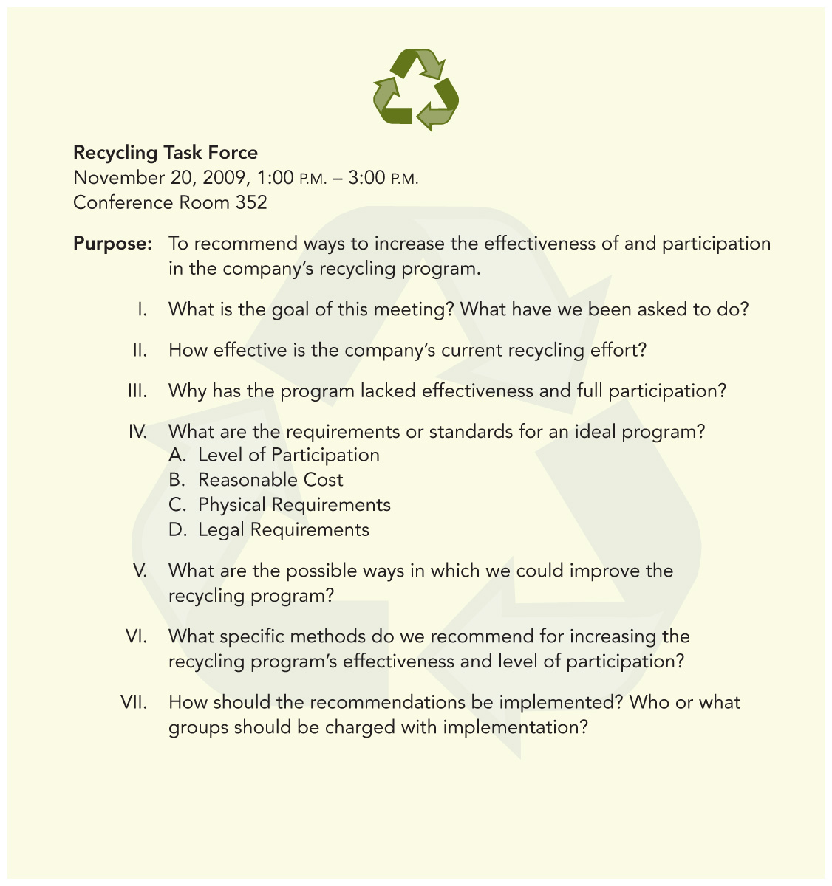
Sample
Discussion
Agenda

Slide 12
PowerPoint Quiz
When is the best time to address important and difficult issues in a meeting?
  At the beginning of the meeting
  During the middle portion of the meeting
  During the last third of the meeting
  At the end of the meeting

Slide 13
Chairperson’s Pre-Meeting Tasks
Notify members
Distribute materials
Remind members
Prepare for discussion

Slide 14
Chairperson’s Tasks
During the Meeting
  Begin on time
  Delegate minutes
  Follow the agenda
  Facilitate the discussion
  Provide closure

Slide 15
Chairperson’s Post-Meeting Tasks
  Evaluate the meeting
  Distribute the minutes
  Monitor assigned tasks

Slide 16
Common Disruptive Behaviors
Nonparticipants
Loudmouths
Interrupters
Whisperers
Latecomers
Early Leavers

Slide 17
Dealing with Loudmouths
How to deal with loudmouths:
Acknowledge that you understand their positions.
Interrupt them and shift the focus to other members.
Tell them the group needs input from everyone.
Assign them side-line tasks (e.g., taking minutes) that shift them from talking to listening and writing.

Slide 18
How to Deal with Disruptive Behavioral Problems
Nonparticipants: _______________________________________________________________________________________
Interrupters: ________________________________________________________________________________________
Whisperers: ________________________________________________________________________________________
Latecomers and Early Leavers: ________________________________________________________________________________________

Slide 19
PowerPoint Quiz
If members are frequently late to meetings, the chairperson should . . .
wait to start until all members have arrived.
review what has been accomplished whenever a latecomer arrives.
let latecomers sit without participating until they have observed enough to be able to contribute.
publicly reprimand latecomers.
assign latecomers tasks that no one else wants to do.

Slide 20
PowerPoint Quiz
In order to run a successful virtual meeting, you should. . .
  begin a virtual meeting by reading the meeting agenda out loud.
  invite more people to participate.
  make sure that all members have access to the technology and know how to use it.
  use technology you’ve used before so you don’t have to worry about testing it prior to meeting with the group.
  Deborah Duarte and Nancy Snyder, Mastering Virtual Teams

Slide 21
Preparing the Minutes
The minutes of a meeting are . . .
the written record of a group’s discussion and activities.
legal documents as well as historical records of organization business.
a way to share what happens with members who don’t attend.
a way to prevent disagreement over member assignments and group decisions.

Slide 22
What to Include in the Minutes
Name of the group
Date and place of meeting
Names of attending members
Name of the chair
Names of absent members
Time the meeting was called to order
Time the meeting adjourned
Name of person preparing the minutes
Summary of discussion and decisions including action items

Slide 23
Taking Minutes
Write clear statements that summarize the meeting’s main ideas and actions.
Word decisions, motions, action items, and deadlines exactly as the group makes them.
If in doubt, ask the group for clarification.
Attach the agenda and any reports to the final copy of the minutes.

Slide 24
Guidelines for Taking Minutes
Report the facts and all sides of a discussion accurately.
_________________________________
_________________________________
_________________________________
Always keep in mind that the minutes are a public record of the meeting.

Slide 25
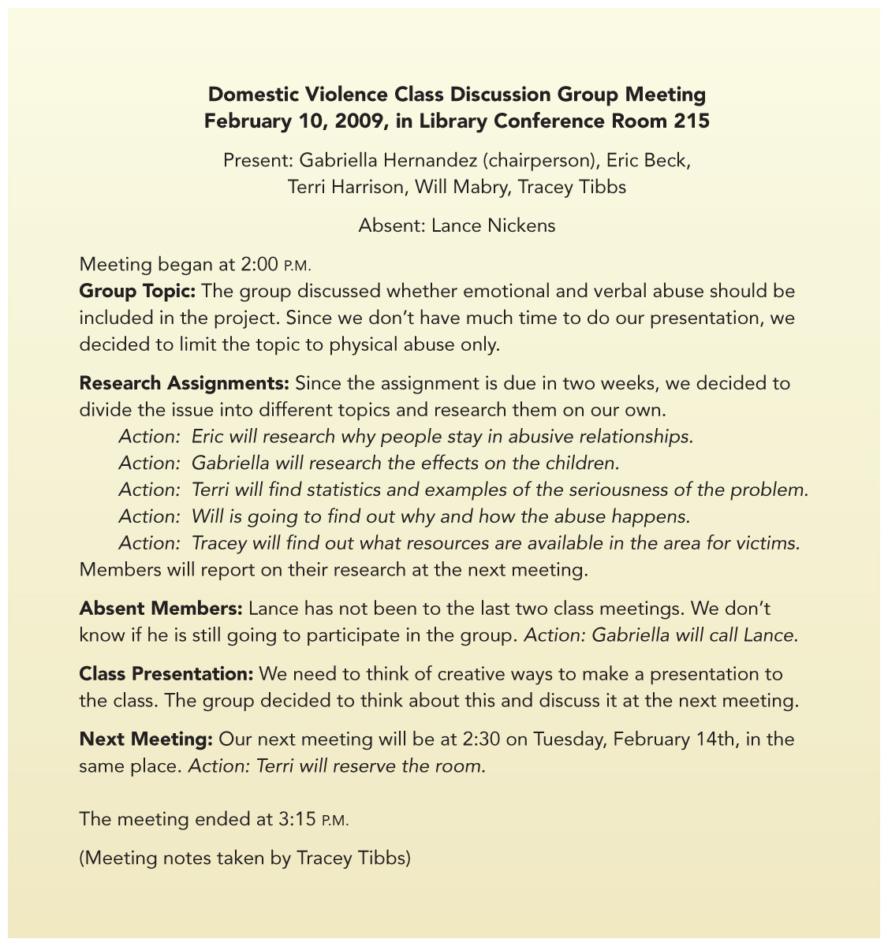
Sample of
Informal
Minutes

Slide 26
Parliamentary Procedure
A set of formal rules used to determine the will of the majority through fair and orderly discussion and debate
Purpose of parliamentary procedure:
To protect the rights of minority members while ensuring majority rule

Slide 27
Basic Principles of
Parliamentary Procedure
Majority Will
Minority Rights
Balanced Discussion
Orderly Progress

Slide 28
Passing a Main Motion
Make the motion. Present a proposal to the group: “I move that we go to lunch.”
Second the motion. A main motion must be seconded .“I second the motion.”
Amend the motion. A main motion can be amended: “I move that we go to lunch at 12:30 pm.”
Voting. The group decides whether to accept or reject the motion: “All those in favor say aye. All those opposed say nay.”

Slide 29
Post-Meeting Evaluation
Was the meeting’s goal clear?
Was the agenda useful and followed?
How prepared were group members?
Did everyone have an equal chance to participate?
Did members listen effectively and consider different points of view?
Were assignments and deadlines made clear by the end of the meeting?

Slide 30
Additional Evaluation Questions
What other evaluation questions would you add to those on the previous slide?
Example: Did the meeting begin and end on time?
Example: ________________________
Example: ________________________
Example: ________________________

