Slide 1

Working in Groups: 5th edition
Isa N. Engleberg
Prince George’s Community College
Dianna R. Wynn
Nash Community College
This multimedia product and its contents are protected under copyright law. The following are prohibited by law:
- any public performance or display, including transmission of any image over a network;
- preparation of any derivative work, including the extraction, in whole or in part, of any images;
- any rental, lease, or lending of the program.
©2010, 2007, 2003 Pearson Education, Inc.

Slide 2
Chapter 3:
Group Membership
©2010, 2007, 2003 Pearson Education, Inc.

Slide 3
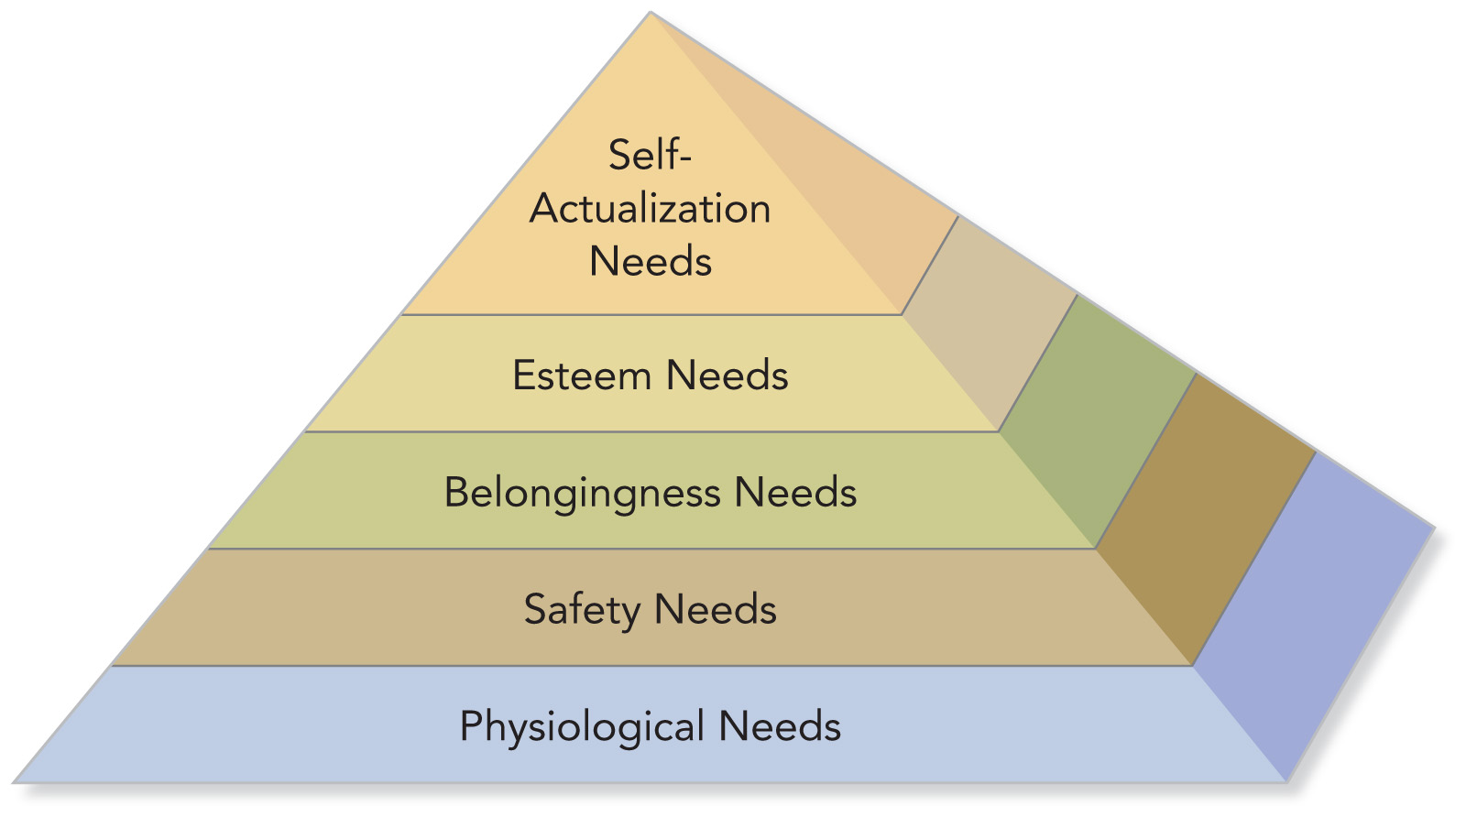
Maslow’s Hierarchy of Needs
©2010, 2007, 2003 Pearson Education, Inc.

Slide 4
Match the Need to the Group
Need
Physiological
Safety
Belongingness
Esteem
Self-Actualization
Group
___ police force
___ family
___ garden society
___ adult literacy group
___ sorority/fraternity
___ executive club
___ pro basketball team
©2010, 2007, 2003 Pearson Education, Inc.

Slide 5
Schutz’s Theory of
Interpersonal Needs
Fundamental Interpersonal
Relationship Orientation (FIRO)
Need for INCLUSION
Need for CONTROL
Need for AFFECTION
©2010, 2007, 2003 Pearson Education, Inc.

Slide 6
Inclusion Needs
“I need to feel accepted by the group.”
“I feel accepted by the group.”
“I don’t feel accepted by or involved in the group.”
“I won’t participate much in group discussions.”
“I try to gain the group’s attention.”
Social Member
Undersocial Member
Oversocial Member
©2010, 2007, 2003 Pearson Education, Inc.

Slide 7
Control Needs
“I need to feel influential and important.”
“Others respect me.”
“I don’t have influence in the group.”
Democratic Member
“I just do what I am told.”
“I try to dominate the group.”
Abdicrat
Autocrat
©2010, 2007, 2003 Pearson Education, Inc.

Slide 8
Affection Needs
“I need to feel that others like me.”
“I feel that others like me and if they don’t, that’s OK.”
“I’m not sure that others like me.”
“I avoid friendships with other members.”
“I confide in and try to become very close with others.”
Personal Member
Underpersonal Member
Overpersonal Member
©2010, 2007, 2003 Pearson Education, Inc.

Slide 9
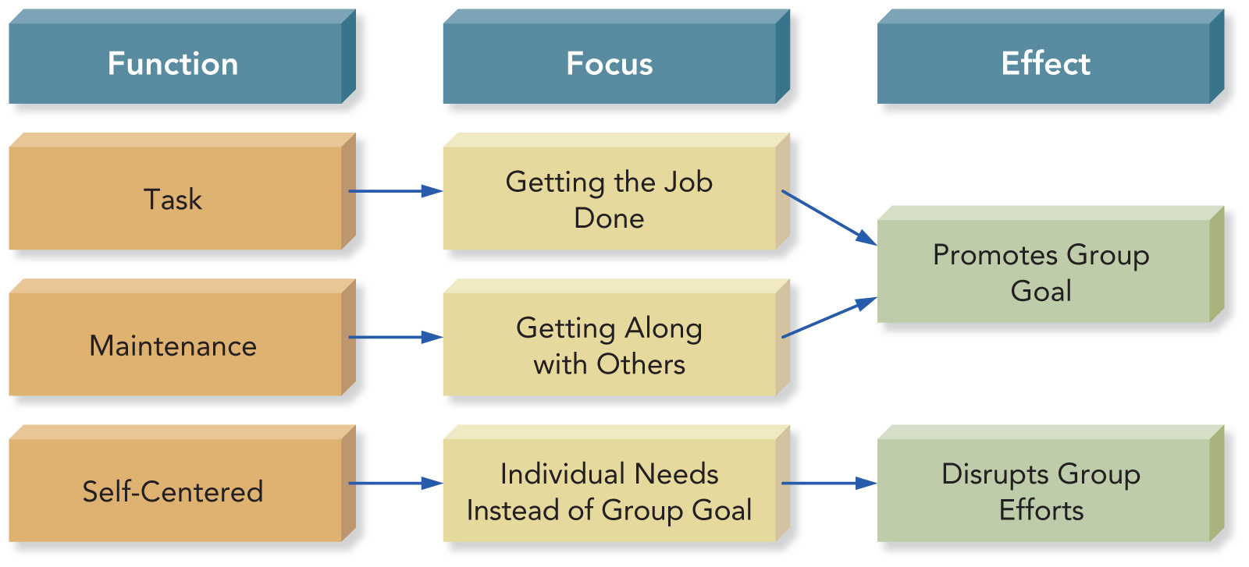
Group Role Categories
©2010, 2007, 2003 Pearson Education, Inc.

Slide 10
Group Task Roles
Initiator
Information Seeker
Coordinator-Chairperson
Information Giver
Opinion Seeker
Opinion Giver
Clarifier-Summarizer
Implementer-Completer
9. Evaluator-Critic
10. Energizer
11. Procedural Technician
12.Recorder-Secretary
©2010, 2007, 2003 Pearson Education, Inc.

Slide 11
Group Maintenance Roles
Encourager-Supporter
Harmonizer
Compromiser
Tension Releaser
Gatekeeper
Observer-Interpreter
Teamworker-Follower
©2010, 2007, 2003 Pearson Education, Inc.

Slide 12
Identify Roland’s Role(s)
Roland expresses his personal opinions and feelings. He summarizes group progress and draws conclusions. When group members argue, he mediates conflict and paraphrases what others say.
___ Compromiser
___ Gatekeeper
___ Harmonizer
___ Observer-Interpreter
___ Evaluator
___ Clarifier-Summarizer
___ Energizer
___ Opinion Giver
___ Recognition Seeker
___ Follower
©2010, 2007, 2003 Pearson Education, Inc.

Slide 13
Self-Centered Roles
Aggressor
Blocker
Dominator
Recognition Seeker
Clown
Deserter
Confessor
Special Interest Pleader
©2010, 2007, 2003 Pearson Education, Inc.

Slide 14
PowerPoint Quiz
“Maria, we haven’t heard from you yet and want to make sure that everyone gets a chance to weigh in on this issue” would most likely be said by a group member assuming the role of a(n):
a. Harmonizer
b. Standard monitor
c. Observer-interpreter
d. Gatekeeper
e. Procedural technician
©2010, 2007, 2003 Pearson Education, Inc.

Slide 15
Group and Member
Confidence
Members who lack confidence are less likely to share what they know or voice their opinions.
Confident members are more effective group members.
Confident groups are more likely to succeed.
©2010, 2007, 2003 Pearson Education, Inc.

Slide 16
Communication Apprehension
“An individual’s level of fear or anxiety associated with either real or anticipated communication with another person or persons.”
About 20 percent of the general population experiences very high levels of communication apprehension.
  Virginia P. Richmond and James C. McCroskey,
  Communication: Apprehension, Avoidance, and Effectiveness
©2010, 2007, 2003 Pearson Education, Inc.

Slide 17
How Confident Are You?
Are you comfortable participating in group discussions?
Do you like to get involved in group discussions?
Are you afraid to express yourself at meetings?
Are you relaxed when answering questions at a meeting?
©2010, 2007, 2003 Pearson Education, Inc.

Slide 18
High Apprehensives
Avoid participation
Talk less often
Agree with others
Smile or giggle inappropriately
Fidget
Use awkward fillers phrases, e.g. “uh”
Have difficulty following a discussion
©2010, 2007, 2003 Pearson Education, Inc.

Slide 19
Low Apprehensives
Initiate discussion
Speak more often
Assert themselves
Are more likely to become leaders
Choose when to speak or be silent
Appear confident
May dominate discussion
©2010, 2007, 2003 Pearson Education, Inc.

Slide 20
Strategies for Coping with Communication Apprehension
Strategy: Know that you are not alone.
Strategy: ________________________.
Strategy: ________________________.
Strategy: Learn communication skills.
Strategy: ________________________.
Strategy: ________________________.
Strategy: ________________________.
©2010, 2007, 2003 Pearson Education, Inc.

Slide 21
Constructive Feedback
Guidelines for providing constructive feedback to enhance member confidence:
  • Focus on the behavior, not the person.
  • Describe rather than judge behavior.
  • Provide observations rather than opinions.
  • Choose an appropriate time and place for feedback rather than ignoring the situation.
  • Give feedback to help others rather than to meet your own needs.
©2010, 2007, 2003 Pearson Education, Inc.

Slide 22
If you are a low apprehensive . . .
Supportive highly apprehensive group members by:
providing constructive feedback.
_______________________________.
_______________________________.
©2010, 2007, 2003 Pearson Education, Inc.

Slide 23
Confidence in Virtual Groups
Why are some people more confident communicating in virtual groups?
____________________________________.
They may not have to reveal information about their appearance, gender, race, status, etc.
Other members may overestimate a person’s qualities and abilities.
____________________________________.
____________________________________.
©2010, 2007, 2003 Pearson Education, Inc.

Slide 24
PowerPoint Quiz
©2010, 2007, 2003 Pearson Education, Inc.

Slide 25
Assertiveness
Speaking up and acting in your own best interests without denying the rights and interests of others
©2010, 2007, 2003 Pearson Education, Inc.

Slide 26
Assertive Group Members
Appear confident, honest, open, and cooperative
Volunteer ideas and opinions
Ask and answer questions without fear or hostility
Stand up for their beliefs, even when others disagree
Express their feelings openly
Respect and defend the rights and opinions of others
©2010, 2007, 2003 Pearson Education, Inc.

Slide 27
Balancing Passivity and Aggression
Passive group members often lack confidence.
  Reluctant to express their opinions and feelings, fear criticism, and usually do what they are told
Aggressive members act in their own self-interest at the expense of others.
  Critical, insensitive, combative, and even abusive
©2010, 2007, 2003 Pearson Education, Inc.

Slide 28
Passive-Aggressive Members
Passive-aggressive members mask aggression by appearing passive or cooperative.
  They rarely exhibit aggressive behavior.
  They do not respect the rights of others.
  They often get what they want by
    undermining others behind their backs.
    deceiving others about their intentions.
©2010, 2007, 2003 Pearson Education, Inc.

Slide 29
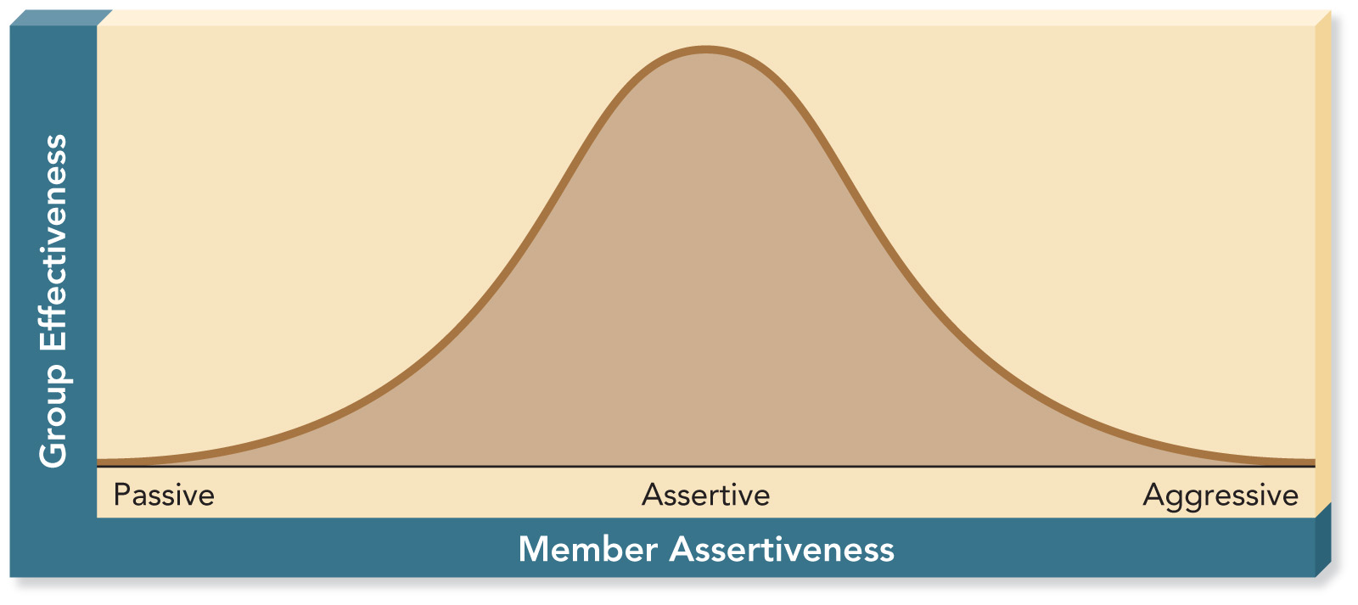
Group Effectiveness and Member Assertiveness
©2010, 2007, 2003 Pearson Education, Inc.

Slide 30
Assertiveness Skills in Groups
Devote time to preparing for meetings.
Ask a colleague to help you get a chance to speak.
Express your opinions clearly.
_______________________________.
_______________________________.
_______________________________.
_______________________________.
©2010, 2007, 2003 Pearson Education, Inc.

Slide 31
Assertiveness Skills in Groups
Devote time to preparing for meetings.
Ask a colleague to help you get a chance to speak.
Express your opinions clearly.
Maintain direct eye contact.
Assume an assertive body posture.
Express your feelings as well as thoughts.
Speak expressively (volume, pitch, rate).
©2010, 2007, 2003 Pearson Education, Inc.

