Slide 1


Working in Groups: 5th edition
Isa N. Engleberg
Prince George’s Community College
Dianna R. Wynn
Nash Community College
This multimedia product and its contents are protected under copyright law. The following are prohibited by law:
- any public performance or display, including transmission of any image over a network;
- preparation of any derivative work, including the extraction, in whole or in part, of any images;
- any rental, lease, or lending of the program.

Slide 2
Chapter 4:
Group Diversity

Slide 3
Definition of Culture
A learned set of shared interpretations about beliefs, values, and norms which affect the behaviors of a relatively large group of people
Myron Lustig and Jolene Koester
Intercultural Competence: Interpersonal Communication across Cultures

Slide 4
Co-Culture
A group of people who coexist within the mainstream society, yet remain connected to one another through a common cultural heritage

Slide 5
Co-Culture Examples
Native American
African American
Italian American
Example: __________________
Example: __________________
Example: __________________

Slide 6
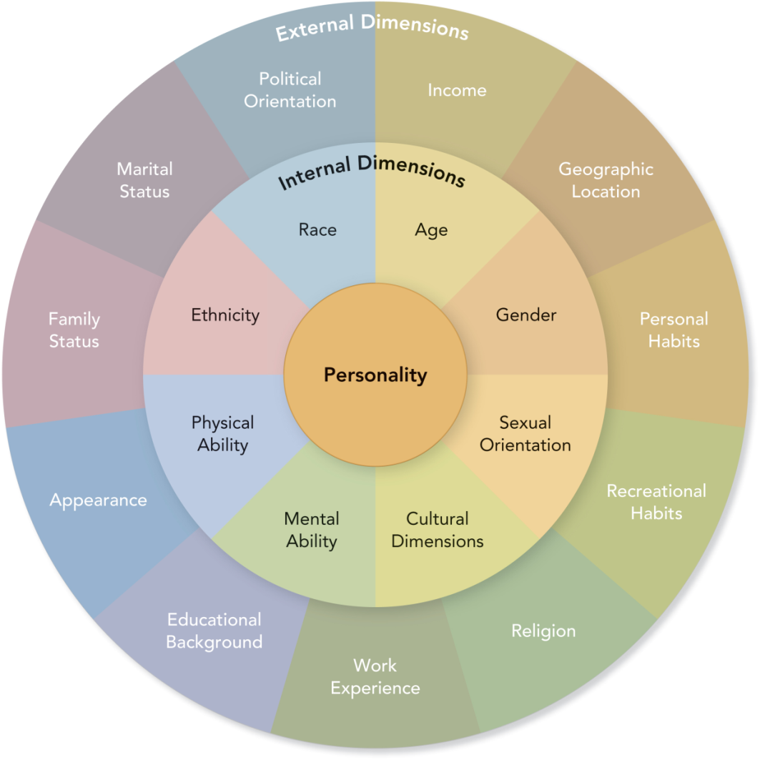
Three Layers of Diversity

Slide 7
PowerPoint Quiz
A. Ethnocentrism
B. Stereotyping
C. Prejudice
D. Discrimination
__ Generalizations about a group of people that oversimplify their characteristics
__ Negative attitudes and beliefs about others based on faulty or inflexible beliefs
__ A belief that your culture is superior to other cultures
__ Actions that exclude certain people from opportunities granted to others

Slide 8
Barriers to Understanding
Ethnocentrism
  Example: _________________________
Stereotyping
  Example: ___________________________
Prejudice
  Example: _________________________
Discrimination
    Example: _________________________

Slide 9
Big Five Personality Traits
Introversion
Disagreeableness
Carelessness
Neuroticism
Closed to Experience
Extraversion
Agreeableness
Conscientiousness
Emotional Stability
Openness to
Experience

Slide 10
Myers-Briggs Personality Types
Myers-Briggs Type Indicator® (MBTI)
  Helps explain why group members think and interact in different ways
  Examines how members use their minds to perceive the world and make decisions
  Divides preferences of thought and behavior into four dialectic categories

Slide 11
Myers-Briggs Categories
Extrovert
Sensor
Thinker
Judger
Introvert
Intuitive
Feeler
Perceiver

Slide 12
Myers-Briggs Implications
Groups are more successful when all personality types are represented.
Understanding personality types helps a group:
  capitalize on differences in personality styles and preferences.
  foster group productivity and cohesiveness.

Slide 13
Match the Personality Traits
___ Extrovert
___ Introvert
___ Sensor
___ Intuitive
___ Thinker
___ Feeler
___ Perceiver
___ Judger
Objective and fair
Well organized
Tenderhearted and tactful
Theoretical
Reserved and private
Talks first, then thinks
Practical and realistic
Goes with the flow

Slide 14
PowerPoint Quiz
Reggie likes to coordinate the group’s work and keep it organized. He never misses a deadline and expects others to do the same. Which Myers-Briggs personality trait best describes Reggie?
  Sensor
  Judger
  Intuitive
  Perceiver
  Thinker

Slide 15
Cultural Dimensions
Geert Hofstede: Four Cultural Dimensions:
  Individualism and Collectivism
  High and Low Power Distance
  High and Low Uncertainty Avoidance
  Masculine and Feminine Values
Edward T. Hall: Two Cultural Dimensions:
  High and Low Context
  Monochronic and Polychronic Time

Slide 16
Individualism-Collectivism
Individualism:
  Emphasizes the independence and individual achievement
  United States, Australia, Canada
Collectivism:
  Emphasizes the needs and goals of the group, rather than the individual
  Asian and Latin American countries

Slide 17
Power Distance
High power distance:
  Accepts differences in power as normal
  Assumes all people are not created equal
  Mexico, India, Singapore
Low power distance:
  Power distinctions are minimized
  New Zealand, Denmark, Israel

Slide 18
Uncertainty Avoidance
High uncertainty avoidance:
  Uncomfortable in unstructured and unpredictable situations “What is different is dangerous.”
  Prefer rules, plans, routines
  Japan, Belgium, Greece
Low uncertainty avoidance:
  Comfortable with ambiguity and unpredictability “What is different is interesting.”
  Can work independently without supervision
  Jamaica, Hong Kong

Slide 19
Masculine-Feminine Values
Masculine Value Societies:
  Men are assertive, tough, and ambitious
  Women are modest, tender, and focused on the quality of life
  Japan, Venezuela, Italy
Feminine Value Societies:
  Gender roles overlap
  Men and women value tenderness and care about the quality of life
  Sweden, Norway, Denmark

Slide 20
High context-Low context
High-context Culture:
  Meaning is communicated through nonverbal behavior and the nature of interpersonal relationships
  Messages are implied and context sensitive
  Japan, China, Greece, Mexico
Low-context Culture:
  Meaning is expressed primarily through language
  Messages are direct, factual, and objective
  England, United States, Germany

Slide 21
Monochronic Time and Polychronic Time
Monochronic time:
  Events are scheduled as separate items, one thing at a time
  Time is valuable; schedule and deadlines are important
  North America, Northern Europe
Polychronic time:
  Schedules are not very important, deadlines are missed, interruptions are tolerated
  Kenya, Argentina

Slide 22
For Women: How to Adapt to Male Group Members
Don’t expect or force men to talk about or display their emotions.
_______________________________
_______________________________
Let men know that you appreciate their objective analysis and detachment.

Slide 23
For Men: How to Adapt to Female Group Members
Don’t use sarcasm or tell women they’re illogical.
________________________________
Don’t worry about being unkind if you disagree a man.
________________________________

Slide 24
Generational Dimensions
Traditionalists: 1900-1945
Baby Boomers: 1946-1964
Generation Xers: 1965-1980
Millennials: 1981-1999

Slide 25
Working with Baby Boomers
Respect Baby Boomers and acknowledge their experience.
Communicate face-to-face rather than relying totally on email.
_________________________________
_________________________________

Slide 26
Working with Generation Xers
Get to the point and state your objectives.
Avoid micromanaging Generation Xers.
________________________________
________________________________
________________________________
________________________________

Slide 27
Religious Literacy
The ability to understand and use the religious terms, symbols, images, beliefs, practices, scripture, heroes, themes, and stories that are employed in American public life

Slide 28
True or False about Religions
True or False:
___ Christianity is older than Islam.
___ Jews celebrate Christmas and Easter.
___ Hinduism is older than Buddhism.
Add your own true/false statements:
___ _____________________________
___ _____________________________

Slide 29
Adapt to Religious Dimensions
How do the needs, attitudes, and practices of others’ religions affect the group’s work?
What adaptations, if any, should you make to accommodate the religious practices or beliefs of other members?

Slide 30
Essay Questions
The Golden Rule—“Do unto others as you would have them do unto you”—may not work in groups with diverse members.
  Why is this true?
  What strategies can help you learn more about different cultures?

