Slide 1


Working in Groups: 5th edition
Isa N. Engleberg
Prince George’s Community College
Dianna R. Wynn
Nash Community College
This multimedia product and its contents are protected under copyright law. The following are prohibited by law:
- any public performance or display, including transmission of any image over a network;
- preparation of any derivative work, including the extraction, in whole or in part, of any images;
- any rental, lease, or lending of the program.

Slide 2
Chapter 5:
Group Leadership

Slide 3
Leaders and Leadership
Leadership
The ability to make strategic decisions and use communication effectively to mobilize group members toward achieving a common goal
A leader is a person.
Leadership is a behavior.

Slide 4
Leadership and Power
Power is “the quality without which leaders cannot lead.”
Power is the ability or authority to influence and motivate others.
Warren Bennis and Bruce Nanus
Leaders: The Strategies for Taking Charge

Slide 5
Types of Position Power
Legitimate Power – Relies on a job title or duty
Reward Power – Controls and gives out valued resources
Coercive Power – Controls and deals out sanctions and punishments
Informational Power – Controls and transmits information and resources

Slide 6
Types of Personal Power
Expert Power – Relies on expertise and credentials
Referent Power – Relies on members’ high opinion of and experiences with the leader
Persuasive Power – Relies on effective communication skills
Charismatic Power – Relies on leader’s character, competence, & vitality

Slide 7
PowerPoint Quiz
At the end of every month, a sales manager awards a cash bonus to the most successful salesperson. What type of power is this leader using?
Referent power e) Expert power
Coercive power f) Informational power
Reward power g) Persuasive power
Legitimate power h) Charismatic power

Slide 8
Becoming a Leader
Designated Leaders
Selected by group members or an outside authority
Being designated leader is no guarantee of leadership ability unless the leader’s skills match the group’s needs.
Emergent Leaders
Gradually achieve leadership by helping the group achieve its goals
Emerging from within a group has the advantage of relying on expert or referent power.

Slide 9
How to Become a Leader
Fill in the strategies for becoming a leader:
Talk early and often (and______________).
Know more (and ____________________).
Offer your opinion (and_______________).

Slide 10
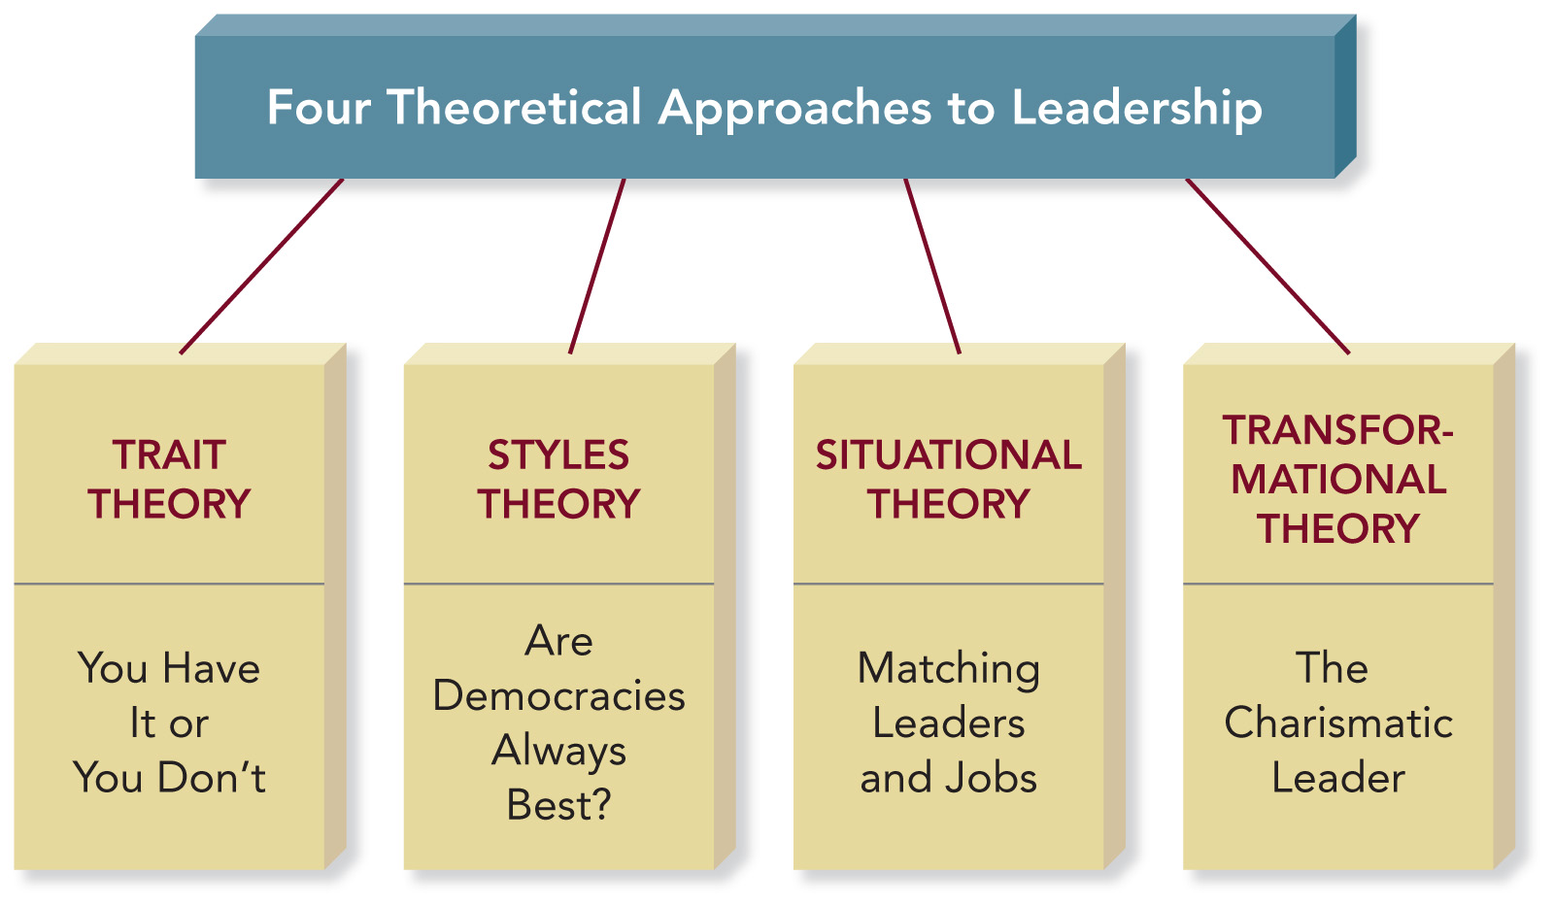
Leadership Theories

Slide 11
Trait Theory
Leaders are born, not made.
Identifies characteristics and behaviors of effective leaders.
Leadership Traits:
  Self-confidence
  Humility
  Trustworthiness
  Tolerance of frustration

Slide 12

Styles Theory
Democratic leaders are usually the best.
Autocratic leaders may be more effective in a crisis or chaotic situation.
Laissez-faire leaders may succeed in mature and highly productive groups.

Slide 13
Situational Theory
Leaders are made, not born.
Fiedler’s Contingency Model of Leadership Effectiveness: Effective leadership occurs only when there is an ideal match between the leader’s style and the group’s work situation.
Hersey-Blanchard’s Situational Leadership Model: Leadership style adapts to the level of member readiness.

Slide 14
Contingency Model of Leadership
What is Your Leadership Style?
  Are You Task Motivated? Do you want to get the job done at whatever cost.
  Are You Relationship Motivated? Do you gain satisfaction from working well with other people even if the group neglects or fails to complete the task.

Slide 15
Contingency Model of Leadership
What Is the Leadership Situation?
Are leader-member relations positive, negative, or somewhere in between?
Is the task highly structured, moderately structured, or unstructured?
Does the leader have a lot of power, moderate power, or little power?

Slide 16
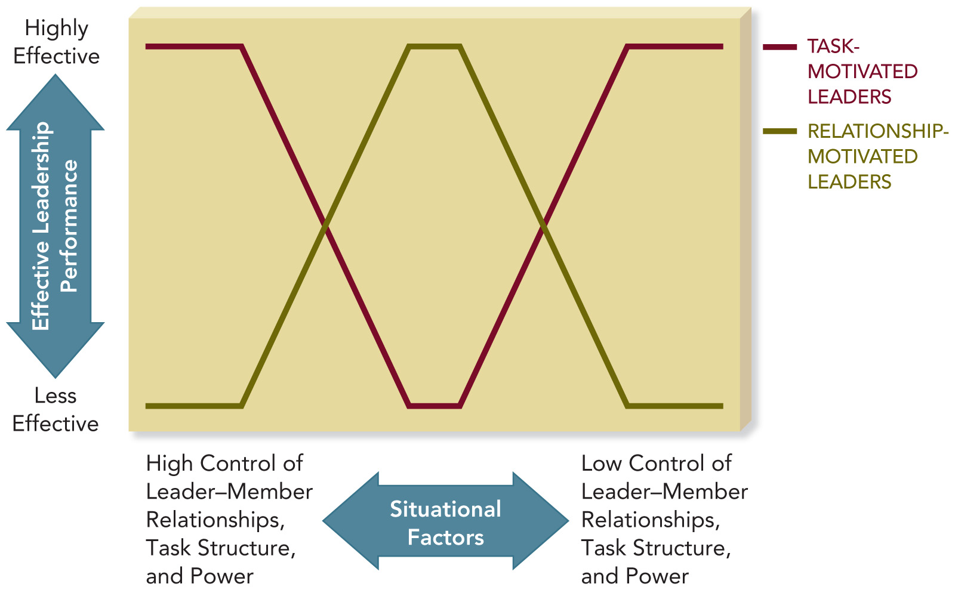
Contingency Model

Slide 17
Implications of the
Contingency Model
Change the situation to your leadership style, rather than changing your leadership style.
You may need to gain group trust and support.
You may need to modify the amount or type of power you have and the structure of the task.

Slide 18
Hersey-Blanchard’s Situational Leadership Model
Leaders adapt their leadership style to the level of member readiness.
Member Readiness: The extent to which group members are willing and able to work together to achieve a common goal.

Slide 19
Hersey-Blanchard’s Model
As a group’s readiness increases, leaders should rely more on relationship behavior than task behavior.
The Telling Stage: Low Readiness
The Selling Stage: Moderate Readiness
The Participating Stage: Moderate to High Readiness
Delegating Stage: High Readiness

Slide 20
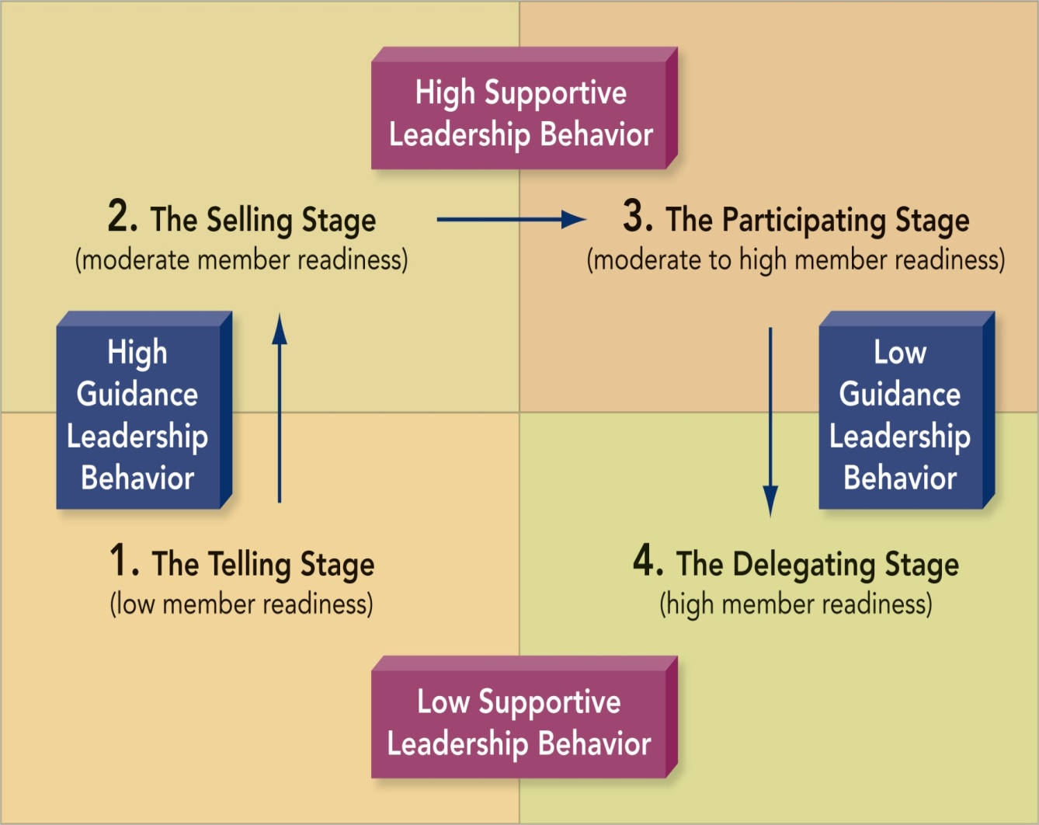
Hersey-Blanchard’s Model

Slide 21
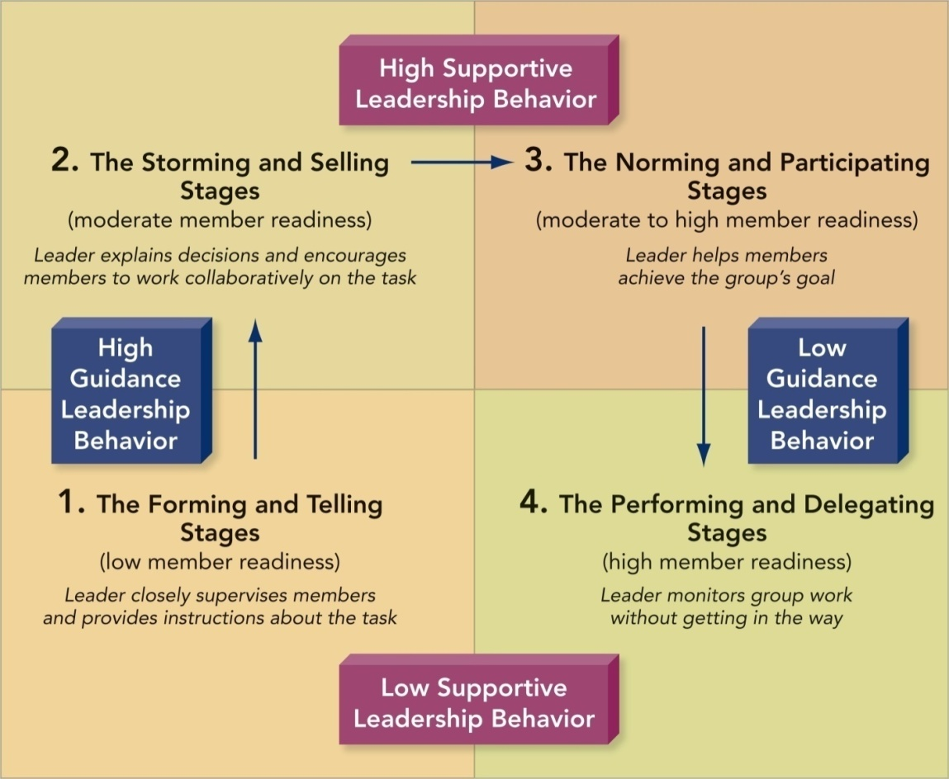
Group Development and Leadership Stages

Slide 22
Transformational Theory
Emphasizes what leaders accomplish rather than their personal characteristics or relationships with group members
Transformational leaders convert goals into action.

Slide 23
Transformational Leadership Characteristics
Charismatic
Visionary
Supportive
Empowering
Innovative
Modeling

Slide 24
5-M Model of Leadership Effectiveness
Interdependent Leadership Functions:
  Model leadership behavior
  Motivate members
  Manage group process
  Make decisions
  Mentor members

Slide 25
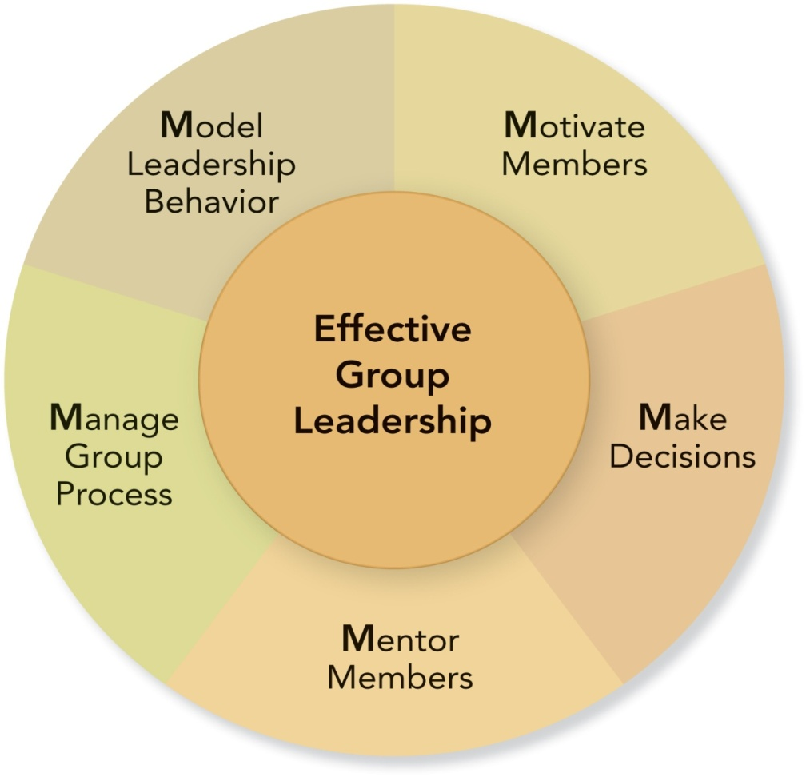
5-M Model of Leadership Effectiveness

Slide 26
Fill in the Blanks
Model Leadership Behavior
Champion your group.
Speak and listen effectively.
_________________
_________________
Motivate Members
Secure member commitment to goals.
Appropriately reward the group and its members.
_________________
_________________

Slide 27
Fill in the Blanks
Manage Group Process
Be well-organized and prepared.
Adapt to member strengths and weaknesses.
_________________
_________________
Make Decisions
Make sure everyone gets the needed information to make a quality decision.
Discuss pending decisions and solicit feedback.
_________________
_________________

Slide 28
Fill in the Blanks
Mentor Members
Be ready and willing to mentor every group member.
Encourage and invite others to lead.
_____________________________.

Slide 29
Gender and Leadership
“Although male and female leaders may act the same, there is a tendency for women to be perceived more negatively or to have to act differently to gain leadership.”
Instead of asking whether a female leader is different than a male leader, ask whether she is an effective leader.
Rodney Napier and Matti Gershenfeld
Groups: Theory and Experience

Slide 30
Are You Ready to Lead?
Do you like having people count on you?
Do you compliment others easily?
Do you cheer people up even when your own spirits are down?
Are your group’s accomplishments more important than your own personal glory?
Would you enjoy representing your group at an outside gathering?

