Slide 1


Q-Forge: An Efficient Two-Stage Framework for Noise-Aware Quantum Model Training
Ngoc-Truong Nguyen, Huy-Tan Thai
Ho Chi Minh, 2025
Notes:
Good afternoon, distinguished chairs, professors, and colleagues.
It is my honor to present our work, titled Q-Forge:
An Efficient Two-Stage Framework for Noise-Aware Quantum Model Training.
This work was conducted at the University of Information Technology,
Vietnam National University Ho Chi Minh City.

Slide 2
Outline
Introduction
Objectives & Contributions
Proposed Q-Forge Framework
The Q-ACS Algorithm
Conclusion
Experimental Evaluation
Notes:
This presentation is organized as follows.
First, I will introduce the background and motivation.
Then, I will present our objectives and main contributions.
Next, I will describe the Q-Forge framework
and the Q-ACS algorithm.
After that, I will show the experimental results.
Finally, I will conclude the presentation.

Slide 3
Introduction
The Potential of QML: Quantum Machine Learning (QML) promises significant computational advantages over classical approaches.
The NISQ Challenge: Current Noisy Intermediate-Scale Quantum (NISQ) devices are severely impacted by quantum noise.
Accuracy Degradation: Noise significantly reduces model performance, potentially causing a drop of 60-64%.
Sim-to-Real Gap: A substantial discrepancy exists between Ideal Simulations and performance on Physical Hardware.
Notes:
Quantum Machine Learning offers strong advantages
over classical methods.
However, current NISQ devices
are strongly affected by quantum noise.
This noise can reduce model accuracy
by sixty to sixty-four percent, compared to ideal simulations.
As a result, there is a large sim-to-real gap
between simulators and real quantum hardware.

Slide 4
Problem
Current Methods
Designing noise-resilient architectures:
  Costly to design, difficult to optimize, and often hardware-specific.
Training on a Realistic Quantum Emulator (RQE):
  Simulates real device architectures and noise profiles snapshot from quantum hardware.
  Prior studies report <5% accuracy degradation on real devices, but training is computationally expensive and slow to converge due to a rugged loss landscape.
Research Question
How can we train quantum models efficiently while preserving strong robustness to realistic quantum noise?
Notes:
Currently, there are two main approaches
to handle quantum noise.
The first approach designs noise-resilient architectures.
This method is effective, but it is costly
and often depends on specific hardware.
The second approach trains models
on a Realistic Quantum Emulator, called RQE.
RQE simulates real quantum devices
using noise models from hardware snapshots.
Previous studies show that models trained on RQE
lose less than five percent accuracy on real devices.
However, training on RQE is very expensive and converges slowly.
This leads to our research question.
How can we train quantum models Efficiently and robustly under realistic quantum noise?

Slide 5
Research Objectives & Contributions
Q-Forge Framework: A novel two-stage curriculum learning strategy addresses slow convergence issues when training directly on noisy quantum environments (RQE).
Q-ACS Algorithm: An adaptive mechanism to automatically detect the optimal transition point based on loss stability. Eliminate manual tuning for the transition between ideal and noisy stages.
Empirical Validation: Demonstrated up to 70% reduction in training time and 6-8% accuracy gain on VQC models.
Notes:
To address these challenges, we propose Q-Forge,
a two-stage training framework.
In the first stage, The model is trained on an ideal,
noise-free simulator to learn basic features quickly.
In the second stage, the model is fine-tuned
on a realistic quantum emulator to adapt to hardware noise.
To automate this process, we introduce Q-ACS,
an adaptive algorithm that finds the best transition point.
Our experiments show that Q-Forge reduces training time
by up to seventy percent, and improves accuracy by six to eight percent.

Slide 6
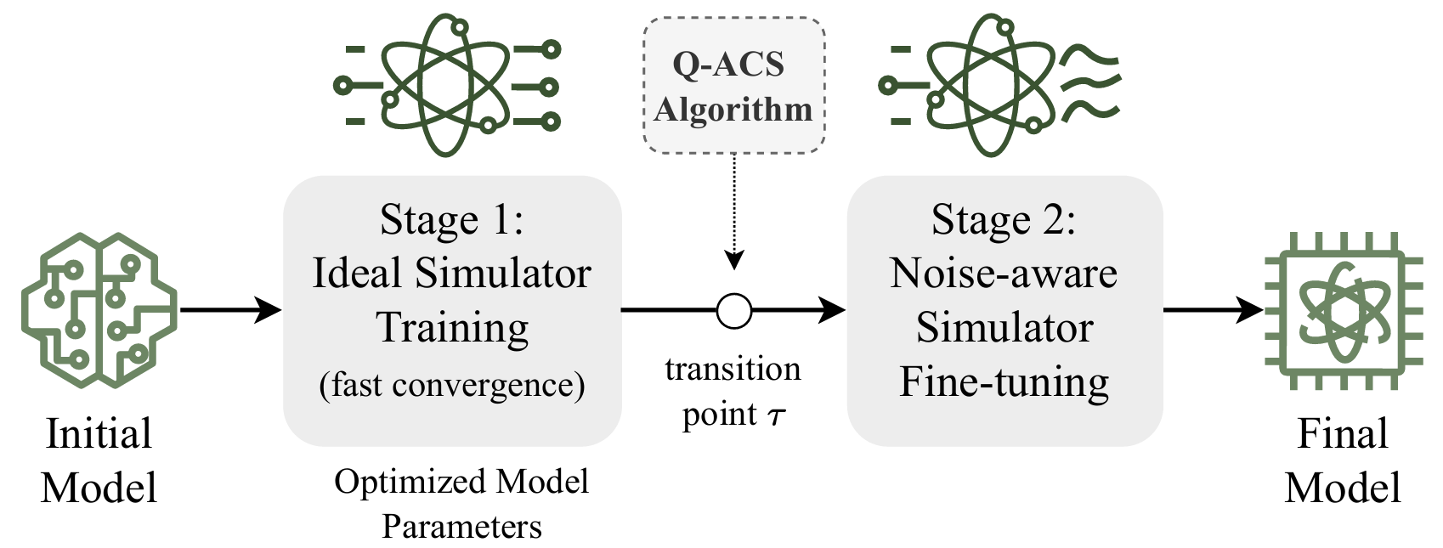
Proposed Q-Forge Framework
Q-Forge is a two-stage curriculum learning framework that enables fast convergence in ideal simulators and robust adaptation to realistic quantum noise.
Fig 1: The architecture of Q-Forge framework.
Notes:
This figure shows the overall architecture
of the Q-Forge framework.
In the first stage, the model is trained
on a noise-free simulator.
After convergence, the training moves
to a noise-aware environment.
This transition is controlled automatically
by the Q-ACS algorithm, without manual intervention.

Slide 7
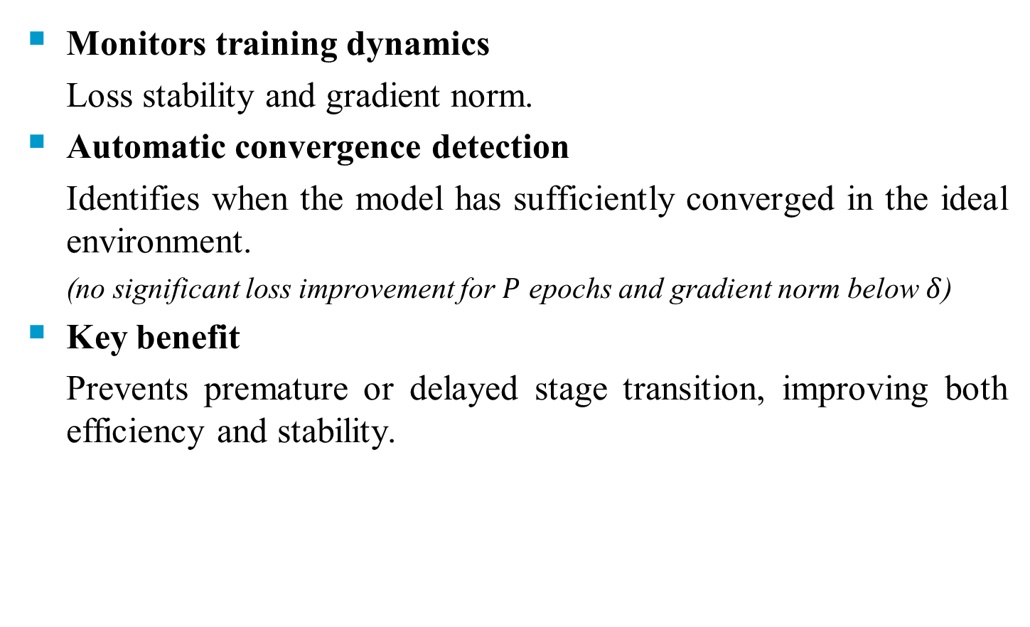
The Q-ACS Algorithm
Monitors training dynamics
Loss stability and gradient norm.
Automatic convergence detection
Identifies when the model has sufficiently converged in the ideal environment.
(no significant loss improvement for $P$ epochs and gradient norm below $δ$)
Key benefit
Prevents premature or delayed stage transition, improving both efficiency and stability.
Notes:
The Q-ACS algorithm controls the transition
between the two training stages.
It monitors the training process by tracking the loss value
and the gradient norm.
When the loss no longer improves and the gradient becomes small,
the model is considered converged.
At this point, Q-ACS automatically switches
to the noise-aware stage.
This helps save training time.

Slide 8
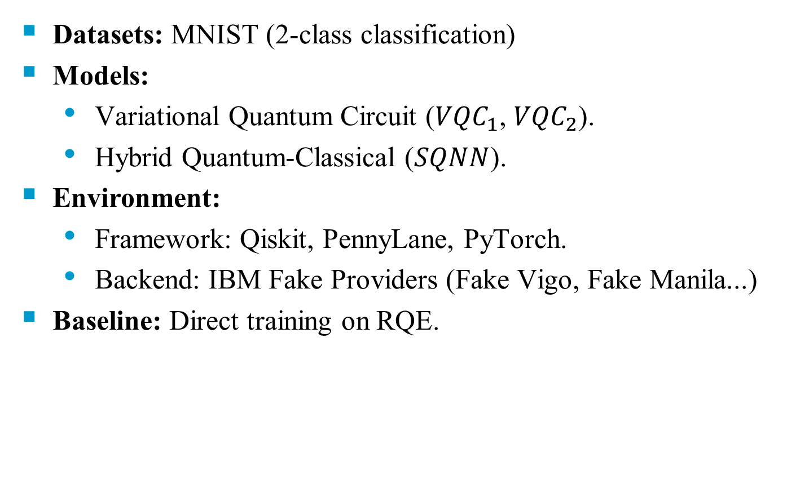
Experimental Setup
Datasets: MNIST (2-class classification)
Models:
  Variational Quantum Circuit (${VQC}_{1}$, ${VQC}_{2}$).
  Hybrid Quantum-Classical ($SQNN$).
Environment:
  Framework: Qiskit, PennyLane, PyTorch.
  Backend: IBM Fake Providers (Fake Vigo, Fake Manila...)
Baseline: Direct training on RQE.
Notes:
For our experiments, we use the MNIST dataset for binary classification.
We evaluate two types of models.
The first is the Variational Quantum Circuit,
including VQC one and VQC two.
The second is a hybrid model called SQNN.
We use Qiskit, PennyLane, and PyTorch.
As a baseline, we compare our method
with direct training on a Realistic Quantum Emulator.

Slide 9
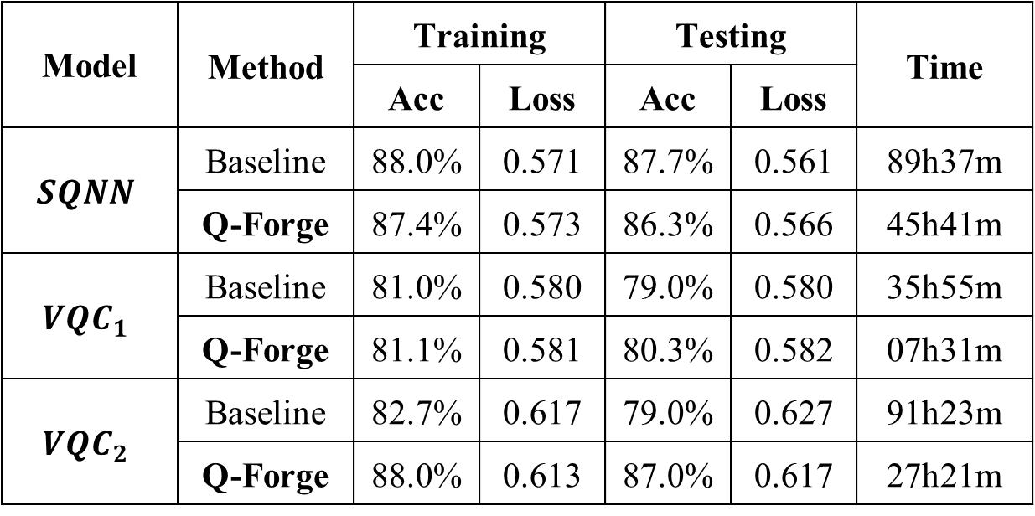
Experiment results
Key Results - Efficiency & Accuracy
Q-Forge reduces training time and can improve accuracy
Model | Method | Training |  | Testing |  | Time
 |  | Acc | Loss | Acc | Loss
$$SQNN$$ | Baseline | 88.0% | 0.571 | 87.7% | 0.561 | 89h37m
 | Q-Forge | 87.4% | 0.573 | 86.3% | 0.566 | 45h41m
$${VQC}_{1}$$ | Baseline | 81.0% | 0.580 | 79.0% | 0.580 | 35h55m
 | Q-Forge | 81.1% | 0.581 | 80.3% | 0.582 | 07h31m
$${VQC}_{2}$$ | Baseline | 82.7% | 0.617 | 79.0% | 0.627 | 91h23m
 | Q-Forge | 88.0% | 0.613 | 87.0% | 0.617 | 27h21m
Table: Performance evaluation of models after 50 epochs trained using Q-forge and baseline. ﻿
Notes:
This table compares the baseline method with Q-Forge.
For SQNN, Q-Forge reduces training time by about half.
For VQC one, it reduces training time by nearly eighty percent.
Most importantly, for VQC two, Q-Forge reduces training time by over seventy percent,
and improves accuracy by about eight percent.
These results show the effectiveness of Q-Forge.

Slide 10
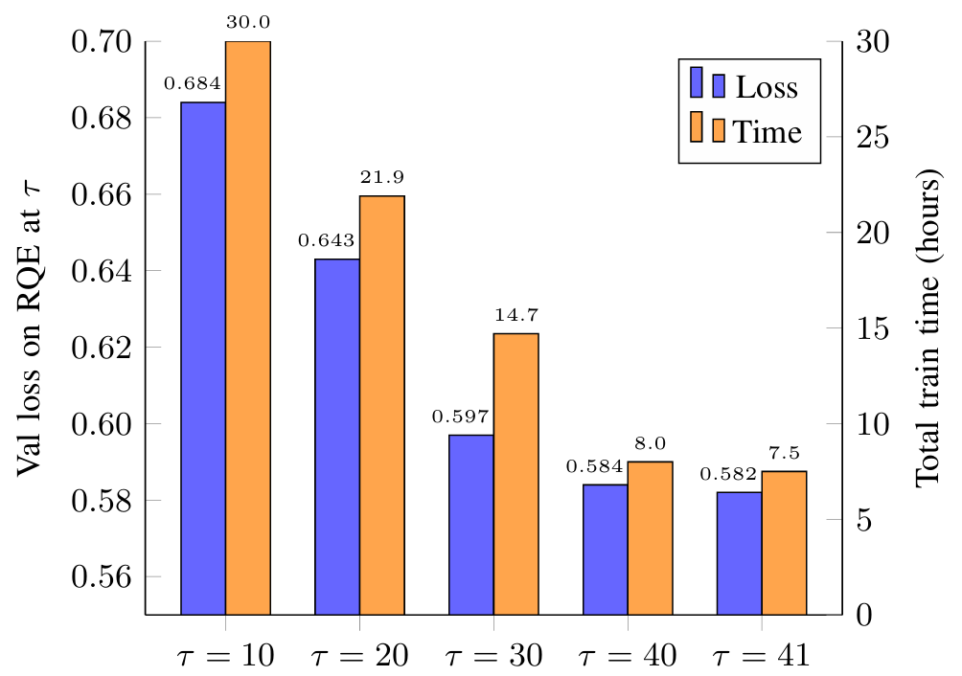
Experiment results
Ablation Study - Why Q-ACS?
The transition point selected by Q-ACS,
at τ equals 41, achieves the best result.
Fig 2:The figure illustrates the impact
of the transition points τ on the training process
Notes:
This figure shows the effect of different transition points.
As the transition point increases, the validation loss decreases, and the training time becomes shorter.
The transition point selected by Q-ACS,
at tau equals forty-one, achieves the best result.
This confirms the effectiveness of the Q-ACS algorithm.

Slide 11
Future Work
Larger-scale quantum systems
Evaluate Q-Forge on models with more qubits and deeper circuits.
More complex datasets and tasks
Extend experiments beyond binary MNIST to multi-class and real-world datasets.
Deployment on real quantum hardware
Validate Q-Forge directly on physical NISQ devices.
Generalization and robustness analysis
Study the stability of Q-Forge under different noise profiles and hardware backends.
Notes:
For future work, we plan to extend Q-Forge in several directions.
First, we will test larger quantum systems.
Second, we will use more complex datasets.
Third, we plan to deploy our method on real quantum hardware.
Finally, we will study robustness under different noise settings.

Slide 12

Notes:
Thank you very much
for your attention.
I would be happy
to answer any questions.

