Slide 1


Huynh Thai Hoc
huynhhoc@gmail.com
Sites.google.com.site/huynhoc

Slide 2
Agenda
History of Git
Version control system
Advantages of Git
DVCS Terminologies

Slide 3
History of GIT
Git is a distributed revision control and source code management system with an emphasis on speed. Git was initially designed and developed by Linus Torvalds for Linux kernel development. Git is a free software distributed under the terms of the GNU General Public License version 2.

Slide 4
Version Control System
Version Control System (VCS): is a software that helps software developers to work together and maintain a complete history of their work.
Functions of VCS:
Allows developers to work simultaneously.
Does not allow overwriting each other’s changes.
Maintains a history of every version.
Following are the types of VCS:
Centralized version control system
Distributed/Decentralized version control system
Notes:
Centralized version control system (CVCS) uses a central server to store all files and enables team collaboration. But the major drawback of CVCS is its single point of failure, i.e., failure of the central server. Unfortunately, if the central server goes down for an hour, then during that hour, no one can collaborate at all. And even in a worst case, if the disk of the central server gets corrupted and proper backup has not been taken, then you will lose the entire history of the project.
Here, distributed version control system (DVCS) comes into picture. DVCS clients not only check out the latest snapshot of the directory but they also fully mirror the repository. If the sever goes down, then the repository from any client can be copied back to the server to restore it. Every checkout is a full backup of the repository. Git does not rely on the central server and that is why you can perform many operations when you are offline. You can commit changes, create branches, view logs, and perform other operations when you are offline. You require network connection only to publish your changes and take the latest changes.

Slide 5


Traditional centralized VC model (CVS, Subversion)
Central Repository
Checkouts & Updates
Commits & Adds

Slide 6

Distributed version control system (git, hg)
Local
Local
Remote repository
Local
Local
Pulls & Clones
Pushes
Commits & Adds
Notes:
Everything is a branch
Every clone is always a backup
Committing is fast
Working offline also can work

Slide 7
Advantages of Git
Free and open source:
- Released under GPL’s open source license.
- Manage propriety projects without paying a single penny.
- Can download its source code and also perform changes according to your requirements.
Fast and small:
The core of Git is written in C → avoids runtime overheads associated with other high level languages.
Implicit backup
The chances of losing data are very rare when there are multiple copies of it. Data present on any client side mirrors the repository, hence it can be used in the event of a crash or disk corruption.

Slide 8
Advantages of Git
Security
Git uses a common cryptographic hash function called secure hash function (SHA1), to name and identify objects within its database. Every file and commit is check-summed and retrieved by its checksum at the time of checkout. It implies that it is impossible to change file, date, and commit message and any other data from the Git database without knowing Git.
No need of powerful hardware
In case of CVCS, the central server needs to be powerful enough to serve requests of the entire team. For smaller teams, it is not an issue, but as the team size grows, the hardware limitations of the server can be a performance bottleneck. In case of DVCS, developers don’t interact with the server unless they need to push or pull changes. All the heavy lifting happens on the client side, so the server hardware can be very simple indeed.
Easier branching
CVCS uses cheap copy mechanism. If we create a new branch, it will copy all the codes to the new branch, so it is time-consuming and not efficient. Also, deletion and merging of branches in CVCS is complicated and time-consuming. But branch management with Git is very simple. It takes only a few seconds to create, delete, and merge branches.

Slide 9
DVCS Terminology
Local Repository
Working Directory and Staging Area or Index
Blobs
Trees
Commit
Branches
Tags
Clone
Pull
Push
Head

Slide 10
DVCS Terminology
Git Directory
The .git directory that holds all information in the repository
Hidden from view
Local Repository
- Every VCS tool provides a private workplace as a working copy. Developers make changes in their private workplace and after commit, these changes become a part of the repository.
- Git takes it one step further by providing them a private copy of the whole repository.
- Users can perform many opertions with this repository such as add file, remove file, rename file, move file, commit changes, etc,...

Slide 11
DVCS Terminology
Working Directory and Staging Area or Index
- Working Directory is the place where files are checked out
- Staging area: whenever you commit an operation, Git looks for the files present in the staging area. Only those files present in the staging area are considered for commit and not all the modified files.

Slide 12
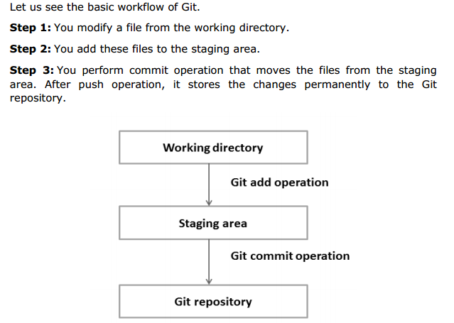
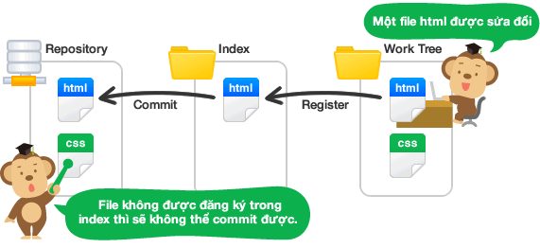
DVCS Terminology
Working Directory and Staging Area or Index

Slide 13
DVCS Terminology
Blobs
Blob stands for Binary Large Object. Each version of a file is represented by blob. A blob holds the file data but doesn’t contain any metadata about the file. It is a binary file and in Git database, it is named as SHA1 hash of that file. In Git, files are not addressed by names. Everything is content-addressed.

Slide 14
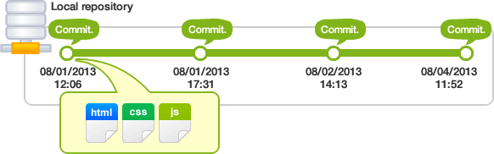
DVCS Terminology
Tree
Tree is an object, which represents a directory. It holds blobs as well as other sub-directories. A tree is a binary file that stores references to blobs and trees which are also named as SHA1 hash of the tree object.
Commit
A set of changes that have been saved to the repository
Can be reverted and even modified to some extent
Identified by a hash of the changes it contains

Slide 15
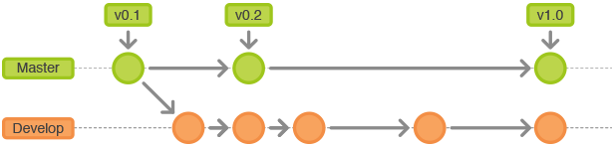
DVCS Terminology
Branches
Branches are used to create another line of development. By default, Git has a master branch, which is same as trunk in Subversion. Usually, a branch is created to work on a new feature. Once the feature is completed, it is merged back with the master branch and we delete the branch. Every branch is referenced by HEAD, which points to the latest commit in the branch. Whenever you make a commit, HEAD is updated with the latest commit.

Slide 16
DVCS Terminology
Tags
Tag assigns a meaningful name with a specific version in the repository. Tags are very similar to branches, but the difference is that tags are immutable. It means, tag is a branch, which nobody intends to modify. Once a tag is created for a particular commit, even if you create a new commit, it will not be updated. Usually, developers create tags for product releases.
Clone
Clone operation creates the instance of the repository. Clone operation not only checks out the working copy, but it also mirrors the complete repository. Users can perform many operations with this local repository. The only time networking gets involved is when the repository instances are being synchronized.

Slide 17
DVCS Terminology
Pull
Pull operation copies the changes from a remote repository instance to a local one. The pull operation is used for synchronization between two repository instances. This is same as the update operation in Subversion.
Push
Push operation copies changes from a local repository instance to a remote one. This is used to store the changes permanently into the Git repository. This is same as the commit operation in Subversion.

Slide 18
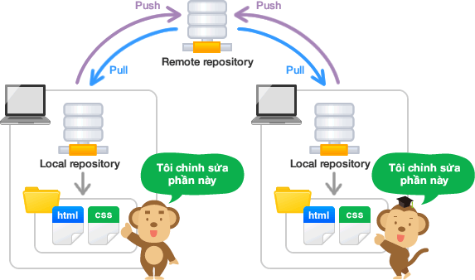
DVCS Terminology

Slide 19
DVCS Terminology
HEAD
HEAD is a pointer, which always points to the latest commit in the branch. Whenever you make a commit, HEAD is updated with the latest commit. The heads of the branches are stored in .git/refs/heads/ directory.
Can be used to reference older revisions with operants
HEAD^^2 == 2 revisions before latest
HEAD^ == 1 revision before latest
HEAD~3 == 3 latest revisions
HEAD^^2..HEAD == 2 revisions before the latest to the latest

Slide 20
DVCS Terminology
Origin
Default name for a remote repository when cloning an existing repository

Slide 21
Git object model – The SHA hash
All git objects are represented in the history of a project with a 40 character hash
Example: 678ce96d260a869eb54aef96c482958257e7d17d
The hash is a SHA1 hash of the contents of the object
=> All hashes are unique
=> Identify commits
=> Are used to check if the files are valid
=> Identical objects can be identified because they will have identical hashes

Slide 22
Git object model - The objects
Every object in the history consists of three things or properties
Type
Size
Content
Git is built around manipulating different types of objects. It could be thought of as it’s own file system in your computer’s file system

Slide 23
Git object model - Types
Blob
A file
Tree
A directory or sub-directories and files associated with them
Commit
A pointer that marks a single tree to what the project looked at a certain point in time. Contains author, timestamp, a pointer to the previous commit
Tag
A way to mark a certain commit special in some way. Usually used to mark
Notes:
As you can see, most of the file types are direct derivatives of UNIX concepts or programs.

Slide 24
Install GIT
Before you start using Git, you have to make it available on your computer. Even if it’s already installed, it’s probably a good idea to update to the latest version. You can either install it as a package or via another installer, or download the source code and compile it yourself.
C:\> mkdir CoolProject
C:\> cd CoolProject
C:\CoolProject > git init
Initialized empty Git repository in C:/CoolProject/.git
C:\CoolProject > notepad README.txt
C:\CoolProject > git add .
C:\CoolProject > git commit -m 'my first commit'
[master (root-commit) 7106a52] my first commit
1 file changed, 1 insertion(+)
create mode 100644 README.txt
Notes:
https://git-scm.com/book/en/v2/Getting-Started-Installing-Git
After you install git on your machine to get started you will need to initialize a repository.
You can do this by going into your file system, creating a folder and doing git init within the folder.
All the magic happens in the Dot Git folder. This folder IS GIT. You can copy this folder to another machine and it will work.
When I first started playing with git, I had setup a new machine, and was having a hell of a time trying to figure out how I should move my git projects over to the new machine. It was kind of embarrassing. Eventually I just tried to copy it over and it worked.
At this point you really don’t have much. You need to do your first commit to make this light up.
You create a file. When then stage it, but telling git the track this file. In this case I told git to add all files.
Then I was able to commit with a message say this is my first commit.
git-init - Create an empty Git repository or reinitialize an existing one
git-add - Add file contents to the index

