Slide 1


Huynh Thai Hoc
huynhhoc@gmail.com
Sites.google.com.site/huynhoc

Slide 2
Agenda
What is Github
How do I use Github
Workflow for working with Git and Github

Slide 3
What is Github
Github is a web-based hosted service for Git repositories. Git is a popular open-source version control system. Github allows you to host remote Git repositories, and has a wealth of community-based services that make it ideal for open source projects.

Slide 4
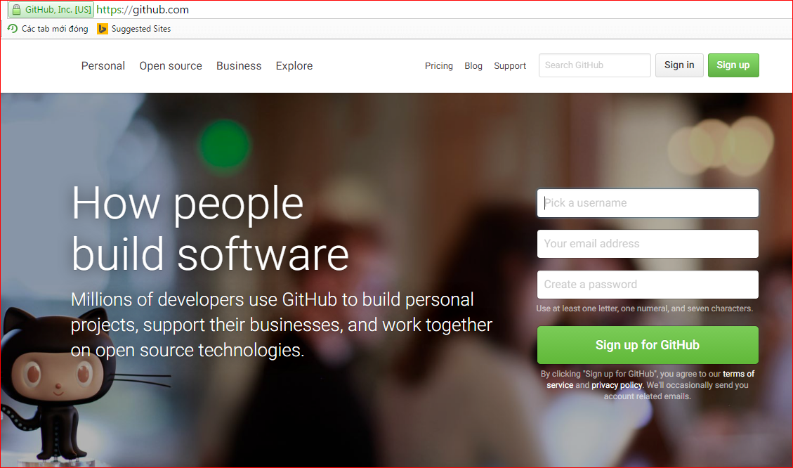

Slide 5
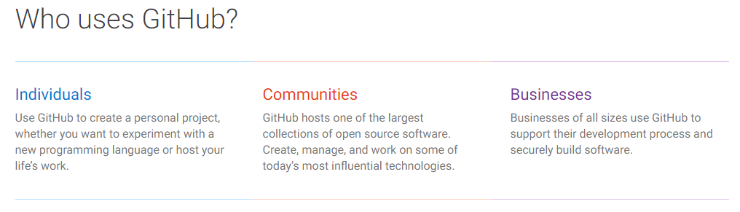
What is Github

Slide 6

How do I use github?
Set up a user account
public account is free, students can request 5 private
e.g. CyndiRader
Remember your password!
Create a repository
e.g. GitDemoCode
Add github as a “remote”
Push your master branch (later we’ll deal with other branches, just work with master for now)
Add collaborators (if public, everyone can read, but not write. If private, must be collaborator to even read)

Slide 7
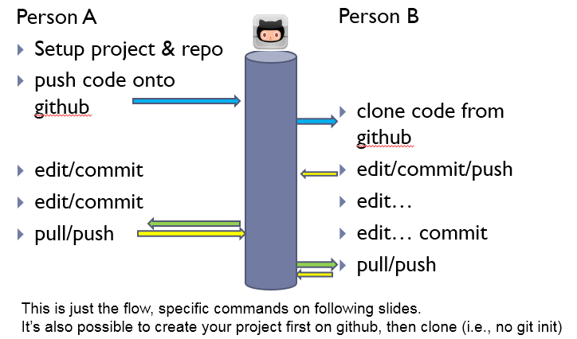
Typical workflow

Slide 8
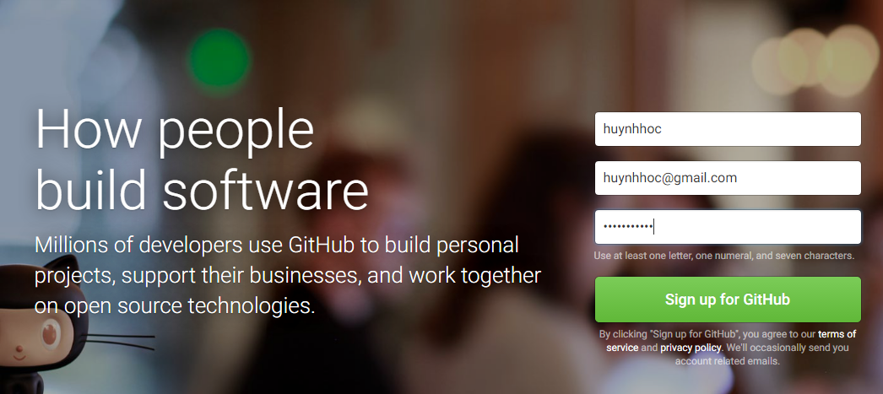

Slide 9
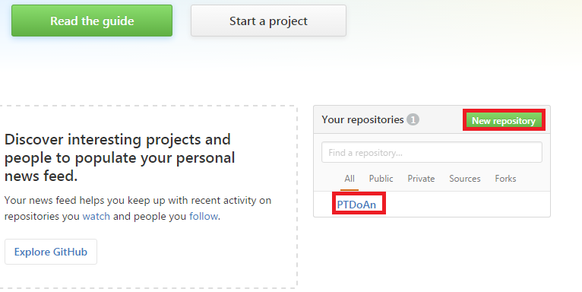
Typical workflow

Slide 10
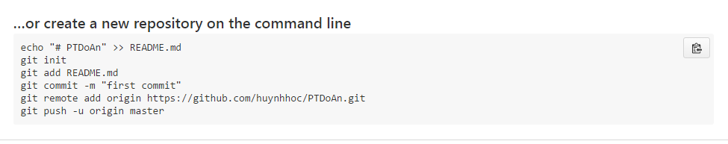
Typical workflow

Slide 11
Workflow for working Git and Github
Step 0: Install git and create a GitHub account
Step 1: Create a local git repository
Step 2: Add a new file to the repo
Step 3: Add a file to the staging environment
Step 4: Create a commit
Step 5: Create a new branch
Step 6: Create a new repository on GitHub
Step 7: Push a branch to GitHub
Step 8: Create a Pull Request (PR)
Step 9: Merge a PR
Step 10: Get changes on GitHub back to your computer
Step 11: Bask in your git glory

Slide 12
Step 0: Install git and create a GitHub account
- Install Git
- Create a GitHub account

Slide 13
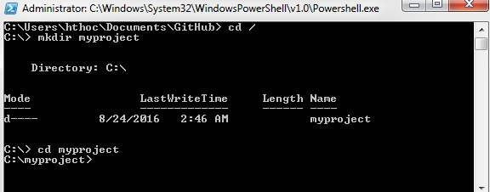
Step 1: Create a local git repository
- Create a new project on your local machine using git, you'll first create a new repository (or often, 'repo', for short).

Slide 14
Step 1: Create a local git repository
- Initialize a git repository in the root of the folder, run the git init command:

Slide 15
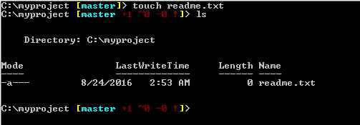
Step 2: Add a new file to the repo
Go ahead and add a new file to the project, using any text editor you like or running a touch command.
Once you've added or modified files in a folder containing a git repo, git will notice that changes have been made inside the repo. But, git won't officially keep track of the file (that is, put it in a commit - we'll talk more about commits next)

Slide 16
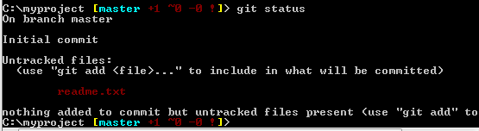
Step 2: Add a new file to the repo
After creating the new file, you can use the git status command to see which files git knows exist
Notes:
untracked

Slide 17
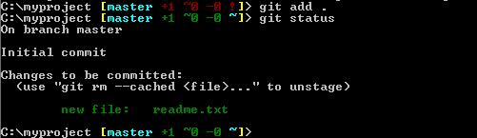
Step 3: Add a file to the staging environment
Add a file to the staging environment using the git add command

Slide 18

Step 4: Create a commit
Git commit –m “Your message about the commit”

Slide 19

Step 5: Create a new branch
Run git checkout -b <my branch name>. This command will automatically create a new branch and then 'check you out' on it, meaning git will move you to that branch, off of the master branch.
After running the above command, you can use the git branch command to confirm that your branch was created:

Slide 20
Step 5: Create a new branch
The branch name with the asterisk next to it indicates which branch you're pointed to at that given time.
Now, if you switch back to the master branch and make some more commits, your new branch won't see any of those changes until you merge those changes onto your new branch.

Slide 21
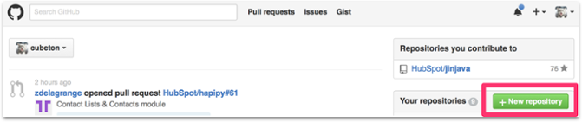
Step 6: Create a new repository on GitHub
To create a new repo on GitHub, log in and go to the GitHub home page. You should see a green '+ New repository' button

Slide 22
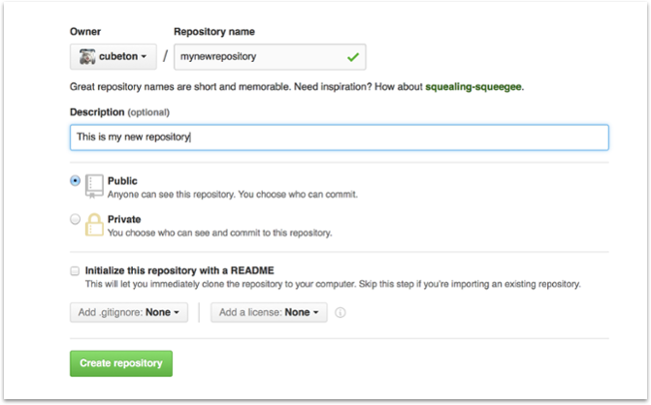
Step 6: Create a new repository on GitHub
After clicking the button, GitHub will ask you to name your repo and provide a brief description:

Slide 23
Step 6: Create a new repository on GitHub
When you're done filling out the information, press the 'Create repository' button to make your new repo.
GitHub will ask if you want to create a new repo from scratch or if you want to add a repo you have created locally. In this case, since we've already created a new repo locally, we want to push that onto GitHub so follow the '....or push an existing repository from the command line' section:

Slide 24
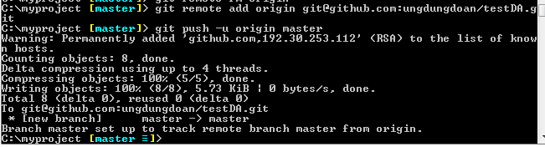
Step 7: Push onto Github
Git remote add origin url (https/ssh)
Git push –u origin master (or yourbranchname)
Note: you could've used either the command: git push git@github.com:git/git.git yourbranchname or git push origin yourbranchname

Slide 25
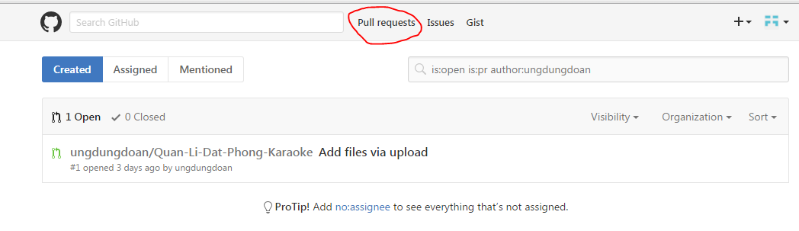
Step 8: Create a Pull Request (PR)
A pull request (or PR) is a way to alert a repo's owners that you want to make some changes to their code. It allows them to review the code and make sure it looks good before putting your changes on the master branch.

Slide 26
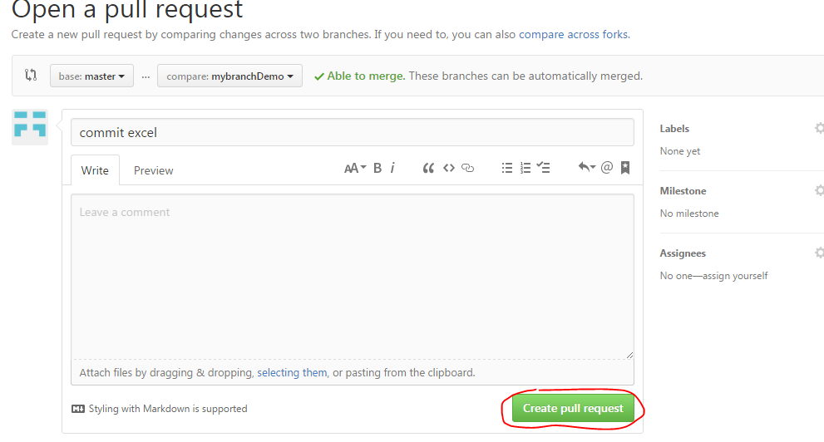
Step 8: Create a Pull Request (PR)
Notes:
once you've submitted the PR request

Slide 27
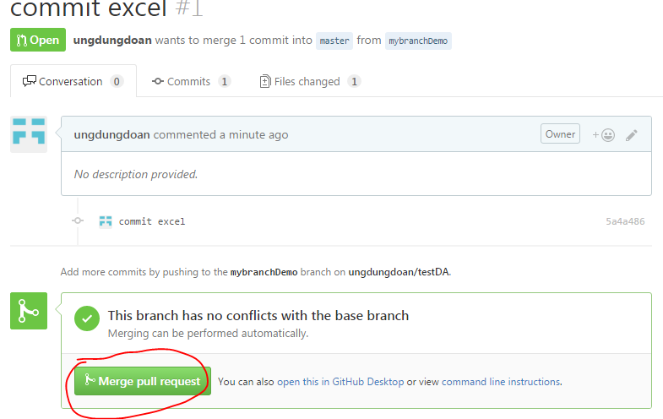
Step 8: Create a Pull Request (PR)
once you've submitted the PR request
Notes:
once you've submitted the PR request

Slide 28
Step 8: Create a Pull Request (PR)
You might see a big green button at the bottom that says 'Merge pull request'. Clicking this means you'll merge your changes into the master branch.
Note that this button won't always be green. In some cases it'll be grey, which means you're faced with a merge conflict. This is when there is a change in one file that conflicts with a change in another file and git can't figure out which version to use. You'll have to manually go in and tell git which version to use.
Sometimes you'll be a co-owner or the sole owner of a repo, in which case you may not need to create a PR to merge your changes. However, it's still a good idea to make one so you can keep a more complete history of your updates and to make sure you always create a new branch when making changes.
Notes:
once you've submitted the PR request

Slide 29
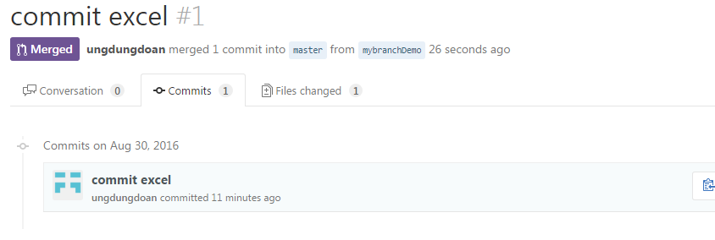
Step 9: Merge PR
Go ahead and click the green 'Merge pull request' button. This will merge your changes into the master branch.
When you're done, I recommend deleting your branch (too many branches can become messy), so hit that grey 'Delete branch' button as well.
You can double check that your commits were merged by clicking on the 'Commits' link on the first page of your new repo.

Slide 30
Step 10: Get changes on GitHub back to your computer
Right now, the repo on GitHub looks a little different than what you have on your local machine. For example, the commit you made in your branch and merged into the master branch doesn't exist in the master branch on your local machine.
In order to get the most recent changes that you or others have merged on GitHub, use the
git pull origin master command (when working on the master branch).
Now we can use the git log command again to see all new commits.
(You may need to switch branches back to the master branch. You can do that using the git checkout master command.)

Slide 31
Reference
http://product.hubspot.com/blog/git-and-github-tutorial-for-beginners
http://blog.appconus.com/2015/08/06/tao-ssh-key-va-su-dung-ssh-key-trong-git/

