Slide 1




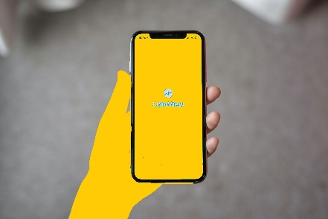
What are you
v
here to do?
v
v
v
v
v
Mobile Internet
v
v
Home Internet
Add a phone-line
Get a device
Upgrade
Start here
◆
⧫
Previous
Next
◆

