Slide 1
Recommendation System

Slide 2
Train Test Split Data
Get last user that visited project as test and other as train set
Filter group (userCode, project_id) not in test
Filter userCode not in test
Filter project_id not in test

Slide 3
Pre Processing
Filter row that userCode not in test

Slide 4

Model Library LightFM
Reference https://github.com/lyst/lightfm

Slide 5
Matrix Factorization + Gradient Descent
 | Project1 | Project2 | Project3
User1 | ? | ? | 1
User2 | ? | 1 | ?
User3 | 1 | ? | 1

Slide 6
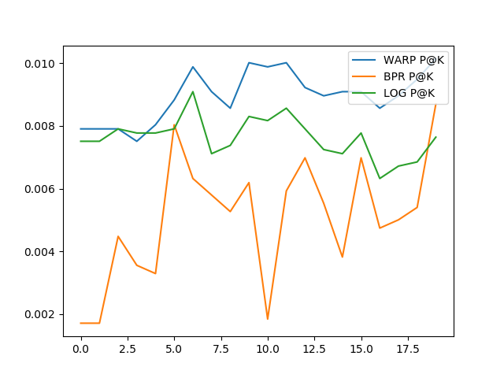
Loss Function
WARP: Weighted Approximate-Rank Pairwise
BPR: Bayesian Personalized Ranking
LOG: logistic

Slide 7
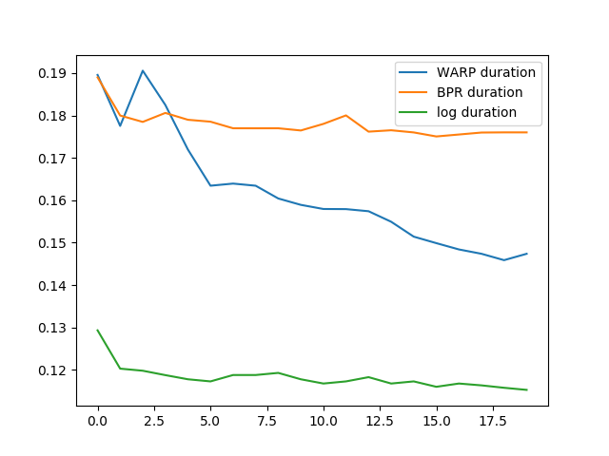
Train Duration

Slide 8
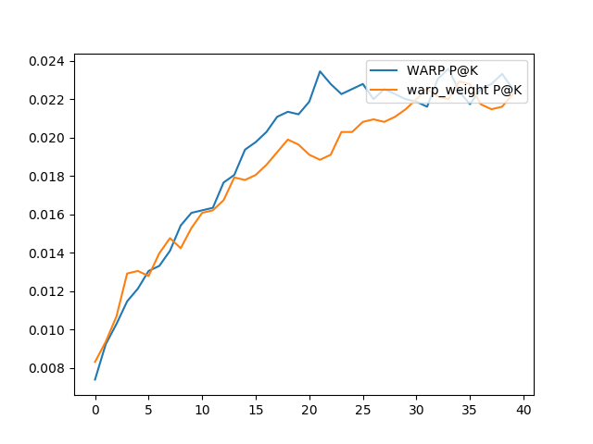
Try to add weight

Slide 9
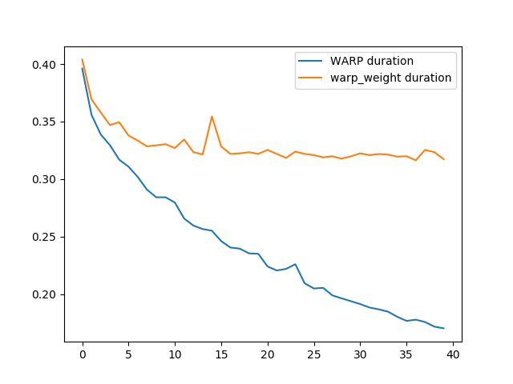

Slide 10
Post Processing
Filter Project in test
Get top-7

Slide 11
Feature Engineering by Decision Tree Regressor
Feature ranking:
1. feature project_interacts: 0.316587
2. feature user_interacts: 0.187386
3. feature district_id: 0.106924
4. feature weekday: 0.069143
5. feature starting_price: 0.055822
6. feature province_id: 0.048683
7. feature land_size: 0.044625
8. feature facility: 0.039754

