Slide 1
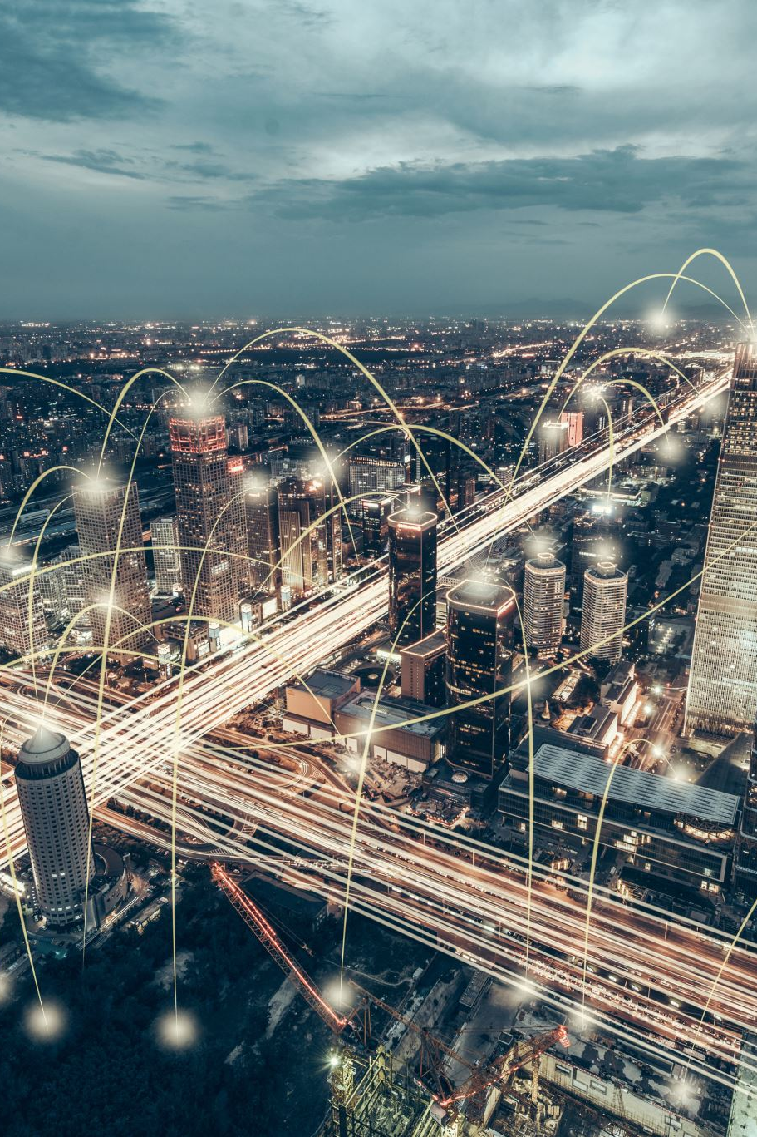
Introduction: Exploring the Potential of AI and IOT in Traffic Management
Introduction:
- AI and IOT are rapidly evolving technologies with immense potential in traffic management.
- These technologies can help improve traffic flow, safety, and efficiency.
Applications:
- Real-time monitoring and analysis of traffic patterns
- Intelligent traffic signal control
- Predictive maintenance for road infrastructure
- Automated toll systems
- Smart parking solutions
Benefits:
- Reduced traffic congestion and travel time
- Increased safety for drivers, passengers, and pedestrians
- Cost savings and efficiency for transportation agencies
- Improved air quality and reduced emissions
Challenges:
- Data privacy and security concerns
- Integration with existing transportation systems
- Initial investment costs
- Need for skilled workforce and technical support
Future prospects:
- Continued advancement and integration of AI and IOT in traffic management
- Potential for autonomous vehicles and seamless transportation systems
- Improved urban planning and city infrastructure
- Benefits for emergency

Slide 2
Understanding the Current Challenges in Traffic Management
1. Current challenges in traffic management include:
Increasing traffic congestion in urban areas
Inefficient traffic flow and delays
Lack of effective communication between different transportation systems
Limited infrastructure and resources for managing traffic
2. Applications of technology in traffic management:
Traffic monitoring systems using sensors and cameras
Intelligent transportation systems for real-time decision making
Advanced traffic signal control to optimize traffic flow
Integration of data from various transportation modes
3. Benefits of implementing efficient traffic management strategies:
Reduced travel time and congestion for commuters
Lower carbon emissions and improved air quality
Enhanced safety for drivers, cyclists, and pedestrians
Cost savings for cities and transportation agencies
4. Key challenges in implementing traffic management solutions:
Upfront costs and investment in infrastructure and technology
Resistance to change and lack of public awareness
Coordination and collaboration between different stakeholders
Potential privacy concerns with data collection and management
5. Future prospects for traffic

Slide 3
How AI and IOT are Revolutionizing Traffic Management Systems
Introduction to AI and IoT
- Explanation of the concepts and how they work together to improve traffic management systems
Applications of AI and IoT in Traffic Management
- Real-time traffic monitoring and analysis
- Predictive maintenance for traffic infrastructure
- Intelligent traffic signal control
- Smart parking management
- Autonomous vehicles and their impact on traffic flow
Benefits of AI and IoT in Traffic Management
- Improved traffic flow and reduced congestion
- Cost savings through optimized resource allocation
- Enhanced safety for drivers, pedestrians, and cyclists
- Reduced carbon footprint and environmental impact
- Better response to emergencies and incidents
Challenges and Limitations of Implementing AI and IoT in Traffic Management
- Data privacy and security concerns
- Availability of reliable and accurate data
- High initial investment and maintenance costs
- Need for skilled workforce to manage and analyze data
- Integration with existing systems and infrastructure
Future Pros

Slide 4
Smart Traffic: How AI and IOT Technologies Work Together
Introduction to Smart Traffic: combining AI and IoT technologies for efficient traffic management
Applications: Traffic flow prediction, real-time monitoring, adaptive traffic signal control
Benefits: Reduced congestion, improved safety, reduced travel time and emissions
Challenges: Data privacy, infrastructure costs, implementation and integration challenges
How AI and IoT work together: Sensors gather data, AI algorithms analyze and make decisions, IoT devices respond in real-time
Future prospects: Advancements in smart vehicle technology, potential for autonomous vehicles integration, potential for further reducing congestion and improving overall transportation system
Case studies: Successful implementation of smart traffic systems in cities like Singapore and Barcelona
Audience engagement: Interactive demonstrations of AI and IoT technologies in action
Solution proposal: Collaborating with local government and transportation authorities to implement a smart traffic system in [specific location]
Conclusion: Smart traffic not only improves transportation but also has positive environmental and economic impacts. Let's work together towards a smarter, more efficient future

Slide 5
Enhancing Traffic Flow with Real-time Data Collection and Analysis
Proposal: Enhancing traffic flow through real-time data collection and analysis
Applications:
Traffic management and control systems
Predictive traffic modeling for route planning
Road safety and accident prevention
Benefits:
Reduced travel time for commuters
Improved traffic flow and reduced congestion
Increased efficiency and cost savings for transportation agencies
Challenges:
Ensuring data accuracy and consistency
Securing and protecting sensitive data
Integration with existing infrastructure and systems
Future Prospects:
Advancements in technology for more precise and real-time data collection
Possibility of automated traffic flow control through machine learning
Potential for smart city integration and improvement of overall transportation systems

Slide 6
Predicting and Preventing Traffic Violations with AI and IOT
Utilization of AI and IoT for predicting and preventing traffic violations
- AI algorithms can analyze traffic patterns and identify potential violations
- IoT devices such as sensors and cameras can collect data in real-time
Applications:
- Traffic management systems to reduce congestion
- Automated ticketing for violations
- Real-time alerts for emergency vehicles
Benefits:
- Improved safety for drivers and pedestrians
- Reduced traffic incidents and delays
- Cost savings for law enforcement agencies
Challenges:
- Privacy concerns for data collection
- Dependence on reliable IoT infrastructure
- Cost of implementing new technology
Future prospects:
- Integration with autonomous vehicles for improved traffic flow
- Potential for predictive maintenance of road infrastructure
- Development of advanced AI algorithms for more accurate predictions.

Slide 7
Case Studies: Successful Implementation of AI and IOT in Traffic Management
AI and IoT technologies have been successfully implemented in traffic management systems, resulting in improved efficiency and safety.
Applications of AI in traffic management include intelligent traffic signal control, predictive traffic modeling, and real-time incident detection and response.
Benefits of AI and IoT in traffic management include reduced congestion, improved flow of traffic, and reduced carbon emissions.
Challenges associated with implementing AI and IoT in traffic management include data privacy concerns, technical complexity, and integration with existing infrastructure.
Future prospects for AI and IoT in traffic management include the use of autonomous vehicles, adaptive traffic control systems, and smart city integration.
By leveraging AI and IoT in traffic management, cities can reduce costs associated with traffic congestion and improve overall quality of life for citizens.
It is crucial for cities and transportation authorities to embrace and invest in these technologies in order to stay competitive and meet the growing demands of urbanization.

Slide 8
The Economic Benefits of Adopting AI and IOT in Traffic Management
Adoption of AI and IOT in traffic management can lead to improved efficiency, cost savings, and enhanced safety in transportation systems.
AI and IOT technology can be applied in traffic control, route optimization, and predictive maintenance of traffic infrastructure.
The use of AI and IOT in traffic management can reduce travel time, congestion, and emissions, resulting in economic benefits for businesses and communities.
Some challenges of implementing AI and IOT in traffic management include data security, privacy concerns, and the need for skilled personnel and infrastructure upgrades.
However, these challenges can be addressed through collaboration with technology experts, proper data governance, and strategic investments.
The future prospects of AI and IOT in traffic management are promising, with the potential for further developments such as connected and autonomous vehicles and dynamic traffic control systems.
Governments, businesses, and individuals can all benefit from the economic advantages of adopting AI and IOT in traffic management, making it a valuable investment for the future.
By embracing

Slide 9
Ethical Considerations and Data Security in Smart Traffic Systems
1. Overview of Smart Traffic Systems and their growing importance in modern cities.
2. Ethical concerns surrounding the use of data in these systems, including privacy and discrimination.
3. Importance of data security in protecting sensitive information collected by these systems.
4. Potential applications of smart traffic data in improving traffic flow and safety.
5. Benefits of data-driven decision making for city planners and transportation agencies.
6. Challenges in implementing ethical and secure practices in smart traffic systems, including technical limitations and cost.
7. Importance of transparency and collaboration with stakeholders in addressing ethical concerns.
8. Opportunities for innovation and collaboration in developing ethical and secure smart traffic systems.
9. Future prospects for smart traffic systems, including advancements in technology and regulations to address ethical concerns.

Slide 10
Addressing Common Concerns and Myths about AI and IOT in Traffic Management
AI and IoT can improve traffic management through real-time data analysis and optimization.
This technology can efficiently manage traffic flow, reducing congestion and travel times.
It can also detect and respond to accidents, reducing emergency response times and improving safety.
AI and IoT can optimize traffic signal timing, reducing wait times at intersections for drivers.
It also has the potential to improve public transportation systems by predicting demand and adjusting schedules accordingly.
This technology is already being implemented in cities around the world, with successful results.
Some common concerns about AI and IoT in traffic management include privacy, security, and job displacement.
However, these concerns can be addressed through proper regulations and protocols.
The benefits of implementing AI and IoT in traffic management far outweigh the challenges, with potential for significant cost savings and increased efficiency.
In the future, this technology could lead to fully autonomous traffic management and vehicles, further improving safety and reducing human error.

Slide 11
Collaborating with Government and Private Entities for Effective Traffic Management
Collaborating with government and private entities for traffic management is crucial for efficient and safe transportation systems.
Government and private entities bring diverse expertise, resources, and funding to address traffic management challenges.
Jointly implementing traffic management strategies can lead to quicker and more effective solutions.
Public-private partnerships can provide innovative solutions, such as real-time traffic monitoring and data analysis, to improve traffic flow.
Collaborative efforts can lead to better integration of transportation modes, including public transport, ride-sharing, and walking/biking options.
Effective traffic management results in reduced travel times, fuel consumption, and air pollution, benefiting both the environment and the economy.
However, collaboration also poses challenges, including differences in priorities, budget constraints, and coordination between multiple stakeholders.
To overcome these challenges, clear communication and transparency between government and private entities is key.
Future prospects of collaboration for traffic management include the use of emerging technologies, such as autonomous vehicles and smart traffic signals.
By working together,

Slide 12
Steps for Implementing AI and IOT Technologies in Traffic Violation Management
Introduction to AI and IoT technologies in traffic violation management
Importance and impact of implementing these technologies
Step 1: Conduct initial assessment of current traffic violation management system
Step 2: Identify specific areas where AI and IoT can be applied
Step 3: Determine relevant data to be collected and analyzed
Step 4: Select AI and IoT technologies suitable for the identified areas
Application: Use of AI for automated license plate recognition and detection of traffic violations
Application: Utilizing IoT sensors for real-time monitoring of traffic flow and patterns
Benefit: Improving accuracy and efficiency in detecting and recording violations
Benefit: Enabling proactive traffic management and congestion control
Challenge: Ensuring privacy and security of collected data
Challenge: Implementing changes and training staff for the new system
Step 5: Develop an integrated system for data collection, analysis, and reporting
Future prospects: Potential for predictive analytics to prevent traffic violations

Slide 13
Demonstrating the User Experience: Interactive Simulations of Smart Traffic Systems
Smart traffic systems aim to improve traffic flow, reduce accidents, and enhance user experience through the use of technology.
Interactive simulations allow for a visual and hands-on demonstration of how smart traffic systems work.
Applications of smart traffic systems include autonomous vehicles, real-time traffic updates, and intelligent traffic signals.
Benefits of smart traffic systems include reduced commute times, improved air quality, and increased safety on the roads.
Challenges of implementing smart traffic systems include high initial costs, integration with existing infrastructure, and user privacy concerns.
Interactive simulations can help stakeholders understand the complexities and benefits of smart traffic systems.
They also allow for testing and refinement of the system design before actual implementation.
In the future, smart traffic systems could be fully integrated with other smart city technologies, such as energy management and waste disposal systems.
They could also lead to the development of fully autonomous transportation systems.
Interactive simulations provide a valuable tool for public education and engagement in the implementation of smart traffic systems.
-

Slide 14
Future Prospects and Continuous Development of AI and IOT in Traffic Management
AI and IoT have the potential to revolutionize traffic management by providing real-time data, predictive analysis, and automation.
This technology can improve traffic flow, reduce congestion, and enhance safety for drivers, cyclists, and pedestrians.
Smart traffic signals, connected vehicles, and intelligent transportation systems are just a few examples of applications for AI and IoT in traffic management.
The use of AI and IoT can lead to significant cost savings for cities and governments by reducing the need for traditional manpower and infrastructure.
Additionally, this technology can help reduce carbon emissions and promote sustainability by optimizing traffic patterns.
However, there are challenges to consider, such as data privacy and security concerns, as well as the need for proper infrastructure and maintenance.
Looking ahead, the future prospects for AI and IoT in traffic management are promising, with potential developments such as autonomous vehicles and smart road infrastructure.
This technology is continuously evolving, with new advancements being made every day, making it essential for cities to keep up with

Slide 15
Conclusion: The Need for Smart Traffic Systems in the Modern World
Introduction to smart traffic systems and their purpose
Growing problem of traffic congestion in cities
Advancements in technology and its potential for solving traffic issues
Applications of smart traffic systems: traffic monitoring, signal control, data analysis
Benefits of smart traffic systems: reduced congestion, improved safety, decreased pollution
Challenges and obstacles in implementing smart traffic systems
Government and public support needed for successful implementation
Potential cost savings for cities and communities
Future prospects of smart traffic systems: potential for expansion and improvement
Impact on quality of life and economic growth in cities
Examples of successful smart traffic systems in other countries
How smart traffic systems can integrate with other technologies (e.g. autonomous vehicles)
Importance of continuous data collection and analysis for optimizing smart traffic systems
Positive impact on emergency response and public transportation
Call to action for governments and communities to invest in smart traffic systems for a more efficient and sustainable future.

