Slide 1
Introduction to AI & IOT in Traffic Violations
Introduction to AI (Artificial Intelligence) and IOT (Internet of Things) in traffic violations
Definition of AI and IOT and their role in traffic management
Applications of AI and IOT in traffic violations:
- Automated traffic monitoring and enforcement
- Real-time traffic data analysis and prediction
- Intelligent traffic signal control
- Automated license plate recognition
- Smart parking management
Benefits of using AI and IOT in traffic violations:
- Improved traffic flow and reduced congestion
- Increased safety for drivers and pedestrians
- Efficient use of resources and cost savings
- Faster and more accurate violation detection and enforcement
Challenges in implementing AI and IOT in traffic violations:
- Data privacy and security concerns
- Integration with existing traffic systems and infrastructure
- Cost of implementation and maintenance
- Potential for bias in AI algorithms
Future prospects of AI and IOT in traffic violations:
- Continued advancements in technology and data analytics
- Potential for autonomous vehicles to further improve traffic management
- Integration with smart city initiatives for overall urban planning and management
- Potential for reducing human error and improving overall traffic safety.

Slide 2
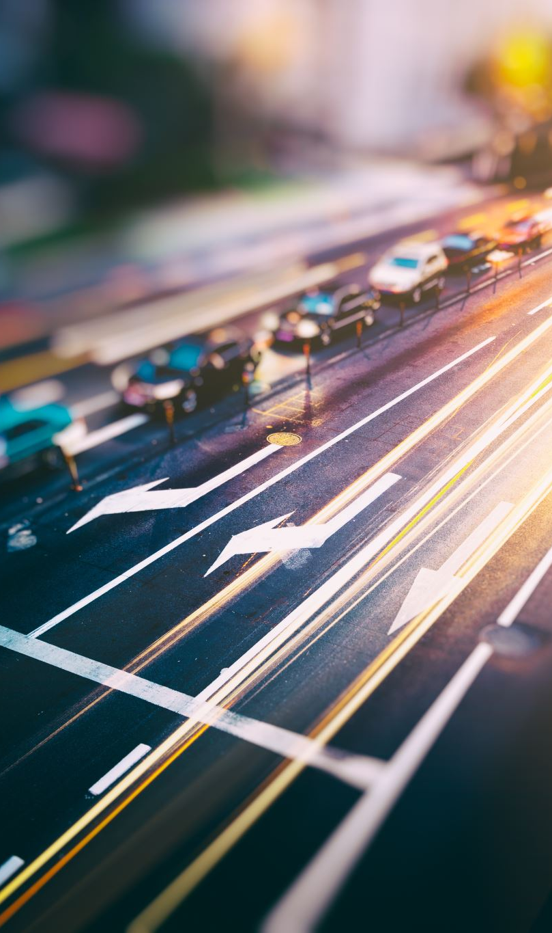
Understanding the Impact of AI & IOT on Traffic Management
AI and IoT are revolutionizing traffic management by providing real-time data and analysis for efficient decision making.
Applications of AI and IoT in traffic management include traffic prediction, route optimization, and adaptive traffic signals.
Benefits of AI and IoT in traffic management include reduced congestion, improved safety, and reduced travel time.
Challenges in implementing AI and IoT in traffic management include data privacy concerns, infrastructure limitations, and cost.
The future prospects of AI and IoT in traffic management include the development of autonomous vehicles and smart cities.
AI and IoT can also be used for intelligent parking management, reducing the time and frustration of finding parking spaces.
With the help of AI and IoT, traffic management systems can adapt to changing traffic patterns and adjust traffic signals accordingly.
Real-time data from connected vehicles and sensors can be used to identify and respond to accidents or road hazards, improving safety.
AI and IoT can also be used for predictive maintenance of traffic infrastructure, reducing maintenance costs and improving efficiency.
The integration of AI and IoT in traffic management has the potential to greatly improve the overall transportation experience for individuals and communities.

Slide 3

How AI & IOT are Revolutionizing Traffic Violation Detection
AI and IoT technologies are being used to revolutionize traffic violation detection, making it more efficient and accurate.
Applications of AI and IoT in traffic violation detection include automated license plate recognition, real-time traffic monitoring, and predictive analytics.
Benefits of using AI and IoT for traffic violation detection include improved safety, reduced traffic congestion, and cost savings for law enforcement agencies.
Challenges in implementing AI and IoT for traffic violation detection include data privacy concerns, technical limitations, and potential biases in algorithms.
Future prospects for AI and IoT in traffic violation detection include the development of smart cities with integrated traffic management systems and the use of advanced technologies such as facial recognition for identifying drivers.
This technology has the potential to greatly improve traffic safety and reduce the number of accidents caused by human error.
By automating the process of traffic violation detection, law enforcement agencies can focus on more pressing issues and improve overall efficiency.
However, it is important to address ethical concerns and ensure transparency in the use of AI and IoT for traffic violation detection.
As technology continues to advance, we can expect even more sophisticated and accurate methods of detecting and preventing traffic violations.
In conclusion, the combination of AI and IoT has the potential to revolutionize traffic violation detection and improve the overall safety and

Slide 4
Real-time Monitoring and Analysis of Traffic Violations using AI & IOT
Real-time monitoring and analysis of traffic violations using AI & IoT is a cutting-edge technology that combines artificial intelligence and internet of things to improve traffic safety and efficiency.
This technology uses cameras, sensors, and other devices to collect data on traffic violations such as speeding, red light running, and illegal turns.
The collected data is then analyzed in real-time using AI algorithms to identify and classify violations, providing instant alerts to authorities.
Applications of this technology include traffic management, law enforcement, and accident prevention.
By providing real-time alerts, this technology can help authorities respond quickly to traffic violations, reducing the risk of accidents and improving overall traffic flow.
The use of AI and IoT in traffic monitoring and analysis also reduces the need for manual monitoring, saving time and resources for authorities.
However, there are challenges to implementing this technology, such as privacy concerns and the need for reliable and secure data transmission.
In the future, this technology has the potential to be integrated with autonomous vehicles, further improving traffic safety and efficiency.
With the continuous advancements in AI and IoT, the capabilities of real-time monitoring and analysis of traffic violations will only continue to improve, making our roads safer for everyone.

Slide 5
Enhancing Traffic Safety with AI & IOT Technology
Introduction to AI & IoT technology and its impact on traffic safety
Applications of AI & IoT in traffic safety, such as smart traffic lights, predictive maintenance for vehicles, and real-time monitoring of road conditions
Benefits of using AI & IoT in traffic safety, including reduced accidents, improved traffic flow, and cost savings
Challenges in implementing AI & IoT in traffic safety, such as data privacy concerns and infrastructure limitations
Future prospects of AI & IoT in traffic safety, such as autonomous vehicles and smart city initiatives
Case studies of successful implementation of AI & IoT in traffic safety, such as the use of sensors and cameras to detect and prevent accidents
How AI & IoT can work together to create a comprehensive and efficient traffic safety system
Potential for AI & IoT to improve emergency response times and reduce fatalities on the road
Importance of collaboration between government agencies, technology companies, and transportation companies in implementing AI & IoT for traffic safety
Conclusion highlighting the potential of AI & IoT to revolutionize traffic safety and save lives.

Slide 6
Case Studies: Successful Implementation of AI & IOT in Traffic Violations
Case studies showcasing successful implementation of AI & IoT in traffic violations
Applications of AI & IoT in traffic violations include automated traffic monitoring, license plate recognition, and real-time traffic analysis
Benefits of using AI & IoT in traffic violations include improved accuracy, efficiency, and cost-effectiveness
Challenges faced during implementation include data privacy concerns and integration with existing systems
Future prospects for AI & IoT in traffic violations include potential for predictive analysis and reducing human error in traffic enforcement
Case study 1: City X reduced traffic violations by 30% after implementing AI-powered traffic cameras
Case study 2: Police department in City Y saw a 50% decrease in response time to traffic incidents with the use of IoT sensors
Case study 3: City Z saved $1 million in traffic enforcement costs by using AI algorithms to identify high-risk areas for violations
These successful implementations demonstrate the potential for AI & IoT to revolutionize traffic enforcement and improve road safety.

Slide 7
Challenges and Limitations of AI & IOT in Traffic Violations
AI and IoT have revolutionized the way traffic violations are monitored and managed.
However, there are still several challenges and limitations that need to be addressed.
One major challenge is the accuracy of AI algorithms in detecting and identifying traffic violations.
Another challenge is the integration of different IoT devices and systems, which can lead to data discrepancies and errors.
The lack of standardization and regulations for AI and IoT in traffic violations is also a major limitation.
Privacy concerns and data security issues are also important considerations when implementing AI and IoT in traffic violations.
Despite these challenges, the benefits of AI and IoT in traffic violations include improved efficiency, reduced human error, and cost savings.
In the future, advancements in AI and IoT technology can lead to more accurate and reliable detection of traffic violations.
Standardization and regulations will also play a crucial role in addressing the limitations and ensuring the ethical use of AI and IoT in traffic violations.
Overall, the potential for AI and IoT in improving traffic safety and reducing violations is immense, but it is important to address the challenges and limitations in a responsible and ethical manner.

Slide 8
Future Possibilities and Advancements in AI & IOT for Traffic Management
AI and IoT are revolutionizing traffic management by providing real-time data and insights for efficient decision making.
Applications of AI and IoT in traffic management include traffic prediction, congestion management, and accident detection.
Benefits of using AI and IoT in traffic management include reduced travel time, improved safety, and reduced carbon emissions.
Challenges in implementing AI and IoT in traffic management include data privacy concerns and infrastructure limitations.
Future prospects for AI and IoT in traffic management include the development of autonomous vehicles and smart cities.
AI and IoT can also be used for dynamic traffic signal control, optimizing traffic flow and reducing wait times.
With the use of AI and IoT, traffic management systems can adapt to changing traffic patterns and adjust in real-time.
The integration of AI and IoT in traffic management can also lead to cost savings for cities and municipalities.
As technology continues to advance, AI and IoT will play an even bigger role in creating smarter and more efficient transportation systems.
The future of traffic management is exciting, with the potential for AI and IoT to greatly improve the overall driving experience for individuals and communities.

Slide 9
Ethical Considerations in the Use of AI & IOT for Traffic Violations
Introduction to AI and IoT in traffic violations
Importance of ethical considerations in the use of AI and IoT
Applications of AI and IoT in traffic violations:
- Automated traffic monitoring and enforcement
- Predictive analysis for traffic management
- Real-time traffic data collection and analysis
Benefits of using AI and IoT in traffic violations:
- Improved road safety
- Efficient traffic management
- Cost savings for law enforcement agencies
Ethical challenges in the use of AI and IoT for traffic violations:
- Privacy concerns
- Bias in algorithms
- Lack of transparency in decision-making
Future prospects of AI and IoT in traffic violations:
- Integration with autonomous vehicles
- Enhanced traffic flow optimization
- Development of ethical guidelines and regulations
Conclusion: Importance of balancing technological advancements with ethical considerations in the use of AI and IoT for traffic violations.

Slide 10
Conclusion: The Role of AI & IOT in Creating Safer and Smarter Roads.
AI and IoT technologies are revolutionizing the transportation industry, specifically in creating safer and smarter roads.
Applications of AI and IoT in road safety include real-time traffic monitoring, predictive maintenance, and autonomous vehicles.
These technologies can significantly reduce the number of accidents and fatalities on the roads.
By analyzing data from sensors and cameras, AI can detect potential hazards and alert drivers in real-time.
IoT devices can also communicate with each other and with vehicles to optimize traffic flow and prevent collisions.
The use of AI and IoT in road maintenance can save time and resources by predicting and addressing issues before they become major problems.
Improved road safety leads to economic benefits, such as reduced insurance costs and increased productivity.
However, there are challenges to implementing these technologies, such as data privacy and security concerns.
The future prospects of AI and IoT in road safety are promising, with the potential for fully autonomous vehicles and smart cities.
In conclusion, the role of AI and IoT in creating safer and smarter roads is crucial for the advancement of transportation and the well-being of society.

