Slide 1

Introduction to AI and IOT in Traffic Management
Applications of AI and IOT in traffic management:
- Real-time traffic monitoring and prediction
- Intelligent traffic signal control
- Automated toll collection
- Smart parking systems
- Accident detection and response
Benefits of using AI and IOT in traffic management:
- Improved traffic flow and reduced congestion
- Enhanced safety for drivers and pedestrians
- Cost savings for cities and governments
- Reduced carbon emissions
Challenges of implementing AI and IOT in traffic management:
- Data privacy and security concerns
- High initial costs
- Need for skilled professionals
- Integration with existing infrastructure
Future prospects of AI and IOT in traffic management:
- Continued advancements in technology
- Potential for autonomous vehicles
- Integration with smart city initiatives
- Improved efficiency and sustainability in transportation
Conclusion: AI and IOT are transforming traffic management and have the potential to greatly improve our daily commute and overall quality of life.

Slide 2

Understanding Traffic Violations and their Impact
Traffic violations are any actions that violate traffic laws and regulations, such as speeding, running red lights, or driving under the influence.
These violations can have serious consequences, including fines, points on your license, and even jail time.
Understanding traffic violations is important for all drivers, as it can help prevent accidents and keep our roads safe.
One application of understanding traffic violations is being able to identify and avoid risky driving behaviors.
By understanding traffic violations, drivers can also make informed decisions about their driving habits and avoid potential consequences.
Benefits of understanding traffic violations include safer roads, reduced accidents, and lower insurance rates.
However, there are also challenges in enforcing traffic laws, such as limited resources and difficulty catching all violators.
In the future, technology may play a larger role in detecting and preventing traffic violations, such as through the use of cameras and automated systems.
It is important for drivers to stay informed about traffic laws and regulations, as they are subject to change and can vary by state or country.
By understanding traffic violations and their impact, we can all contribute to creating a safer and more responsible driving culture.

Slide 3
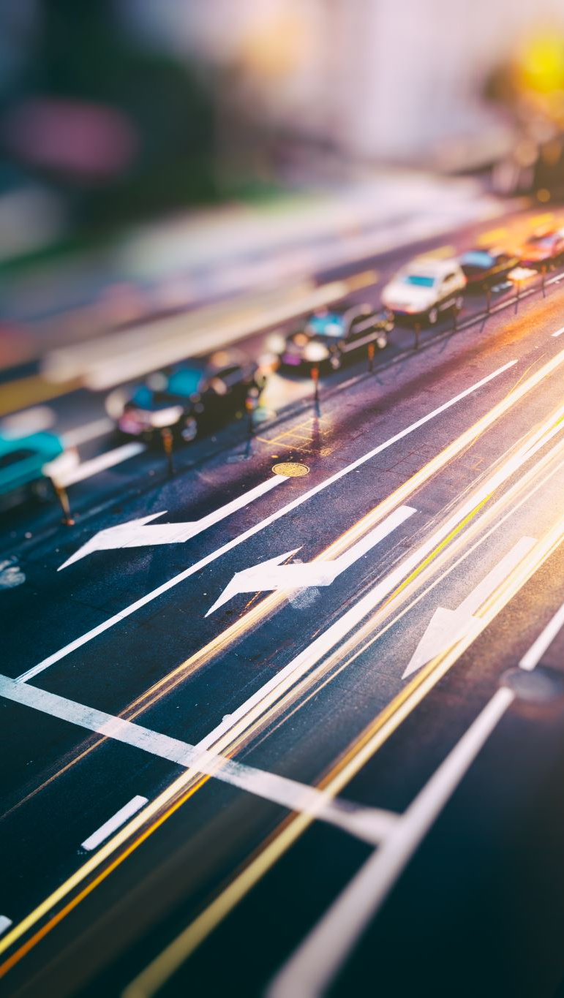
The Role of AI in Detecting Traffic Violations
Benefits of using AI for traffic violation detection:
- Increased accuracy and efficiency compared to human detection
- Reduction in human error and bias
- Cost-effectiveness for law enforcement agencies
Challenges of implementing AI for traffic violation detection:
- Privacy concerns and potential misuse of data
- Technical limitations and potential errors
- Need for continuous updates and improvements
Future prospects of AI in detecting traffic violations:
- Integration with other technologies such as smart cameras and sensors
- Potential for real-time detection and prevention of accidents
- Possibility of automated ticketing and penalty systems
Conclusion: AI has the potential to greatly improve road safety by accurately detecting and preventing traffic violations. However, careful consideration and ethical use of this technology is necessary for its successful implementation.

Slide 4

How IOT Devices Can Aid in Traffic Monitoring
Introduction to IOT devices and their role in traffic monitoring
Examples of IOT devices used for traffic monitoring such as sensors, cameras, and GPS trackers
Applications of IOT devices in traffic monitoring including real-time data collection, traffic flow analysis, and accident detection
Benefits of using IOT devices for traffic monitoring such as improved efficiency, reduced congestion, and enhanced safety
Challenges in implementing IOT devices for traffic monitoring such as cost, privacy concerns, and data management
Future prospects of IOT devices in traffic monitoring, including advancements in technology and potential for smart city integration
Case studies of successful implementation of IOT devices in traffic monitoring in cities around the world
Tips for incorporating IOT devices into existing traffic management systems
Potential for IOT devices to aid in emergency response and disaster management in case of accidents or natural disasters
Conclusion highlighting the potential of IOT devices to revolutionize traffic monitoring and improve overall transportation systems.

Slide 5
Real-Time Data Collection and Analysis for Traffic Violations
Real-time data collection and analysis is a method of gathering and processing traffic violation data in real-time.
This technology uses sensors, cameras, and other devices to collect data on traffic violations such as speeding, red light running, and illegal turns.
The data is then analyzed using algorithms and machine learning to identify patterns and trends in traffic violations.
Applications of real-time data collection and analysis include improving traffic flow, identifying high-risk areas for accidents, and enforcing traffic laws.
Benefits of this technology include increased efficiency in identifying and addressing traffic violations, improved safety for drivers and pedestrians, and reduced traffic congestion.
Challenges of real-time data collection and analysis include privacy concerns and the need for proper maintenance and calibration of equipment.
Future prospects for this technology include integration with autonomous vehicles and the potential for predictive analysis to prevent traffic violations before they occur.
This technology has been successfully implemented in cities such as London and Singapore, resulting in significant improvements in traffic management and safety.
As technology continues to advance, real-time data collection and analysis will play a crucial role in creating smarter and safer cities.
By utilizing real-time data, we can make informed decisions and take proactive measures to improve our transportation systems and make our roads safer for everyone.

Slide 6
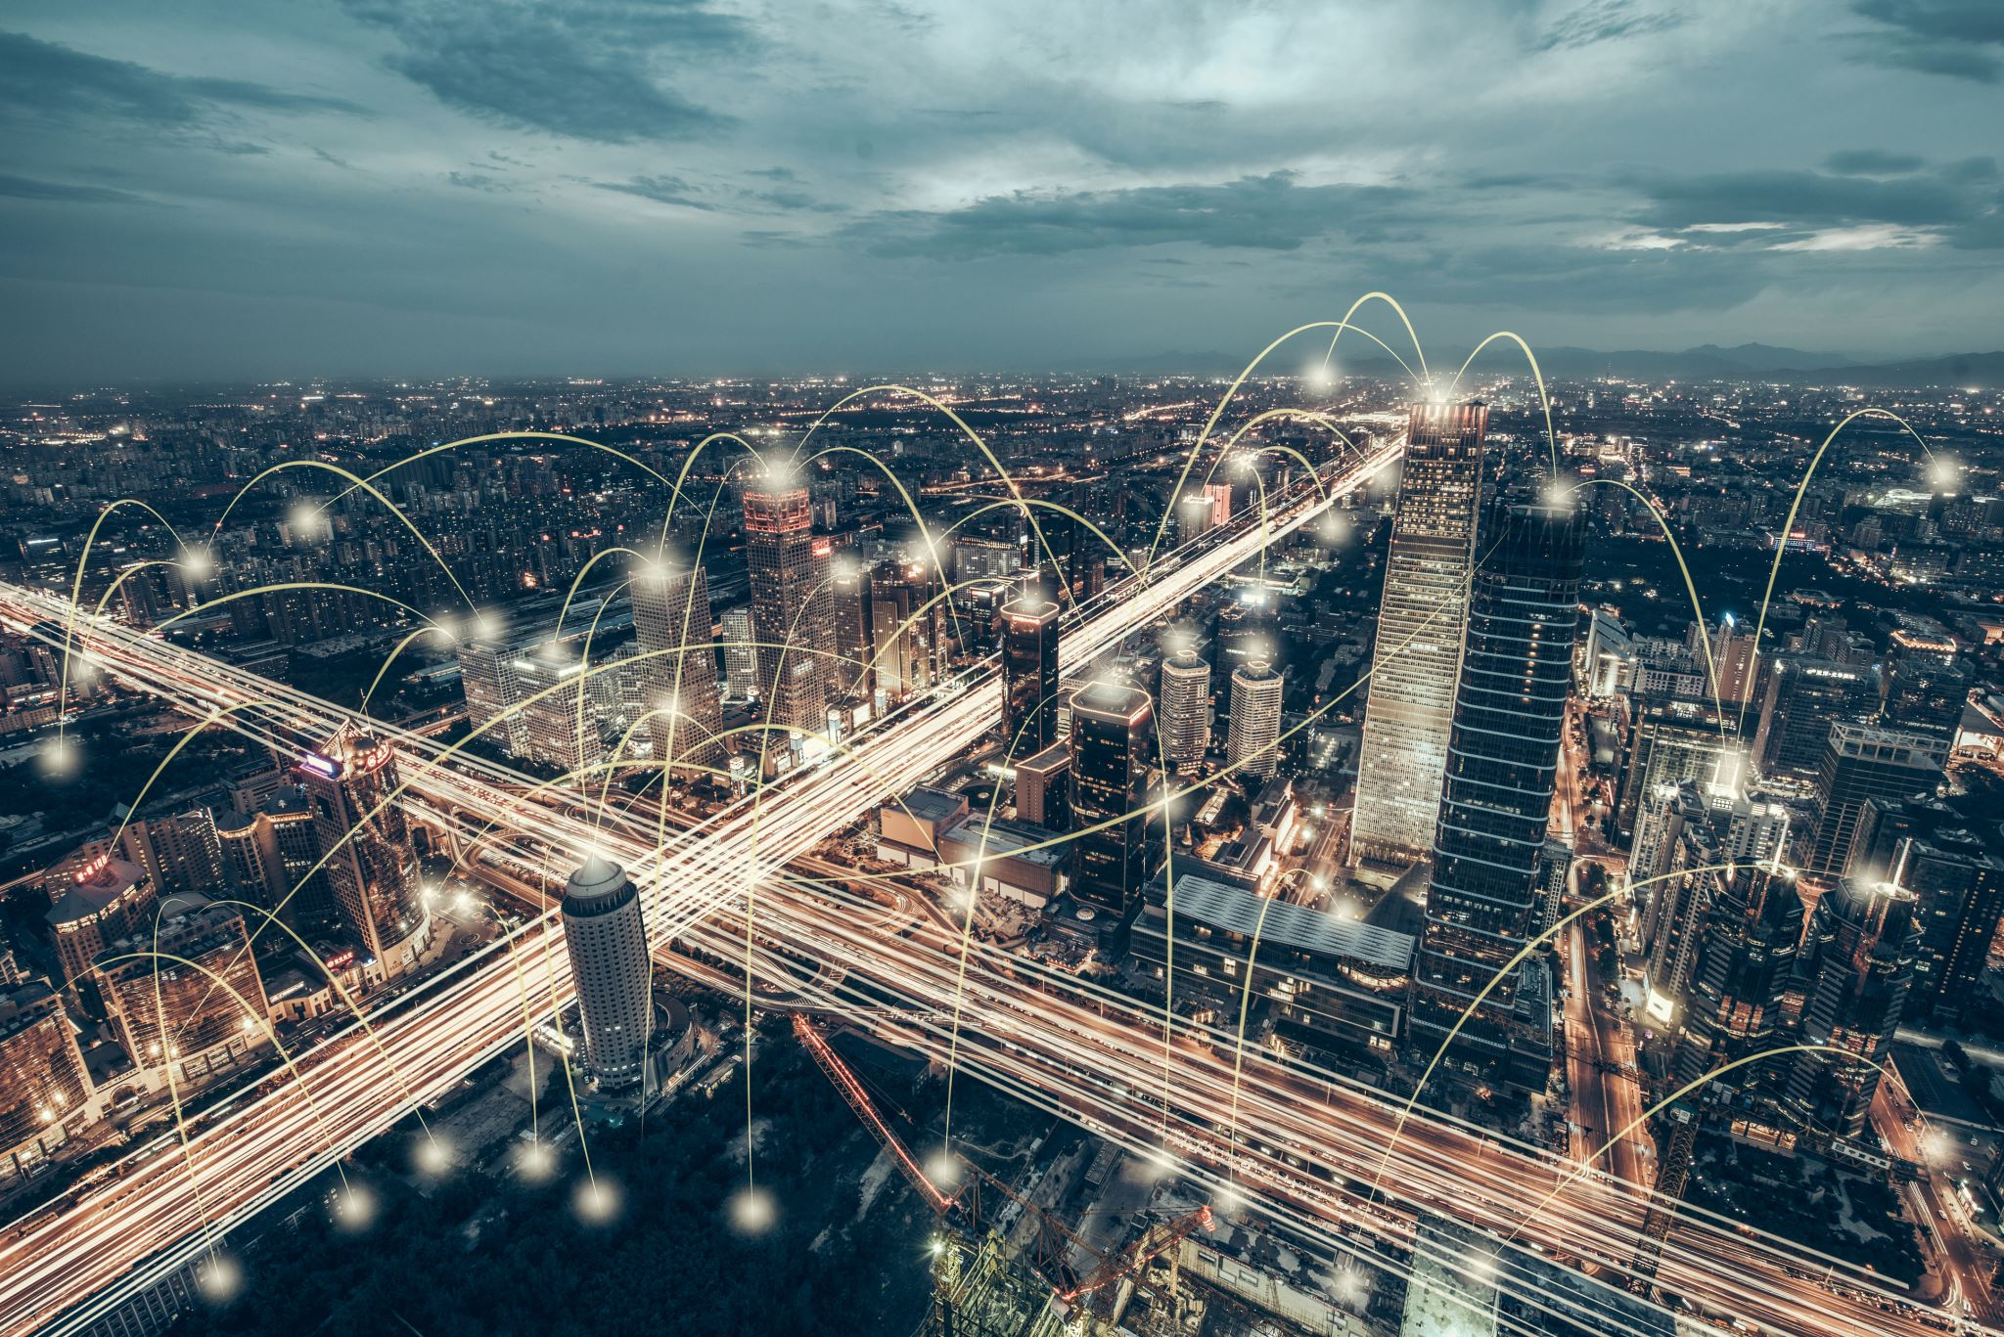
Case Studies: Successful Implementation of AI and IOT in Traffic Management
Introduction to AI and IoT in traffic management
Definition and explanation of AI and IoT
Applications of AI and IoT in traffic management:
- Real-time traffic monitoring and prediction
- Intelligent traffic signal control
- Automated vehicle management
- Smart parking systems
- Accident detection and response
Benefits of implementing AI and IoT in traffic management:
- Improved traffic flow and reduced congestion
- Enhanced safety for drivers and pedestrians
- Reduced carbon emissions
- Cost savings for cities and governments
Challenges of implementing AI and IoT in traffic management:
- Data privacy and security concerns
- Integration with existing infrastructure
- High initial investment
- Need for skilled professionals
Case studies of successful implementation:
- Singapore's Smart Nation Initiative
- Los Angeles' Automated Traffic Surveillance and Control System
- London's Smart Traffic Management System
Future prospects and potential advancements:
- Integration with autonomous vehicles
- Use of AI and IoT for emergency response and disaster management
- Expansion to other modes of transportation (e.g. public transit)
Conclusion: AI and IoT have the potential to revolutionize traffic management and create smarter, safer, and more efficient cities.

Slide 7
Benefits of Using AI and IOT for Traffic Violations
AI and IoT (Internet of Things) are advanced technologies that can be used to improve traffic management and reduce traffic violations.
AI refers to the ability of machines to perform tasks that typically require human intelligence, while IoT refers to the connection of devices to the internet.
The combination of AI and IoT can help in real-time monitoring of traffic violations, such as speeding, red light running, and illegal parking.
This technology can also assist in identifying and tracking repeat offenders, leading to better enforcement and deterrence.
By using AI and IoT, traffic violations can be detected and addressed more efficiently, reducing the burden on law enforcement personnel.
The data collected through these technologies can also be used for analysis and planning, leading to better traffic management strategies.
Some challenges of using AI and IoT for traffic violations include the need for reliable and accurate data, privacy concerns, and potential technical issues.
However, the benefits of using these technologies far outweigh the challenges, and with advancements in technology, these challenges can be addressed.
In the future, AI and IoT can be integrated with other smart city initiatives, such as smart traffic lights and autonomous vehicles, to further improve traffic flow and safety.
Overall, the use of AI and IoT for traffic violations has the potential

Slide 8
Challenges and Limitations of AI and IOT in Traffic Management
Introduction to AI and IoT in traffic management
Definition of AI and IoT
Applications of AI and IoT in traffic management:
- Real-time traffic monitoring and prediction
- Intelligent traffic signal control
- Automated vehicle routing and navigation
- Accident detection and response
- Parking management
Benefits of AI and IoT in traffic management:
- Improved traffic flow and reduced congestion
- Enhanced safety for drivers and pedestrians
- Time and cost savings for commuters
- Reduced carbon emissions
- Data-driven decision making for city planners
Challenges of implementing AI and IoT in traffic management:
- Data privacy and security concerns
- High initial costs and infrastructure requirements
- Integration with existing systems and technologies
- Lack of standardization and interoperability
- Potential job displacement
Limitations of AI and IoT in traffic management:
- Reliance on accurate and up-to-date data
- Vulnerability to cyber attacks and system failures
- Potential for biased decision making
- Limited effectiveness in extreme weather conditions
- Ethical considerations in decision making
Future prospects and developments:
- Advancements in AI and IoT technology
- Integration with smart city initiatives

Slide 9
Future Possibilities: Advancements in AI and IOT for Traffic Violations
Introduction to AI and IoT and their role in traffic violations
Current applications of AI and IoT in traffic management and enforcement
Benefits of using AI and IoT for traffic violations:
- Improved accuracy and efficiency in detecting violations
- Reduction in human error and bias
- Real-time monitoring and response
- Cost savings for law enforcement agencies
Challenges in implementing AI and IoT for traffic violations:
- Privacy concerns
- Data security issues
- Integration with existing systems
Future prospects of AI and IoT in traffic violations:
- Predictive analytics for identifying high-risk areas
- Automated ticketing and payment systems
- Vehicle-to-vehicle communication for accident prevention
- Integration with smart city initiatives
Examples of successful implementations of AI and IoT for traffic violations
Potential impact on society and the environment
How individuals can benefit from AI and IoT in traffic violations:
- Safer roads and reduced accidents
- Faster and more efficient traffic flow
- Reduced commute times
Conclusion: The future of traffic violations with AI and IoT and the need for responsible and ethical use of these technologies.

Slide 10
Conclusion: The Importance of AI and IOT in Improving Traffic Safety
AI and IoT (Artificial Intelligence and Internet of Things) are rapidly advancing technologies that have the potential to greatly improve traffic safety.
These technologies can be applied in various ways to enhance road safety, such as in smart traffic lights, autonomous vehicles, and predictive maintenance systems.
One of the main benefits of AI and IoT in traffic safety is the ability to collect and analyze real-time data, allowing for more efficient and accurate decision-making.
With the use of AI and IoT, traffic accidents can be reduced through features like collision avoidance systems and real-time traffic monitoring.
However, there are also challenges to implementing these technologies, such as the need for reliable and secure communication networks and potential ethical concerns.
Despite these challenges, the future prospects for AI and IoT in traffic safety are promising, with the potential to greatly reduce traffic fatalities and improve overall transportation efficiency.
In addition to improving safety, AI and IoT can also have a positive impact on the environment by reducing traffic congestion and emissions.
Governments and organizations around the world are investing in research and development of AI and IoT for traffic safety, highlighting the importance and potential of these technologies.
As these technologies continue to evolve, it is crucial for stakeholders to work together to ensure responsible and ethical use for the benefit

