Slide 1
Family Tree
Julia Hilber (k1356591)
Markus Weißenbek (k1355864)

Slide 2
Overview
Show relationship between persons
Base facts
Gender
Parents
Marriage/Relationship
Relationship rules over 5 generations

Slide 3
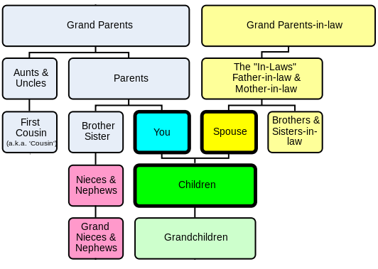
Overview

Slide 4
Thank you!

