Slide 1
Automated Recycling Containers Monitoring
Cisco Meraki Global Hackathon 2022

Slide 2
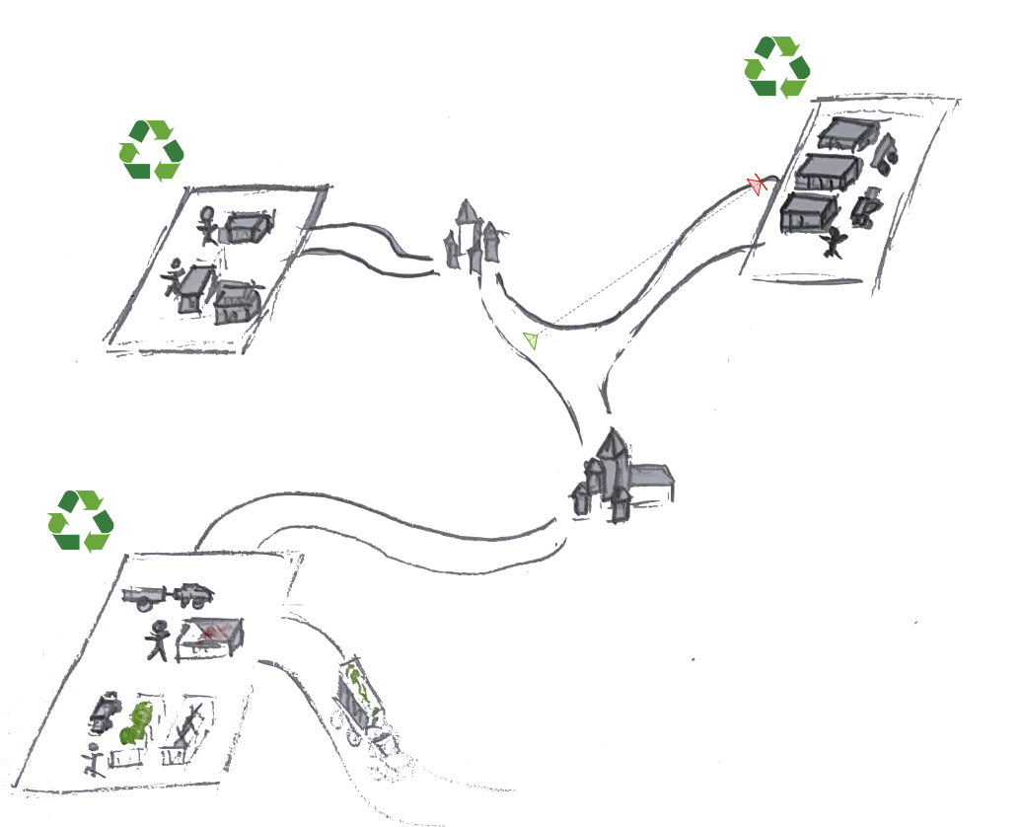
Context
Actual situation:
Nearly 50 centers
Container almost full: employee calls for a truck
Container full: users are not allowed to throw away their waste
Ideal situation:
Automatic monitoring of filling rate of containers
Notification on high filling rate
Optimize trucks routes

Slide 3
Motivation
Increase user satisfaction: always a container available
Save time and fuel cost: optimization of trucks routes

Slide 4
Proposal
Monitoring filling rate with Meraki cameras and AI
Notification on fullness
Prediction on fullness depending on: past data, day of week, weather, holidays period
Priority depending on: speed of filling rate, number of users/type of waste
Adressed in this hackathon

Slide 5
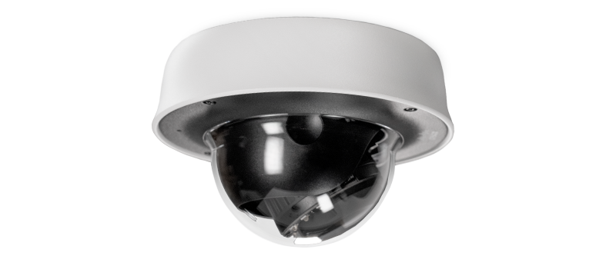
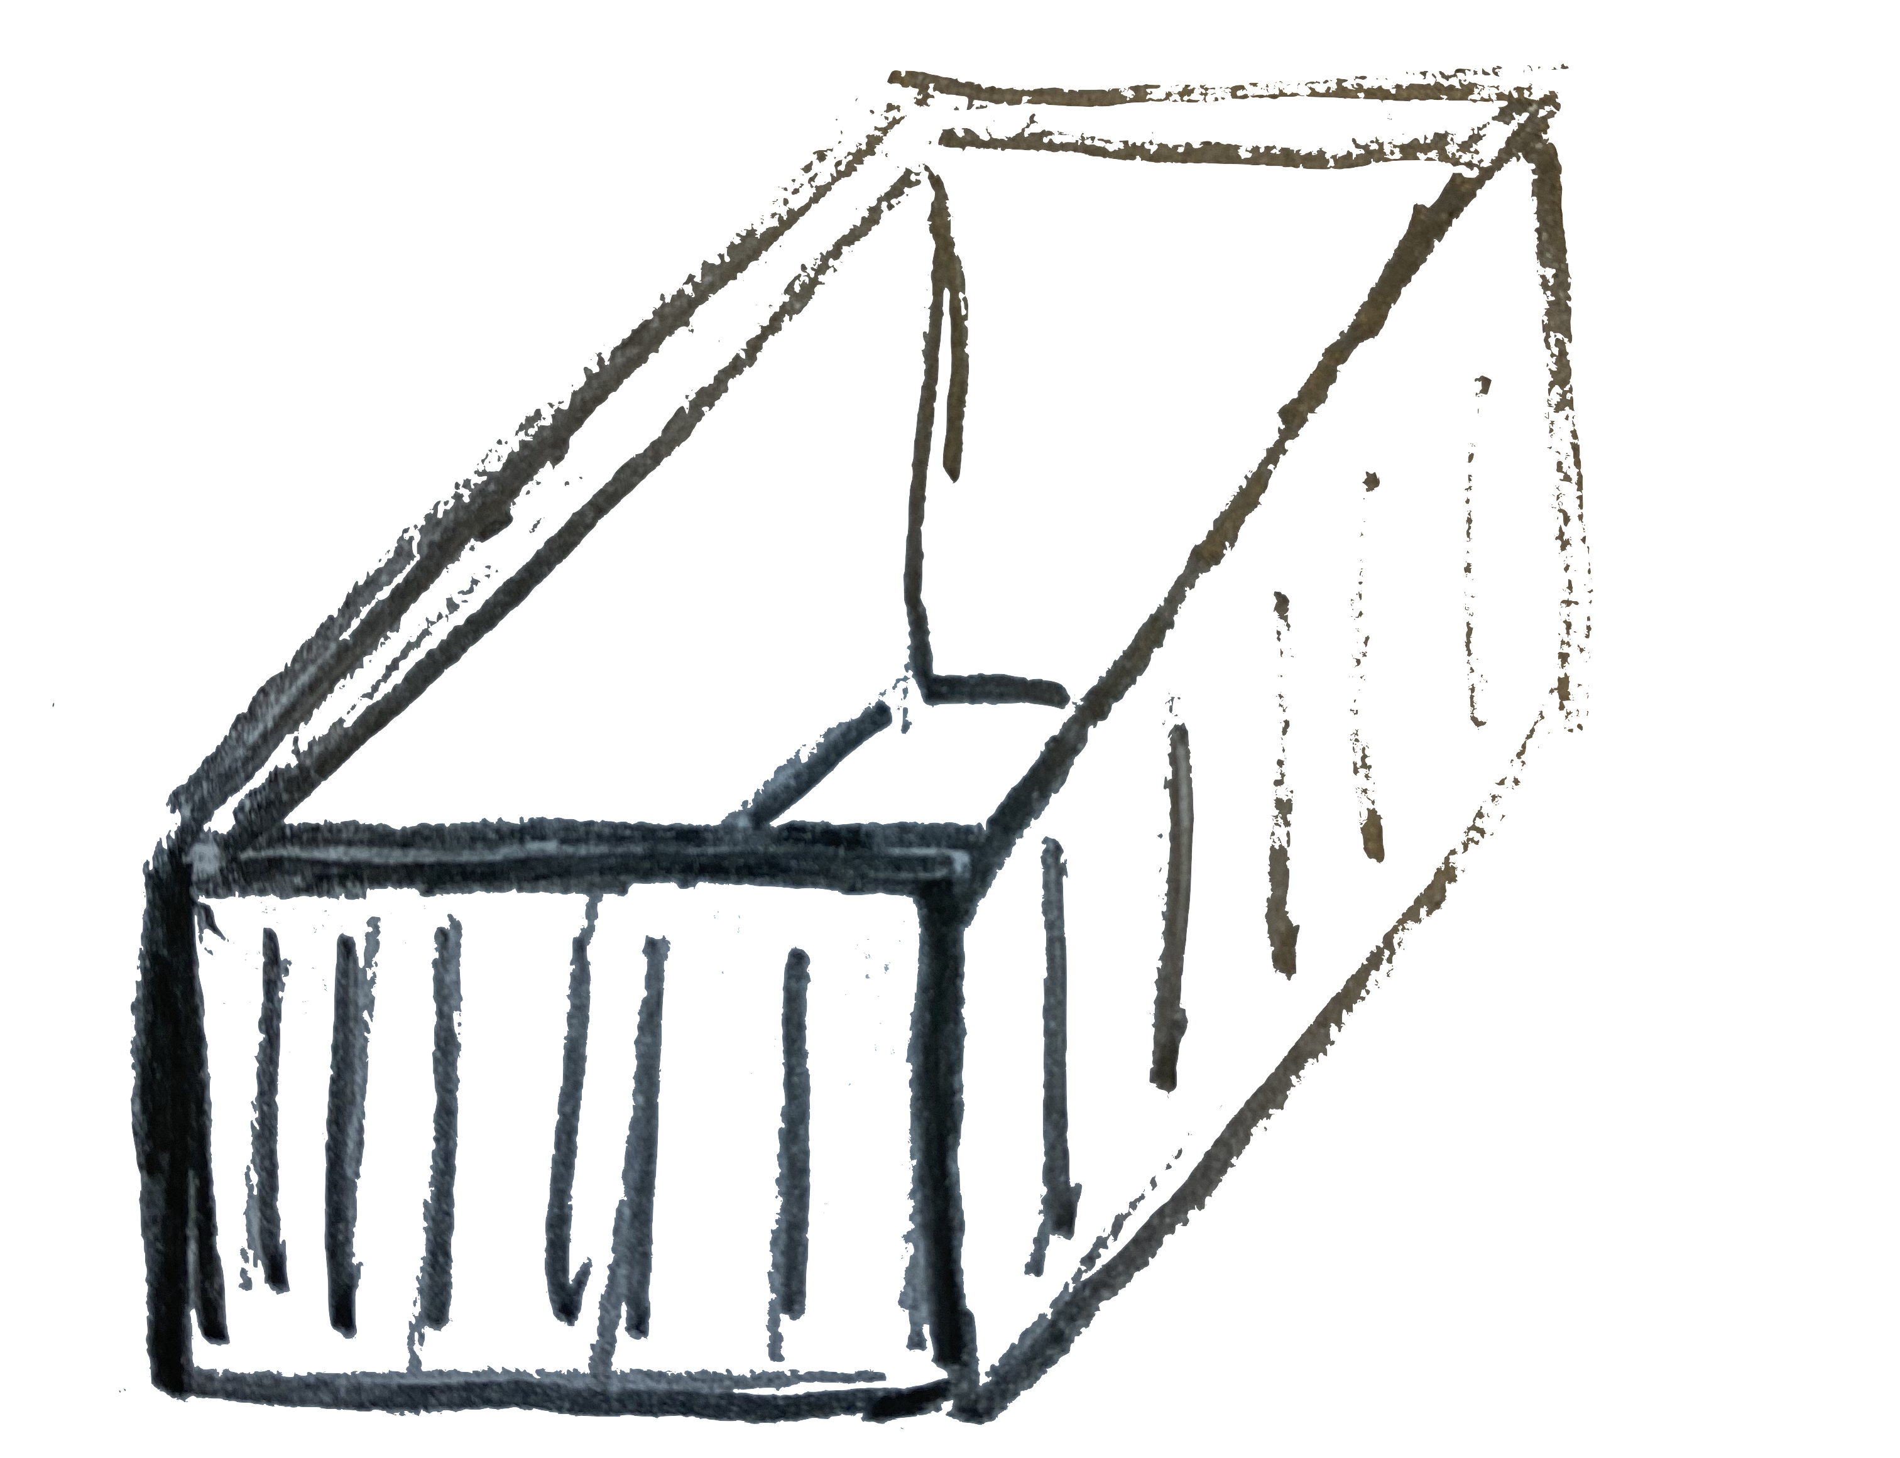
Architecture
Meraki camera
1. collect images
+ # persons
(API)
.jpeg
HDD
.jpeg’s
2. AI
depth maps
.jpeg’s, csv
3. Filling rate
processing
4. Visualisation
csv: .jpeg filename; filling rate (0%-100%)

Slide 6
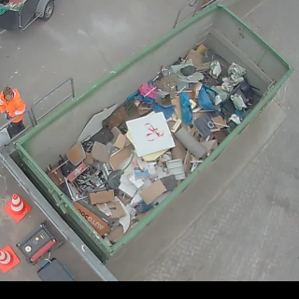

Filling rate estimation
Meraki image
Depth map

Slide 7
Demo

