Slide 1
Python Framework and Libraries to DSP GUI demos
Author: Nguyen Thanh Tung
9 May, 2017

Slide 2
Agenda
Python Framework and Libraries for DSP GUI demos
Motivations
Previous work
Design of Python Framework for DSP GUI demos
Design of supporting Libraries for DSP GUI demos
Conclusion

Slide 3
Overview
Framework to integrate and navigate all available DSP GUI demos.
Automatically search and categorize apps
Libraries to help creating the DSP GUI demos
With use of common GUI components and DSP components.

Slide 4
Previous work
Many demonstration of DSP concepts
MATLAB, web applets, digital apps,…
DSP in Python
ThinkDSP (Allen B. Downey, Massachusetts), Pyo - Python DSP module, other scripts and modules.

Slide 5
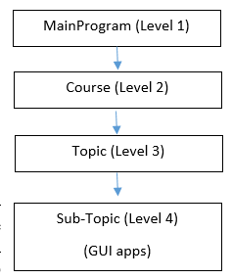
Python Framework for DSP GUI demos
Main Program
Digital Signal Processing
Digital Communication
Signals and Systems
Z Transform
Discrete Time Convolution
Continuous time to Discrete Time

Slide 6
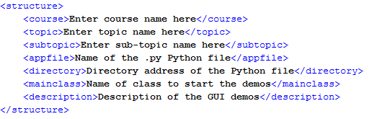
Structure of Python GUI demos
Store in XML files

Slide 7
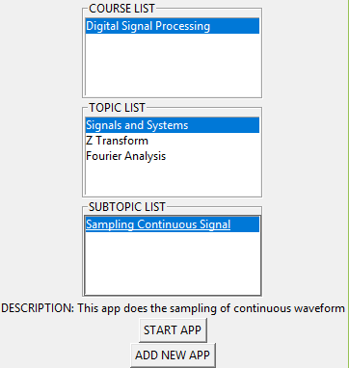
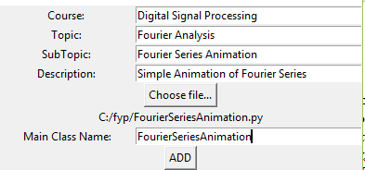
Framework GUI

Slide 8
Supporting Libraries for creating Python GUI demos
For creating GUI demos without knowing native GUI libraries
2 libraries are created:
Layout generating library
UI components library

Slide 9
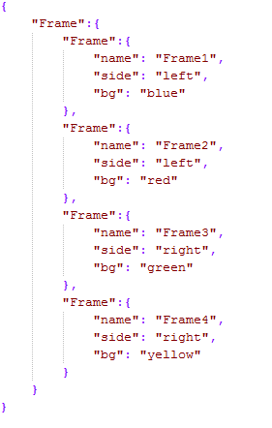
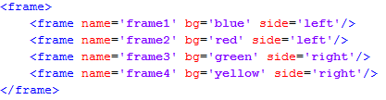
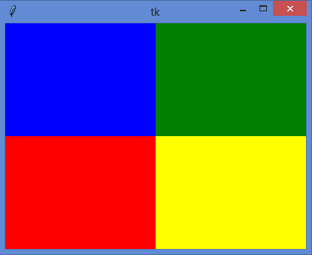
Layout Generating Library
Translate either XML or JSON layout contents into GUI demo’s layout

Slide 10
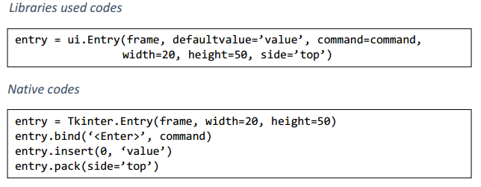
UI components Library
Contains basic components like Label, Entry, Button, …

Slide 11
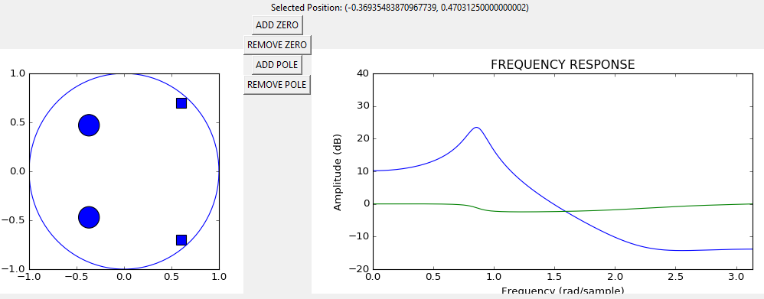
UI components Library
DSP widgets: Discrete Signal, LTI System, Waveform, Draggable Points, Animations

Slide 12
Summary of achievement
Framework to assemble and navigate GUI demos
Possible to add new courses, new topics
Supporting Libraries to create individual GUI demo
Future: add more components to the UI components library

Slide 13
Reference
James H. McClellan, Mark A. Yoder, and Ronald W. Schafer. Signal Processing First, 1st edition. Pearson/Prentice Hall, 2003
Using MATLAB to develop standalone graphical user interface (GUI) software packages for educational purposes, retrieved from: http://cdn.intechopen.com/pdfs-wm/11608.pdf
Think DSP: Digital Signal Processing in Python Book by Allen B. Downey

