Slide 1


Please mark your attendance.
Deep Learning Bootcamp 2026
Session 5: Reinforcement Learning (RL)
Si Qi Goh
PhD Student (CCDS), Year 4
Minh H. Le
PhD Student (MAE), Year 3
Subrat Prasad Panda
PhD Student (CCDS), Year 4
NTU Singapore
10th April 2026, 2 PM @ ARC-LHN-TR+12

Slide 2
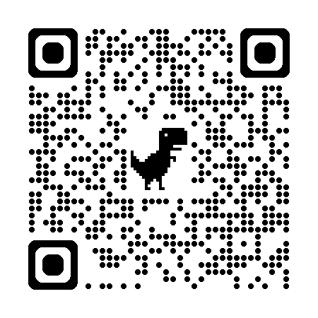
Link to Resources
Google Colab Notebooks (for this session):
https://github.com/ntu-dl-bootcamp/deep-learning-2026
Go to SESSION 5
Slides and notebooks are available
Recommended Lecture Series:
Reinforcement Learning, CS 285, UC Berkley (Sergey Levine)
Foundation of RL, 6 Lecture Series by Pieter Abbeel
Recommended Books:
Reinforcement Learning: An Introduction, Sutton and Barto

Slide 3
Outline
Supervised Learning: Recap
New Problem Setting
Examples
Identifying the Problem
Reinforcement Learning (RL)
Formulating RL Problems
Defining Environment
Specifying Reward
Introduction to OpenAI Gym
write 2 environments, reward, run random policy, show plots)
RL Algorithms (10 mins)
Value-based
Policy-based
StableBaselines3 (5 mins)
DQN and PPO (40 mins)
Advanced Methods (5 mins)
~15 mins
~15 mins
~1 hour
Break
~1 hour
Notes:
Welcome to Session 5 of the Deep Learning Bootcamp, today we’re going to talk about Reinforcement Learning, or RL.
Before we start, I want to ask a quick question.
How many of you have trained a model before using labeled data like classification or regression?
so most of what we’ve done so far falls under supervised learning.
You give the model:
an input
a correct answer
and it learns by minimizing error.
Everything is very clean, very structured.
But today, we’re going to move into a completely different setting.
A setting where:
there are no labels
no ground truth
no correct answers given
Instead, the only thing we get is… feedback.
And from that feedback alone, the model has to learn how to behave.
That is what reinforcement learning is about.

Slide 4
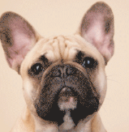



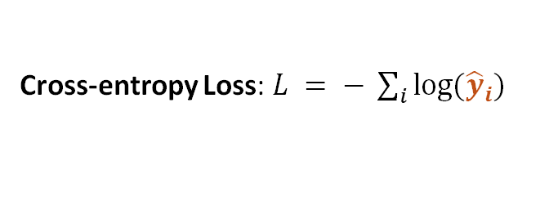
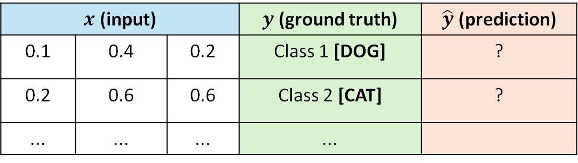

Supervised Learning: Recap
Dataset Provided
Where does this come from?
E.g ( , Class 1 [DOG] )
How did it get labeled?
Learn a function $f\left(⋅\right)$ such that${ f\left(x\right)=y}_{}$
$$f\left(x\right)$$
[DOG]
$$x$$
$$\hat{y}$$
Cross-entropy Loss: $L = − \sum_{i}{log⁡({\hat{y}}_{i})}$
$x$ (input) |  |  | $y$ (ground truth) | $\hat{y}$ (prediction)
0.1 | 0.4 | 0.2 | Class 1 [DOG] | ?
0.2 | 0.6 | 0.6 | Class 2 [CAT] | ?
... | ... | ... | ...
Notes:
Let’s briefly recall how supervised learning works.
We have:
an input, like an image
a label, like ‘dog’ or ‘cat’
and the model tries to predict that label
If it gets it wrong, we compute a loss — for example, cross-entropy — and we update the model.
So the key thing here is:
The model always knows what the correct answer is.
But now let me ask you something.
Where do these labels come from?
Someone has to:
collect the data
annotate it
verify it
And in many real-world problems, this is:
expensive
slow
sometimes even impossible.
So what happens if we don’t have labels?
What if instead of knowing the correct answer, we only know whether something is good or bad?”

Slide 5
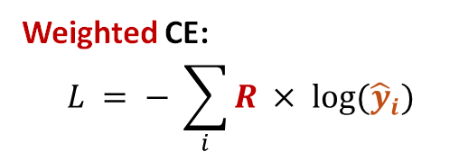
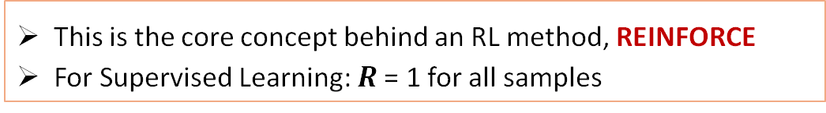
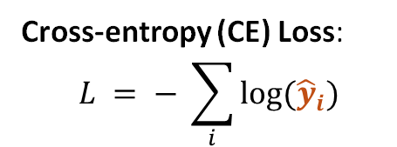
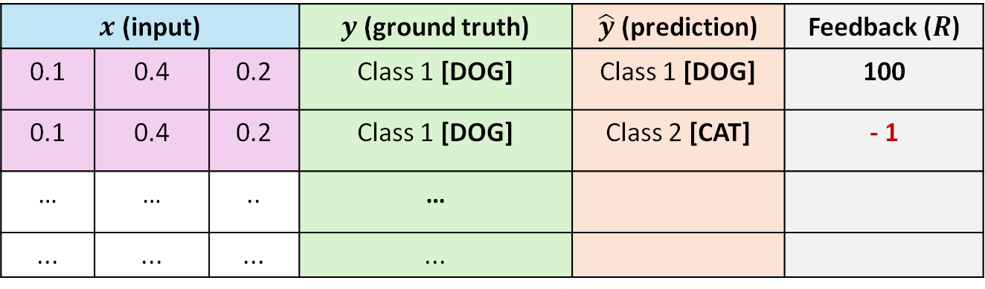
No Datasets and No Labels??
Need to collect your own dataset
A provision to collect the samples (simulators)
No labels (only feedback):
Only information about how good/bad (correct/wrong) your sample is
$x$ (input) |  |  | $y$ (ground truth) | $\hat{y}$ (prediction) | Feedback ($R$)
0.1 | 0.4 | 0.2 | Class 1 [DOG] | Class 1 [DOG] | 100
0.1 | 0.4 | 0.2 | Class 1 [DOG] | Class 2 [CAT] | - 1
… | … | .. | …
... | ... | ... | ...
Cross-entropy (CE) Loss:
$$L = − \sum_{i}{log⁡({\hat{y}}_{i})}$$
SAME INPUT
Weighted CE:
$$L = − \sum_{i}{R × log⁡({\hat{y}}_{i})}$$
NOT AVAILABLE
This is the core concept behind an RL method, REINFORCE
For Supervised Learning: $R$= 1 for all samples
Notes:
For example:
you take an action → you get +10
you take another action → you get −1
No one tells you the correct answer. You only get a score.
And from that, you have to figure out what to do.
That’s the transition from supervised learning… to reinforcement learning.
So instead of learning from labels, we now learn from something called a reward.
You can think of reward as:
a signal that tells you how good your action was
For example:
correct decision → high reward
bad decision → low or negative reward
But here’s the challenge:
The reward is often delayed.
You don’t immediately know if your action was good.
Sometimes:
you make a decision now
and only much later you find out if it was correct.
So the problem becomes much harder.

Slide 6
Where does this kind of problem arise? [ROBOTICS]
Current Pose → Direction to Move (Decision) → New Pose
Current Position
of the Robot
BEFORE
Possible Decision
UP
DOWN
LEFT
RIGHT
Choose UP
AFTER
New Position
of the Robot
Notes:
Let’s look at some examples to build intuition.
First: Robotics
Imagine a robot navigating a room.
At each step, it decides:
move left
move right
move forward
No one tells it the correct move.
It only knows:
did I reach the goal?
did I crash?
So it learns through trial and error.

Slide 7
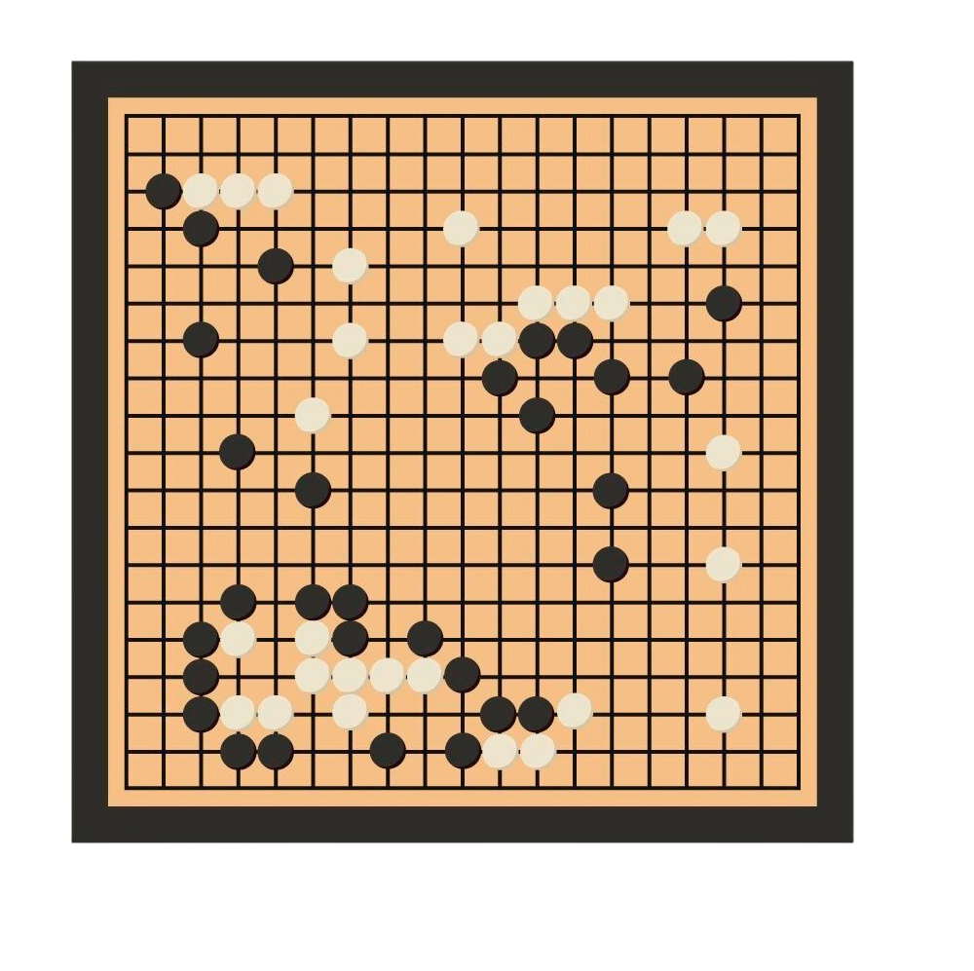
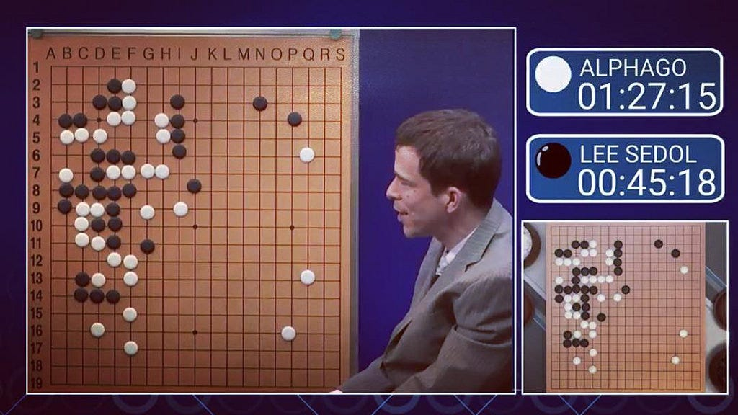
Where does this kind of problem arise? [GAMES]
Current Board Configuration → Place Stone (Decision) → New Board Configuration
Given the current board, which move should I decide next?
Many possible moves,
but only some leads to winning
AlphaGO won the match against Lee Sedol
Notes:
In chess or Go:
at every step, there are many possible moves
but only some lead to winning
The reward — winning or losing — comes at the end of the game.

Slide 8
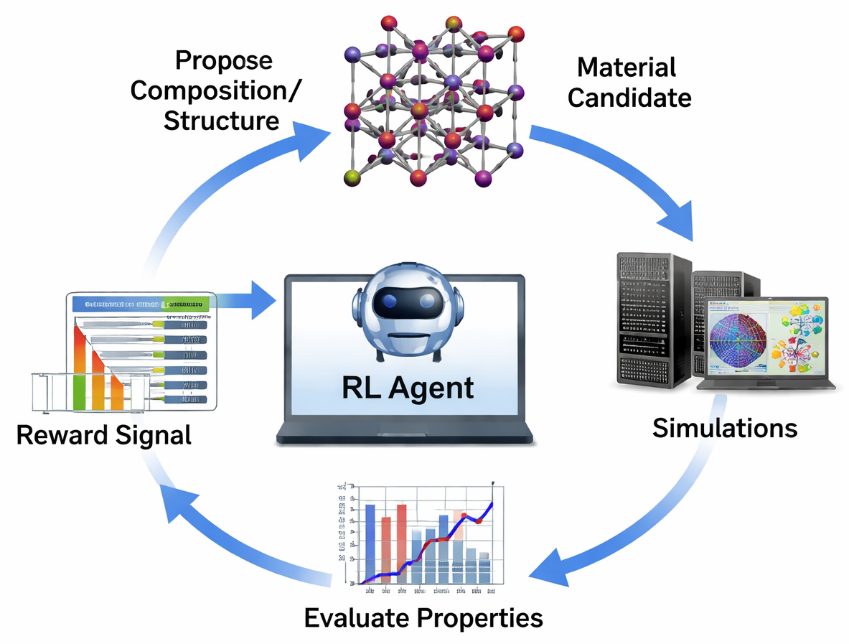
Where does this kind of problem arise? [Material Sc.]
Material Structure→ Add/Remove Molecule (Decision) → New Material Structure

Slide 9
Where does this kind of problem arise? [LLMs]
Reward
Model
action
feedback
Reinforcement Learning from Human Feeback
(typically applied in chatbots)
LLM generates multiple answers
Humans rank the best one
RL updates the model to prefer responses that humans like
Agent
User
observation
observation
action
trajectories
Environ-
ment
Notes:
Large language models can generate many possible answers to the same question.
So what we do is: we ask humans to compare these answers and tell us which one is better.
Then, using reinforcement learning, we update the model so that it prefers those better responses in the future.
In short, RL helps the model learn what humans consider a good answer.

Slide 10
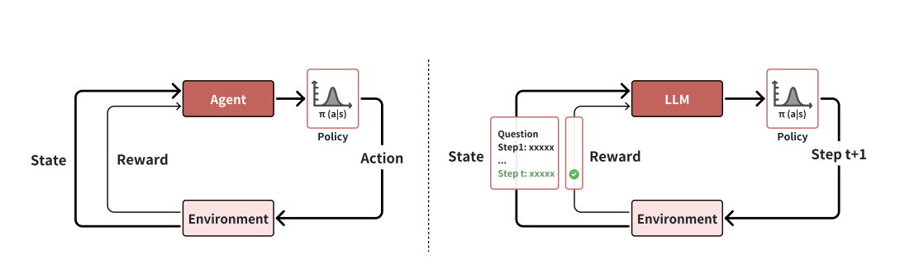
Comparison of Traditional RL vs RL in LLMs
Traditional RL
RL for LLMs
The agent interacts with a physical or simulated environment
The action of LLM can be token-, step-, or solution-level
A Roadmap to o1 from Reinforcement Learning Perspective

Slide 11
Identify Common Themes in These Problems
Collect your own dataset by sampling (trial and error)
Receive a feedback score for each trial (single step or multiple steps)
The objective is to make good decisions (which gives a high score)
Current Configuration
New Configuration
Takes Decision
Receives feedback score
How to make optimal decisions that maximize the total feedback scores?

Slide 12
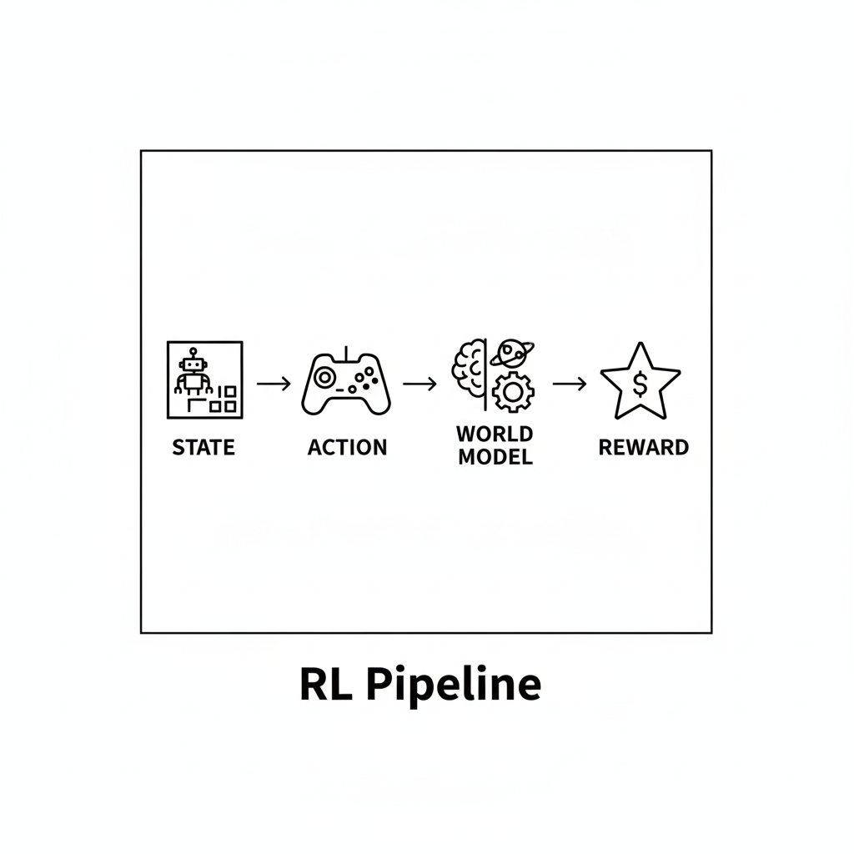
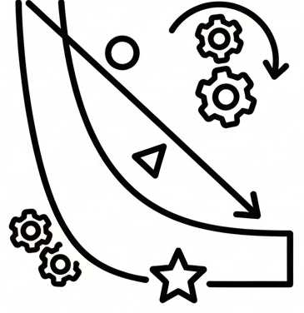
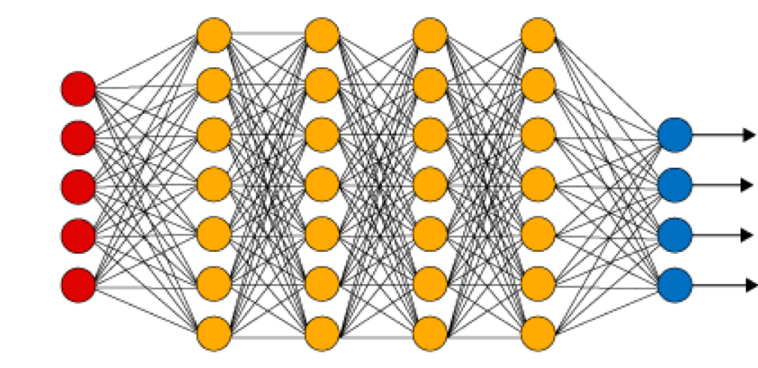

Reinforcement Learning
Current Configuration
New Configuration
Takes Decision
Sequence Continues
Receives feedback
A framework for modeling sequential decision-making problems
Also includes a sequence with a single step (Bandit)
MDPs, POMDPS, Bayesian MDPs, etc.
A framework for solving sequential decision-making problems
Solving: finding the best/optimal actions which gives best feedback scores
DQN, PPO, SAC, etc.
There should be a feedback mechanism
Takes Decision: ACTION
Action
Current Configuration: STATE
$$f\left(x\right)$$
Optimization
Agent Policy
Value Function
Environment:
Problem Domain
Feedback: REWARD

Slide 13
Sequential Decision Making
Objective: select actions to maximize total future reward
Actions may have long-term consequences
Rewards may be delayed
It may be better to sacrifice immediate reward to gain more long-term reward
Examples:
A financial investment (may take months to mature)
Refueling a helicopter (might prevent a crash in several hours)
Losing one chess piece (might help winning chances many moves from now)
Typically formulated as Markov Decision Processes (MDPs)

Slide 14
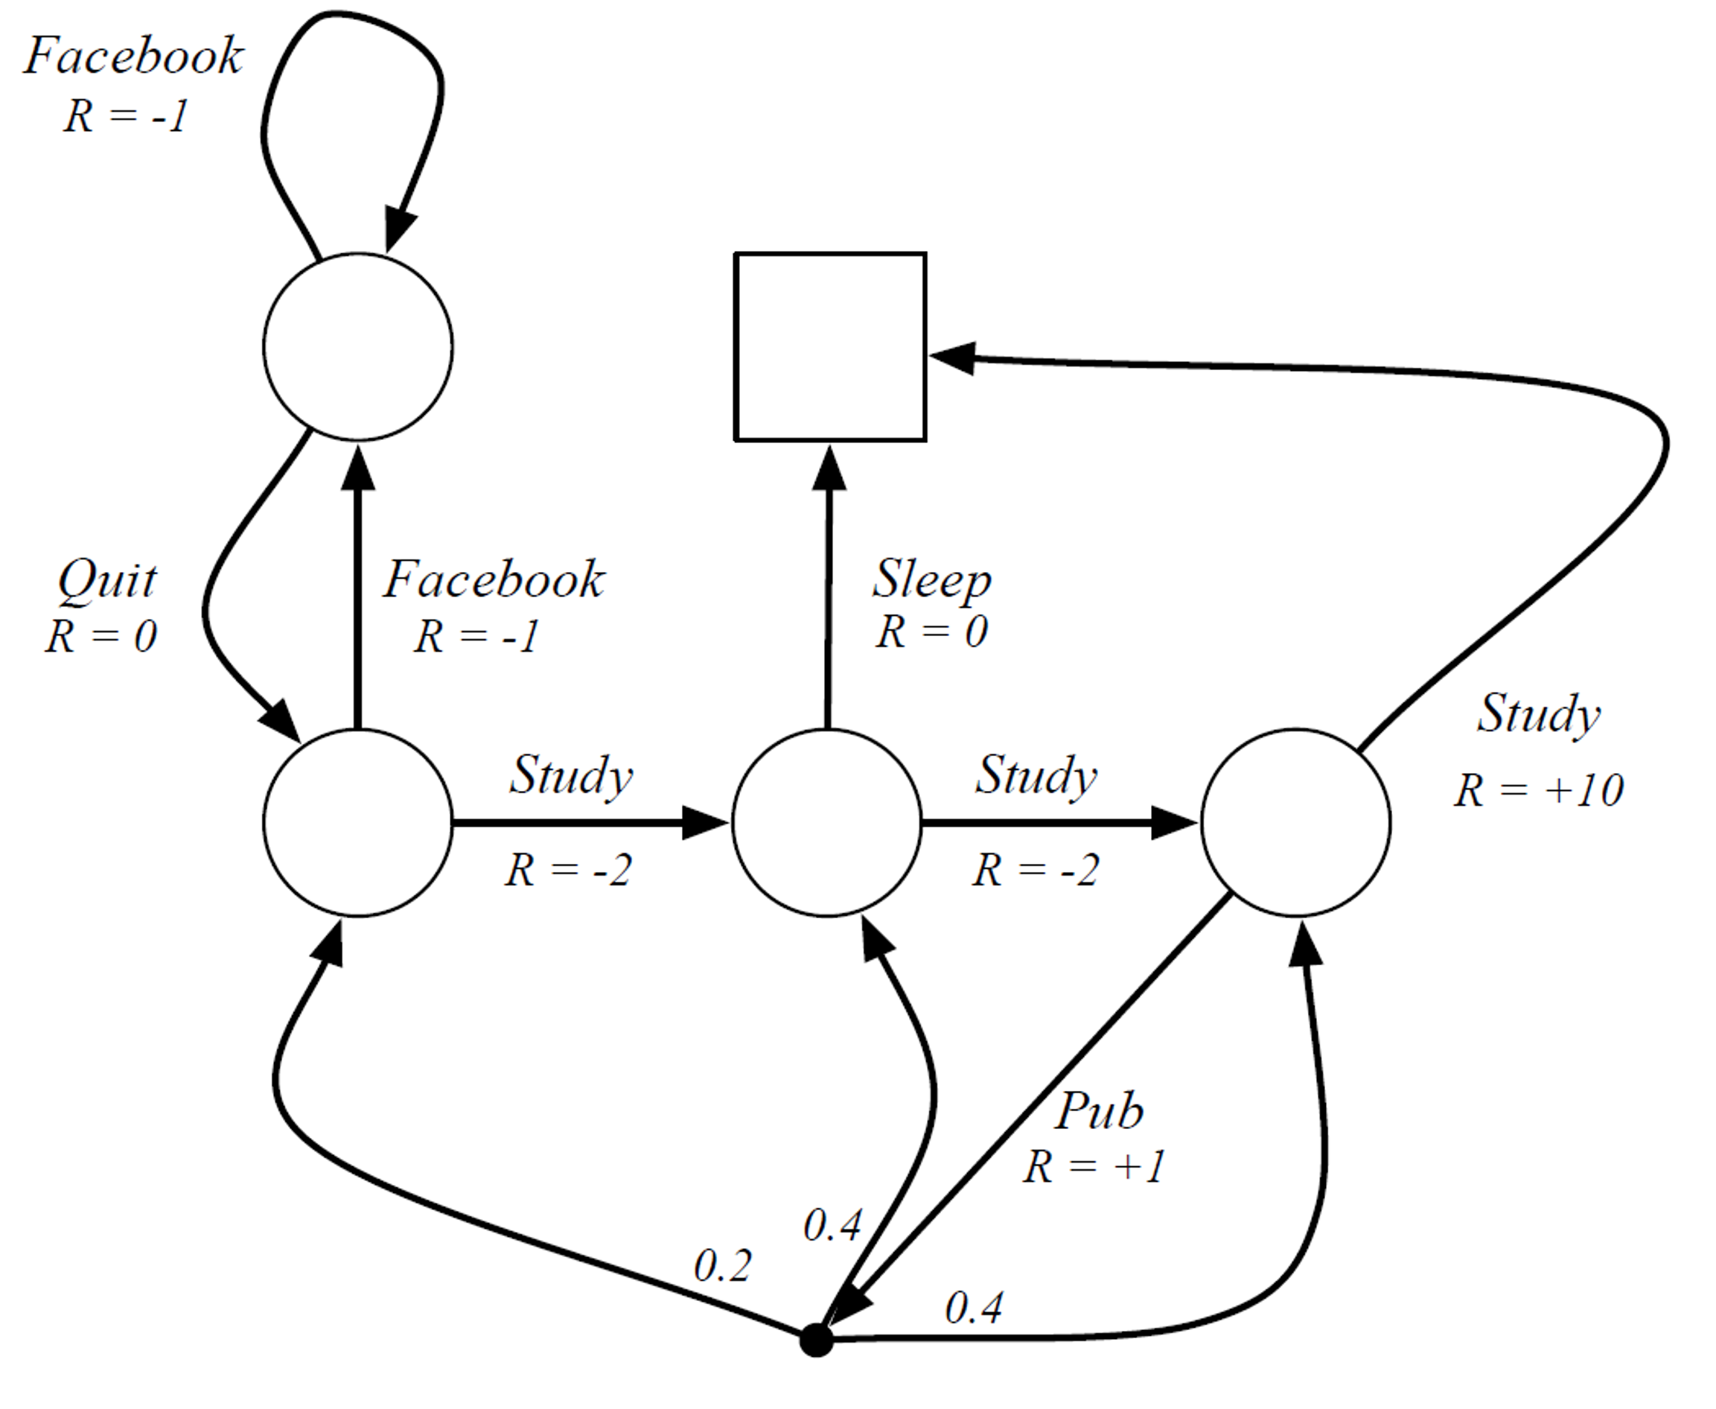
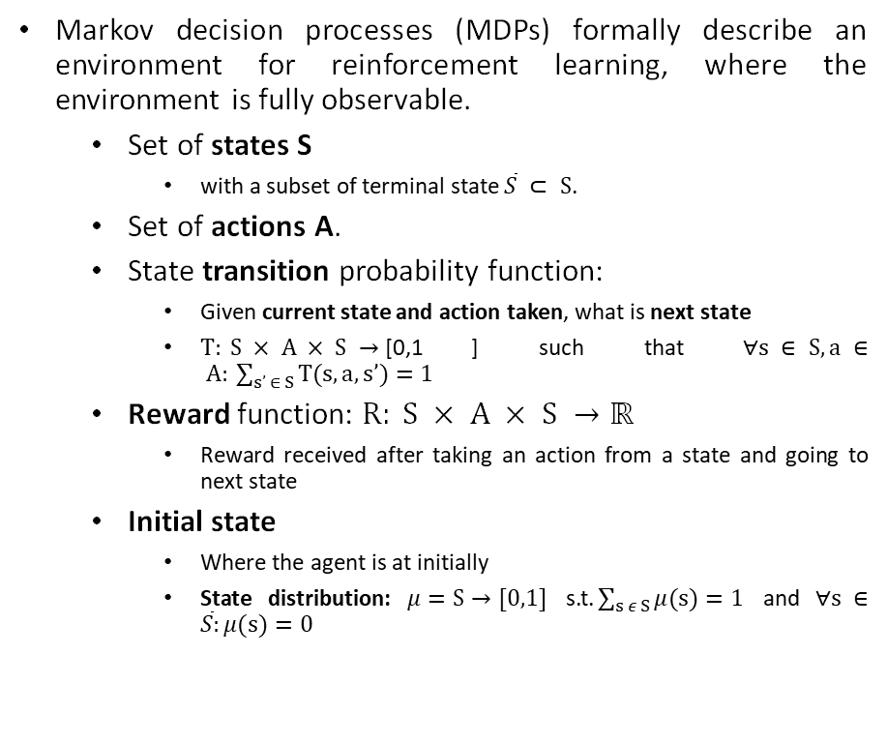
Markov Decision Process (MDP)
Markov decision processes (MDPs) formally describe an environment for reinforcement learning, where the environment is fully observable.
Set of states S
with a subset of terminal state $\overline{S} ⊂ S$.
Set of actions A.
State transition probability function:
Given current state and action taken, what is next state
$T: S × A × S →\text{[0,1}$] such that $∀s ∈ S, a ∈ A: \sum_{s’ ∈ S}{T(s,a,s’)=1}$
Reward function: $R: S × A × S →\text{ℝ}$
Reward received after taking an action from a state and going to next state
Initial state
Where the agent is at initially
State distribution: $μ=S→[0,1]$ s.t.$\sum_{s ε S}{μ(s)=1}$ and $∀s ∈\overline{S}:μ(s)=0$
Terminal State
S5
S4
S1
S2
S3
Initial State
Albrecht, Stefano V., Filippos Christianos, and Lukas Schäfer. Multi-Agent Reinforcement Learning: Foundations and Modern Approaches. 2024.
Figure: Student Markov Decision Process

Slide 15

Markov Decision Process (MDP)
Markov property: future state and reward are conditionally independent of past states and actions, given the current state and action:
Almost all RL problems can be formalized as MDPs.
Or variants of it: POMDP, Bayesian MDPs, etc.
Albrecht, Stefano V., Filippos Christianos, and Lukas Schäfer. Multi-Agent Reinforcement Learning: Foundations and Modern Approaches. 2024.

Slide 16
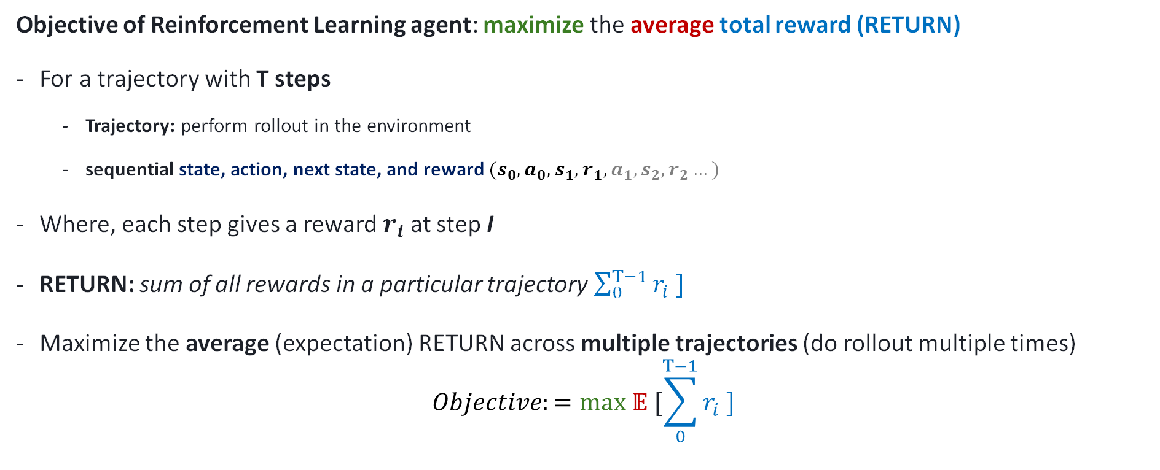
Formulating Reinforcement Learning problem
Objective of Reinforcement Learning agent: maximize the average total reward (RETURN)
For a trajectory with T steps
Trajectory: perform rollout in the environment
sequential state, action, next state, and reward $(s_{0},a_{0},s_{1},r_{1},a_{1},s_{2},r_{2}…)$
Where, each step gives a reward $r_{i}$ at step I
RETURN: sum of all rewards in a particular trajectory $\sum_{0}^{T−1}{r_{i} ]}$
Maximize the average (expectation) RETURN across multiple trajectories (do rollout multiple times)
$$Objective:=max 𝔼 [\sum_{0}^{T−1}{r_{i} ]}$$

Slide 17
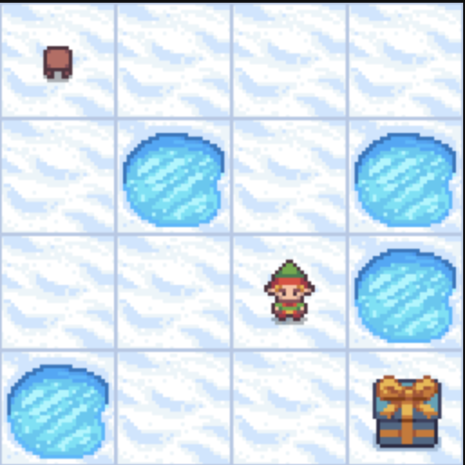
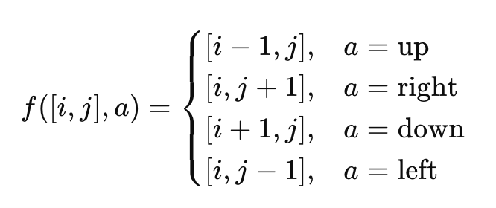
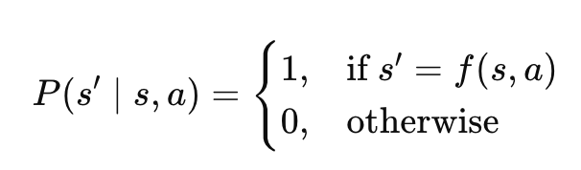
Formulating Reinforcement Learning problem – Example – Grid World
State: S={[0,0],[0,1],[0,2],[0,3],[1,0],[1,1],[1,2],[1,3],[2,0],[2,1],[2,2],[2,3],[3,0],[3,1],[3,2],[3,3]}
Action: A={up, right, down, left}
Probability transition function:
Reward:
0
0
0
0
-1
-1
-1
-1
Figure: Frozen Lake (Gym Environment)
0
-10
0
-10
-1
-10
-1
-10
0
0
0
-10
-1
-1
-1
-10
-10
0
0
+10
-10
-1
-1
+10

Slide 18
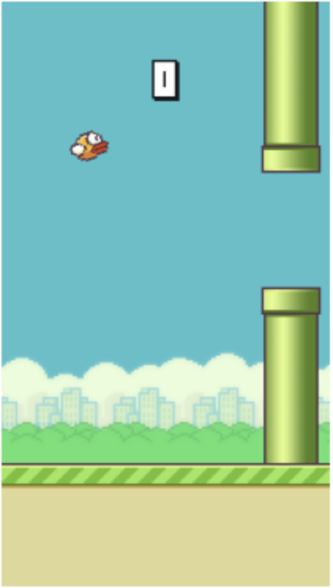
Formulating Reinforcement Learning problem – Example 2 – Flappy Bird
How can we formulate states, actions, probability transition function and rewards?
Figure: Flappy Bird (Gym Environment)

Slide 19
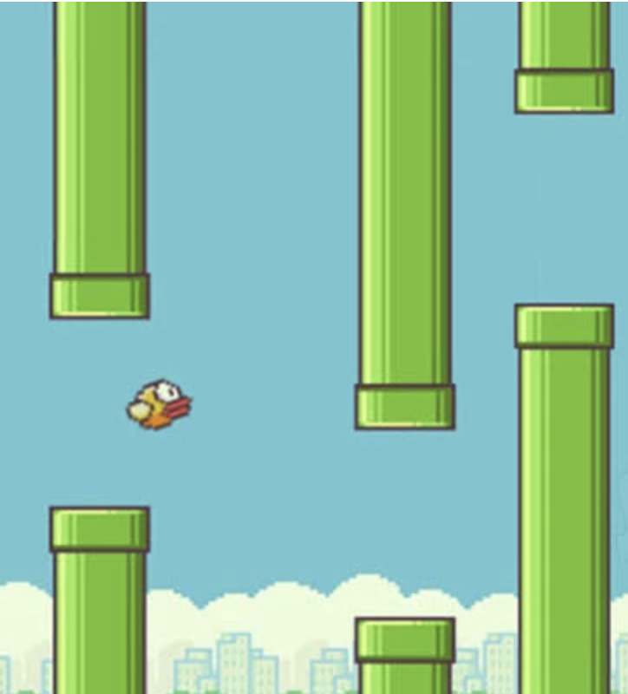












Formulating Reinforcement Learning problem – Example 2 – Flappy Bird
States:
$$O2: 3th top pipe$$
$$vertical position$$
$$O5: 1st top pipe$$
$$vertical position$$
$$O11: Bird velocity$$
$$O3: 3th bottom pipe$$
$$vertical position$$
$10: Bird vertical$ position
$$O12: Bird rotation$$
$$O6: 1st top pipe$$
$$vertical position$$
$$O9: 2nd bottom pipe$$
$$vertical position$$
$$O4: 1st pipe$$
$$horizontal position$$
$$O7: 2nd pipe$$
$$horizontal position$$
$$O1: 3th pipe$$
$$horizontal position$$
Figure: Flappy Bird (Gym Environment)
$$Observation = [O1, O1,… O12]$$

Slide 20
Formulating Reinforcement Learning problem – Example 2 – Flappy Bird
Action: tab/do nothing
State transition function:
Action effect: If the agent chooses flap, the bird gains upward velocity.
Player dynamics: The bird’s position, velocity, and rotation are updated based on gravity and previous motion.
Pipe dynamics: Pipes move left continuously; new pipes are generated when old ones leave the screen.
Scoring: The score increases when the bird successfully passes a pipe.
Collision check: The episode ends if the bird hits the ground or a pipe.
Observation update: A new 12-dimensional state is returned based on updated positions.
Rewards:
+0.1 - every frame it stays alive
+1.0 - successfully passing a pipe
-1.0 - dying
−0.5 - touch the top of the screen
Figure: Flappy Bird (Gym Environment)

Slide 21
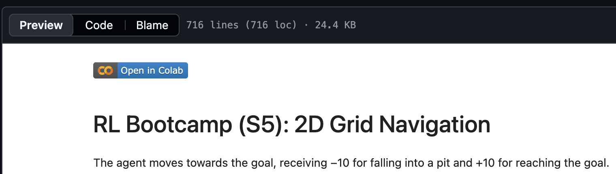
OpenAI Gym (Notebook Exercise)
https://github.com/ntu-dl-bootcamp/deep-learning-2026
Click here!

Slide 22


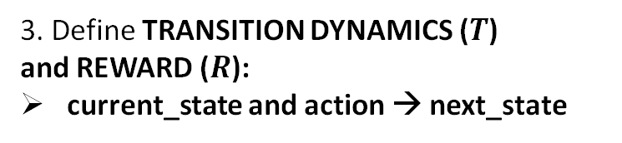
OpenAI Gym (Notebook Exercise)
Expressing the MDP in code
import gym
from gym import spaces
import numpy as np
class MyEnv(gym.Env):
def __init__(self):
super(MyEnv, self).__init__()
self.action_space = spaces.Discrete(3)
self.observation_space = spaces.Box(
low=-np.inf, high=np.inf, shape=(4,), dtype=np.float32
)
def reset(self, seed=None, options=None):
. . .
return self.state, {} # (obs, info)
def step(self, action):
. . .
return self.state, reward, terminated, truncated, {}
def render(self):
. . .
def close(self):
. . .
Easy: Navigation in 2D Grid
Hard: Flappy Bird
1. Define STATE ($s$) and ACTION ($a$)
2. Define Initial STATE ($s_{0}$)
3. Define TRANSITION DYNAMICS ($T$)
and REWARD ($R$):
current_state and action → next_state
4. Visualization of environment

Slide 23
Break
~3:45 PM – 4:00 PM
Think about a sequential optimization problem in your domain!
Understanding Check:
What are sequential problems?
Comfortable with terms STATE, ACTION, REWARD
Understand ROLLOUTs and TRAJECTORY

Slide 24


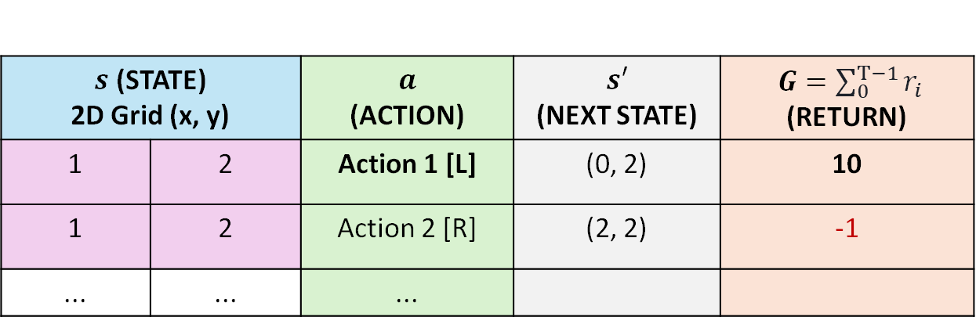




Solving the RL formulation
Perform TRAJECTORY ROLLOUT to collect ($s,a,s^{′},G$). Store it in the REPLAY BUFFER
$s$ (STATE) 2D Grid (x, y) |  | $a$ (ACTION) | $s′$ (NEXT STATE) | $G=\sum_{0}^{T−1}{r_{i}}$ (RETURN)
1 | 2 | Action 1 [L] | (0, 2) | 10
1 | 2 | Action 2 [R] | (2, 2) | -1
... | ... | ...
SAME STATE {
Objective: Given the STATE, predict what ACTION to take
Policy-based Methods
Value-based Methods
For the given STATE:
directly predict which action has a high RETURN
For the given STATE:
Predict the RETURN for each ACTION
Then select ACTION with the max return
$$s$$
$$π\left(s\right)$$
$a$ [Action 1: L]
$$Q\left(s,a\right)$$
$$s,a$$
$$G [10]$$
Policy Network
Value Network

Slide 25
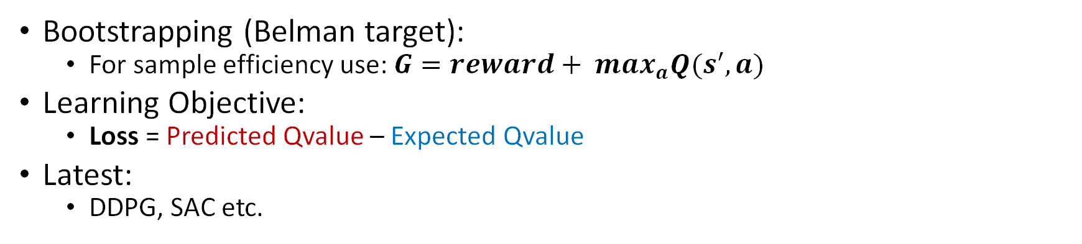
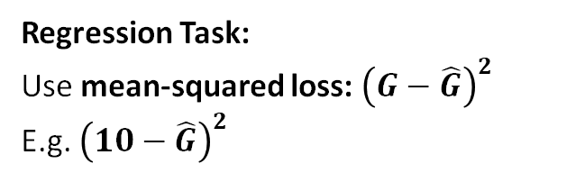
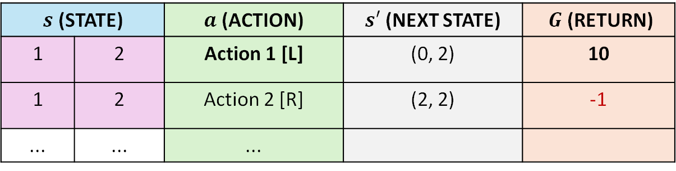



DQN Intuition (Value-based)
$s$ (STATE) |  | $a$ (ACTION) | $s′$ (NEXT STATE) | $G$(RETURN)
1 | 2 | Action 1 [L] | (0, 2) | 10
1 | 2 | Action 2 [R] | (2, 2) | -1
... | ... | ...
Regression Task:
Use mean-squared loss: ${\left(G−\hat{G}\right)}^{2}$
E.g. ${\left(10−\hat{G}\right)}^{2}$
$$s,a$$
$$Q\left(s,a\right)$$
$$\hat{G}$$
Value Network
Bootstrapping (Belman target):
For sample efficiency use: $G=reward+ max_{a}Q(s^{′},a)$
Learning Objective:
Loss = Predicted Qvalue – Expected Qvalue
Latest:
DDPG, SAC etc.

Slide 26

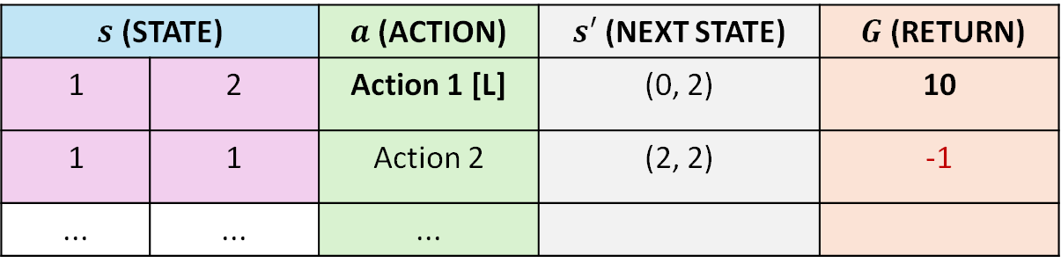
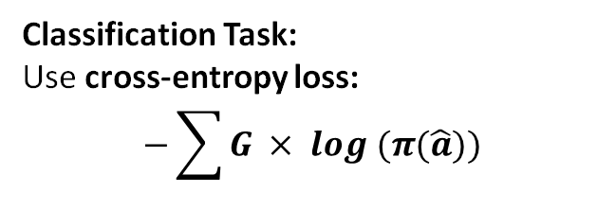


REINFORCE Intuition (Policy-based)
$s$ (STATE) |  | $a$ (ACTION) | $s′$ (NEXT STATE) | $G$(RETURN)
1 | 2 | Action 1 [L] | (0, 2) | 10
1 | 1 | Action 2 | (2, 2) | -1
... | ... | ...
Classification Task:
Use cross-entropy loss:
$$−\sum{G × log (π(\hat{a}))}$$
$$s$$
$$π\left(s\right)$$
$$\hat{a}$$
Policy Network
Learning Objective:
Loss = weighted negative log likelihood of action
Use of RETURN:
Creates noisy updates: the latest methods attempt to fix this
Read more about the use of ADVANTAGE (instead of RETURN)
Advantage: the difference between the best G from a state and the average G from that state
This makes the value smaller, hence a reduction in noise
Latest Algorithms:
TRPO, PPO, GRPO, etc.

Slide 27






Summary: Different RL Algorithms
Policy-based:
Direct optimization objective
Required more samples:
Can’t reuse samples from the old policy (On-policy)
REINFORCE, TRPO, PPO, etc.
Better handling of Continuous Action
Value-based:
Indirect optimization objective
Sample efficient:
Can reuse samples from old policy (Off-policy)
DQN, SAC, etc.
$$s$$
$$π\left(s\right)$$
$$a$$
Policy Network
$$s,a$$
$$Q\left(s,a\right)$$
$$G$$
Value Network
The latest algorithms are hybrid (Actor-Critic)

Slide 28
Libraries for RL Algorithms
StableBaselines3:
Easy to use
Hard to modify the underlying algorithms
CleanRL:
Easy to modify RL algorithms (single-file implementation)
For small-scale experiments
RLLib
Industry grade
Used for resource-intensive tasks: distributed training
TorchRL
New PyTorch-compatible library (may get famous in the future)

Slide 29
StableBaselines3 (Notebook Exercise)
Using RL Algorithms (DQN and PPO) to solve the MDP
1. Initialize your environment
env = GridWorld4x4(max_steps=40)
model = DQN(
"MlpPolicy",
env,
learning_rate=1e-3, # step size for the Adam optimizer
buffer_size=10_000, # replay buffer capacity; stores past (s, a, r, s') transitions
learning_starts=5000, # number of steps to collect before training begins
batch_size=128, # number of transitions sampled per gradient update
gamma=0.95, # discount factor; how much future rewards are valued
train_freq=16, # update the network every 4 environment steps
target_update_interval=500, # steps between copying online network weights to target network
exploration_fraction=0.5, # fraction of training spent decaying epsilon (explore → exploit)
exploration_final_eps=0.01, # minimum epsilon; agent still acts randomly 5% of the time
verbose=1, # 0 = silent, 1 = training info
seed=SEED,
)
2. Initialize RL method: DQN
model.learn(total_timesteps=40_000, callback=callback)
3. Start training

Slide 30
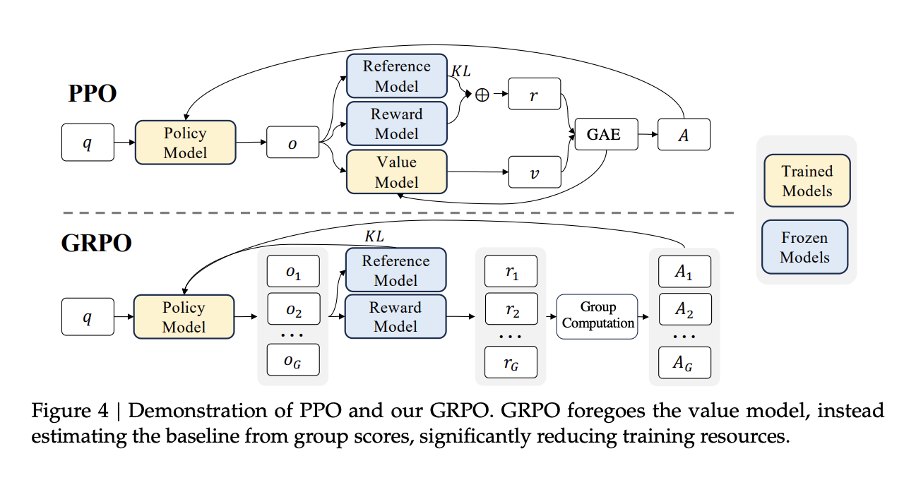
Advanced Algorithms: PPO
Input q → (e.g., state or prompt)
Policy model generates an output o
That output is evaluated by:
Reward model → gives reward r
Value model → estimates expected reward V
Reference model → used for KL constraint (stability)
PPO computes an Advantage (A) = Reward (r) − Expected Reward (V)
DeepSeekMath: Pushing the Limits of Mathematical Reasoning in Open Language Models
Notes:
PPO updates the policy carefully, staying close to the previous version
Now let’s zoom into one of the most widely used algorithms today — Proximal Policy Optimization, or PPO.
At a high level, PPO is still doing reinforcement learning:
we have a policy model that generates outputs
we evaluate those outputs using a reward
and we update the model to improve future outputs
But what makes PPO special is how it updates the model.
Let’s walk through the components here.
We start with an input — for example, a question or prompt.
The policy model generates an output — maybe a response, or a sequence of tokens.
Now, we evaluate this output using two things:
First, a reward model This tells us: how good is this response?
Second, a value model This estimates: what reward did we expect to get?
And the key idea comes from comparing these two.
We compute something called the advantage:
Advantage = actual reward − expected reward
Intuitively:
if the reward is higher than expected → this was a good action
if it’s lower → this was a bad action
Now here comes the most important part of PPO.
When we update the model, we don’t allow it to change too much in one step.
Why?
Because if we update too aggressively:
the model may collapse
it may forget useful behaviors
training becomes unstable
So PPO introduces a constraint:
Stay close to the previous policy
You can think of it like this:
Instead of taking a big leap in learning, we take small, careful steps.
GRPO updates the policy by preferring better actions within a group

Slide 31
Advanced Algorithms: GRPO
Input q → (e.g., state or prompt)
Policy generates multiple outputs: o1,o2,...,oG
Each output gets a reward: r1,r2,...,rG
GRPO has no value model.
It computes an advantage by performing group computation
and comparing rewards within the group.
DeepSeekMath: Pushing the Limits of Mathematical Reasoning in Open Language Models
Notes:
GRPO updates the policy by preferring better actions within a group
Now let’s look at a newer idea — GRPO, which stands for Group Relative Policy Optimization.
At first glance, it looks similar:
we still have a policy
we still generate outputs
we still evaluate them
But there is one key difference
In PPO:
we generate one output
we evaluate it
we compare it to an expected value
But in GRPO:
we generate multiple outputs at once
Let’s say:
o1, o2, o3, … oG
Each of these outputs gets a reward:
r1, r2, r3, … rG
Now instead of comparing to a value model, GRPO does something simpler — and quite clever.
It compares outputs within the group
So rather than asking:
“Was this output good in absolute terms?”
We ask:
“Was this output better than the others?”
So the advantage is computed relatively.
For example:
if one response is the best among the group → increase its probability
if another is worse → decrease its probability
Notice something important here:
GRPO does not need a value model
So compared to PPO:
fewer components
simpler pipeline
potentially faster training

Slide 32
Advanced Algorithms: PPO vs GRPO
Feature | OpenAI o1 (PPO) | DeepSeek R1 (GRPO)
Models Trained | 2 (policy + critic) | 1 (policy only)
Training Method | Compares responses one by one | Ranks multiple responses at once
Training Speed | Slower | Faster
Computational Cost | Higher | Lower
DeepSeekMath: Pushing the Limits of Mathematical Reasoning in Open Language Models

Slide 33
Summary and Key Takeaways
Problem Setting for RL:
No datasets available, but can sample it from the simulator
No labels available, but a feedback mechanism to assign a reward
Sequential: feedback after a long time
Formulate as MDP:
Define the correct state and action space
Careful with the choice of reward
RL Algorithms:
Try out different RL algorithms, such as DQN and PPO.
Mostly empirical:
PPO: for discrete actions
SAC: for continuous actions

Slide 34
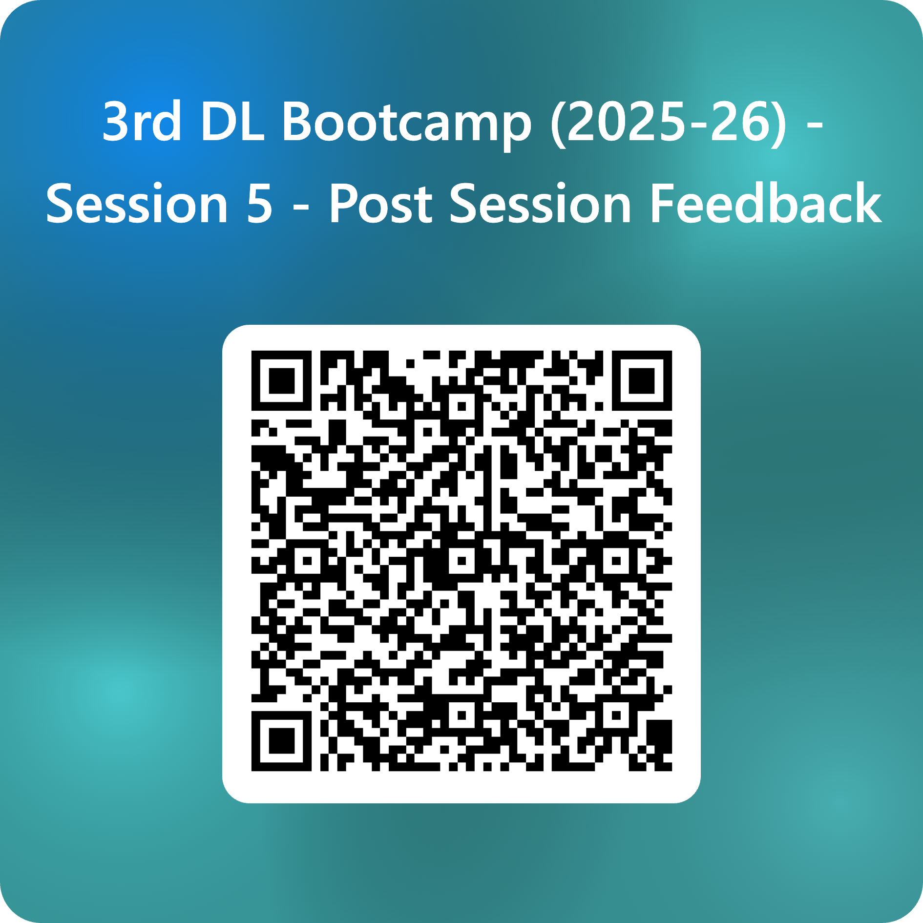
Closing of Deep Learning Bootcamp 2026
Deep Learning Bootcamp ends here!
We will come back again next semester.
Thanks for attending the session!
Please submit your feedback!
Thanks to all the supporting clubs.

Slide 35
Give us Feedback

Slide 36

Where does this kind of problem arise? [ROBOTICS]
Current Pose → Move Direction (Decision) → New Pose
Current
Pose
$$f\left(x\right)$$
Given the current pose,
predict which class
(Up, Down, Left, and Right)

