Slide 1
第二讲 论文的构成与基本表达
鞠小林
Ju.xl@ntu.edu.cn
南通大学 人工智能与计算机学院

Slide 2
Main Sections
Abstract, Keywords
Introduction
Related Work (Literature Review)
Preliminary
Algorithm (Method)
Experimental Results
Conclusion & Future Work

Slide 3
1. Abstract
Motivation
Topic Importance
Literature Review: However, existing work...
Method: In this paper, we....
Experimental Results
implication

Slide 4
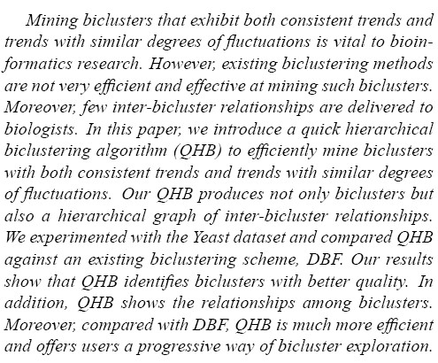
1. Abstract
Example

Slide 5
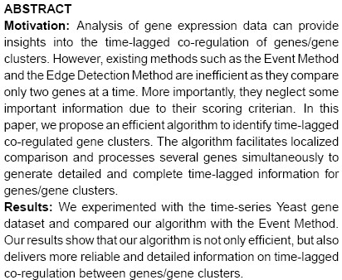
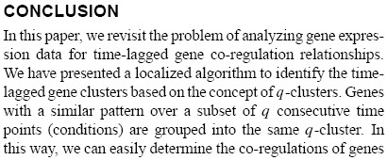
1. Abstract VS Conclusion
Example

Slide 6
Main Sections
Abstract, Keywords
Introduction
Related Work (Literature Review)
Preliminary
Algorithm (Method)
Experimental Results
Conclusion & Future Work

Slide 7
2. Introduction
Background → Topic (1-2 paragraphs)
Literature Review → Motivation (1 paragraph)
Algorithm Overview (1 paragraph)
Contributions (1 paragraph)
Experiment Overview
Roadmap (1 paragraph)

Slide 8
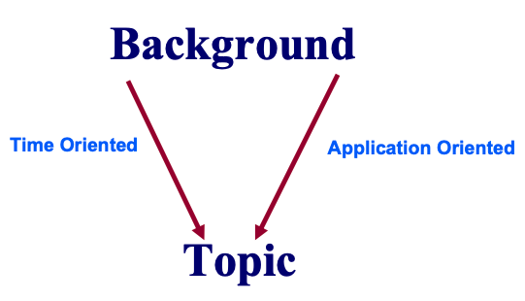
Background → Topic
Concept, Characteristics, Application, Importance, and etc.

Slide 9
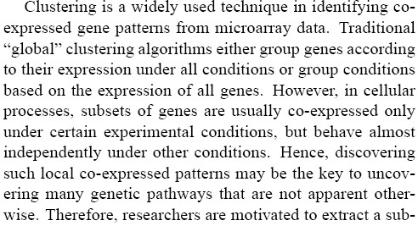
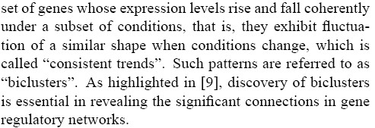
Background → Topic
Time Oriented

Slide 10
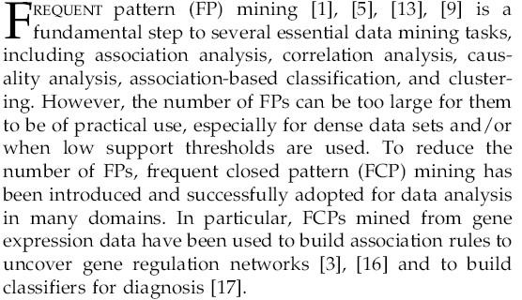
Background → Topic
Application Oriented

Slide 11
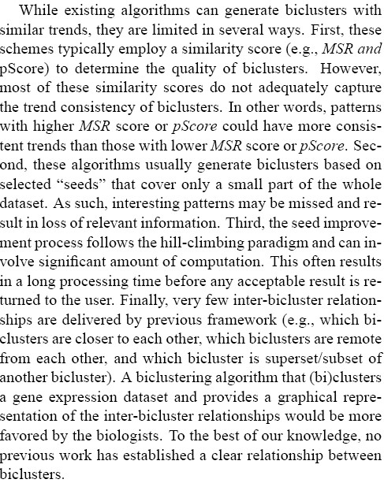
Literature Review →Motivation
Notable Method Summarization
focus on nearest neighbors
Comments
weakness
Motivation
against the weakness

Slide 12
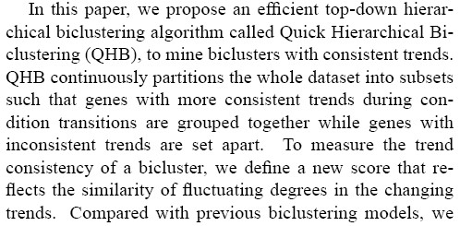
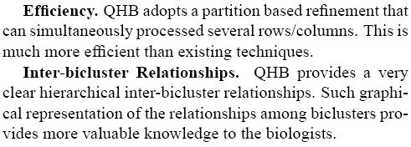
Algorithm Overview & Contribution
Method Definition
Principle Description
How to make
it better?
Contribution

Slide 13
Contributions
New Concept
New Model
New Algorithm
More Efficient, Less Memory, Parallelism and etc.
New Result
Significant in Application Domain

Slide 14


Experiment Overview
Implementation
Data
Result

Slide 15
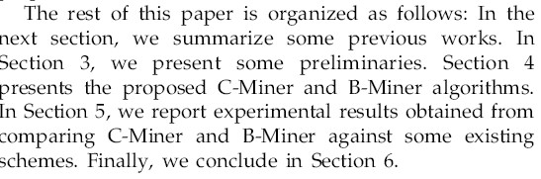
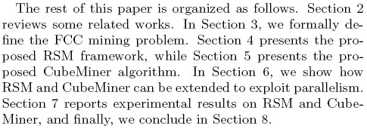
Roadmap
one paragraph

Slide 16
Main Sections
Abstract, Keywords
Introduction
Related Work (Literature Review)
Preliminary
Algorithm (Method)
Experimental Results
Conclusion & Future Work

Slide 17
3. Related work
Detail some notable works
Give comments individually or by group
Summarize irrelevant works in a few words
Head and tail
In time or advancing order
Put to the bottom the methods to be compared

Slide 18
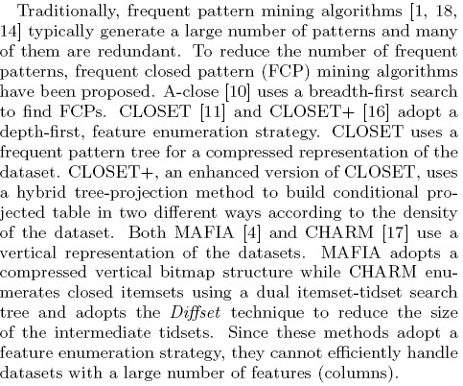
3. Related work

Slide 19
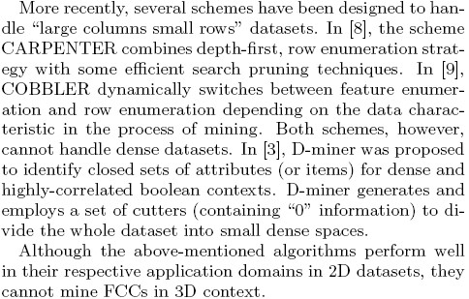
3. Related work

Slide 20
3. Related work (supplement)
Add the head
There are plenty of covert channel methods in literature. Here, we will only review some notable work due to space limitation.
Now (Here/ In this section), we will review some notable methods (previous work)......

Slide 21
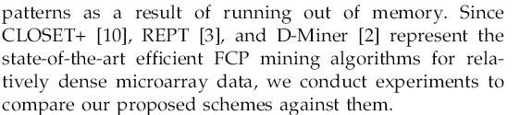
3. Related work (supplement)
Add the tail
Hence, we are motivated to......

Slide 22
Main Sections
Abstract, Keywords
Introduction
Related Work (Literature Review)
Preliminary
Algorithm (Method)
Experimental Results
Conclusion & Future Work

Slide 23
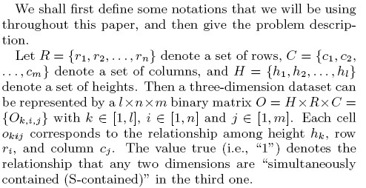
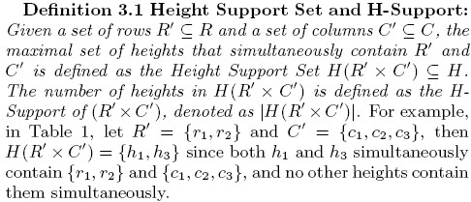

4. Preliminary
Applying to paper with
lots of definitions
Three Components:
Overview
Definitions
Problem Definition

Slide 24
Main Sections
Abstract, Keywords
Introduction
Related Work (Literature Review)
Preliminary
Algorithm (Method)
Experimental Results
Conclusion & Future Work

Slide 25
5. Algorithm (method)
Overview
Preliminaries (Definitions, Model Description)
Put the whole idea in Phases or Steps
Emphases which phase/step/part makes the algorithm outstanding
Use running examples, figures, tables, pseudo-code......
Supplementary (limitations, suggestions, future work...)

Slide 26
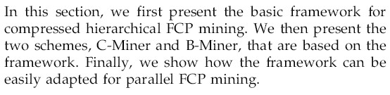
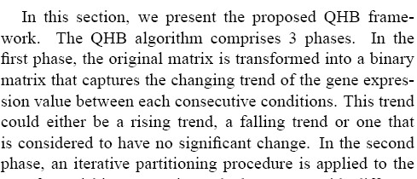
5. Algorithm (method)

Slide 27
5. Algorithm (main content)
Phase 1
Step 1
Step 2
Phase 2
In the 1st step
In the 2nd step
Phase 3
......

Slide 28
5. Algorithm (main content)
Example
In our method, the Step 2 and 3 ensure that each sending message would learn from the normal network traffic (Reference) so that messages from our channel have similar length distribution as normal network messages. To better resist the detection, our scheme could be further enhanced through the way that Alice periodically sends to Bob redundant normal network messages during the transmission.

Slide 29
Main Sections
Abstract, Keywords
Introduction
Related Work (Literature Review)
Preliminary
Algorithm (Method)
Experimental Results
Conclusion & Future Work

Slide 30
6. Experimental Results
Overview: tool, data, methods to compare
Data Description
Data Preprocessing
Compare against other algorithms (methods)
Parameter Studies (Optimization)

Slide 31
6. Experimental Results
Example
Experimenting on the Clartnet dataset [9], we compared our scheme with Girling’s[3] and Yao’s[8] models, and estimated the upper bound of our model’s bandwidth.
4.1 Dataset
Clarknet dataset [5] contains the logs of 1.6 million HTTP queries from two weeks. We take the 7239 queries from Client ‘piweba5y.prodigy.com’ as the messages for our experiments. In each query, the average size of transmitted message is 489 bytes (39 bytes message + 450 bytes header).

Slide 32
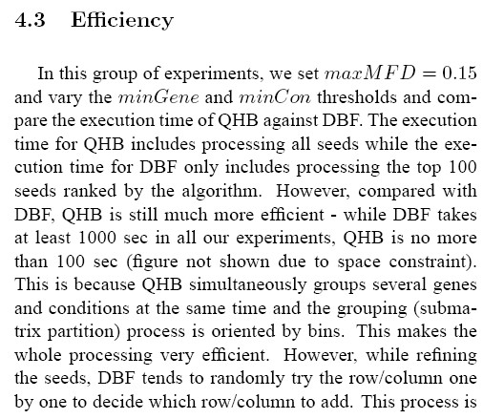
6. Experimental Results
Example

Slide 33
Main Sections
Abstract, Keywords
Introduction
Related Work (Literature Review)
Preliminary
Algorithm (Method)
Experimental Results
Conclusion & Future Work

Slide 34
7. Conclusion & Future Work
Summarize what we did in the paper
Method
Experimental Results
Benefits (Application)
Future Work

Slide 35
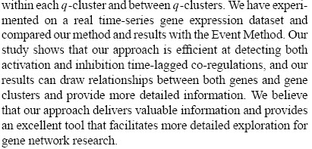
7. Conclusion & Future Work
Example

Slide 36


Slide 37


