Slide 1

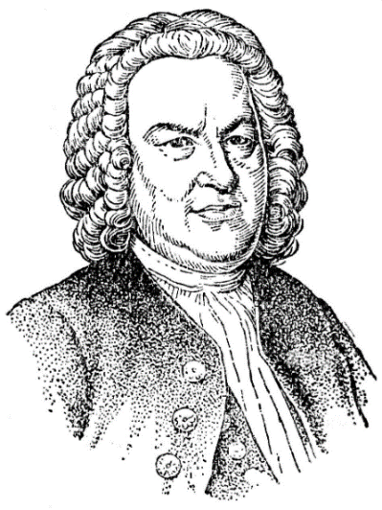
Imitating Bach Training a Diffusion Model to Compose Fugues
Andreas Kalavas
National Technical University of Athens
andreaskalavas@gmail.com

Slide 2
Outline
We introduce a new MIDI dataset, consisting of compositions by Bach.
We outline a method for generating binary image datasets from MIDI files and vice versa.
We train an existing Diffusion Model with our dataset.
We test the model on the tasks of Unconditional Generation and Infilling.
We provide a critical viewpoint for our work.

Slide 3
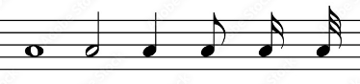
MIDI Dataset
Consists of compositions by Bach, namely the inventions, the sinfonias and the two Well-Tempered Clavier books.
We refined the compositions and tried to ensure that the smallest note value is the demisemiquaver or the thirty-second note, with any additional note values being multiples thereof.
All pieces have been transposed to the key of C major or C minor.

Slide 4
Binary Image Dataset Creation
One axis – the pitch axis – will comprise 88 pixels, corresponding to the number of available pitches on a standard keyboard.
The other axis – the time axis – can be configured to incorporate any number of pixels, depending on the desired length.
A pixel can be regarded as a discrete time tick, and the determination of its duration involves assessing the number of ticks within a demisemiquaver, which constitutes the smallest musical note value in the most of the MIDI files.
Augmentation Techniques:
Overlapping the images, so the ending of one image aligns with the beginning of the next one.
Transposing the pieces, to facilitate the spread of melodies across a broader range of pitches.
Reducing the Tempo of the pieces, to generate additional segments without introducing an excessive volume of new information into the model.

Slide 5
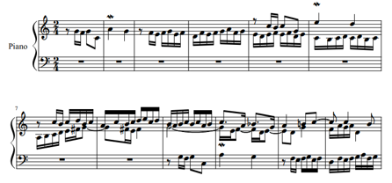
One Slide Lesson in Fugues
Polyphonic composition.
In two or more voices.
Built on a subject (a musical theme) that is introduced in the beginning.
The theme recurs frequently throughout the course of the piece.
Theme
New voice with the theme
Another voice with the theme

Slide 6



Training Dataset
Time axis set to 192 pixels – Equals to 6 measures in 4/4 time signature.
We used the 24 fugues of the first Well-Tempered Clavier book.
Augmentation techniques: overlap, transposition by one octave, reducing the tempo to half.
Final size is 2262 binary images.
Why Fugues?
High degree of structural organization.
Short and simple musical motifs.
We believe that the model is likely to distinguish them more effectively compared to longer and more intricate melodies.

Slide 7
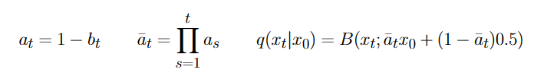
Model (1) – Efficient Forward Process
The model employs binomial prior distribution.
It is feasible to establish a forward process that solely depends on the input x₀.
We can efficiently compute the output at step t.
We can shuffle the order of noisy training data within minibatches, enabling the model to generate them dynamically, thus requiring less memory.
The kernel is:

Slide 8
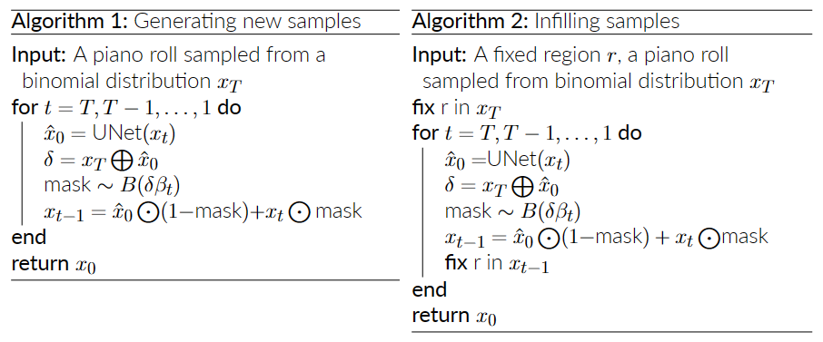
Model (2) – Sampling Algorithms
The sampling algorithm differs from the conventional sampling approach.
In the typical sampling procedure, where the extraction and addition of noise can result in a point x_{t-1} being considerably distant from x_{t}, the samples can be unstable.
A refined approach involves partially adding the initial noise x_{T} back into the estimated x₀.
For infilling, we fix the areas of the image that are given and need to stay intact before each step.

Slide 9
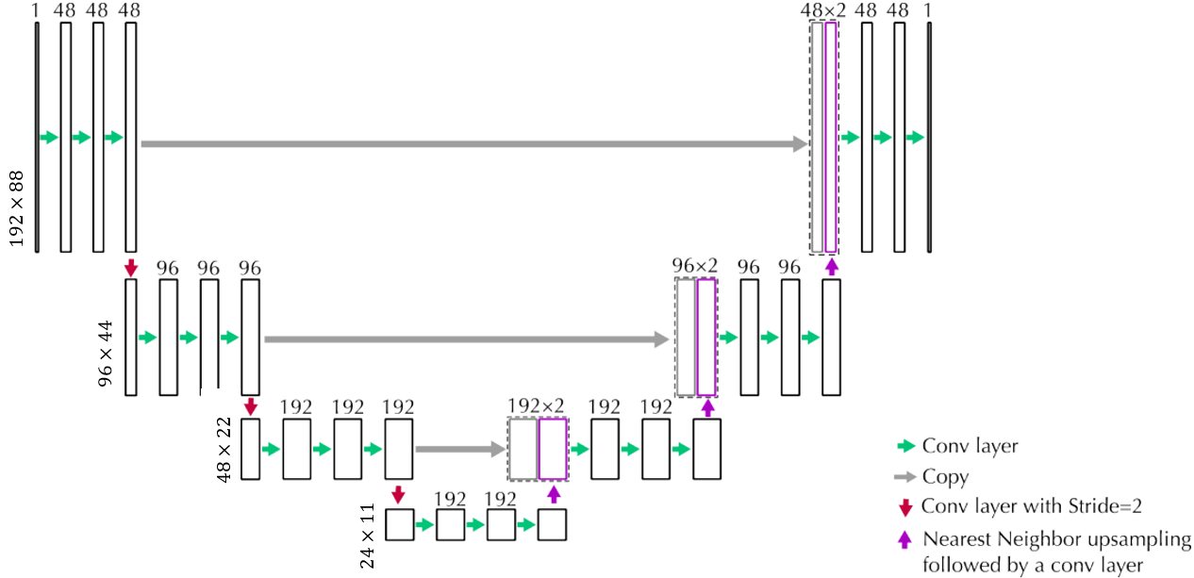
Model (3) – Architecture
Within the steps of the Diffusion Model, a UNet model is incorporated.
Similar to the hourglass architecture of autoencoders, with the additional existence of horizontal connections that connect the feature maps at the same scale from the first half of the network to the second half.

Slide 10





Results – Unconditional Generation
The model can generate from single voice to multi voice piano rolls.
Piano roll 1: like the beginning of a fugue, where the theme is exposed and then other voices are entering.
Piano roll 2: the model recognized themes, and repeated them in a higher pitch.
Piano roll 3: we observe the polyphonic texture.

Slide 11



Results – Infilling (1)
Infill in the time domain by fixing the beginning and the ending of the image.
The generated part adheres to the musical key (stays in C major) and the textural attributes present in the fixed segments.

Slide 12

Results – Infilling (2)
Infill with the top voice given by fixing the melody and all the area above.

Slide 13


Results – Infilling (2)
Infill with the top voice given by fixing the melody and all the area above.
The model generates a coherent harmony along with a contrasting fast paced base line.

Slide 14

Results – Infilling (3)
Infill with the middle voice given by just fixing the melody.

Slide 15


Results – Infilling (3)
Infill with the middle voice given by just fixing the melody.
The model generated a harmonious arrangement, finishing in a perfect cadence (IV-V-I), that notably reminds an ending of a fugue.

Slide 16
Limitations
Not all noise is filtered, as it can be seen and heard in the previous samples.
Heavily compacted pieces in time axis.
Loss of many musical elements (tempo, dynamics, articulation etc.).
Sources - needed 130 hours for a dataset of 2262 images.
No efficient statistical metrics for quality evaluation of samples.
Questionable comprehension of the model, as it sees images.

Slide 17
References (1)
[1] G. Mittal, J. Engel, C. Hawthorne, and I. Simon, “Symbolic music generation with diffusion models,” ISMIR, 2021. [arXiv:2103.16091]
[2] A. Roberts, J. Engel, C. Raffel, C. Hawthorne, and D. Eck, “A hierarchical latent vector model for learning long-term structure in music”, in Proceedings of the 35th International Conference on Machine Learning, ser. Proceedings of Machine Learning Research, J. Dy and A. Krause, Eds., vol. 80. PMLR, 10–15 Jul 2018, pp. 4364–4373. [http://proceedings.mlr.press/v80/roberts18a.html]
[3] C. Raffel, “Learning-based methods for comparing sequences, with applications to audio-to-midi alignment and matching,” Ph.D. dissertation, Columbia University, 2016. [https://doi.org/10.7916/D8N58MHV]
[4] M. Plasser, S. Peter, G. Widmer, “Discrete Diffusion Probabilistic Models for Symbolic Music Generation”, IJCAI, 2023. [arXiv:2305.09489]
[5] J. Austin, D. Johnson, J. Ho, D. Tarlow, R. Van Den Berg, “Structured denoising diffusion models in discrete state-spaces”, in Advances in Neural Information Processing Systems, volume 34, pages 17981–17993. Curran Associates, Inc., 2021
[6] L. Atassi, “Generating symbolic music using diffusion models”, University of California, 2023. [arXiv:2303.08385]

Slide 18
References (2)
[7] O. Ronneberger, P. Fischer, T. Brox, “U-net: Convolutional networks for biomedical image segmentation”, in International Conference on Medical image computing and computer-assisted intervention. Springer, 2015, pp. 234–241.
[8] J. Ho, A. Jain, P. Abbeel, “Denoising diffusion probabilistic models”, Advances in Neural Information Processing Systems, vol. 33, pp. 6840–6851, 2020.
[9] A. Bansal, E. Borgnia, H.-M. Chu, J. S. Li, H. Kazemi, F. Huang, M. Goldblum, J. Geiping, T. Goldstein, “Cold diffusion: Inverting arbitrary image transforms without noise,” 2022. [arXiv:2208.09392]
[10] M. F. Naeem, S. J. Uh, Y. Uh, Y. Choi, and J. Yoo. “Reliable fidelity and diversity metrics for generative models”.
[11] W. Y. Hsiao, J. Y. Liu, Y. C. Yeh, and Y. H. Yang. “Compound word transformer: Learning to compose full-song music over dynamic directed hypergraphs”. In Proceedings of the AAAI Conference on Artificial Intelligence, volume 35, pages 178–186,2021.

Slide 19

Questions?

Slide 20
Thank you!!!

