Slide 1
Placenta Segmentation in MRI with Deep Learning
Diploma Thesis Presentation Grigorios Tsenos

Slide 2
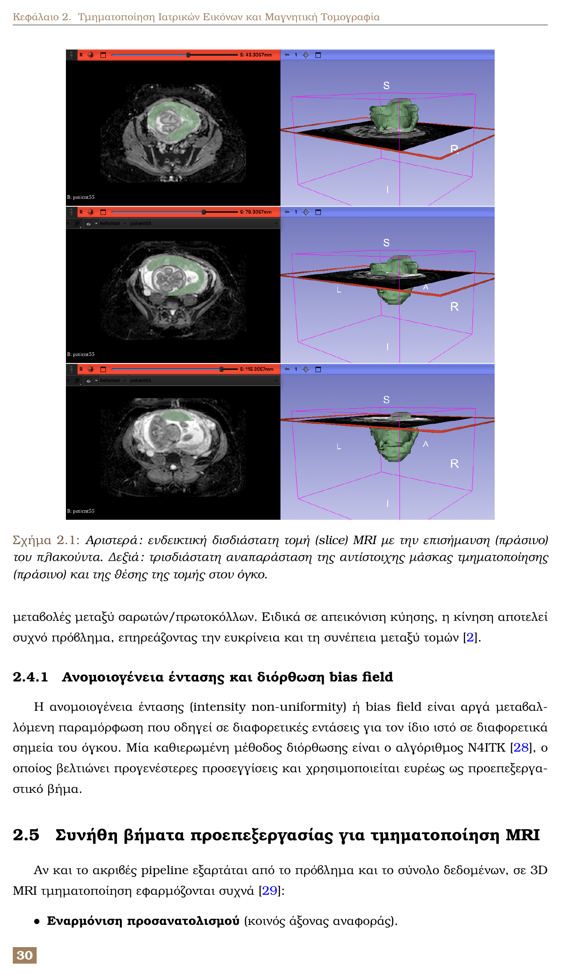
Topic and Context
National Technical University of Athens (ECE School)
Thesis focus: 3D placenta segmentation from MRI
Goal: fair and reproducible model comparison

Slide 3
Why This Problem Matters
Placenta health is critical for pregnancy outcome
Quantification needs reliable segmentation masks
Manual delineation is slow and observer-dependent
Automation enables scalable analysis

Slide 4
Core Challenges
Strong shape and location variability
Ambiguous organ boundaries in MRI
Motion artifacts and intensity inhomogeneity
Limited amount of annotated 3D data

Slide 5
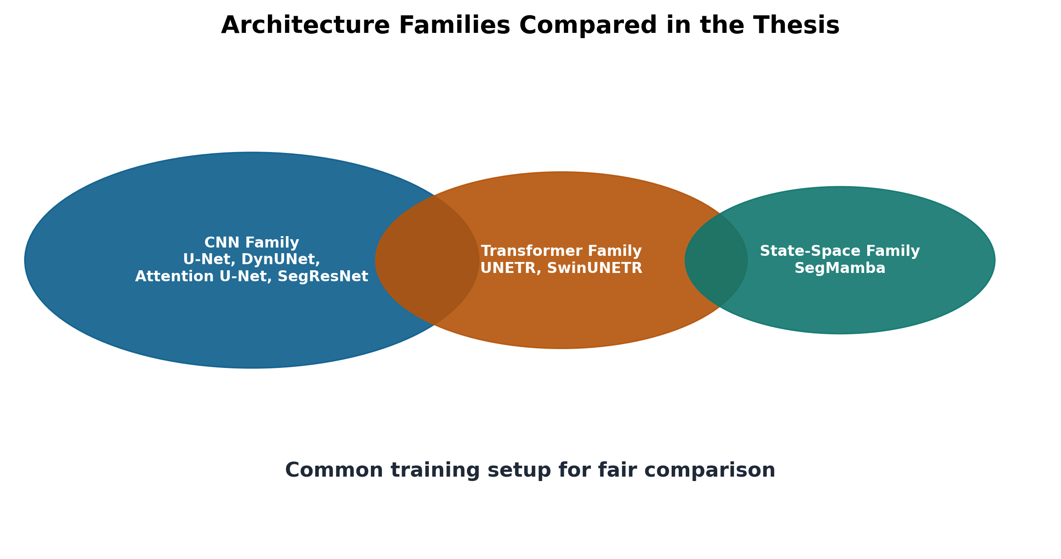
Study Objectives
Build one unified experimental protocol
Compare CNN, Transformer, and SSM families
Keep training conditions identical across models
Combine quantitative and qualitative evaluation

Slide 6
Architecture Families Compared
CNN: U-Net, Attention U-Net, DynUNet, SegResNet
Transformer: UNETR, SwinUNETR
State-space: SegMamba
Same data pipeline for all runs

Slide 7
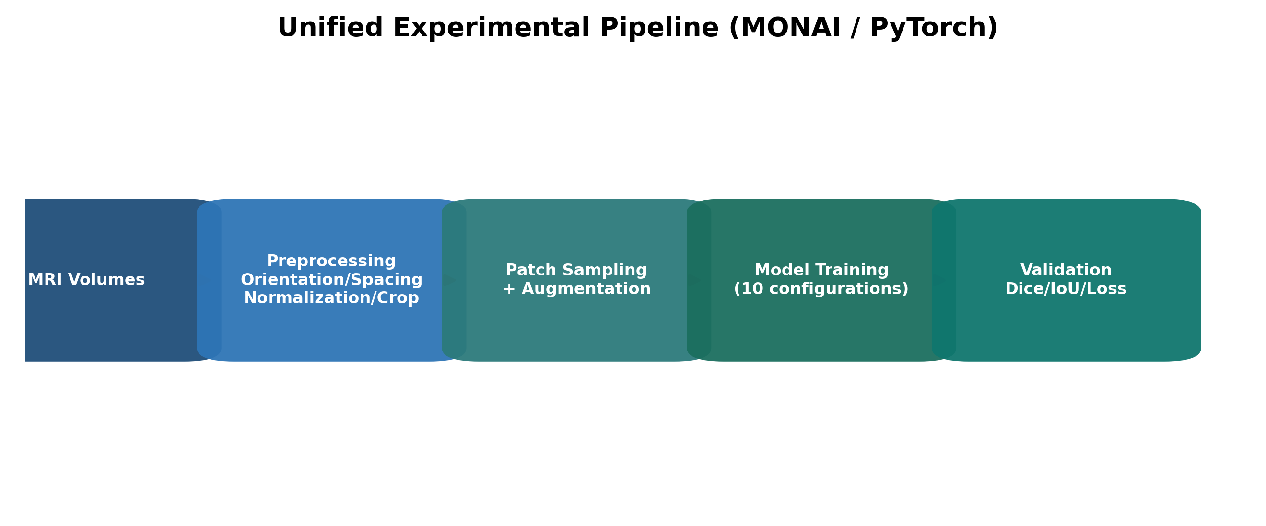
Unified Experimental Pipeline
Input standardization and geometric alignment
Patch sampling and augmentation strategy
Common optimization and validation flow
Fair comparison by design

Slide 8
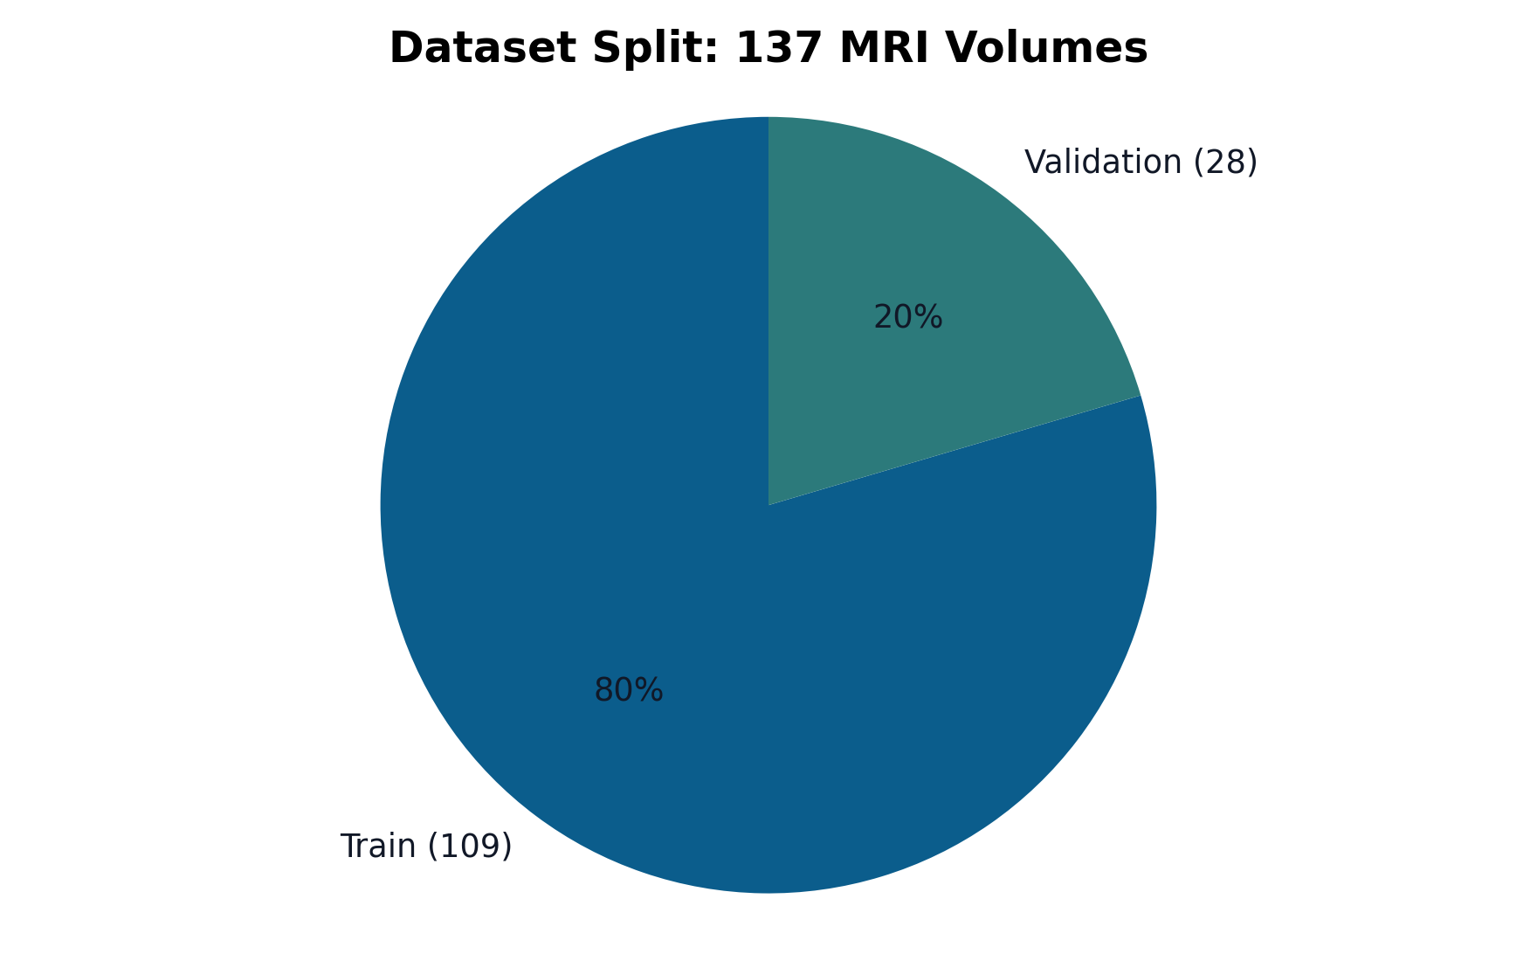
Dataset and Split
Total MRI volumes: 137
Training set: 109 volumes
Validation set: 28 volumes
3D volume-level evaluation

Slide 9
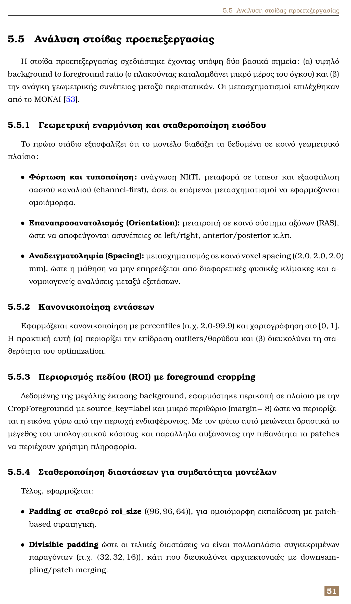
Preprocessing Choices
Orientation normalization to RAS
Resampling to voxel spacing (2.0, 2.0, 2.0) mm
Intensity normalization with percentiles
Foreground ROI cropping and fixed patch shape

Slide 10
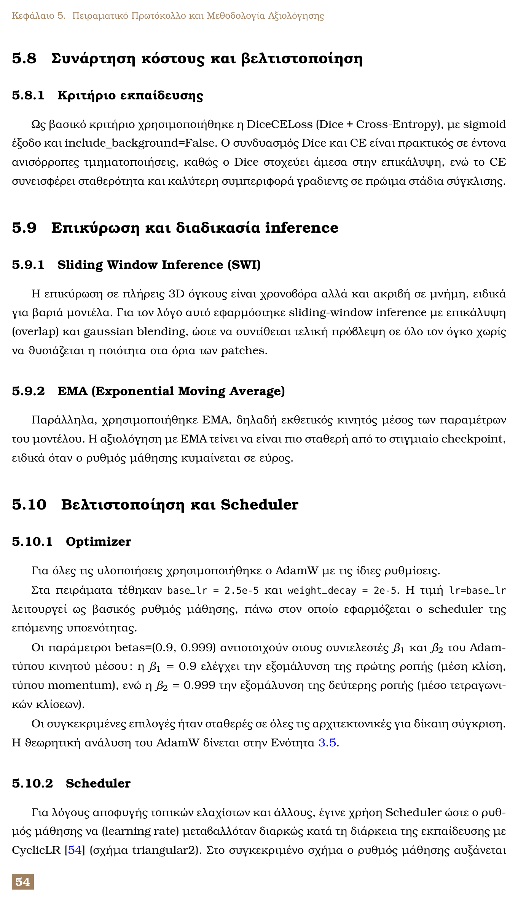
Training Protocol
Patch size: (96, 96, 64)
Loss: DiceCE (with sigmoid, no background)
Optimizer: AdamW + CyclicLR scheduler
120 epochs, EMA, sliding-window inference

Slide 11
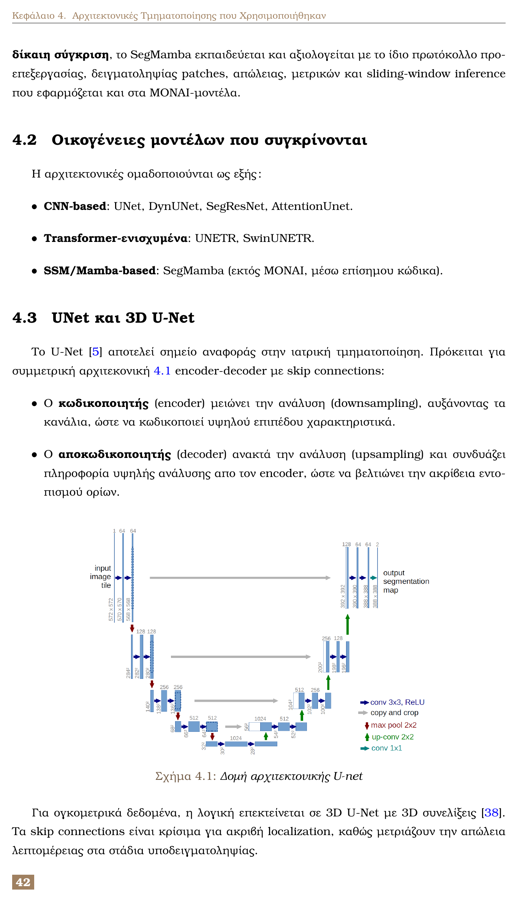
U-Net Foundation
Encoder-decoder with skip connections
Strong baseline for medical segmentation
3D variants capture volumetric context

Slide 12
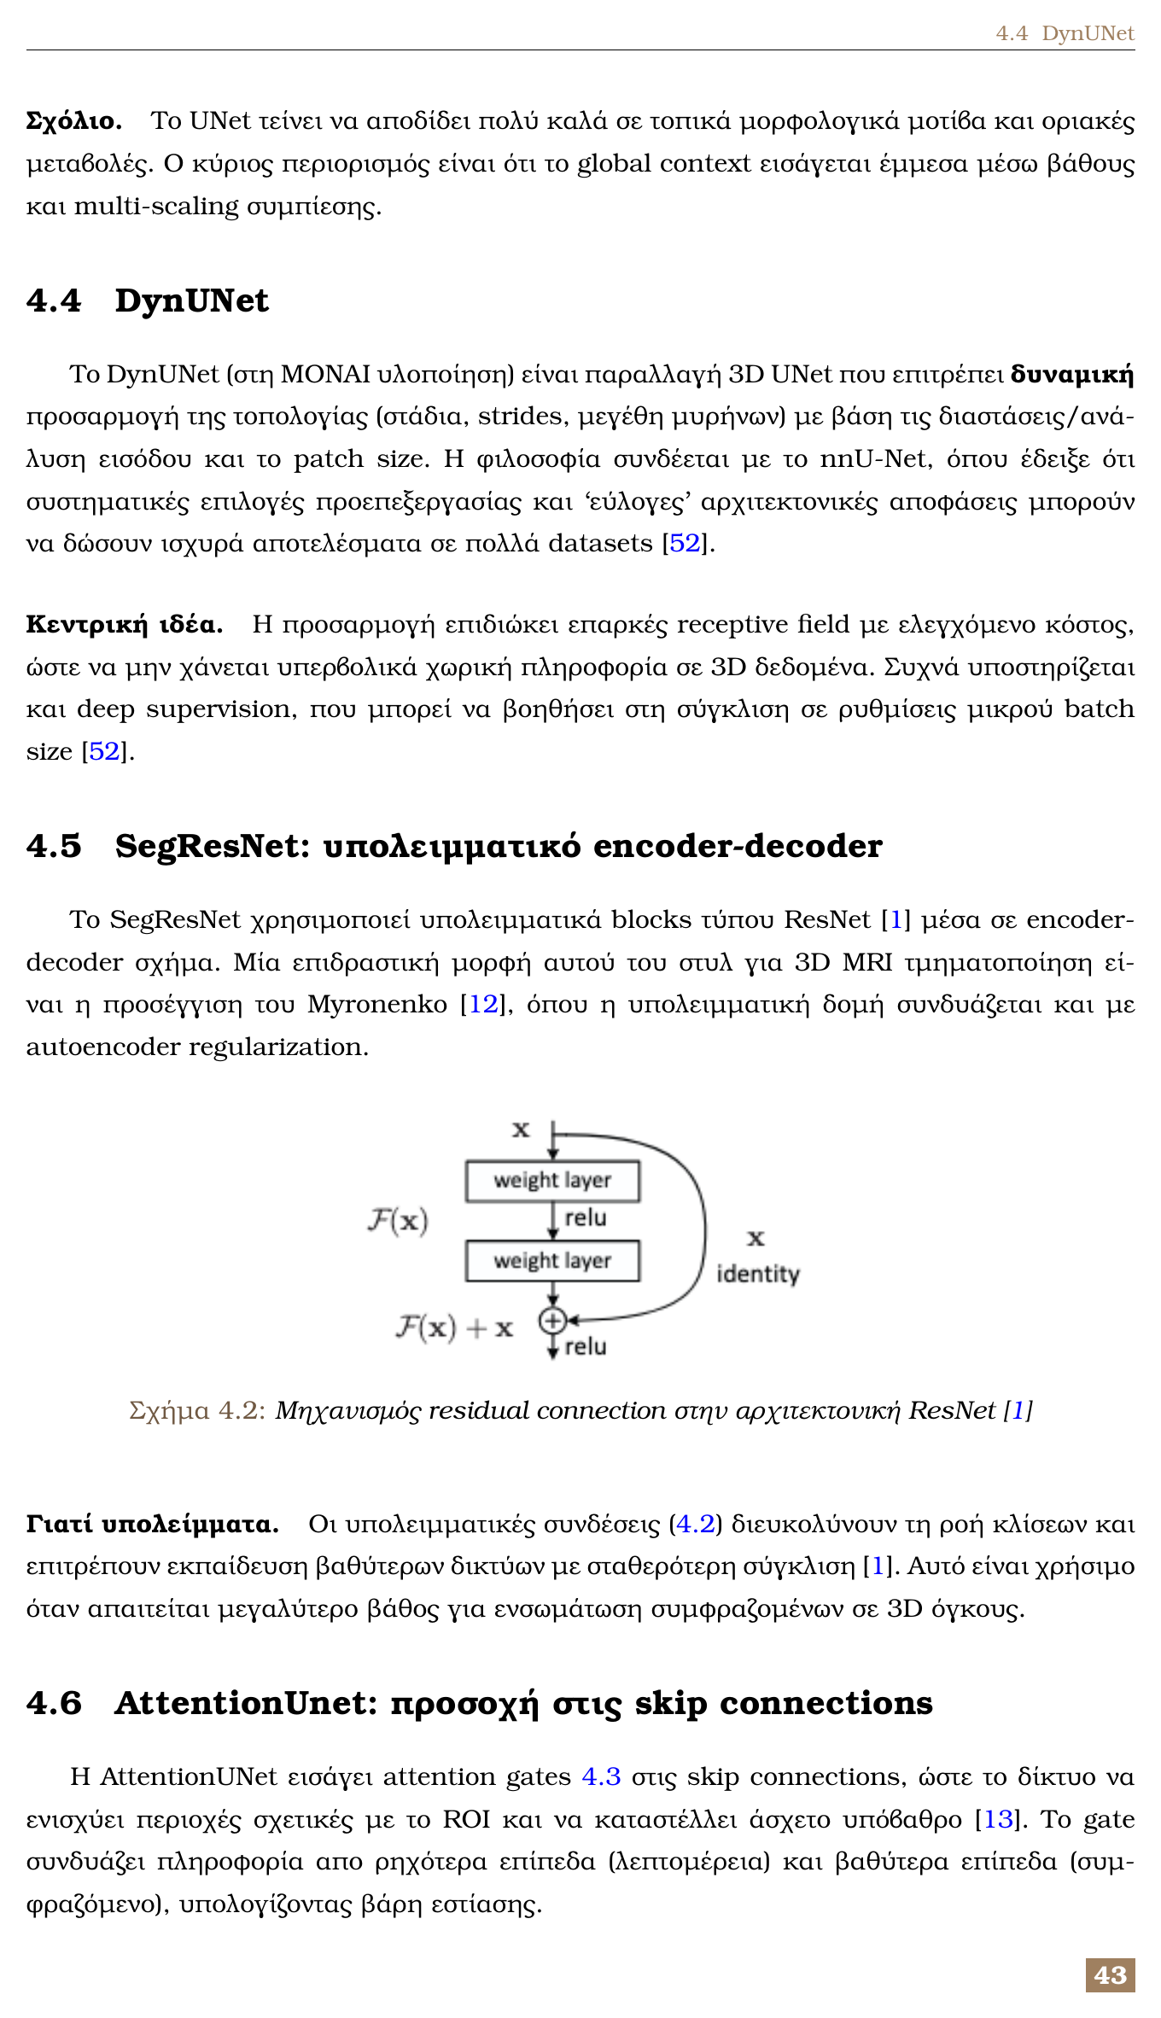
Residual and Attention Ideas
Residual blocks support deeper optimization
Attention gates refine skip features
Better focus on the target organ boundaries

Slide 13
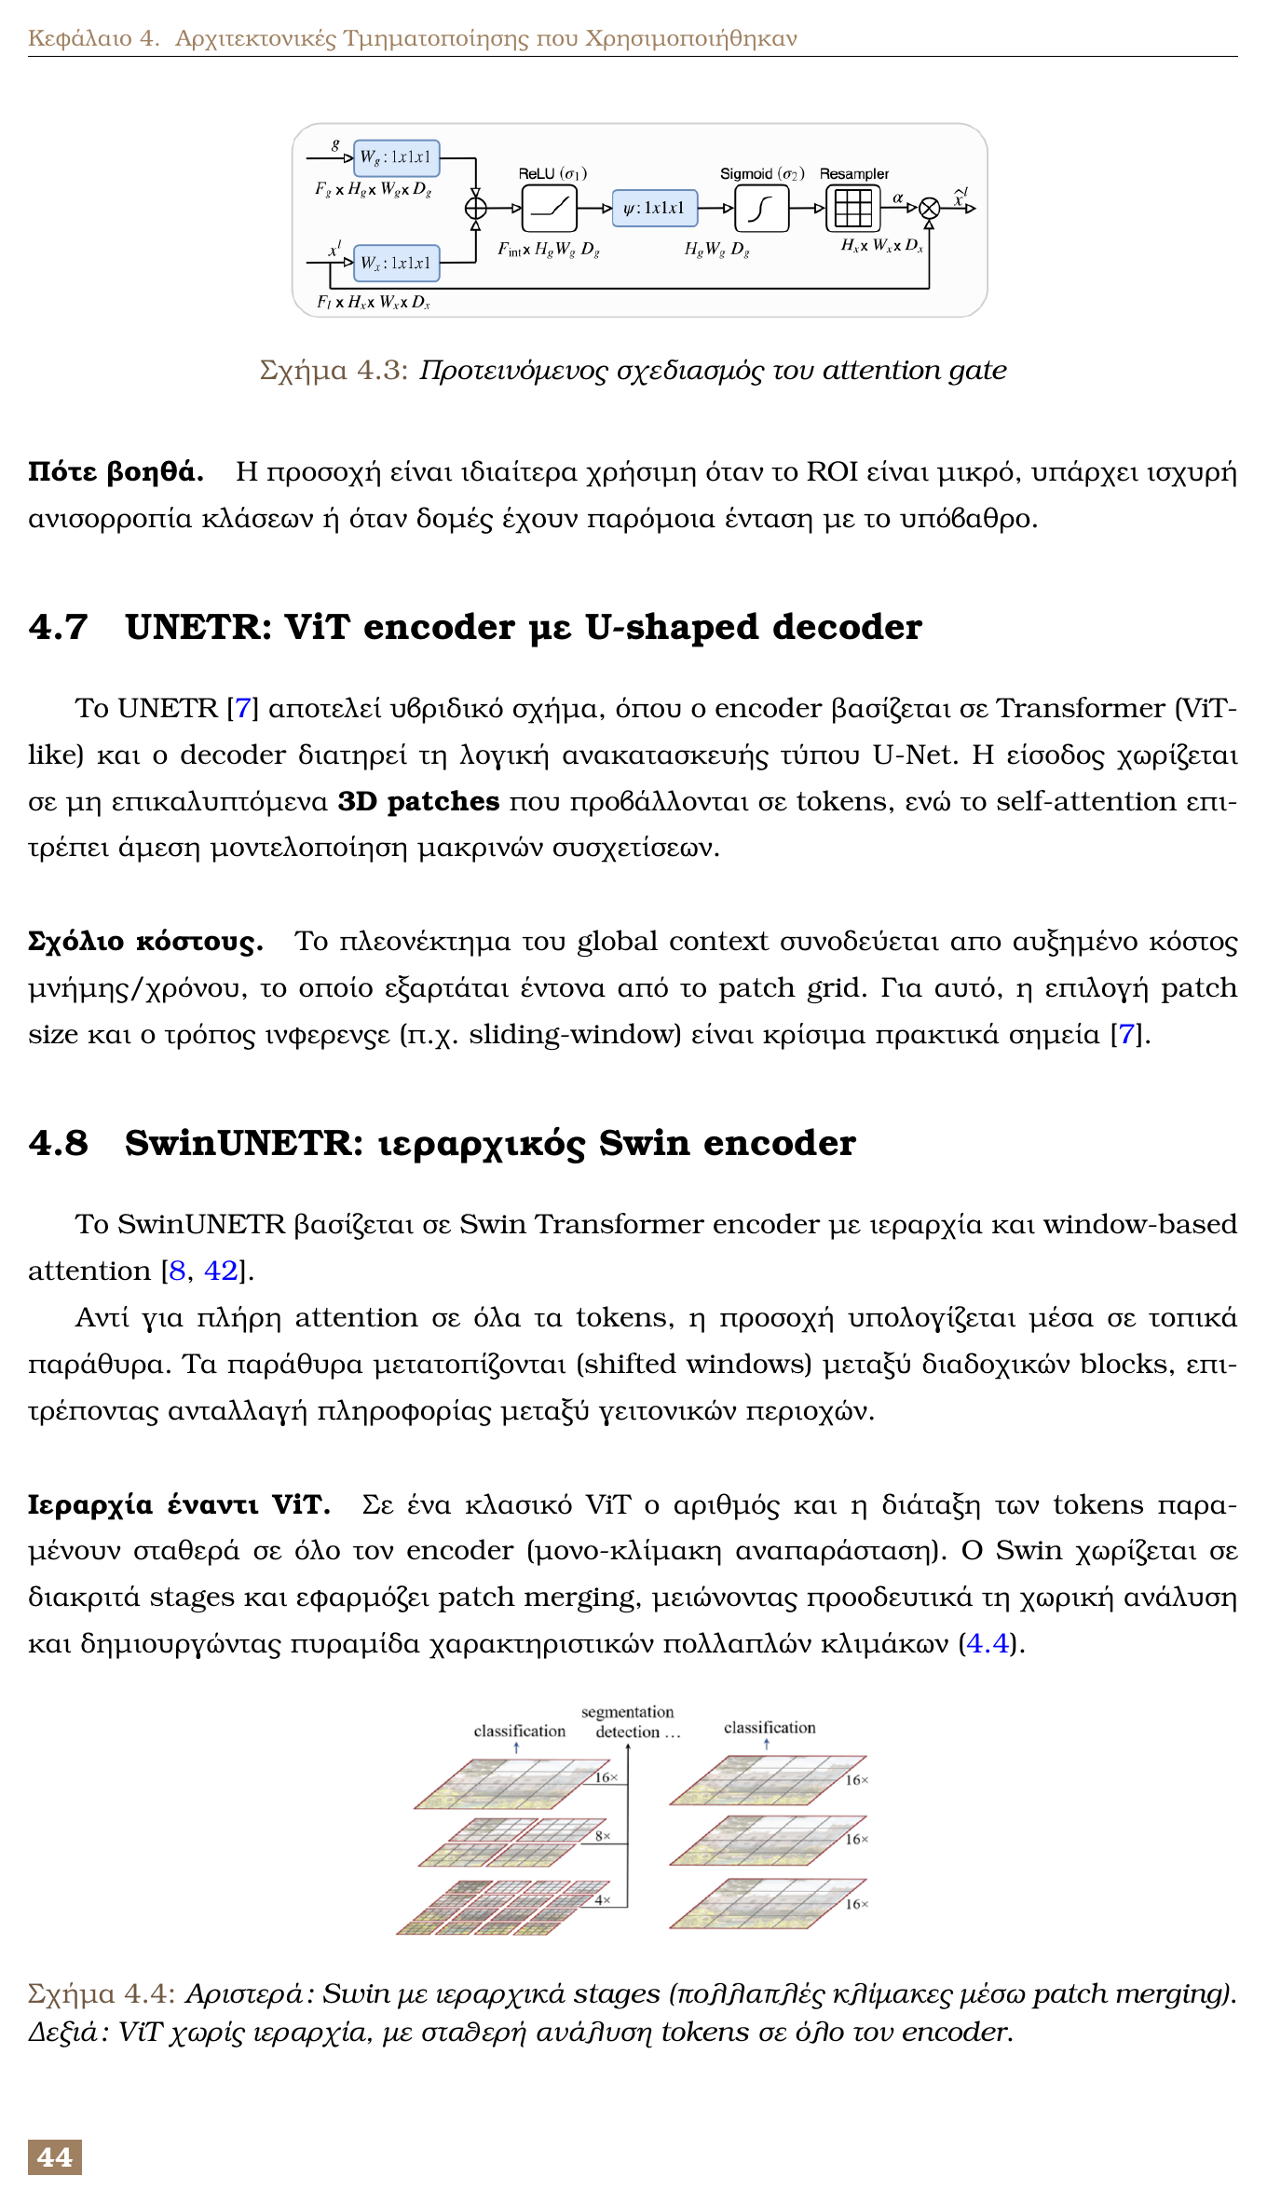
Transformer Design Choices
UNETR: ViT-style encoder with U-shaped decoder
SwinUNETR: hierarchical windows and patch merging
Locality priors improved stability versus pure ViT

Slide 14
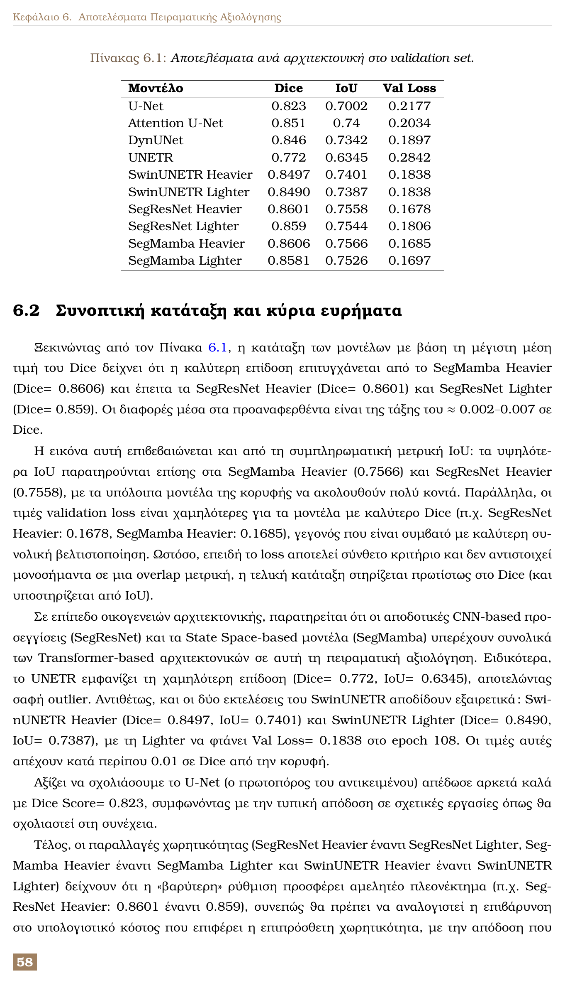
Quantitative Results (Validation Set)
Best Dice: SegMamba Heavier = 0.8606
Very close: SegResNet Heavier = 0.8601
Strong Transformer baseline: SwinUNETR ~0.849
Lowest performer: UNETR = 0.772

Slide 15
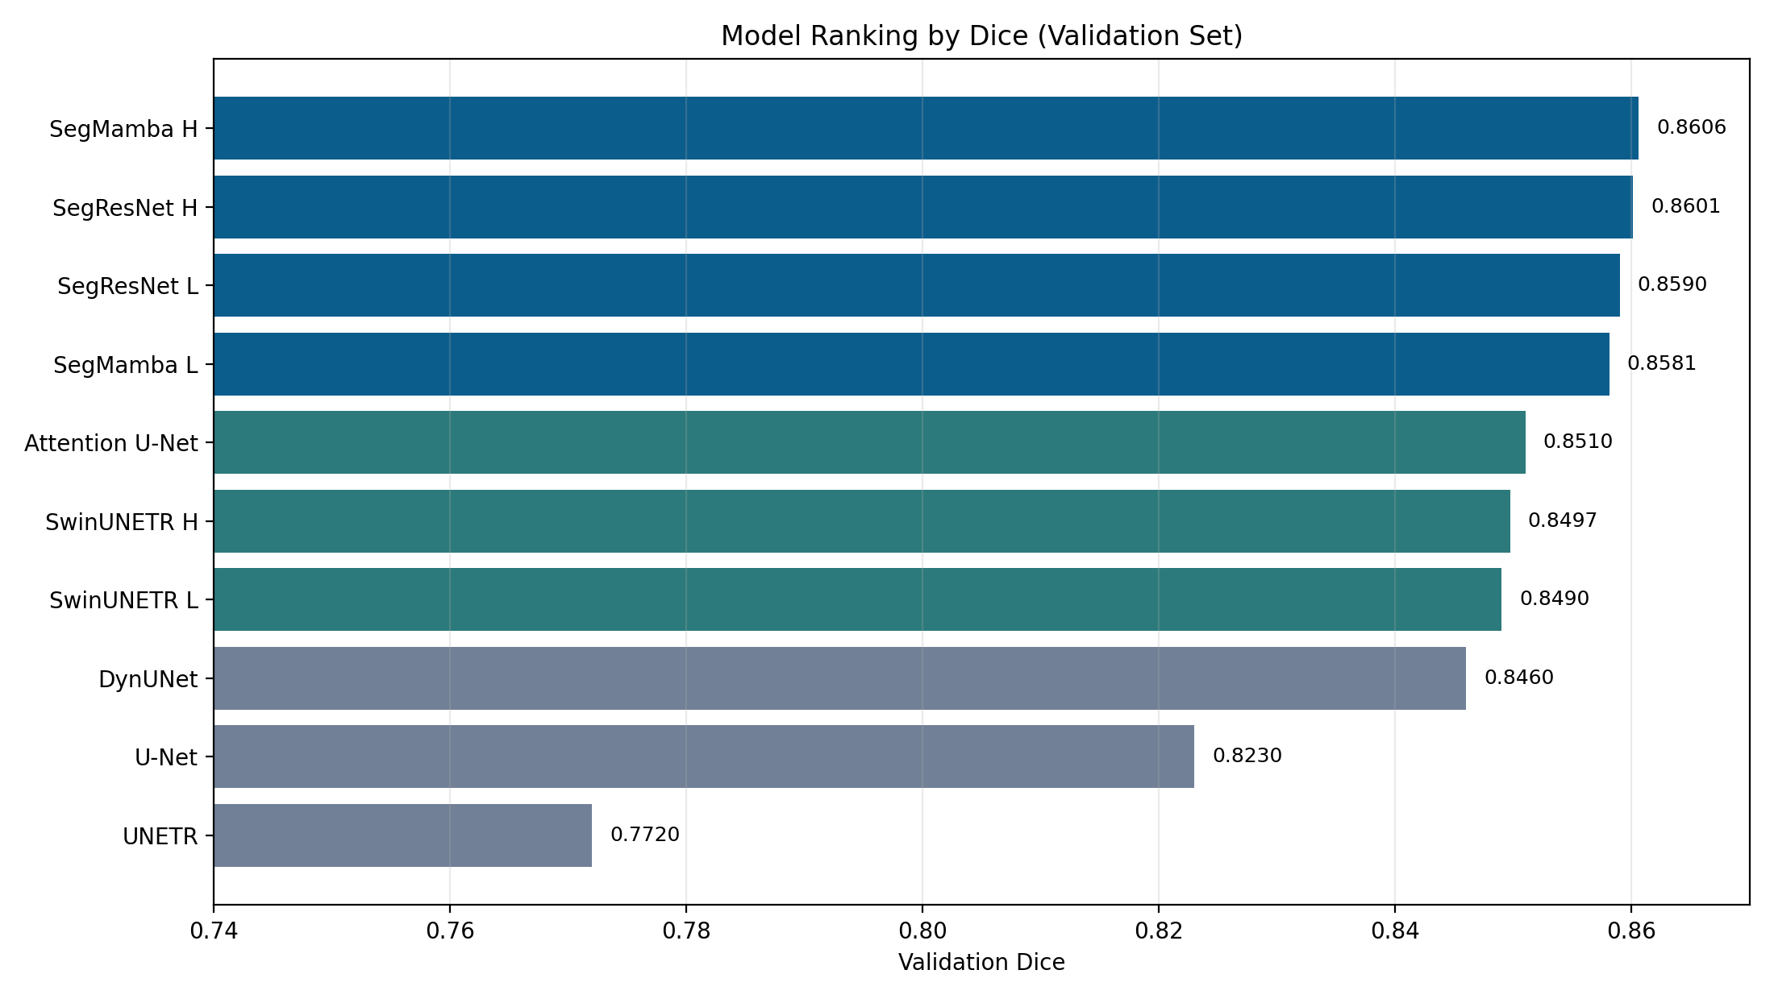
Ranking by Dice
Top cluster around Dice ~0.86
Small differences among top 4 models
Classic U-Net still competitive baseline

Slide 16
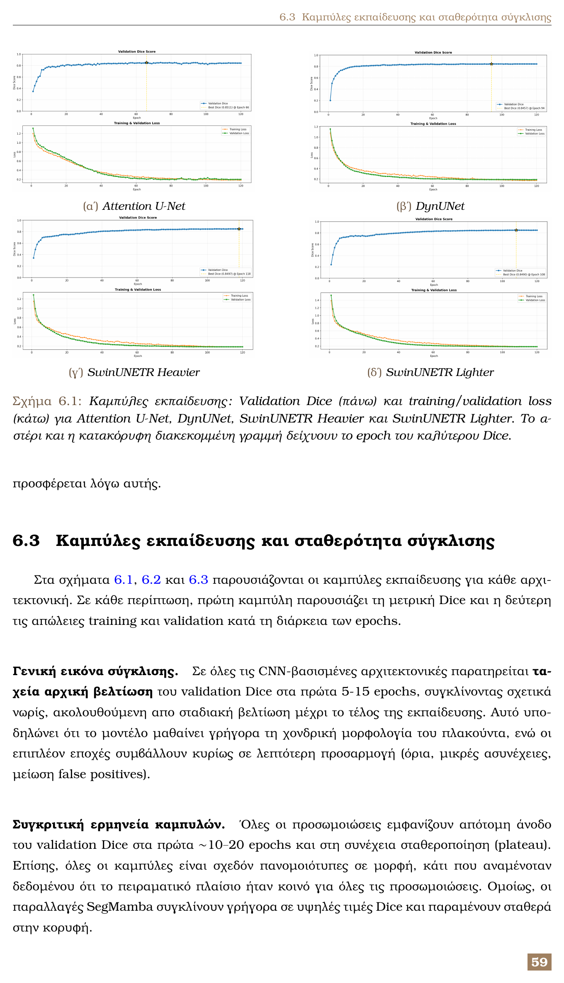
Training Curves: Group A
Attention U-Net, DynUNet, and SwinUNETR converge fast
Early gains in first epochs, then plateau behavior
Best epoch selected by validation Dice

Slide 17
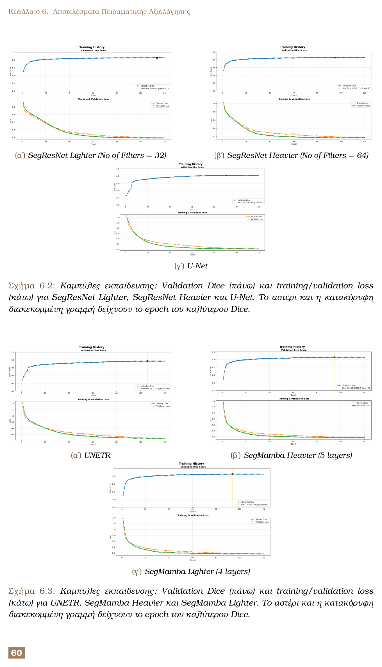
Training Curves: Group B
SegResNet and SegMamba show strong stability
UNETR behaves as an outlier in convergence quality
Curves support the final ranking trend

Slide 18
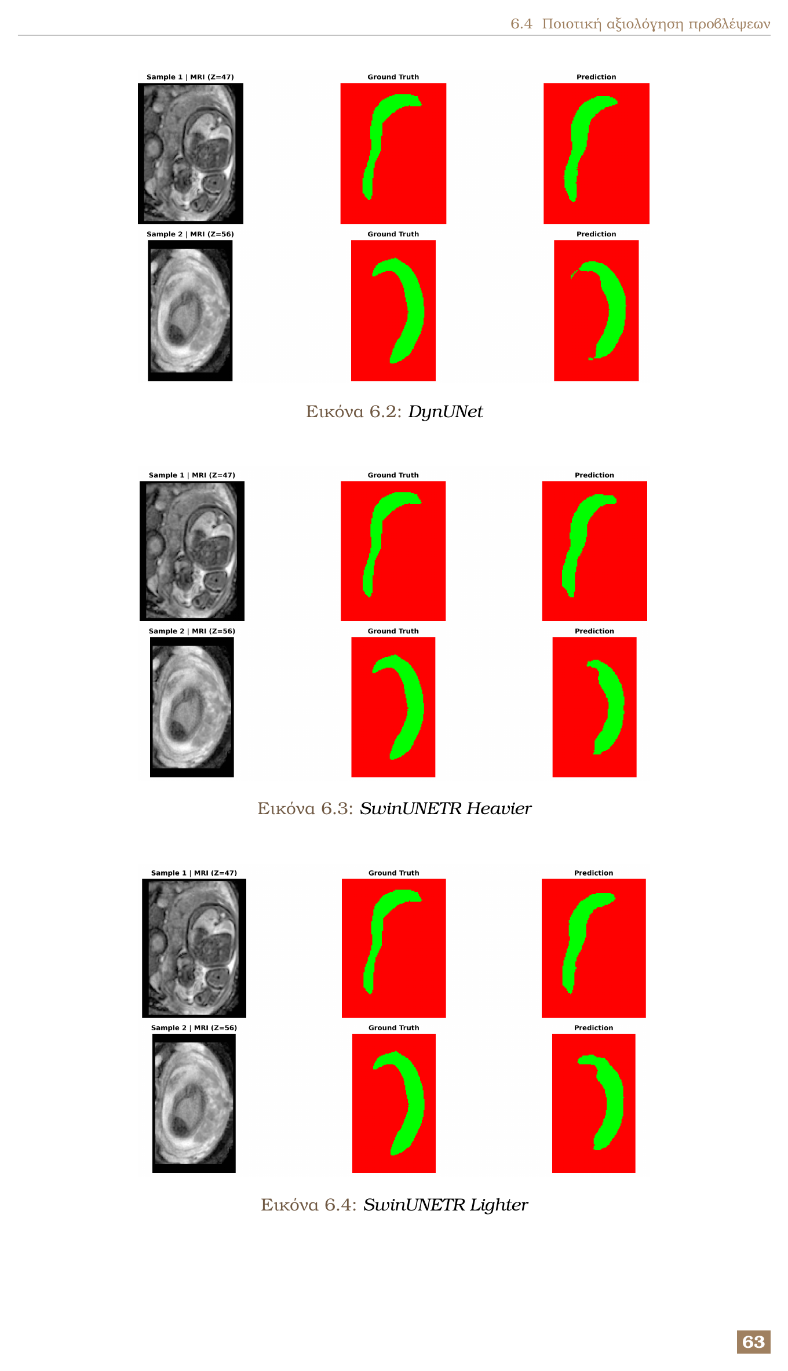
Qualitative Results (Set 1)
Clear masks for DynUNet and SwinUNETR variants
Good shape consistency across examples
Boundary quality aligns with Dice/IoU trends

Slide 19
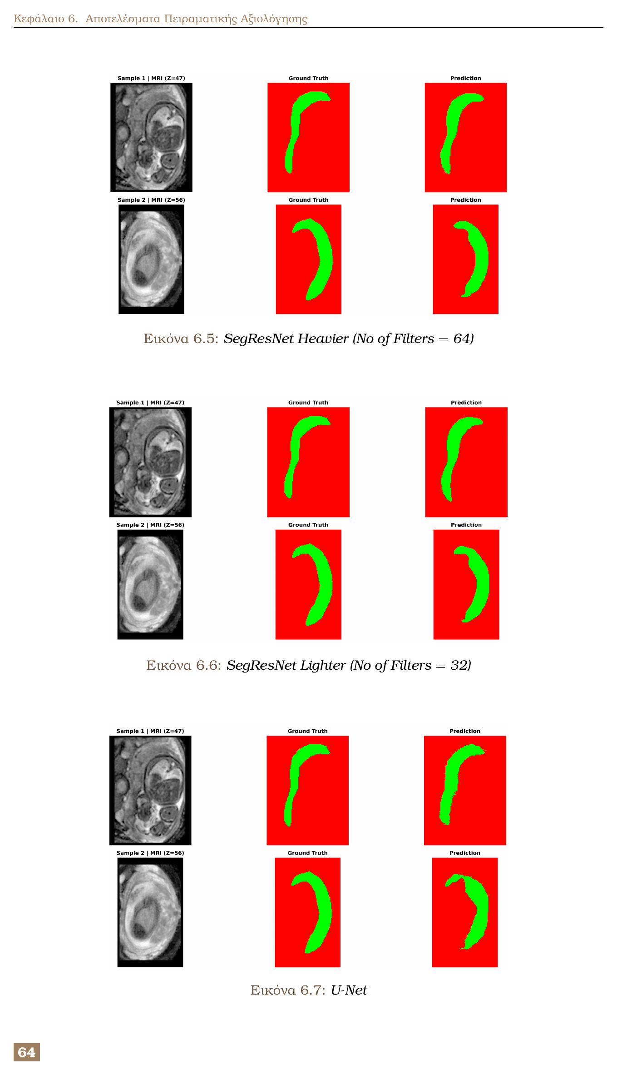
Qualitative Results (Set 2)
SegResNet variants yield clean, continuous masks
U-Net is acceptable but less consistent at boundaries
Visual behavior matches quantitative scores

Slide 20
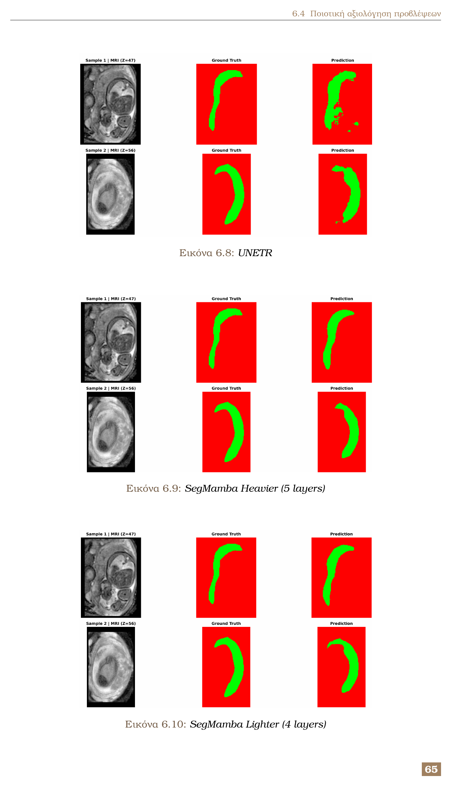
Qualitative Results (Set 3)
SegMamba predictions are close to ground truth
UNETR shows more false positives and instability
Qualitative inspection reinforces outlier behavior

Slide 21
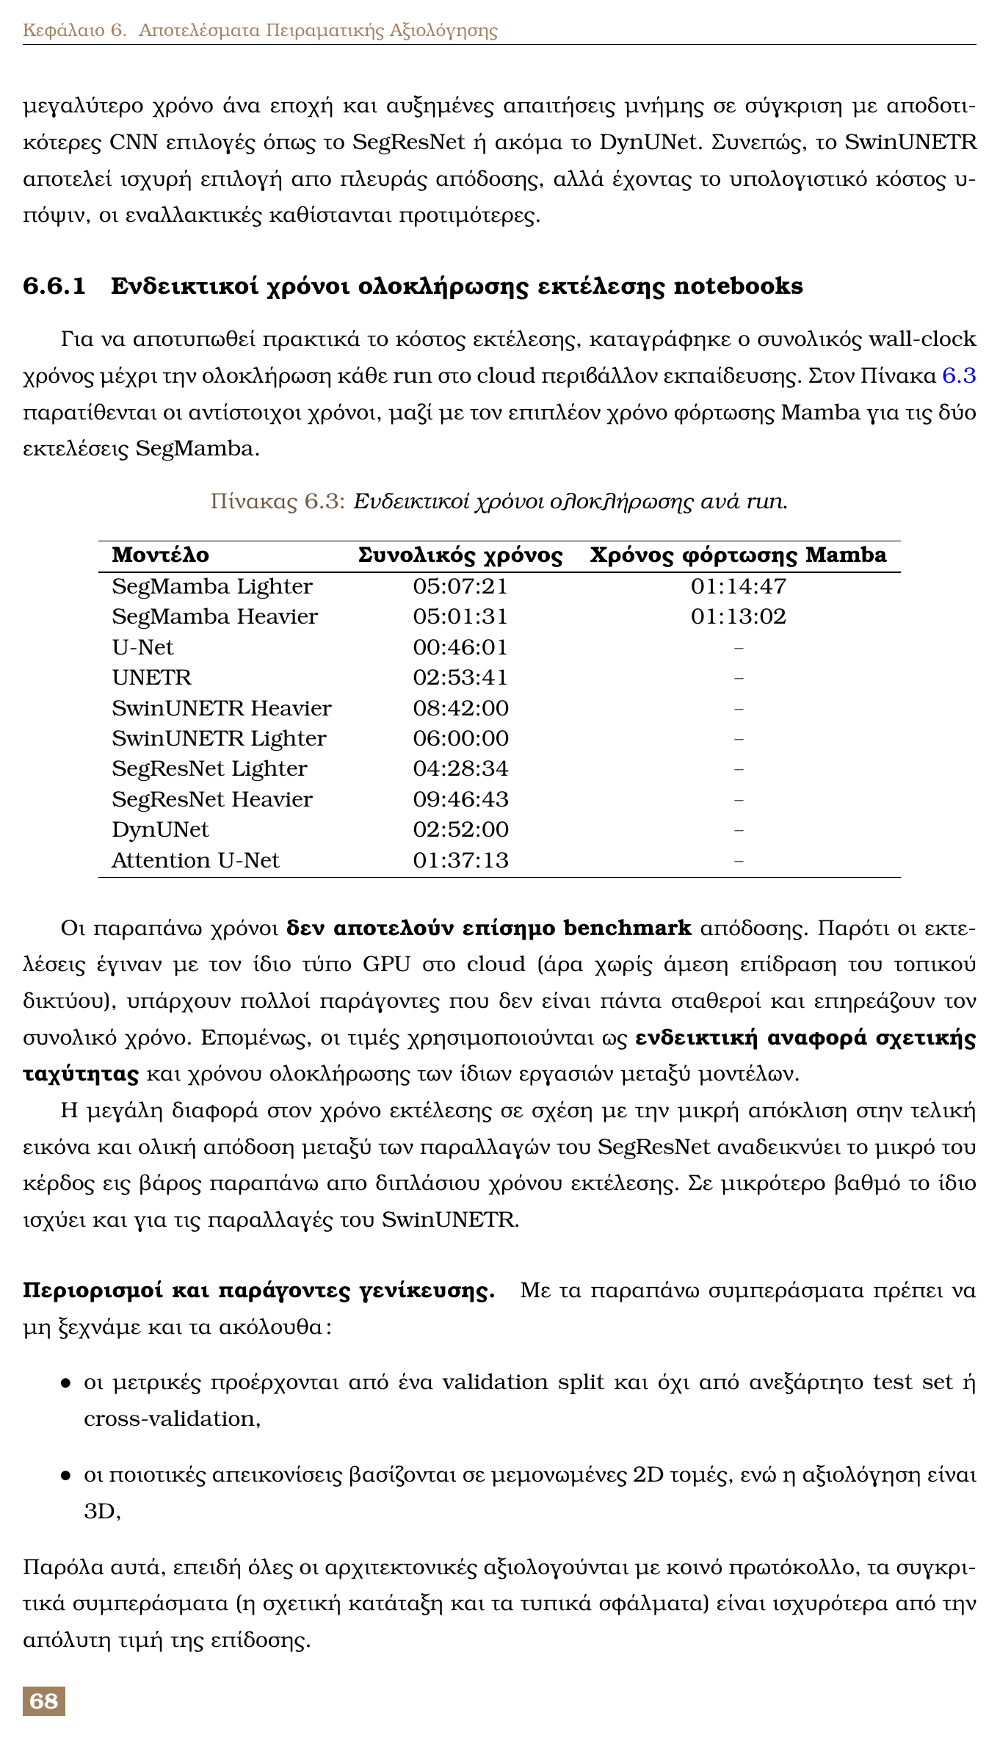
Runtime and Practical Cost
Fastest run: U-Net (~0.77 h)
SwinUNETR and SegResNet Heavier are costly
SegMamba includes additional loading overhead
Accuracy gains must justify compute cost

Slide 22
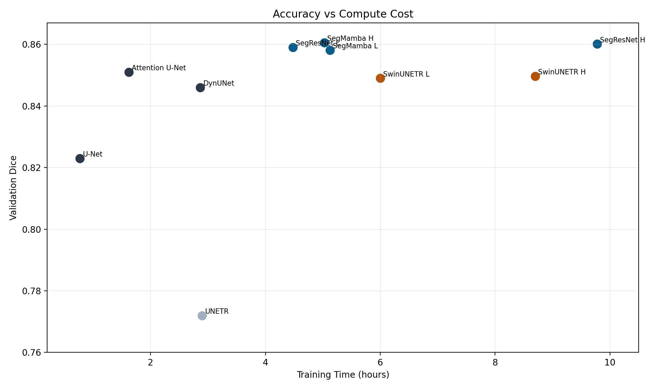
Accuracy vs Compute Trade-off
Top accuracy does not always mean best efficiency
Lighter variants are often near-identical in quality
Practical deployment should optimize both axes

Slide 23
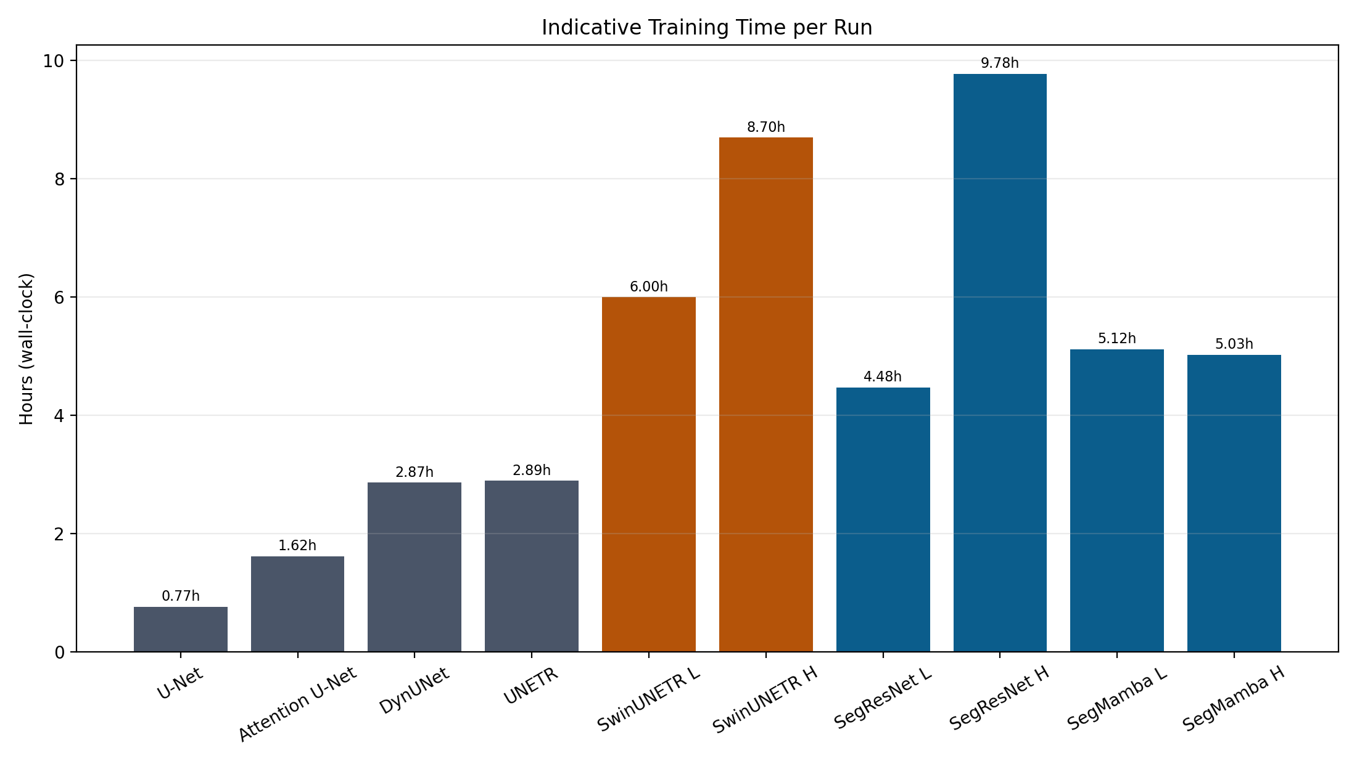
Key Conclusions
Unified protocol enabled fair cross-family comparison
Best overall performers: SegMamba and SegResNet
SwinUNETR remained competitive with higher cost
UNETR underperformed in this dataset/split

Slide 24
Future Work and Next Steps
Add independent test set and cross-validation
Validate on external, multi-center datasets
Integrate uncertainty estimation for trust
Explore fine-tuning from best checkpoints
Extend to multimodal and multi-task learning

Slide 25
Thank You
Questions and discussion

